Slide 1
Phong Shading and
Texture Mapping
10 March 2009
CMPT370
Dr. Sean Ho
Trinity Western University

Slide 2
What's on for today
Shading polygons
  Flat shading
  Gouraud shading
  Phong shading
Texture mapping
  Coordinate transforms
  Cylinder, sphere, cube maps
  Bump mapping
  Environment mapping

Slide 3
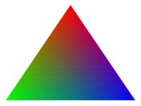
Shading polygons
We specify in our model for each vertex:
  Vertex coordinates
  Vertex colours
  Vertex normal
Use lighting model to calculate vertex shades
Smooth shading: vertex shades are interpolated across the polygon
    glShadeModel( GL_SMOOTH );
Flat-shading uses the colour of the first vertex:
    glShadeModel( GL_FLAT );

Slide 4
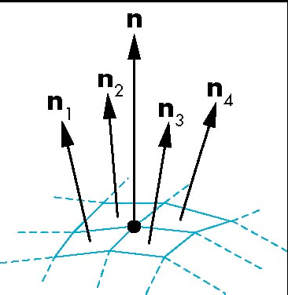
Calculating vertex normals
Each polygon is flat: we can find normal vector
One strategy: average the normals of the faces surrounding that vertex
For triangular faces ABC: AB x AC gives normal
  Magnitude is area of parallelogram
Sum these cross-products:
  Get a weighted average of
  face normals
  Weighted by area

Slide 5
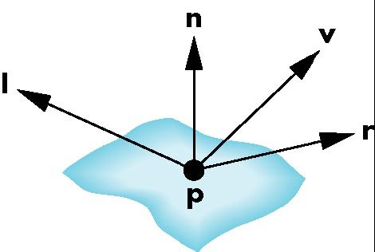
Gouraud shading
Specify vertex normals
Apply lighting model (ambient, diffuse, specular) to each vertex to get vertex shades
Interpolate vertex shades across polygon
  Interpolate along edges first
  Then along each scan line (done in hardware)
vertex normals
vertex shades
filled fragment

Slide 6
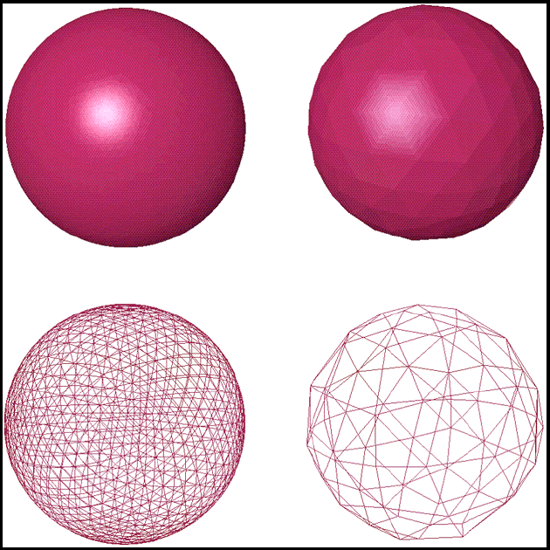
Gouraud shading: quality
Depends on how big each polygon appears on screen, compared to pixel size
  Fewer polygons =>
  bigger on screen =>
  worse quality

Slide 7
Phong shading
Specify vertex normals
Interpolate vertex normals across polygon
    Interpolating vectors, not intensities!
Apply lighting model at each pixel to get shades
  Gouraud may miss small specular highlights
OpenGL implements Gouraud but not Phong
  Work to calculate lighting model at each pixel
    Or use programmable shaders!

Slide 8
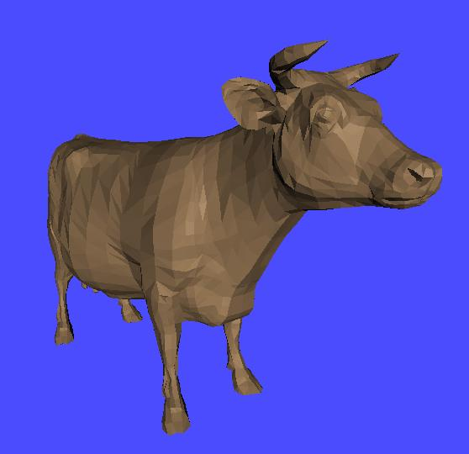
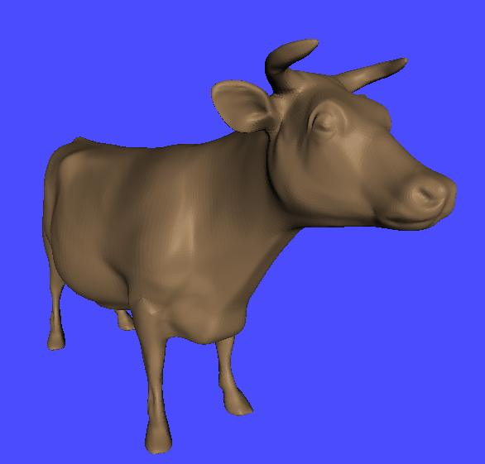
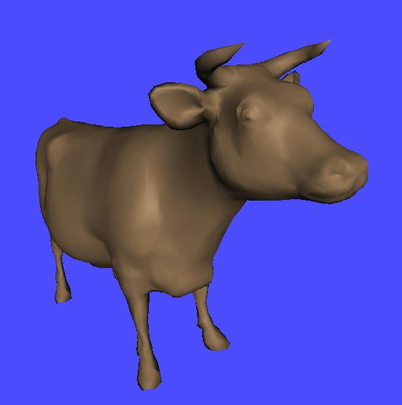
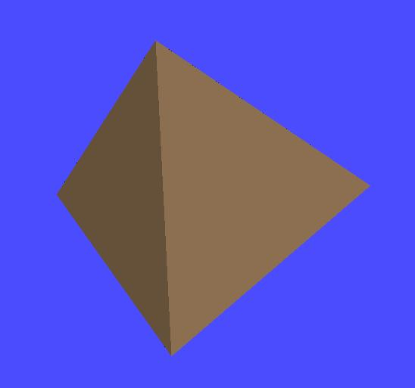
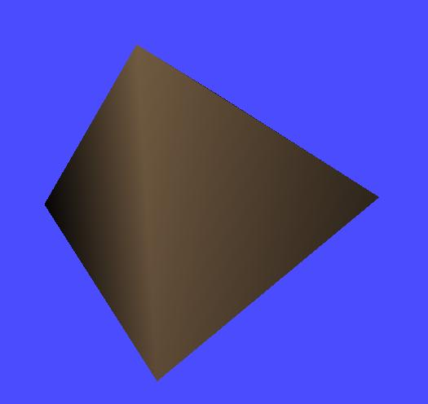
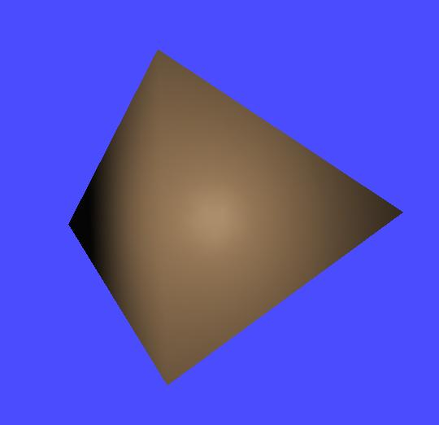
Flat vs. Gouraud vs. Phong

Slide 9
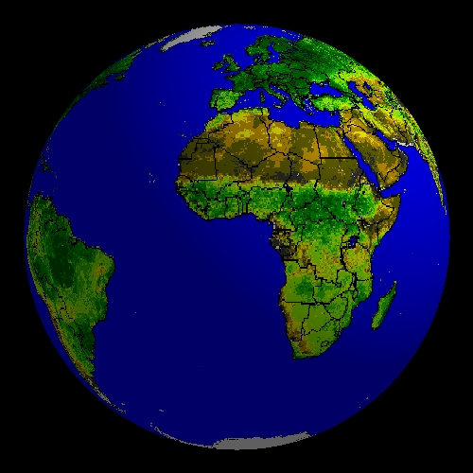
Texture mapping
Complex objects with many varying shades:
  Could use a new polygon for every shade
  Or use an image pasted on top of the surface
E.g., modeling the earth:
  Blue sphere is too simple
  Modeling every continent
  and mountain range with
  little polygons is too much
  Texture-map a picture
  onto the sphere

Slide 10
Bump mapping
e.g., modeling an orange:
  Geometry is just a simple sphere
  Texture map colours, striations, etc.
  But surface is still smooth: what about small dimples?
    Shading should change as light and view directions change
Bump mapping tweaks the normal vectors to simulate dimples or bumpiness
  Silhouette still reflects underlying geometry

Slide 11
Kinds of maps
Texture map:
  Paste an image onto a surface
Bump map:
  Perturbs normal vectors in lighting model to simulate small changes in surface orientation
Environment (reflection) map:
  Use a picture of the surrounding room/sky for a texture map
  Simulates reflections in very specular surfaces
Only texture maps are built-in to OpenGL

Slide 12
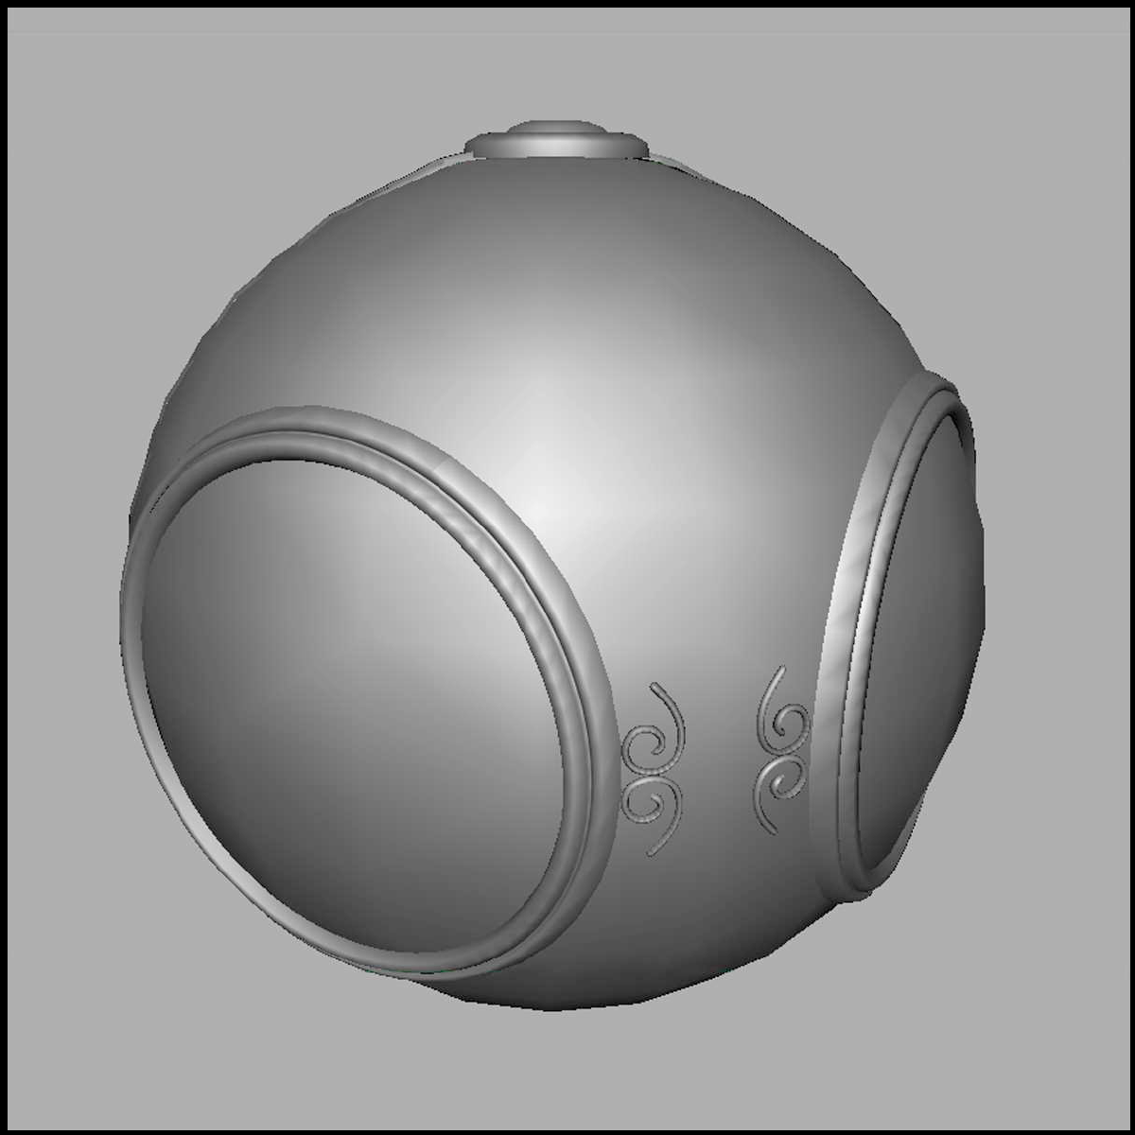
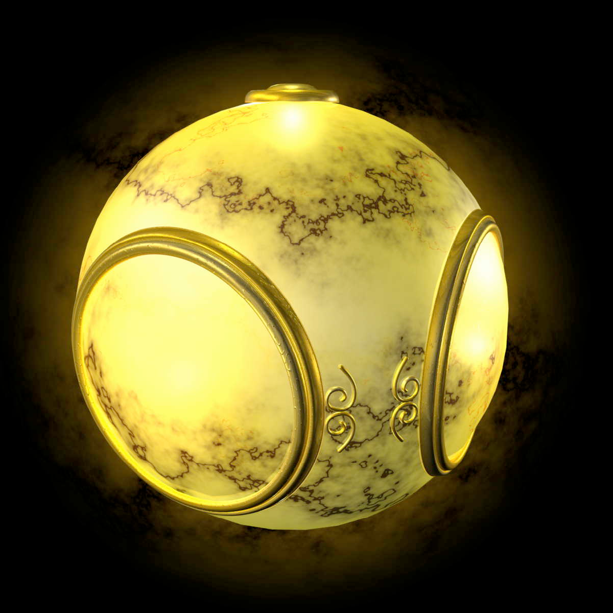
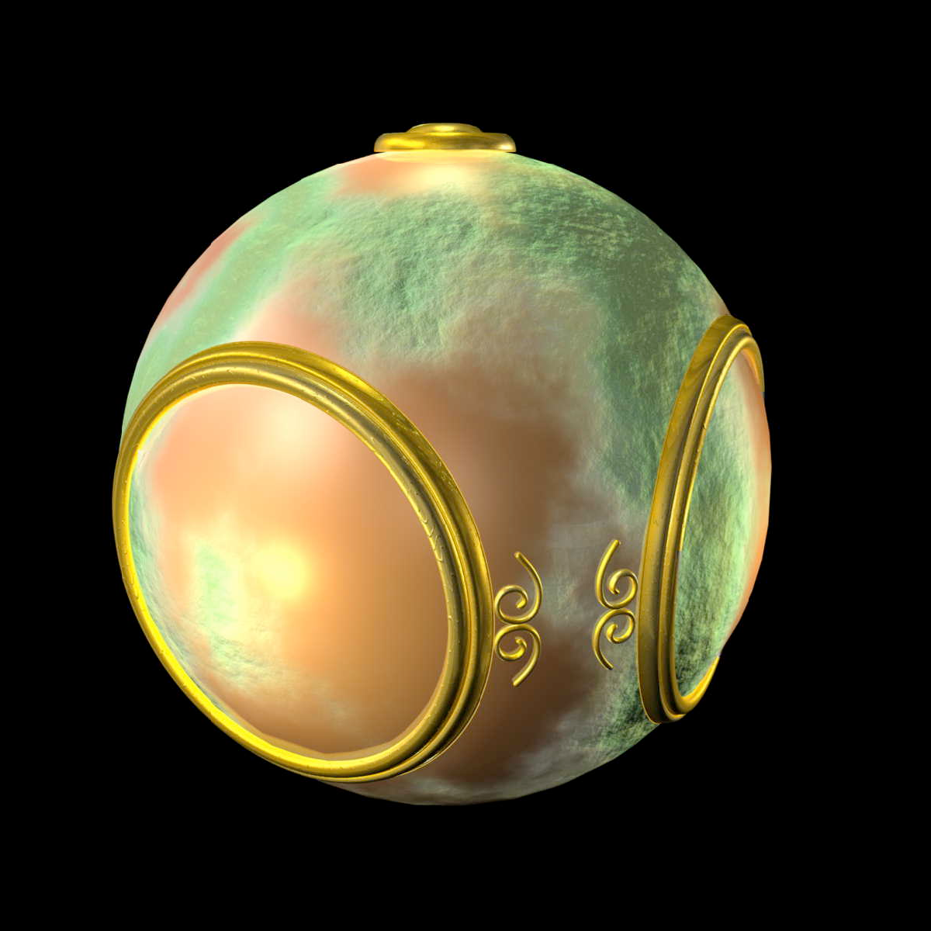
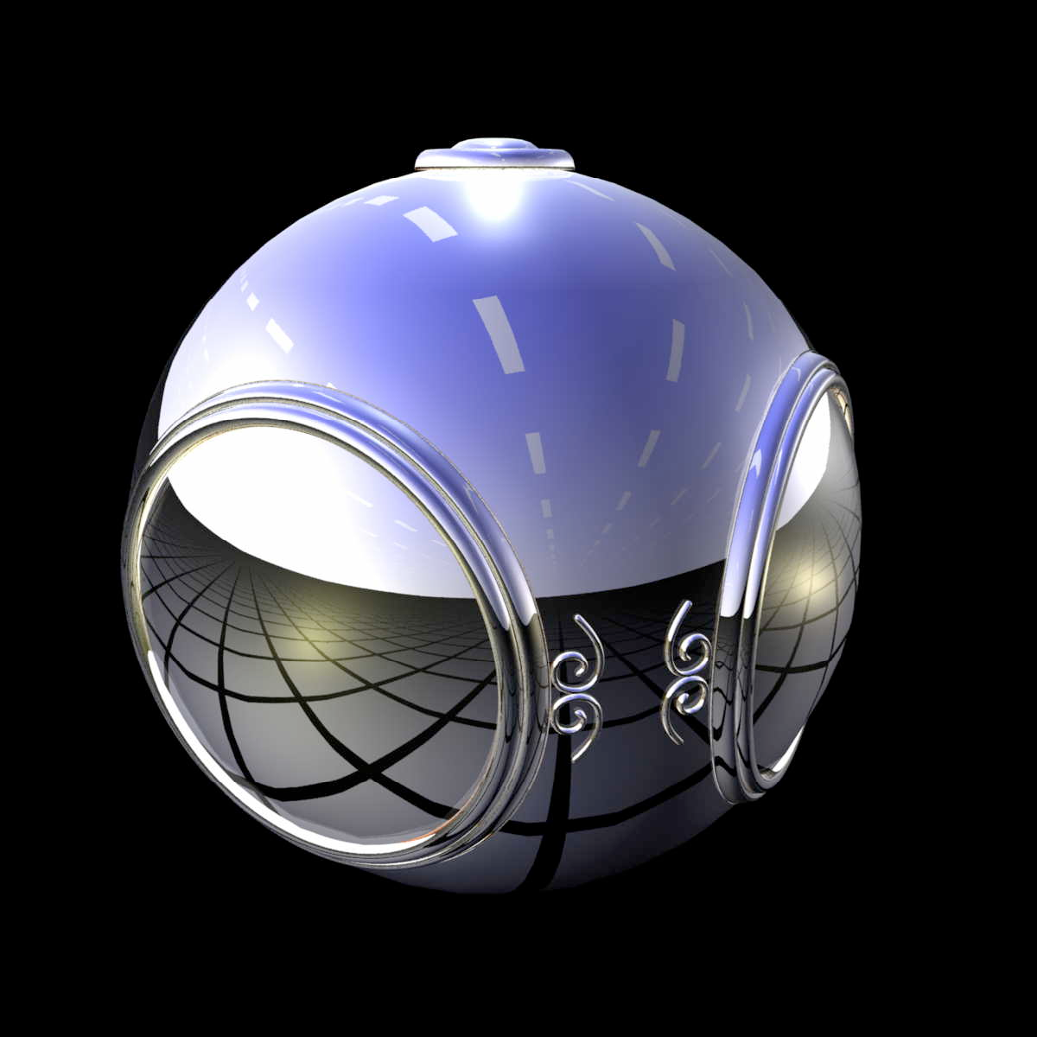
Texture/bump/environ maps
No map
Texture map
Bump map
Environment map

Slide 13
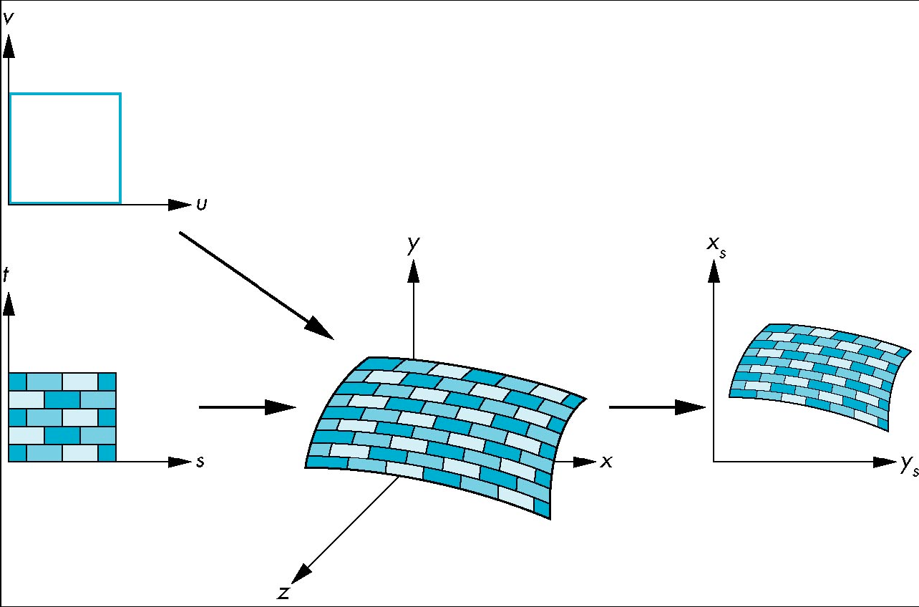
Mapping: coordinate systems
Essential question for maps: how to map coordinate systems?
  Parametric coords (u,v) describing the surface
  Texture coords
  (s,t)
  World coords
  (x,y,z)
  Window coords
  (x_{s}, y_{t})

Slide 14
Backward mapping
For each point (x,y,z) on the surface in world coords, we want to go backwards to find which pixel (s,t) in the texture we should paste:
    s = s(x,y,z);
    t = t(x,y,z);
Two-part mapping:
  First map texture onto a simple intermediate shape
    Cylinder
    Sphere
    Cube

Slide 15
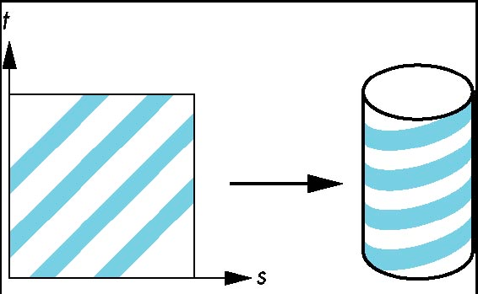
Cylindrical mapping
Parametric cylinder:
    x = r cos(2πs)
    y = r sin(2πs)
    z = t/h
Map from
  Square [0,1] x [0,1] in (s,t) texture space to
  Cylinder of radius r, height h
  in (x,y,z) world coordinates

Slide 16
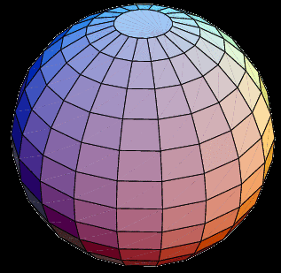
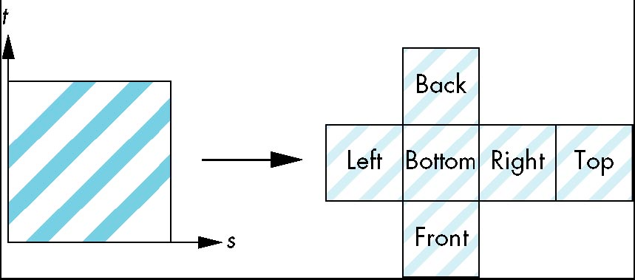
Spherical maps, cube maps
Parametric sphere:
    x = r cos(2πs)
    y = r sin(2πs) cos(2πt)
    z = r sin(2πs) sin(2πt)
  Bad distortions at the poles
Cube/box mapping:
  Easy with
  orthographic projection
Both are widely used for environment maps

Slide 17
Implementing bump mapping
Parameterized surface:
    p(u,v) = (x(u,v), y(u,v), z(u,v))
  Tangent vectors: p_{u} = ∂p/∂u, p_{v} = ∂p/∂v
  Normal vector: n = p_{u} x p_{v}
Perturbed surface: p'(u,v) = p(u,v) + d(u,v) n(u,v)
  d(u,v) is the displacement function/map
Perturbed normal: n' = p'_{u} x p'_{v}
  n' ≈ ( ∂d/∂u )( n x p_{v} ) + ( ∂d/∂v )( n x p_{u} )

Slide 18
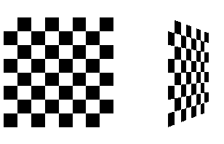
Texture mapping in OpenGL
Bump mapping / environment mapping are not provided in OpenGL
  Can be done with fragment programs (GLSL)
Using texture mapping in OpenGL:
  Create texture and bind to object
  Select how texture will affect each pixel
  Enable texture mapping
  Draw object, specifying
  texture coordinates
See Redbook examples, checker.c

Slide 19
Creating a texture
The following steps should be done once during initialization, not on every display refresh:
Read in an image: 3D array (rows, cols, RGBA)
  Programmatically generate (checker.c), or
  Read from file (Fl_JPEG_Image->data())
Bind new texture object: glBindTexture()
Specify parameters: wrapping, filtering
Load image data to texture: glTexImage2D()

Slide 20
Texture objects (OpenGL 1.1)
Akin to display lists, but for textures
Allows us to reuse textures, bind to objects
  Request a new texture object id
    glGenTextures( 1, &texName );
  Can also request several texture object ids
  Bind this new texture object
    glBindTexture( GL_TEXTURE_2D, texName );
All subsequent texture commands are stored in this texture object
Use glBindTexture() to switch texture objects

Slide 21
Loading image data to a texture
glTexImage2D( GL_TEXTURE_2D, level, intFmt,
width, height, 0, format, type, pixels )
  level: mip-mapping level, usually 0
  intFmt: GL_RGB, GL_RGBA, etc.
  width, height: must be power of 2, ≥64
    (border: most hardware only supports '0')
  format, type: describe incoming pixels:
    e.g., GL_RGB, GL_UNSIGNED_BYTE
    Affected by glPixelStore(), similar to glDrawPixels()
  pixels: pointer to the actual image data

Slide 22
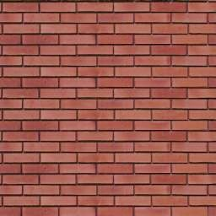
Texture size must be 2^{n}
OpenGL requires the width and height of textures to be powers of 2
  But need not be square
GLU provides a helper function to scale:
    gluScaleImage(
    fmtIn, wIn, hIn, typeIn, *pixelsIn,
    wOut, hOut, typeOut, *pixelsOut )
2ª
2^{b}

