Slide 1
Texture Mapping and
Blending / Compositing
12 March 2009
CMPT370
Dr. Sean Ho
Trinity Western University
See: Edward Angel's text,
“Interactive Computer Graphics”

Slide 2
Textures in the rendering pipeline
Texture processing happens late in the pipeline
Relatively few polygons make it past clipping
Each pixel on the fragment maps back
to texture coordinates:
(s,t) location on the texture map image
Textures
Vertex
list
Vertex
processor
Clipping /
assembly
Rasterizer
Fragment
processor
Pixels

Slide 3
(1) Steps to create a texture
On initialization:
  Read or generate image to pixel array
  Request a texture object: glGenTextures()
  Select texture object: glBindTexture()
  Set options (wrap, filter): glTexParameter()
  Load image to texture: glTexImage2D()
    Or copy from framebuffer
    Or load with mip-maps: gluBuild2DMipmaps()

Slide 4
(2) Steps to use a texture
On every frame (draw()):
  Enable texturing: glEnable(GL_TEXTURE_2D)
  Select texture object: glBindTexture()
  Set blending modes: glTexEnvf()
  Assign texture coordinates to vertices
    glTexCoord() with each vertex
    Or use generated texcoords: glTexGen()

Slide 5
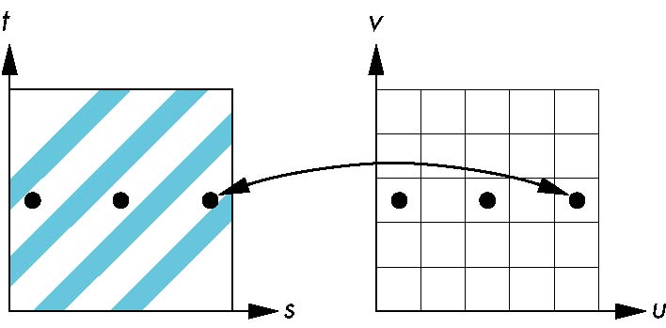
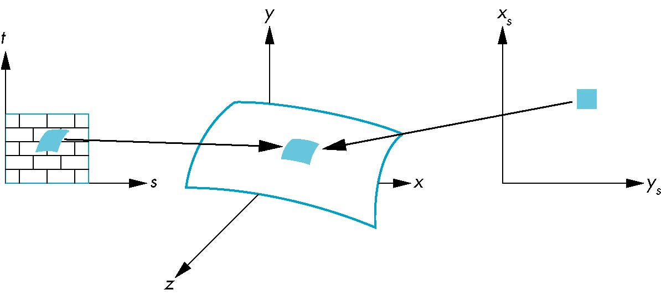
Filtering: avoiding aliasing
Pixels in fragment may map back to widely-spaced locations in texture coordinates
Results in aliasing artifact
Solution: average
over an area:
preimage of pixel
GL provides 2x2
area averaging
misses blue bars entirely!
preimage of pixel in general is curved!

Slide 6
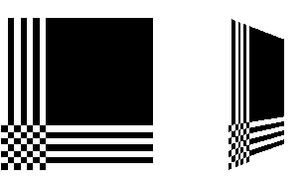
Parameters for texmaps
Filtering:
  Magnification (MAG) and minimization (MIN)
    glTexParameteri( GL_TEXTURE_2D,
    GL_TEXTURE_MAG_FILTER, GL_NEAREST );
  Nearest-neighbor or GL_LINEAR interpolation
    2x2 interp needs 1-pixel border around texture
Wrapping: what about texcoords outside (0,1)?
  Repeat (tile) or clamp (border pixels)
  In either s or t directions in texture
    glTexParameteri( GL_TEXTURE_2D, GL_TEXTURE_WRAP_S, GL_REPEAT );
GL_CLAMP

Slide 7
Texture blending functions
    glTexEnvf( GL_TEXTURE_ENV, GL_TEXTURE_ENV_MODE, GL_DECAL );
Last param is the blending mode:
  How the texture colour is combined with the existing colour (e.g., shaded via Gouraud)
  GL_REPLACE: uses only this texture
  GL_DECAL: pastes texture on top
  GL_MODULATE: multiplies colours
  GL_BLEND: uses texture to determine amount of blend between old colour and a fixed blend colour (set w/GL_TEXTURE_ENV_COLOR)

Slide 8
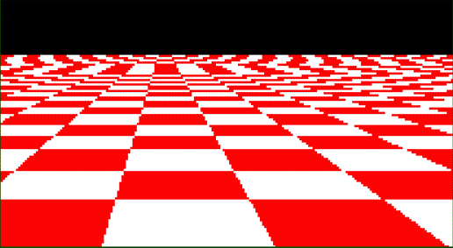
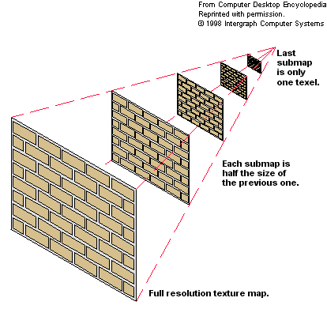
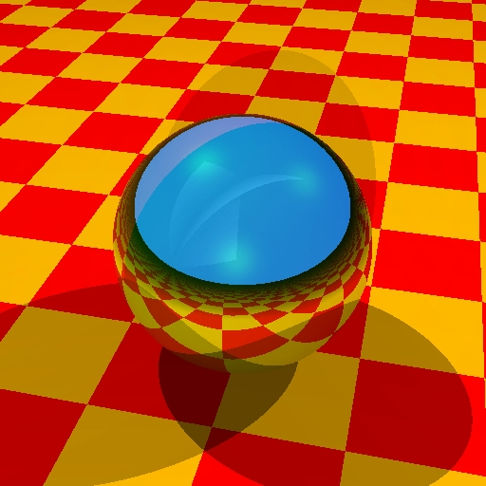

Mip-maps
Aliasing (jaggies) can occur when
textures become very small on-screen
Pre-calculate filtered low-res versions of the texture: levels of detail (LoD)
  Use gluBuild2DMipmaps()
  (it calls glTexImage2D() for you)
w/o mipmaps
with mipmaps

Slide 9
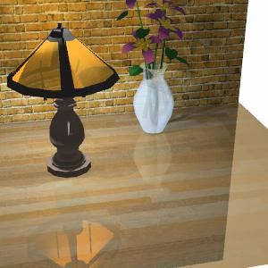
Using framebuffer as a texture
Instead of loading a JPEG file for a texture, you can use the framebuffer itself:
    glCopyTexImage2D( GL_TEXTURE_2D, level,
    intFmt, x, y, w, h, border )
  Copies a rectangle from the framebuffer, starting at (x,y) with size (w,h)
  level, intFmt, border just
  as in glTexImage2D
Can use to do cheap reflections:
  Flip model-view matrix and render
  Texture-map framebuffer onto object

Slide 10
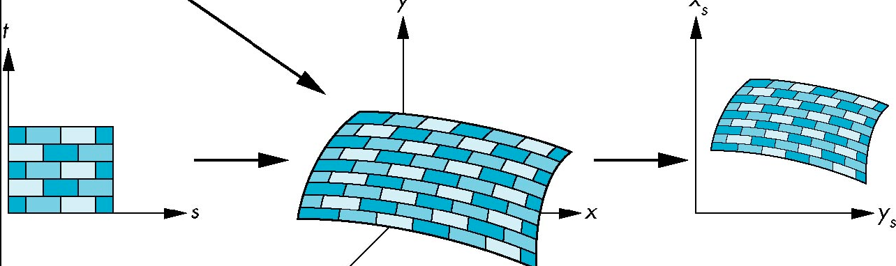
Texture coordinates
The rectangular texture is parameterized by (s,t) in the range (0,1)
Specify texture coordinates with each vertex
    glTexCoord2f( 0.5, 0.7 )
  Part of the OpenGL state for the vertex, just like colour / material properties
  Texcoords are interpolated just like shades

Slide 11
Automatic texcoord generation
    glEnable( GL_TEXTURE_GEN_S ); // or GL_T
    glTexGeni(GL_S, GL_TEXTURE_GEN_MODE, mode)
    mode: GL_OBJECT_LINEAR, GL_EYE_LINEAR,
    or GL_SPHERE_MAP
If mode is Object-linear: texture is fixed to object
  Generated texcoord (s) is distance from
  vertex {x, y, z, w} to
  a reference plane {p₁, p₂, p₃, p₄}:
  s = p₁x + p₂y + p₃z + p₄w
Teapot example (Redbook texgen.c):
reference plane = {1., 1., 1., 0.} (slanted)

Slide 12
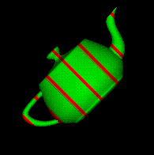
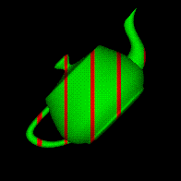
Object vs. eye coordinates
If mode is GL_OBJECT_LINEAR,
generated texcoords are in
the model coordinate system
  Texture fixed to object
If mode is GL_EYE_LINEAR, generated texcoords are in the eye (camera) coordinate system
  Object appears to “swim” in the texture
Reference plane is specified with
    glTexGenfv( coord, GL_OBJECT_PLANE,
    {p₁, p₂, p₃, p₄} )
Obj coords
Eye coords

Slide 13
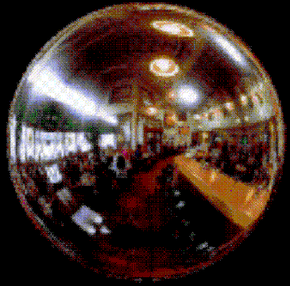
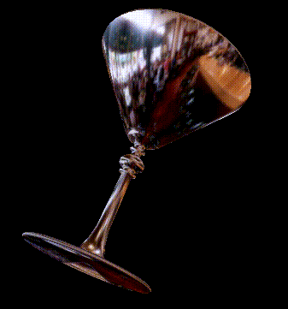
Spherical environment maps
The last mode of auto texcoord generation is GL_SPHERE_MAP:
Photograph a large silvered ball, or
use a fisheye wide-angle lens
Use automatic spherical texcoords for both s and t:
    glTexGeni( GL_S, GL_TEXTURE_GEN_MODE, GL_SPHERE_MAP )
Assumes environment is far away (e.g., small object in large room)

Slide 14
Multitexturing
Recent OpenGL implementations allow cascading application of multiple textures
Texture blending function is important
Specifies how to combine:
  Previous colour (either from lighting model or from previous textures)s
  Current texture colour

Slide 15
Compositing and blending
Learning to use the A (alpha) component of RGBA for:
  Blending of translucent surfaces
  Compositing images
    e.g., layering several textures
  Antialiasing
    e.g., motion blur, depth of field

Slide 16
Opacity and transparency
RGBA: alpha (A) is opacity: 1=opaque, 0=clear
Say we have an opaque polygon (destination): (Rd, Gd, Bd, Ad=1)
Now blend in a translucent poly (source):
(Rs, Gs, Bs, As)
Use source and destination blending factors:
    (dRd+sRs, dGd+sGs, dBd+sBs, dAd+sAs)
    Clamp to [0, 1]
  One choice: s=As, d=(1-As)
    ( (1-As)Rd + AsRs, etc...

Slide 17
Blending in OpenGL
Enable blending in the pipeline:
  glEnable( GL_BLEND );
Set source and dest blend factors:
  glBlendFunc( src_factor, dst_factor );
Options for factors: GL_ZERO, GL_ONE,
GL_SRC_ALPHA, GL_ONE_MINUS_SRC_ALPHA,
GL_DST_ALPHA, GL_ONE_MINUS_DST_ALPHA,
a few others …
  glBlendFunc( GL_SRC_ALPHA, GL_ONE_MINUS_SRC_ALPHA );

Slide 18
Depth buffer and blending
By default, polygons are rendered in the order they come down the pipeline (from program)
Need hidden-surface removal
Use depth buffer: glEnable( GL_DEPTH_TEST );
  Tracks depth of each fragment
  Only renders fragment nearest to camera
But with blending, this isn't what we want!
Need to render several fragments
  Can't use depth buffer for translucent polygons

Slide 19
Mixing translucent and opaque
Solution: order polygons
First render all opaque polygons
  Can use the depth buffer
Then set the depth buffer to read-only
    glDepthMask( GL_FALSE );
Now render translucent polygons in order
  Must sort them first, back to front

Slide 20
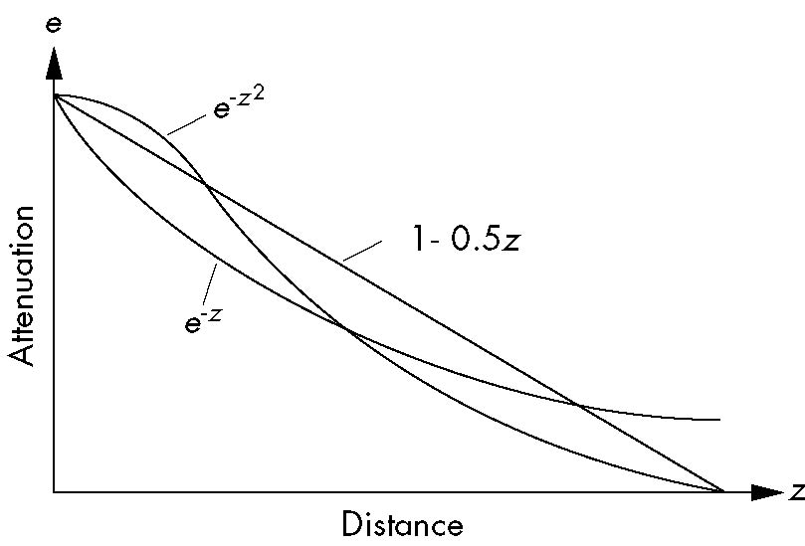
Fog
Fog is just blending with
a fixed fog colour,
with a blending function
that depends on depth
    GLfloat fogCol[4] = { 0.5, 0.5, 0.5, 0.5 };
    glEnable( GL_FOG );
    glFogf( GL_FOG_MODE, GL_EXP );
    glFogf( GL_FOG_DENSITY, 0.5 );
    glFogv( GL_FOG, fogCol );
Fog functions: linear, exponential, Gaussian

Slide 21
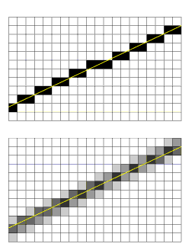
Antialiasing
Aliasing occurs when a
mathematical line gets
rasterized onto a pixel grid
With blending enabled, GL can
shade a pixel according to how
much of the pixel's area is
covered by the line
    glEnable( GL_LINE_SMOOTH );
  Also for ...POINT..., ...POLYGON...

Slide 22
Accumulation buffer
Blending involves a lot of math:
multiplications and additions
Limited by the precision of the frame buffer: typically 8 bits per channel (RGBA)
  Gets worse with number of blends
Accumulation buffer is a high-precision buffer (usually 16-bit) for blending
  Read/write into it with a scale factor
  Copied to framebuffer at the end
  Slower than compositing directly onto fb

Slide 23
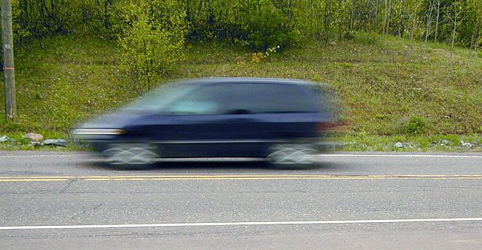
Application: motion blur
With real-world
video cameras,
a freeze-frame of
a moving scene
has motion blur
Makes motion
appear more fluid
Emulate this in GL:
  Render object several times as it moves
  Composite in accumulation buffer

Slide 24
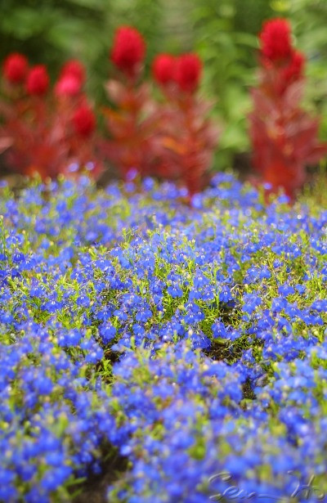
Application: depth of field
Cameras with aperture are
in-focus only in a narrow plane (spherical shell)
Portions in front of or behind
focal point are blurry
Emulate in GL:
  Render scene several
  times with different
  projection matrices:
  Same image plane;
  different centre of projection
  Composite in accumulation buffer

