Slide 1
Programmable Shaders
17 March 2009
CMPT370
Dr. Sean Ho
Trinity Western University

Slide 2
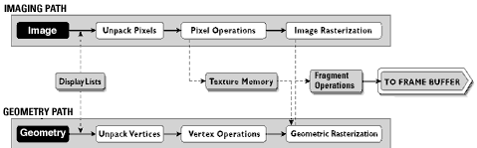
Review of rendering pipeline
OpenGL rendering pipeline:
Vertex operations:
  Transform points via model-view matrix
  Normals, other per-vertex data
Fragment operations:
  Shading: colour for each pixel of fragment

Slide 3
Vertex processing: input
Vertex processing operates per-vertex
  Mostly geometric operations
  Vertices may come from program,
  display list, GL evaluator
Input:
  (x,y,z,w) coords of vertex: glVertex
  Normal vector: glNormal
  Texture coordinates: glTexCoord
  RGBA colour, material properties, GL state
  Other user-defined data via GLSL

Slide 4
Vertex processing: tasks
Transform vertex location: model-view matrix
Transform normals, too!
  What if model-view matrix has scaling?
Vertex colour if desired
Auto-generate texture coordinates if needed, and apply texture matrix
  Maps from texture coords to object coords
Any other per-vertex calculations desired
  e.g., calculate other vectors needed for lighting model

Slide 5
Primitive assembly
The output of the vertex processing is:
transformed vertices in camera coordinates
Next steps in pipeline:
  Vertices assembled into objects (topology)
  Transformed into 2D by projection matrix
    Perspective involves a division
  Clipped:
    Against user-defined planes
    Against the view volume
    May produce new vertices

Slide 6
Rasterization
The next step in the pipeline is rasterization
Produces fragments: partial contributions of each primitive to the final image
  Each fragment is a “potential pixel”
    May be occluded or blended
    Fragment tests come afterward
  Each fragment has:
    Colour
    Depth value (possibly)
    Texture coordinates (if needed)

Slide 7
Fragment processing
Fragment processing operates per-fragment
  More intense than per-pixel!
Input:
  Colour/material properties
  Texture coordinates
  Any user-defined data via GLSL
  Vertex values have been interpolated over the primitive by the rasterizer
Output: final colour of fragment according to shading model

Slide 8
Programmable shaders
Shaders are programs run by the GPU to implement parts of the graphics pipeline
  First introduced by NVIDIA's GeForce 3
We are programming on a dedicated GPU chip
What language to use?
  Early models: form of assembly
  NVIDIA's Cg uses C-like syntax
  Microsoft DirectX 8, 9, 10, HLSL
  OpenGL ARB extensions
  GLSL incorporated as a part of OpenGL2.1

Slide 9
Fixed-function vs. programmable
Fixed-function pipeline:
  Standard, widely compatible, easy to learn
  Gouraud shading: lighting model done only per-vertex, not per-pixel
  Limited number of lights
Programmable:
  Enhanced functionality per-vertex/per-frag
  Parallel on GPU; built-in vector/matrix math
  Must replace functionality of fixed pipeline
  Debugging!

Slide 10
e.g.: Phong lighting
Let's use vertex+fragment shaders to implement per-pixel Phong shading
  Default is per-vertex Gouraud lighting
(Shade) = (Ambient) + (Diffuse) + (Specular)
  I = k_{a}I_{a} + k_{d} I_{d} (l * n) + k_{s} I_{s} (v * r)^{α}
Need vectors l (to light) and r (reflection)
Use vertex shader to calculate l, n
  Rasterizer will interpolate these vectors
Use fragment shader to calc r and do Phong shading

Slide 11
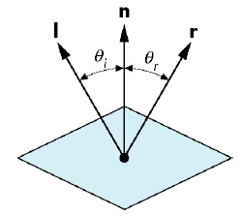
Calculating the reflection vector
Calculate l vector to light: (light_pos) – (vertex)
Calculate r (reflection) vector:
  cos(θ_{I}) = cos(θ_{r}), so l*n = r*n
  r, n, l are all coplanar, so r = a(l)+b(n)
  All normal vectors, so r*r = n*n = l*l = 1
  Solve: r = 2(l*n)n - l

Slide 12
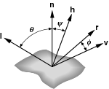
Blinn's halfway vector
Blinn proposed a simplified model of specularity: instead of k_{s} I_{s} (v * r)^{α}, we use k_{s} I_{s} (n * h)^{α}:
Replace v*r with n*h,
where h is the unit halfway vector: h = (l+v) / 2
Normalize h: (l+v) / |l+v|
If n, l, and v are coplanar:
then psi = phi/2
The exponent needs to be
adjusted

Slide 13
Vertex shader program
    varying vec3 N, L;
    void main() {
    gl_Position = gl_ModelViewProjectionMatrix * gl_Vertex;
    N = gl_NormalMatrix * gl_Normal;
    L = gl_LightSource[0].position.xyz;
    gl_FrontColor = vec4(0.5, 0.5, 0.8, 1.0);
    }
Input: gl_Vertex, gl_Normal
Output: gl_Position (eye coords),
N, L (send to fragment shader)

