Slide 1
NURBS (Redbook ch12)
31 March 2009
CMPT370
Dr. Sean Ho
Trinity Western University
IBiblio e-notes
Cambridge notes

Slide 2
Review last time: cubic curves
Polynomial curves and surfaces
Cubic polynomial curves:
  Interpolating
  Hermite
  Bezier
Solving for the geometry matrix to get coefficients
Blending functions
Types of continuity

Slide 3
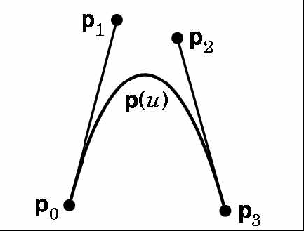
Bezier curves
Widely used, provided in OpenGL
Use control points to indicate tangent vectors
  Does not interpolate middle control points!
  p'(0) = 3(p₁–p₀), p'(1) = 3(p₃–p₂)
p₀, p₃ specify start+end position
start+end velocity derived from control points
Use Hermite form
C⁰ but not C¹

Slide 4
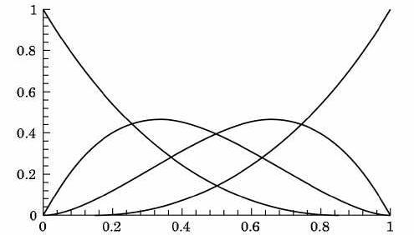
Bezier blending functions
Blending functions are smooth polynomials
    b₀(u) = (1-u)³
    b₁(u) = 3u(1-u)²
    b₂(u) = 3u²(1-u)
    b₃(u) = 3u³

Slide 5
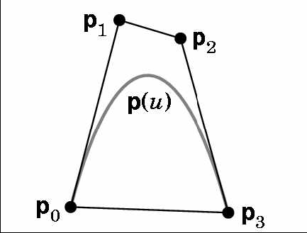
Convex hull property
Why the factor of 3 in the definition of Bezier curves?
  p'(0) = 3(p₁–p₀)
  p'(1) = 3(p₃–p₂)
Ensures that the curve is contained within the convex hull of the four control points

Slide 6
Bezier evaluators in OpenGL
Specify array (1D or 2D) of control points:
    GLfloat ctrlpoints[4][3] = { {-4.0, -4.0, 0.0}, ...
Create a Bezier evaluator: (type=GL_MAP1_VERTEX_3)
    glMap1f( type, u_{min}, u_{max}, stride, order, points );
Enable the evaluator:
    glEnable( type );
Evaluate the Bezier at a particular u/v:
    glEvalCoord1f( (GLfloat) u );
  Use this instead of glVertex(), e.g., within glBegin( GL_LINE_STRIP )

Slide 7
How OpenGL computes Beziers
de Casteljau's algorithm: opengl/bezierdemo/
4 control points:
  Plot a point u of the way from p₀ to p₁
  Similarly between (p₁, p₂), and (p₂, p₃)
  Get 3 points (q₀, q₁, q₂)
Plot points u of the way between (q₀, q₁), (q₁, q₂)
  Get 2 points (r₀, r₁)
Plot a point u of the way between (r₀, r₁)
  This is our point on the Bezier curve

Slide 8
Splines
Draftsman's tool for drawing smooth curves:
  Flexible wood/plastic strip
  Bent to pass through knots (control points)
A spline is any sort of smooth curve that has a series of control points
  Interpolating splines
    Interpolating cubic spline
    Interpolating Catmull-Rom spline
  Cubic Bezier is a spline
  B-splines: basis splines

Slide 9
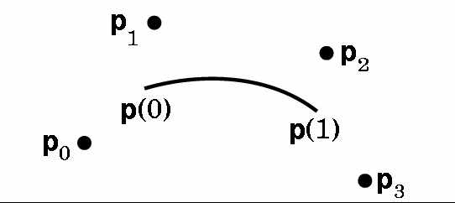
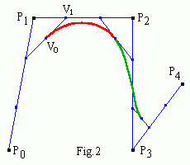
Cubic B-splines
n+3 deBoor control points p₀, ..., p_{n+2}.
Make n Bezier curve segments
  Want C² at the joins; sacrifice interpolation
  Derive Bezier control points (v₀, v₁, v₂, v₃)
  from deBoor points (p₀, p₁, p₂, p₃):
  v₁ is (1/3)-way btw p₁ and p₂
  v₀ is halfway between v₁ and
  (1/3)p₀ + (2/3)p₁
Cubic B-spline: order == 4

Slide 10
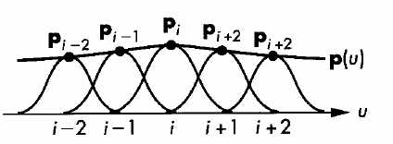
Knot spacing
Region of influence for each deBoor control point p_{i} is 4 Bezier segments
Knots (u₀, ..., u_{n+4}) specify where the joins are in parameter space: e.g., {.0, .25, .50, .75, 1.0}
  # knots == n+7
Open-spacing: duplicate end knots to get interpolation:
    {.0, .0, .0, .0, .25, .50, .75, 1.0, 1.0, 1.0, 1.0}
    (4 Beziers)
Uniform B-spline: uniform spacing of knots

Slide 11
NURBS
Spline:
  Smoothish curve defined by control points
B-spline:
  Joined Bezier curves with C² continuity
Non-uniform B-spline:
  Non-uniform spacing of knots (e.g., can use multiplicity to get interpolation of endpoints)
Rational B-spline:
  Add weights to each control point
  Leverages perspective division hardware

Slide 12
Properties of NURBS
More computationally expensive than Bezier curves/patches
C² continuity makes shading look much better
Local control: moving a control point only affects 4 Bezier segments
Convex hull property: each point on the spline is within the convex hull of the four control points it's affected by
Affine-invariant (including perspective):
  Transforming control points ==
  transforming the curve

Slide 13
Using NURBS with GLU
See Redbook example: surface.c
Create pointer to new NURBS object:
    #include <GL/glu.h>
    GLUnurbsObj *n = gluNewNurbsRenderer();
Enable auto-generation of normals:
    glEnable( GL_AUTO_NORMAL );
Set rendering options and register for errors:
    gluNurbsProperty( n, GLU_SAMPLING_TOLERANCE, 25.0);
    gluNurbsProperty( n,
    GLU_DISPLAY_MODE, GLU_FILL);
    gluNurbsCallback( n, GLU_ERROR, nurbsError);

Slide 14
GLU NURBS, cont.
In the display() callback: start a curve/surface:
    gluBeginSurface( n );
Specify the NURBS:
    gluNurbsSurface( n, … );
  # knots and list of knots in each dim u,v
  array of control pts (give stride in u,v)
  polynomial order (cubic=4) in u,v
  surface type: GL_MAP2_VERTEX_3 for pts,
  GL_MAP2_TEXTURE_COORD_2 for texcoords
Finish with gluEndSurface( n );

Slide 15
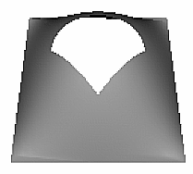
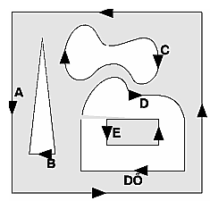
Trimming NURBS surfaces
You can trim a NURBS surface by cutting
out part of the parameter space ((0,1) in u,v)
Specify trimming curves before gluEndSurface:
    gluBeginTrim( n ) / gluEndTrim( n );
Piecewise linear trim: gluPwlCurve()
Use a NURBS to trim: gluNurbsCurve()
Orientation matters:
include left side, exclude right side
Can cut out islands
See Redbook trim.c

