Slide 1
Spatial Data Structures
2 April 2009
CMPT370
Dr. Sean Ho
Trinity Western University
Refs:
Jessica Crouch's ODU course

Slide 2
Spatial data structures
Storing the geometry in a smarter way
Space-subdivision:
  Grids
  Octrees
  k-d trees and BSP trees
Object-centred:
  Bounding volumes
  Scene graphs
OpenSceneGraph

Slide 3
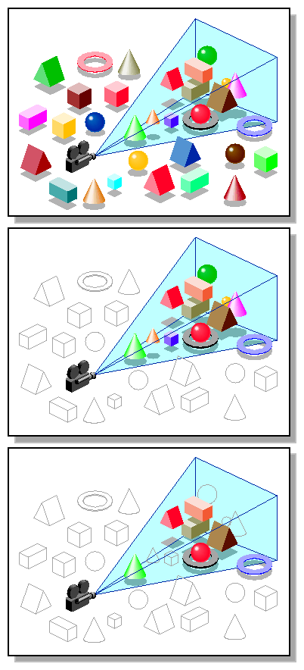
Why use spatial data structs?
Geometry culling for speed
  View frustum culling
  Hidden-surface culling
  Culling small details
Collision detection
    Robotics
    Virtual world / gaming
    Chemical / drug simulation
Ray tracing
Parallel rendering
SGI

Slide 4
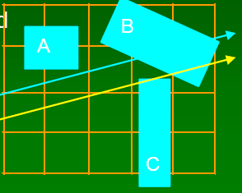
Spatial subdivision: grids
Partition space (view frustum)
Grids: 3D array of cells
that tile the space: voxels
Each voxel keeps list of all intersecting surfaces
For each voxel intersected by the ray:
  Test for intersection with each surface in voxel
Best if objects are uniformly spread in space
  Voxels too big => too many surfaces per cell
  Voxels too small => wasted empty cells
Try non-uniform cell spacing

Slide 5
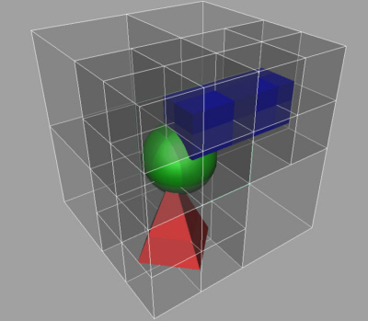
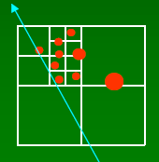
Octrees
In 1D: binary tree
In 2D: quadtree
Each cell (node of tree)
is a cube
Recursively split into 8 equal sub-cubes
  Adaptive subdivision: stop dividing based on number of surfaces in the cell
Ray intersection: traverses tree
  Tradeoff: tough to step to
  next cell along ray

Slide 6

k-d trees and BSP trees
Relaxing the rules on octrees
k-d (k-dimensional) trees:
  Split each cell one dimension at a time
  at arbitrary point within cell
BSP (binary space partitioning) trees:
  Split with plane of any orientation
    In k-dims, split with hyperplane of dimension k-1
  Used for hidden-surface removal
    Painter's algorithm: planes oriented relative to camera

Slide 7
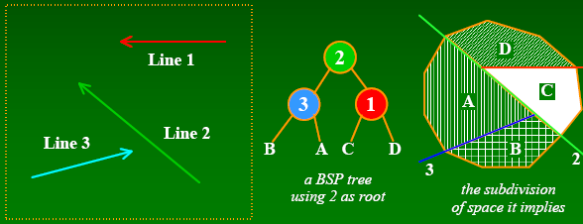
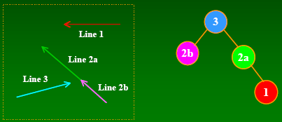
Building balanced trees
Use the objects to guide choice of splitting plane
Example with
simple line
segments
Using Line3 as root
requires splitting Line2
Splitting gives more surfaces but often a more balanced tree

Slide 8
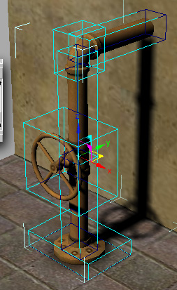
Object bounding volumes
Object-centred data structure
Wrap complex objects in simple ones
  Level of detail
If ray does not intersect bounding
volume, it won't intersect the object
Common types:
  Axis-aligned boxes
  Oriented boxes
  Spheres
  Convex hulls

Slide 9
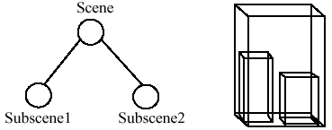
Bounding volume hierarchies
Straightforward bounding volumes still store objects in a flat list: O(n) intersection tests
Use a tree structure: boxes within boxes
Recursively test for intersections:
  If ray misses large box,
  don't need to descend tree
  If ray hits large box,
  recurse into smaller boxes
Challenges:
  Constructing full balanced tree

Slide 10
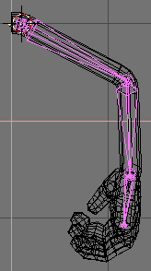
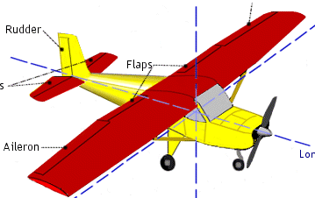
Scene graph
Hierarchical grouping of objects
  crowd → person → torso → arm → elbow
  Directed acyclic graph; usually a tree
Geometry is in leaf nodes
Nodes may contain matrix transforms
plane
wing
fuselage
flaps
aileron

Slide 11
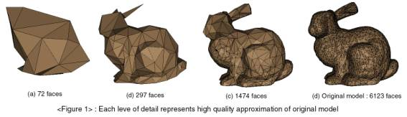
Controlling detail
Consider projected size of geometry on screen
Detail culling:
  Don't render tiny triangles
Levels of detail (LoD):
  Like mip-maps but for geometry
  Generate several versions of geometry
  Choose LoD based on projected size
CVC @U Texas

Slide 12
OpenSceneGraph library
    www.openscenegraph.org
Layer above OpenGL
Heavy use of OO, templates, design patterns
  C++, plus bindings in Java, Python, etc.
Still developing, but growing popularity in graphics community
Supports: view frustum cull, occlusion cull, detail cull, LoD, much more
Alternatives: OpenSG (parallelized),
VTK (visualization, 2D/3D image processing), OpenInventor (old), OpenRM, Fahrenheit (old)

Slide 13
The OSG distribution
Core OSG: main libraries, node types
NodeKits: additional node classes
Plugins: for reading/writing various file types
  3D geometry: 3DS, AC3D, Alias LightWave, OpenFlight, TerraPage, VRML, etc.
  Images: jpg, gif, png, tiff, etc.
Interoperability libraries: for interfacing with other libraries, languages
Examples

Slide 14
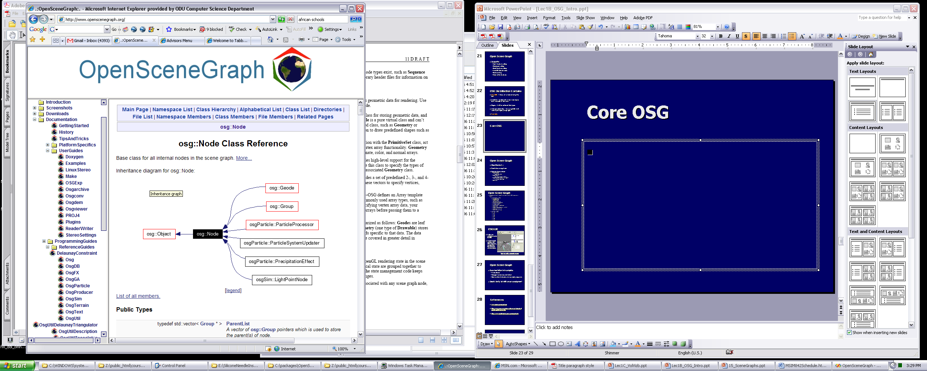
OSG class hierarchy: Node
Everything subclasses from OSG::Node

Slide 15
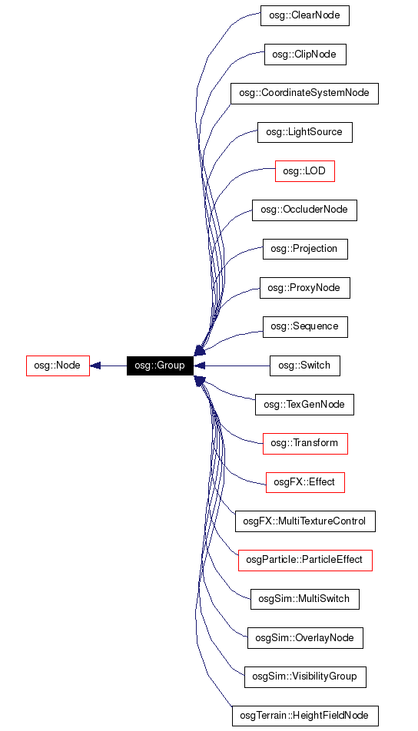
OSG::Group
Generic node that
may contain
children

Slide 16
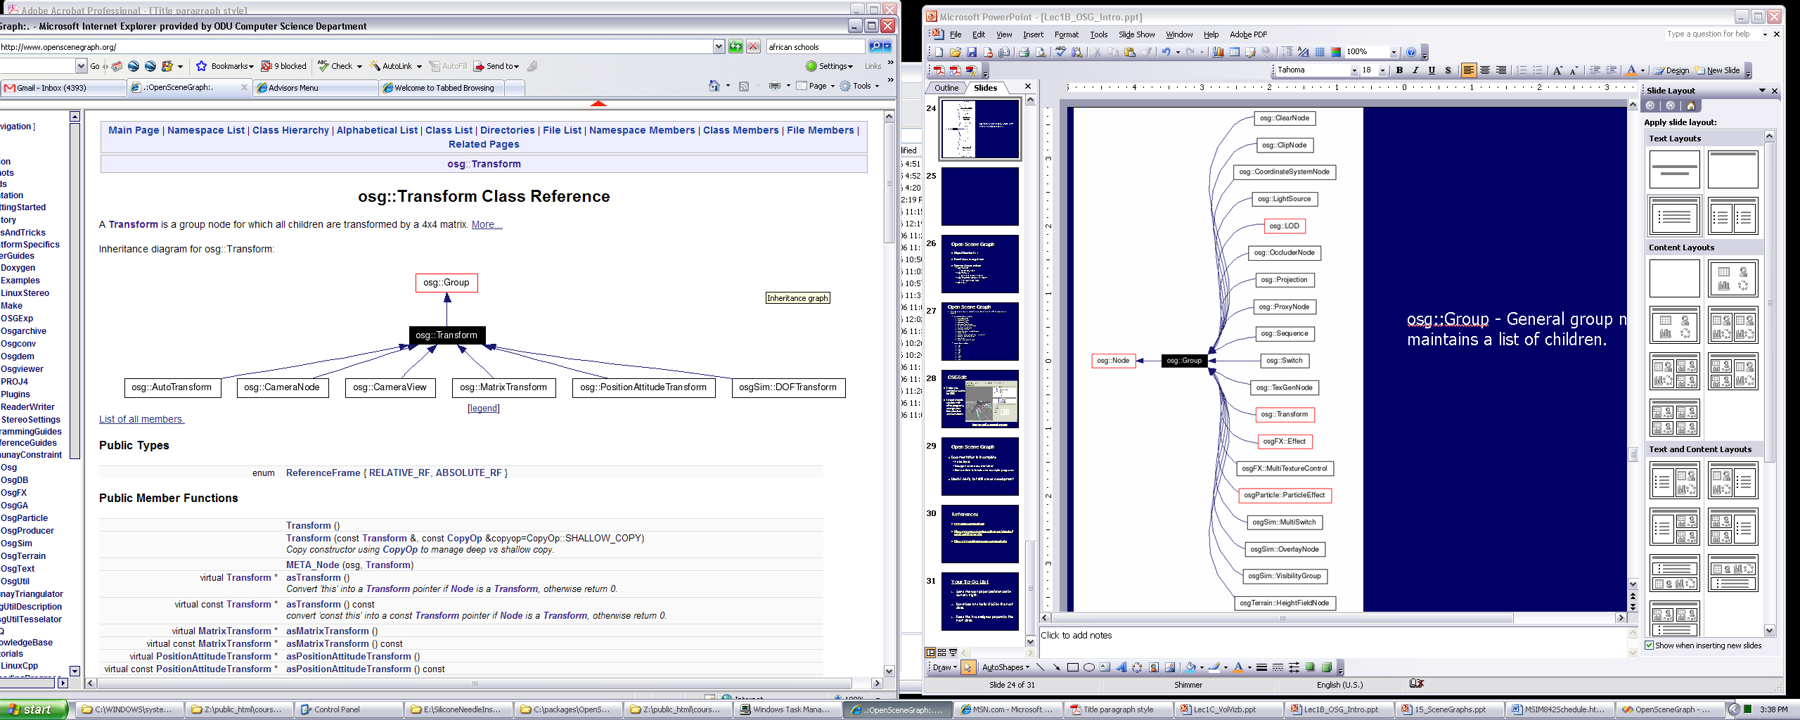
OSG::Transform
Transforms all children by a 4x4 matrix
  Position objects
  Move camera / trackball
  Animation

Slide 17
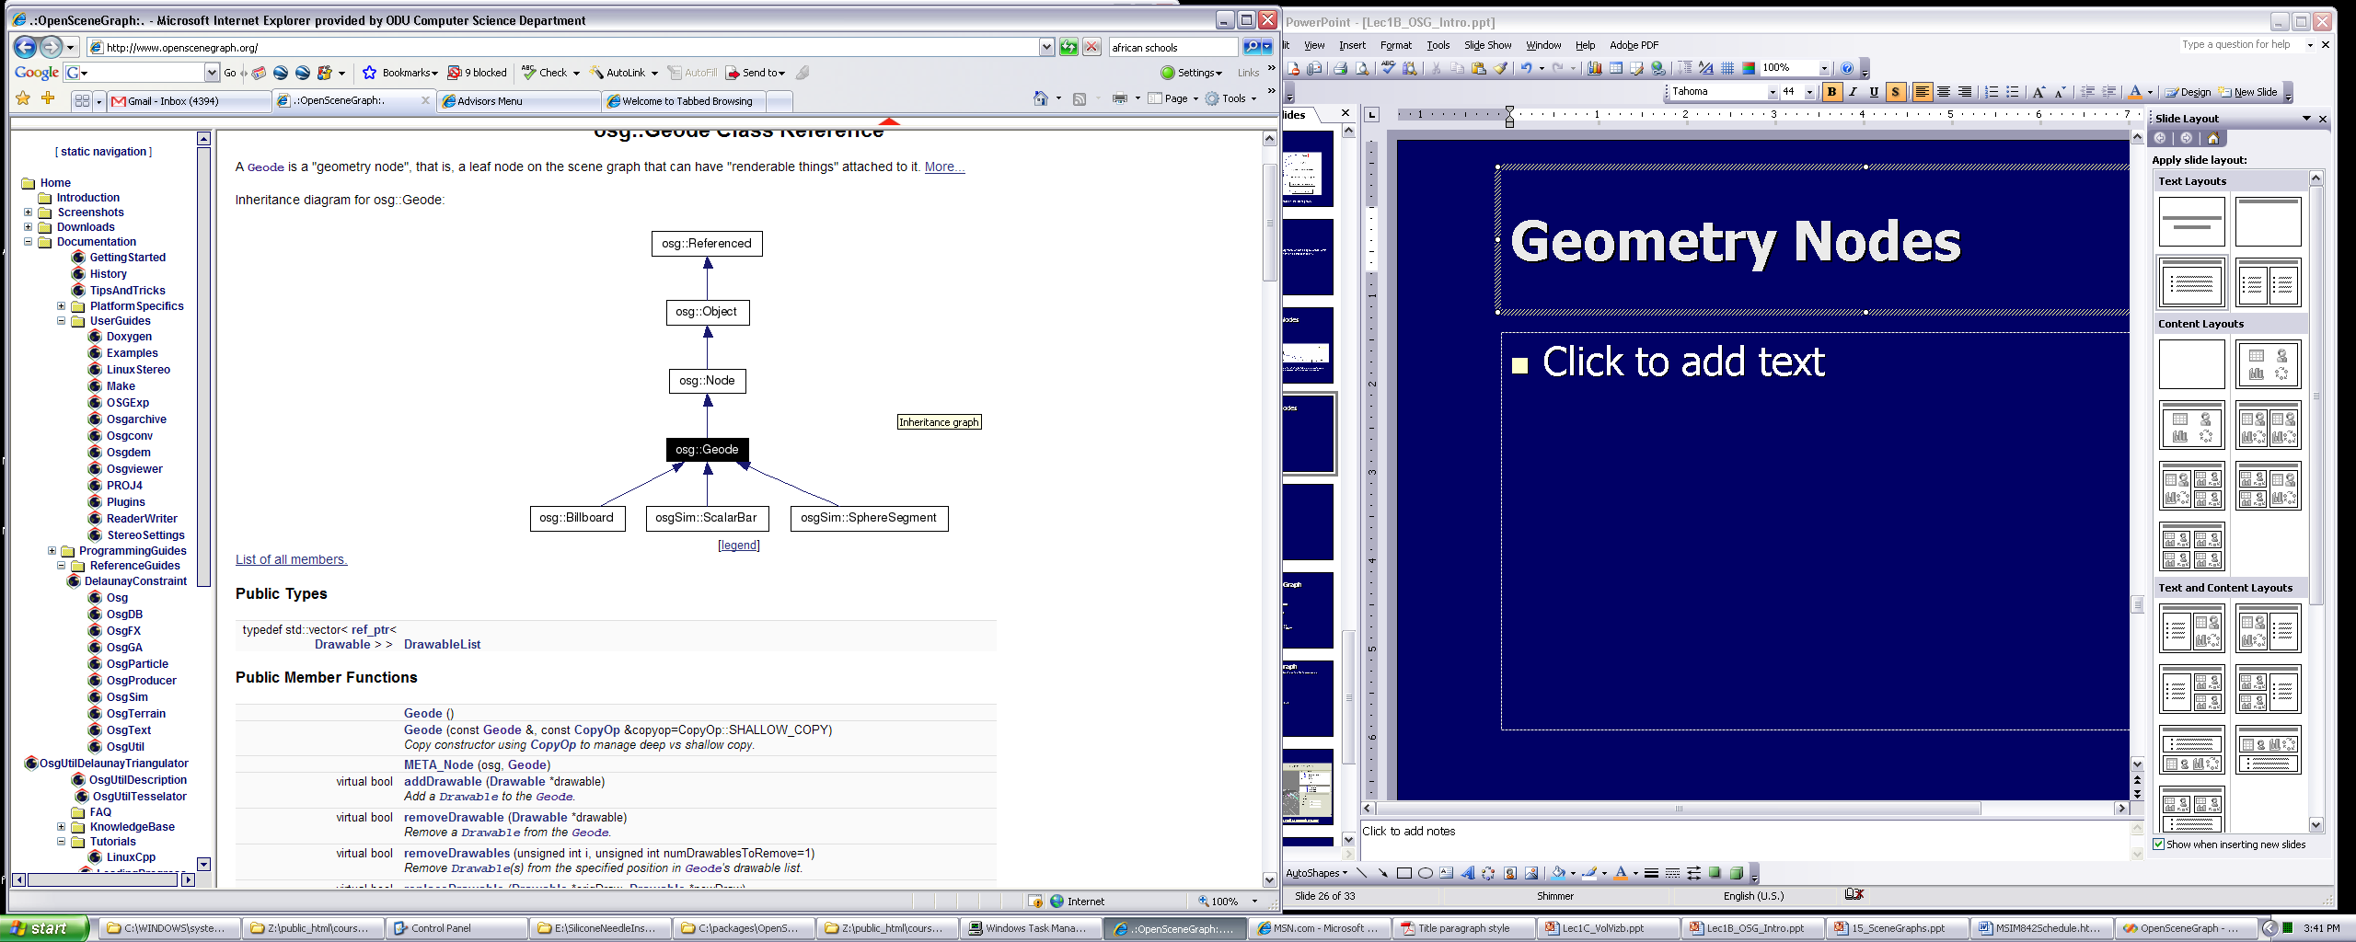
OSG::Geode
Contains the actual geometry: leaf node
Groups together OSG::Drawable objects

Slide 18
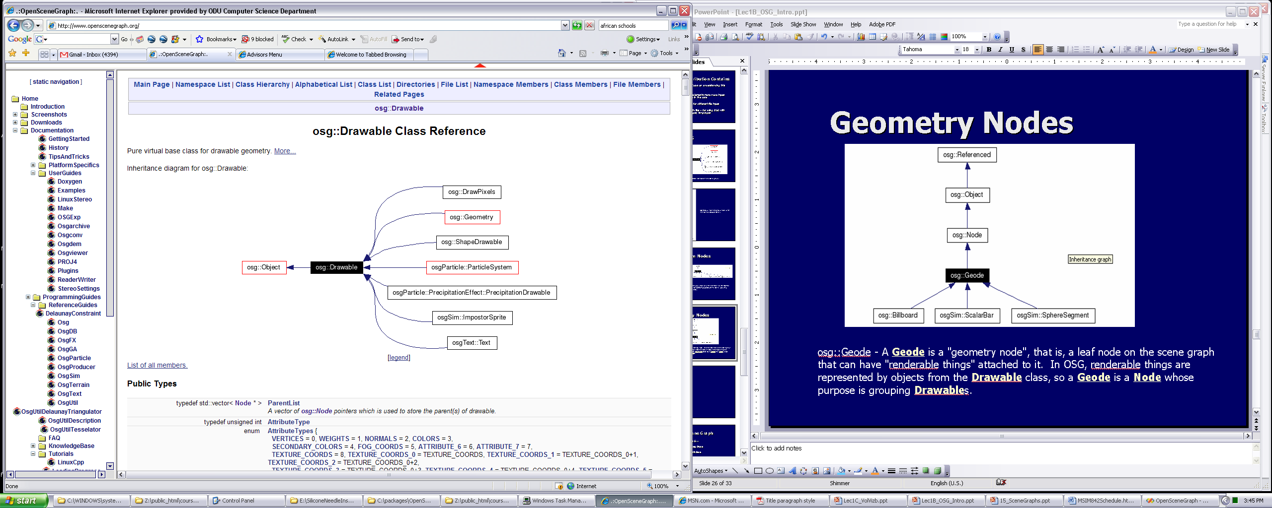
OSG::Drawable
Anything that is
renderable
Not a Node, but
attached to a Geode
OSG::Drawable is abstract (pure virtual) supercl
Drawables may be shared with several Geodes
  Same geometry used
  several ways
  Scene graph not a tree,
  but directed acyclic graph
Transform
Geode
Geode
Drawable

Slide 19
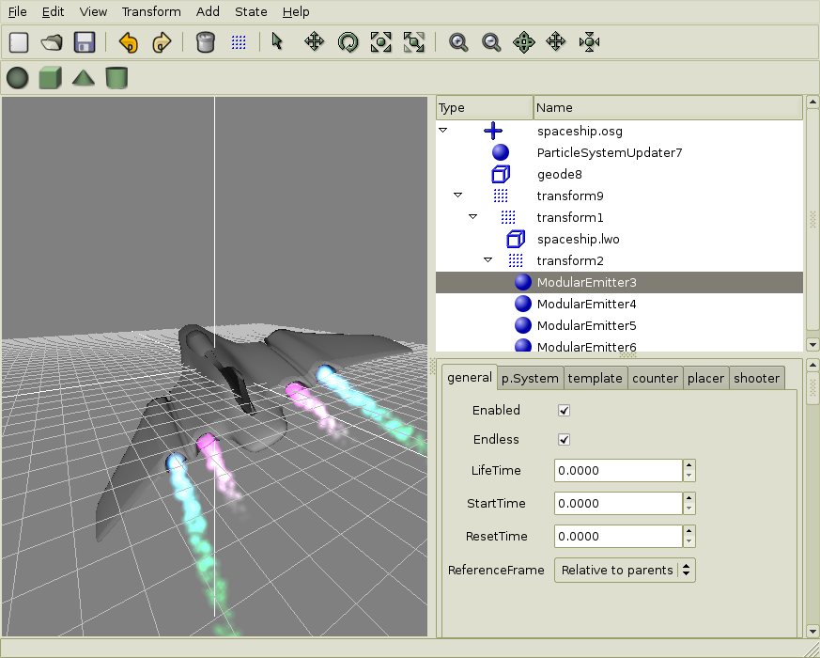
OSGEdit
Import models from other programs
Arrange and
organize
complex scenes
Use hierarchical
transforms
osgedit.sf.net

