Slide 1
I/O Channels,
Serialization: pickle
28 Oct 2010
CMPT140
Dr. Sean Ho
Trinity Western University

Slide 2
Quiz 4 (5min, 10pts)
Name 3 out of the 4 modes in which a file may be opened (excluding “binary modes”).
Also indicate the letter codes used to
specify the file mode to Python:
open( 'input.txt', mode ) [3]
What is aliasing? [3]
Write Python code to demonstrate an alias.
What are accessor/mutator methods?
Why are they a good idea? [4]

Slide 3
Quiz 4: answers #1-2
Name 3 out of the 4 modes in which a file may be opened (excluding “binary modes”). [3]
  read ('r'), write ('w'), append ('a'), both ('r+')
What is aliasing? [3]
Write Python code to demonstrate an alias.
  Multiple names which refer to the same object.
  apples = [ 'Fuji', 'Gala', 'Honeycrisp' ]
  appleAlias = apples

Slide 4
Quiz 4 (5min, 10pts)
What are accessor/mutator methods?
Why are they a good idea? [4]
  Protect access to attributes of an object [1]
  Accessor: read. Mutator: write. [1]
  Attributes should be made private [1]
  Prevent code outside the class from direct access to attributes:
  e.g., error-checking before allowing an attribute to be modified [1]

Slide 5
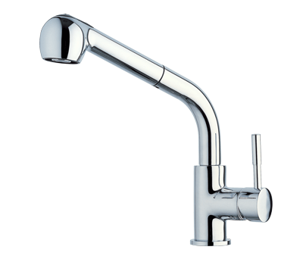
I/O channels
Abstractly, a stream of input comes
over a channel from a source
  e.g., source can be keyboard, file, program,...
A stream is output over a channel to a sink
  e.g., sink can be screen, file, program, etc.
I/O channels (file descriptors, file handles) can be opened in one of three modes:
  Read, write, and read/write
Default: source is keyboard, sink is screen
Can redirect channels to other source/sink

Slide 6
Standard I/O channels
In the standard sys library: import sys
Standard Input: sys.stdin
  Default: keyboard
Standard Output: sys.stdout
  Default: screen, but we can redirect to a file
Standard Error: sys.stderr
  Default: screen (in case stdout is redirected)
Alternative to print(): sys.stdout.write()
  Newlines must be explicit
Alternative to input(): sys.stdin.readline()

Slide 7
Redirecting standard I/O
You can redirect the standard I/O channels just by reassigning them:
e.g., make print() go to a file:
import sys
old_stdout = sys.stdout # save stdout
with open('log.txt', 'w') as sys.stdout: # redirect
  print( 'Hello!' ) # goes to file
  …
sys.stdout = old_stdout # restore stdout

Slide 8
Serialization
Python's I/O framework is flexible enough to support I/O with any kind of stream:
  Files, network sockets, other programs (IPC), hardware drivers (e.g., robotics)
To send data, it must be serialized: converted into a stream of bytes which we can .write() to a file handle or I/O stream
Different data types serialize differently
  If we make our own new data types,
  we have to specify how to serialize
Pickle is Python's framework for serialization

Slide 9
How to pickle/unpickle?
  import pickle
  Open the file (read or write mode)
  Write the object: pickle.dump(obj, file)
  Read an object: obj = pickle.load(file)
Pickled objects can be interspersed with regular text in the file; you just have to seek() to the right spot where the pickled object should be
Get the pickled object without writing to file:
  pickledObj = pickle.dumps(obj)
  This is just a string; you can then write() it

Slide 10
What can be pickled?
None, True, False
ints, floats, complex, strings,
Tuples, lists, sets, dictionaries, but
only if all elements are picklable
Functions defined at the top level of a module
Classes (user-defined types) that are
defined at the top level of a module
Instances of such classes, but
only if all attributes are picklable
  .__dict__ tells you what an object contains

Slide 11
For more information
Python Tutorial ch7 on I/O:
  http://docs.python.org/py3k/tutorial/inputoutput.html
Python I/O Library reference:
  http://docs.python.org/lib/bltin-file-objects.html
Python pickle library reference:
  http://docs.python.org/library/pickle.html

