Slide 1
Unit Testing and
Software Development Models
2 Dec 2010
CMPT140
Dr. Sean Ho
Trinity Western University

Slide 2
Outline for today
Unit testing (continued from last time)
  doctest: test narratives
  unittest (PyUnit), test suites
Software development models
  Waterfall
  V
  Agile (spiral)
    XP (Extreme Programming)
    Scrum

Slide 3
doctest: test narratives
See factorialtest.txt
doctest searches your docstrings for text resembling a test script (e.g., '>>>')
You can also put your test scripts in a separate file, interspersed amongst your documentation
  As though the whole file were a docstring
A test narrative is a document written for humans (e.g., user manual) where test cases are interleaved with the narrative
Run tests: python -m doctest factorialtest.txt
Or from code: doctest.testfile(“factorialtest.txt”)

Slide 4
unittest (PyUnit)
doctest is quick and easy to use, but limited
The unittest module provides more flexibility:
  Organize test cases into suites
  (in separate classes and even separate files)
  Fixtures: common setup / tear-down
  for all test cases in a suite
Uses standard methodology from Java (JUnit)
Test suites are classes (inherit from TestCase)
Test cases are methods within a suite
  Prefix method name with “test_”

Slide 5
unittest: test suites
See factorialunit.py
Usually, put the test suites in separate files from the modules you are testing
Import unittest and the module you want to test
Create test suites as subclasses of TestCase:
  class FactorialTests( unittest.TestCase ):
Fixtures: define setUp() / tearDown() methods to be run before/after each test (separately)
Test cases: define test_() methods
Use self.assert() methods to check results:
  self.assertEqual( factorial(6), 720 )

Slide 6
unittest: running tests
Put the following at the end of the file of tests:
  if __name__ == '__main__':
  unittest.main()
Run from the command line:
  python myunittests.py
Outputs results and any failures
Can also run from IDLE, but it will try to SystemExit after tests are finished

Slide 7
Top-down development
Requirements
WADES!
Waterfall model: assumes
every step is done perfectly
But in the real world:
  Written requirements change
  (client changes mind)
  Apprehension
  of requirements is fuzzy
  Design is incomplete at first
  Execution is sloppy (“spaghetti code”)
  Scrutinization results in endless debugging!
Specification
Design
Implementation
Testing
Deployment/
Maintenance

Slide 8
Software development process
Lots of people have tried to design better ways to develop that reflect the real world:
  Development process: how you do the work
No silver bullet: different projects, different people may require different processes
Be flexible: your future employer may demand that you use a particular process
  Or might not have any process in mind:
  then it's up to you to structure your time!
  Get results; make the client happy!

Slide 9
V development model
Design from Top-Down:
  What does the client want? (requirements)
  What will our system do? (specification)
  How will we do it? (design)
  What components will we need?
Test from Bottom-Up:
  Does each component work as it should?
  Do the components integrate correctly?
  Does it do what we promised it would?
  Is the client happy?

Slide 10
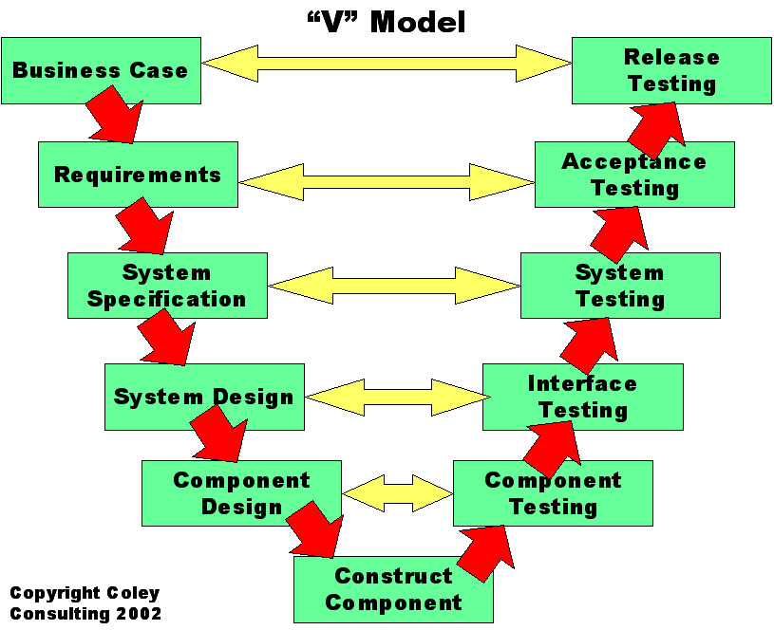
V model (Coley)
gate

Slide 11
Agile development
Waterfall and V are very rigid, slow
Agile refers to a broad class of methods:
  Get results quickly and adapt to change
“Agile Manifesto” philosophy:
Individuals and Interactions | Not: Software and Tools
Working Software | Not: Comprehensive Documentation
Customer Collaboration | Not: Contract Negotiation
Responding to Change | Not: Following a Plan

Slide 12
Agile: spiral model
Agile methods follow a spiral process,
like an iterative waterfall:
  Repeat parts of WADES, refining as you go
Get a prototype out early
Get feedback early
  Don't waste time developing
  what the client doesn't want
Client: “I'll know it when I see it”
  Developer: “Is this what you want?”
Anticipate several cycles/refinements!

Slide 13
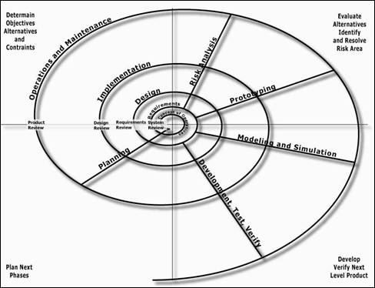
Agile: highway construc. (FHA)

Slide 14
Agile and the Toyota Way
Agile does not mean total anarchy!
  Clear goals, communication with client
  Rapid development with frequent feedback
  No room for procrastination!
Agile influenced the “Toyota Way”, lean process:
  Have a long-term philosophy or goal
  The right process
  Invest in people
  Continuously solve root problems

Slide 15
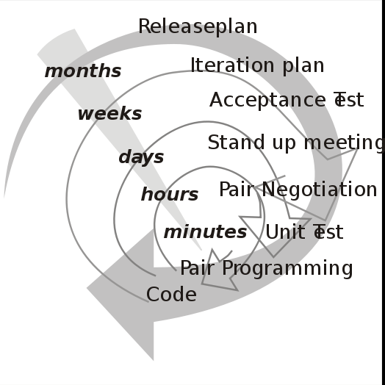
Agile: Extreme Programming
Extreme programming (XP) was coined by Kent Beck in 1999 while making Chrysler's payroll sys.
Many spirals, with varying scope and frequency
Code: if there are two competing solutions, implement both!
See which works better.
Test: it's the only way
to be sure it works
Values: Communication,
Simplicity, Feedback,
Courage, and Respect
(wikipedia)

Slide 16
Agile: Scrum
Most prevalent form of spiral dev. now is Scrum
“Pig” Roles (committed):
  Team (5-9 ppl): design, impl., test, comm., etc.
  ScrumMaster: protect, keep Team on-task
  Product Owner: “voice” of the client,
  writes use-cases (“stories”, requirements),
  gives feedback on results to Team
“Chicken” Roles (involved):
  Client, stakeholders: business need, marketing, artistic vision, design studio, etc.

Slide 17
Scrum process
Prioritized features go in backlog
Divide backlog into sprints (1-4 wks)
Sprint planning meetings
  Choose features to tackle
Daily stand-up scrum meetings
  Time-boxed to 15min
  Only “pigs” may speak
Sprint review meetings
  Get client feedback
  Team feedback on process
Backlog
Sprint
Feature
Feature
Feature
Feature

