Slide 1

Power Analysis:
Sample Size, Effect Size,
Significance, and Power
17 Sep 2010
Dr. Sean Ho
CPSY501
cpsy501.seanho.com
Please download:
SpiderRM.sav and
Missirlian article

Slide 2
Outline for today
Discussion of research article (Missirlian et al)
Power analysis (the “Big 4”):
  Statistical significance (p-value, α)
    What does the p-value mean, really?
  Power (1-β)
  Effect size (Cohen's rules of thumb)
  Sample size (n)
    Calculating min required sample size
Overview of linear models for analysis
SPSS tips for data prep and analysis

Slide 3
Practice reading article
Last time you were asked to read this journal article, focusing on the statistical methods:
Missirlian, et al., “Emotional Arousal, Client Perceptual Processing, and the Working Alliance in Experiential Psychotherapy for Depression”, Journal of Consulting and Clinical Psychology, Vol. 73, No. 5, pp. 861–871, 2005.
How much were you able to understand?

Slide 4
Discussion:
What research questions do the authors state that they are addressing?
What analytical strategy was used, and how appropriate is it for addressing their questions?
What were their main conclusions, and are these conclusions warranted from the actual results /statistics /analyses that were reported?
What, if any, changes/additions need to be made to the methods to give a more complete picture of the phenomenon of interest (e.g., sampling, description of analysis process, effect sizes, dealing with multiple comparisons, etc.)?

Slide 5
Outline for today
Discussion of research article (Missirlian et al)
Power analysis (the “Big 4”):
  Statistical significance (p-value, α)
    What does the p-value mean, really?
  Power (1-β)
  Effect size (Cohen's rules of thumb)
  Sample size (n)
    Calculating min required sample size
Overview of linear models for analysis
SPSS tips for data prep and analysis

Slide 6
Central Themes of Statistics
Is there a real effect/relationship
amongst the given variables?
  How big is that effect?
We evaluate these by looking at
  Statistical significance (p-value) and
  Effect size (r², R², η, d, etc.)
Along with sample size (n) and statistical power (1-β), these form the “Big 4” of any test

Slide 7
The “Big 4” of every test
Any statistical test has these 4 facets
Set 3 as desired → derive required level of 4th
Significance
0.05
as desired, depends on test
Effect size
Sample size
derived!
(GPower)
usually 0.80
Power

Slide 8
Significance (α) vs. power (1-β)
α is our tolerance of Type-I error:
incorrectly rejecting the null hypothesis (H₀)
β is our tolerance of Type-II error: failing to reject H₀ when we should have rejected H₀.
Set H₀ so that Type-I is the worse kind of error
Power is 1-β
e.g., parachute
inspections
(what should
H₀ be?)
 | Actual truth
 | H₀ true | H₀ false
Reject H₀ | Type-I error (α) | Correct
Fail to reject H₀ | Correct | Type-II error (β)
Our decision

Slide 9
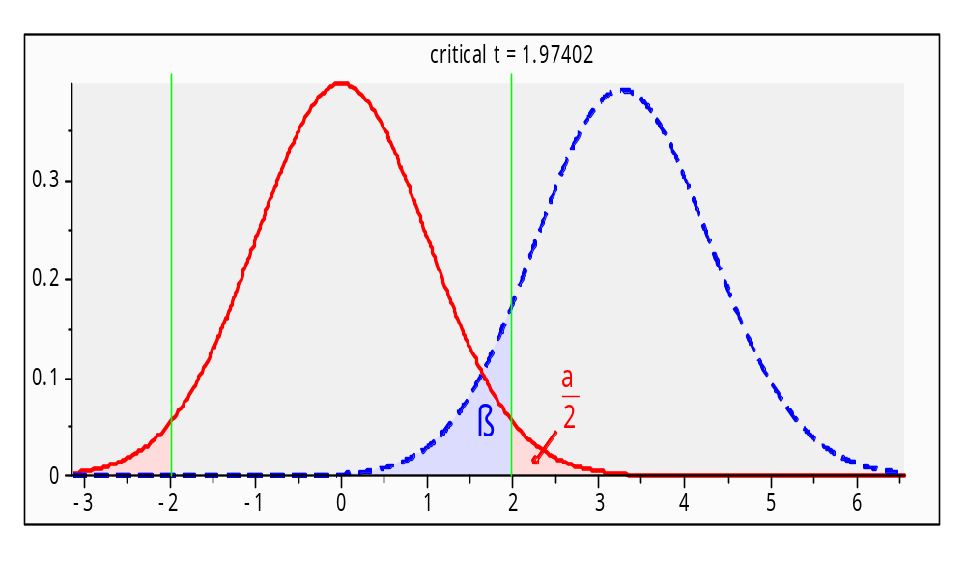
Significance: example
RQ: are depression levels higher
in males than in females?
  IV: gender; DV: depression (e.g., DES)
  What is H₀? (recall: H₀ means no effect!)
Analysis: independent-groups t-test
What does Type-I
error mean?
What does Type-II
error mean?

Slide 10
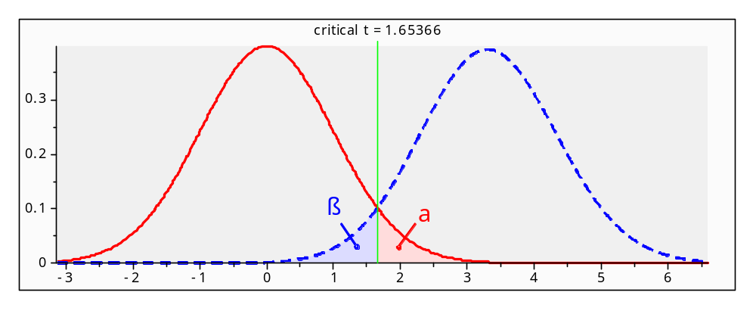
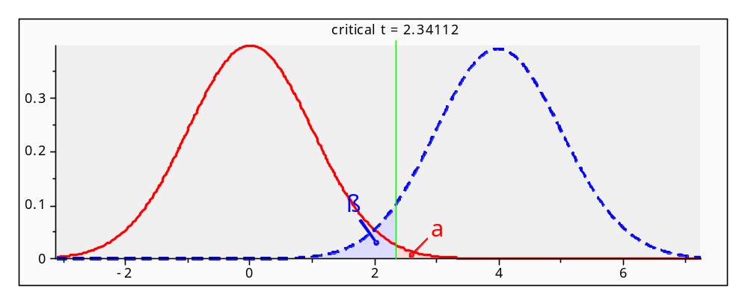
Impact of changing α
α=0.05
(without changing data)
decreasing Type-I means increasing Type-II!
α=0.01

Slide 11
What is the p-value?
Given data and assuming a model, the p-value is the computed probability of Type-I error
  Assuming model is true and H₀ is true, p is the probability of getting data that is
  at least as extreme as what we observed
  Note: this does not tell us the probability that H₀ is true! p(data|H₀) vs. p(H₀|data)
Set the significance level (α=0.05) according to our tolerance for Type-I error: if p < α, we are confident enough to say the effect is real

Slide 12
Myths about significance
  (why are these all myths?)
Myth 1: “If a result is not significant, it proves there is no effect.”
Myth 2: “The obtained significance level indicates the reliability of the research finding.”
Myth 3: “The significance level tells you how big or important an effect is.”
Myth 4: “If an effect is statistically significant, it must be clinically significant.”

Slide 13
Problems with relying on p-val
When sample size is low, p is usually too big
  → if effect size is big, try bigger sample
When sample size is very big,
p can easily be very small even for tiny effects
  e.g., avg IQ of men is 0.8pts higher than IQ of women, in a sample of 10,000: statistically significant, but is it
  clinically significant?
When many tests are run, one of them is bound to turn up significant by random chance
  → multiple comparisons: inflated Type-I

Slide 14
Outline for today
Discussion of research article (Missirlian et al)
Power analysis (the “Big 4”):
  Statistical significance (p-value, α)
    What does the p-value mean, really?
  Power (1-β)
  Effect size (Cohen's rules of thumb)
  Sample size (n)
    Calculating min required sample size
Overview of linear models for analysis
SPSS tips for data prep and analysis

Slide 15
Effect size
Historically, researchers only looked at significance, but what about the effect size?
A small study might yield non-significance but a strong effect size
  Could be spurious, but could also be real
  Motivates meta-analysis –
  repeat the experiment, combine results: with more data, it might be significant!
Current research standards require reporting both p-value as well as effect size

Slide 16
Measures of effect size
For t-test and any between-groups comparison:
  Difference of means: d = (μ₁ – μ₂)/σ
For ANOVA: η² (eta-squared):
  Overall effect of IV on DV
For bivariate correlation (Pearson, Spearman):
  r or r²: r² is fraction of variability in one var explained by the other var
For regression: R² and ΔR² (“R²-change”)
  Fraction of variability in DV explained
  by overall model (R²) or
  by each predictor (ΔR²)

Slide 17
Interpreting effect size
What constitutes a “big” effect size?
Consult literature for the phenomenon of study
Cohen '92, “A Power Primer”: rules of thumb
  Somewhat arbitrary, though!
For correlation-type r measures:
  0.10 → small effect (1% of var. explained)
  0.30 → medium effect (9% of variability)
  0.50 → large effect (25%)

Slide 18
Example: dependent t-test
Dataset: SpiderRM.sav
12 individuals, first shown picture of spider, then shown real spider → measured anxiety
Compare Means → Paired-Samples T Test
SPSS results: t(11)=-2.473, p<0.05
Calculate effect size: see text, p.332 (§9.4.6)
  r ~ 0.5978 (big? Small?)
Report sample size (df),
test statistic (t), p-value,
and effect size (r)
$r=\sqrt{\frac{t^{2}}{t^{2}+df}}$

Slide 19
Finding needed sample size
Experimental design: what is the minimum sample size needed to attain the desired level of significance, power, and effect size (assuming there is a real relationship)?
Choose level of significance: usually α = 0.05
Choose power: usually 1-β = 0.80
Choose desired effect size
  From literature or Cohen's rules of thumb
→ use GPower or similar to calculate the required sample size (do this for your project!)

Slide 20
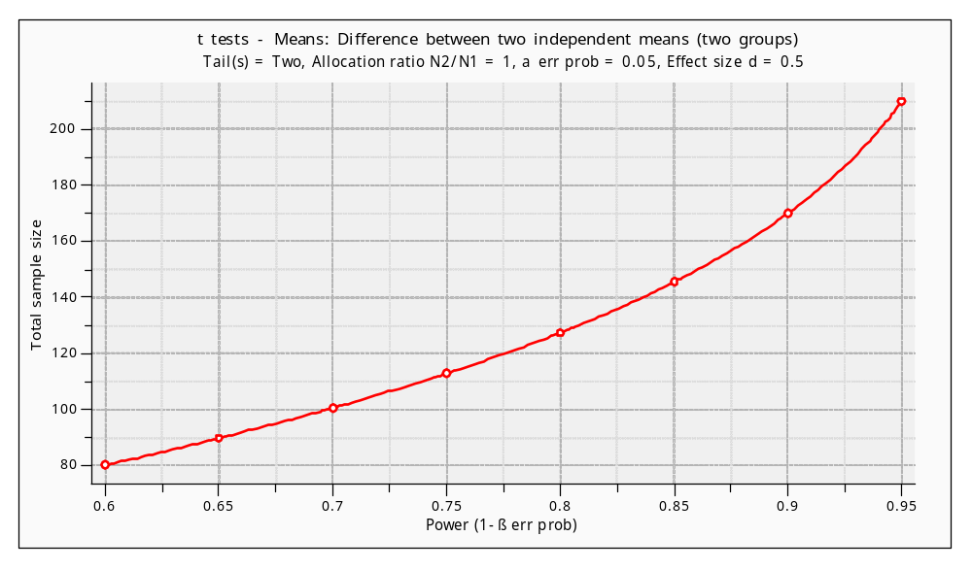
Power vs. sample size
Choose α=0.05, effect size d=0.50, and vary β:

Slide 21
Outline for today
Discussion of research article (Missirlian et al)
Power analysis (the “Big 4”):
  Statistical significance (p-value, α)
    What does the p-value mean, really?
  Power (1-β)
  Effect size (Cohen's rules of thumb)
  Sample size (n)
    Calculating min required sample size
Overview of linear models for analysis
SPSS tips for data prep and analysis

Slide 22
Overview of Linear Methods
For scale-level DV:
  dichotomous IV → indep t-test
  categorical IV → one-way ANOVA
  multiple categorical IVs → factorial ANOVA
  scale IV → correlation or regression
  multiple scale IVs → multiple regression
For categorical DV:
  categorical IV → χ² or log-linear
  scale IV → logistic regression
Also: repeated measures and mixed-effects

Slide 23
SPSS tips!
Plan out the characteristics of your variables before you start data-entry
You can reorder variables: cluster related ones
Create a var holding unique ID# for each case
Variable names can't have spaces: try “_”
Add descriptive labels to your variables
Code missing data using values like '999'
  Then tell SPSS about it in Variable View
Clean up your output file (*.spv) before turn-in
  Add text boxes / headers; delete junk

