Slide 1

Data Preparation and Exploration
Please download from
“Example Datasets”:
SPSSExam.sav
24 Sep 2010
Dr. Sean Ho
CPSY501
cpsy501.seanho.com

Slide 2
Research / Analysis Cycle
Research
Question
Design
& Plan
Collect
Data
Interpret
Results
Fit Model,
Assumptions
Clean &
Explore
The relationship between exploring, preparing and analyzing is reciprocal and hermeneutic!

Slide 3
Data Preparation & Exploration
With real data, we often spend far more time examining and preparing the data than actually running the statistical tests!
Failure to identify and correct problems will prevent the tests from working properly
  Or worse: lead to misleading results that do not reflect real relationships / effects.
(1) Create / fix variables
(2) Deal with missing data & outliers
(3) Assess assumptions of tests

Slide 4
Outline: Data Preparation
Creating secondary “derived” variables
Descriptives of a dataset, error checking
Missing data and outliers
Assumptions of Parametricity
What to report:
“Informationally adequate” statistics
Appendix: Project data sources

Slide 5
Derived Variables
Not new data: derived from existing vars. Why?
Build total or “subscale” scores from individual test items
  e.g., BDI total
Create grouping vars or modify categories
  e.g., age groups by year of birth
Correct problems in the data
  e.g., transform data to make it more normally distributed
  e.g., missing data

Slide 6
SPSS: Compute Variable
Transform → Compute Variable
Many kinds of transformations / computations from existing variables into new variables
Can combine information from multiple old variables into a single new variable
  e.g., sum, average
  Must address missing scores first
Can compute for specific subsets/groups within a data set using the “if” option

Slide 7
Application Examples
Example dataset: SPSSExam.sav
Combining marks:
Create a new var: “Average assignment mark”
  Transform → Compute Variable → Mean
Mean vs. Sum:
  Generally, means are easier to interpret: does not depend on number of assignments
  However, many standard subscales do use sum of individual questions

Slide 8
Recode Options
Recoding can be done into the same variable, or into a new variable
  I generally recommend recoding into new:
  Transform → Recode into different vars
    Specify what variable you want to recode
    Specify old and new values
We can recode specific parts of a variable using the “if” option

Slide 9
Example: Coding for Ethnicity
We can draw upon categories used by StatsCan and information on generational status
Once data gathering has been completed and demographic description is conducted, then
That sample can be recoded for ethnic, cultural, linguistic, and generational status
e.g., recode from country of heritage
  e.g., China, Philippines, etc.
To ethnicity:
  e.g., Asian, Pacific Islander, etc.
Notes:
Links: Take time to become familiar with StatsCan websites: http://www.statscan.ca/; Article – Wintre & al (2000). → see appendices

Slide 10
Outline: Data Preparation
Creating secondary “derived” variables
Descriptives of a dataset, error checking
Missing data and outliers
Assumptions of Parametricity
What to report:
“Informationally adequate” statistics
Appendix: Project data sources

Slide 11
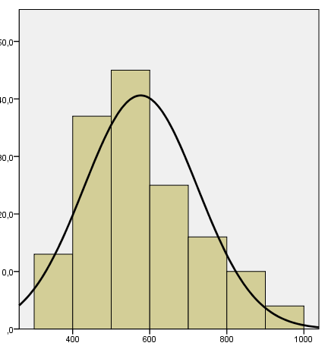
Data Exploration
Get overall feel of the dataset
and identify any problems
with the data (for fixing)
In final rounds: report & describe
basic characteristics of the data (use APA style)
SPSS: Analyze → Descriptive Statistics
  → Descriptives, Frequencies, P-P plots, ...
  → Explore has more stats, plots
Graphs: Legacy Dialogs → Boxplot, Error Bar, Histogram, Scatterplot, ...
Notes:
Tabachnick & al. (2007). On cleaning data

Slide 12
Signs of Data Entry Errors
Scores that are outside of what is possible
Unexplained gaps in the frequency output / histogram, or odd patterns in boxplots
Cases on your boxplots or histograms that do not fit with the rest of the sample (outliers?)
Standard deviations much larger than expected
Means much different from expected
For possible errors, compare the SPSS file against your original data source
Notes:
RUN: freq for NOMINAL VARIABLES FOR the demo data set…

Slide 13
Missing Data
Reasons for missing data, in real research?
  Systematic gaps indicate a real problem
  Random gaps may be okay, as long as less than ~5% of the data is missing
To check if missing data impacts analysis:
  code it as a separate variable
    Dichotomous: “missing” vs. “not missing”
  compare responses on other variables for “missing” vs. “not missing” groups
Notes:
Schafer & al. (2002). Missing data primer

Slide 14
Random Missing: Strategies
Go back and obtain the bits that were missing
  Not always practical, ethical, or effective
Eliminate variables with the most problems
  Unless they are central to the study!
Drop cases/people with too much missing data
  May result in insufficient sample size
Estimate and replace missing values
  Simple imputation methods like mean substitution have problems

Slide 15
Systematic Missing: Strategies
Code “missing” var and include it in analysis
  Might not help clarify import of omissions
Return to participants & collect missing data
  No guarantee of improved response rates
Exclude the kind of participants that choose not to respond from your sample
  Reduces generalizability of the results
  May end up altering research question
Start over, change design and data collection procedures

Slide 16
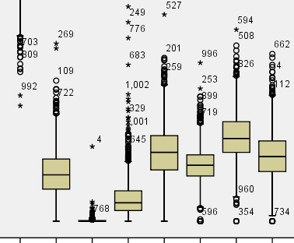
Univariate Outliers
Definition: Patterns that reflect persons from a different population from the rest of the sample
Use boxplots to spot them (outliers: *)
From (a) knowledge of the literature and
(b) extremity of an outlying score, decide
  whether to keep or
  exclude the outliers
  whether to use robust
  strategies for analysis
Multivariate outliers
can also exist

Slide 17
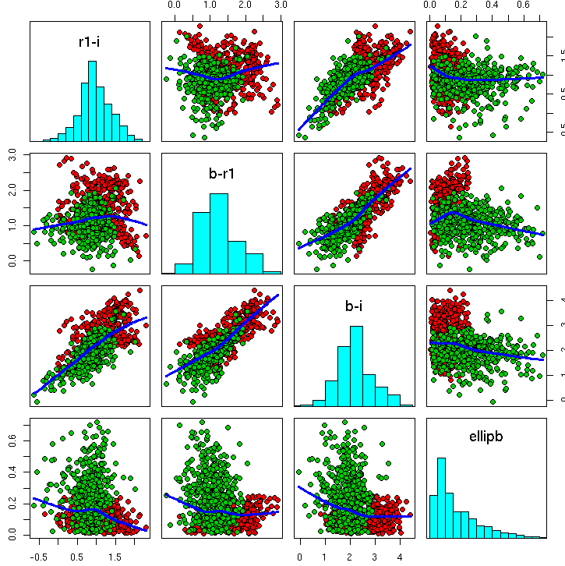
Multivariate Outliers
Cases that might not appear
extreme in any one variable,
but that don't fit the pattern
across several variables
Try using scatter plots to detect outliers:
  Graphs → Legacy Dialogs → Scatter/Dot
  Choose “matrix scatter” to examine several quantitative variables at once.
Use the “simple scatter” option to “zoom in” on a combination of variables of interest.
Richard Holbrey, Uni. Leeds

Slide 18
Handling Outliers
If the person is a valid case,
keep it in the dataset and check for impact.
  Compare results with and without it
Otherwise, remove the entire case from dataset
  Other strategies exist, but more complex
Check for univariate outliers ONCE, then
Check for multivariate outliers ONCE
  Do not repeat!
  Excessive elimination of outliers may result in a very distorted dataset!

Slide 19
Outline: Data Preparation
Creating secondary “derived” variables
Descriptives of a dataset, error checking
Missing data and outliers
Assumptions of Parametricity
What to report:
“Informationally adequate” statistics
Appendix: Project data sources

Slide 20
Checking Test Assumptions
Most statistical tests make assumptions of data.
  Must always check these assumptions!
If any assumptions are violated:
  Use a different procedure, and/or
  “Clean up” the data to meet assumptions
Procedures based on the General Linear Model all assume that the data are parametric.
  e.g., parametric correlation, t-tests, multiple regression, the ANOVA family, factor analysis, multi-level modeling, ...!

Slide 21
Assumptions of Parametricity
  (These generally apply to the DV)
Scale (interval/ratio) level of measurement
Independence:
  No systematic links between cases
Homogeneity of variance:
  Variability of scores should be roughly similar across all variables and all participant groups
Normally distributed within each group
  Bell-shape, not skewed or kurtotic

Slide 22
Parametricity: Interval/ratio
Check: level of measurement for each variable
Solutions: try alternative, non-parametric tests:
Parametric | Non-parametric
Pearson's r | Spearman's r_{s}, Kendall's τ
Multiple Regression | Log-linear or Logistic Regression
Between-group t-test, Within-group t-test | Mann-Whitney U, Wilcoxon Signed-Rank
ANOVA family | Friedman's ANOVA, Chi-square, ...
Notes:
Spearman’s non-parametric correlation (r_{s}) was formerly symbolized the a Greek lower-case “r” = rho (ρ). In the current edition of the APA style guide, the symbol “r_{s}” is now specified instead.

Slide 23
Parametricity: Independence
Check: sampling process, meaning of vars
  e.g., participants from same family?
Solutions:
  Eliminate the offending cases or vars
  Methods designed for “dependent” data
    Repeated-measures ANOVA,
    multi-level (hierarchical) modelling, …
  Split data into independent subgroups
    e.g., analyze males and females separately

Slide 24
Homogeneity of Variance
Check: examine variance of each subgroup:
    Analyze → Descriptive Statistics → Explore
    Plots → Spread vs. Level → Untransformed
    Choose group (factor) vars and DVs
  If ratio of largest variance to smallest is more than 4:1, we have a problem
Or: use Levene's test:
  If p<0.05, then assumption may be violated. (non-significance = good)
Solutions: use conservative α, transform data, or try non-parametric methods

Slide 25
Parametricity: Normality
Check: Kolmogorov-Smirnov, Shapiro-Wilk tests
  Skewness / kurtosis (w/confid. interval)
    If p<0.05, then we may have a problem
  Normality plots, P-P plots
    Analyze → Descriptive Statistics → Explore → Plots → check “Normality plots w/tests”
Solutions:
  Transform data as appropriate, or
  Change problematic scores (yipes!)
Remember normality applies per-cell
Notes:
Also: NonParametric → 1-sample K-S for just that test; Also, need to check assumptions for key subgroups such as gender;

Slide 26
Transform Data for Normality
(cf. Beherns, 1997)
Minor deviations: try square-root (sqrt)
Medium deviations: try logarithmic (log10)
Severe deviations: try reciprocal (1/score)
  If tail is to the right, reflect data first:
    maximum_score – variable
SPSS: Transform → Compute Variable
  Apply appropriate transformation
  Use menus (Arithmetic, etc.) to find operations
Notes:
For a longer list of a “Ladder of reexpression” for transformations, see Beherns 1997, p. 149

Slide 27
Practise: Check Parametricity
  Datasets: SPSSExam.sav, HW1-ADD.sav
Let's study the “effect” of gender (IV) on number of lectures (DV) or ADD symptoms (DV)
Are the data parametric? Try it yourself!
  Level of measurement
  Independence
  Homogeneity of variance
  Normality

Slide 28
Order of Data Preparation
Clean: spot/fix data entry errors, missing data
Explore: overall patterns, use lots of graphs!
Create derived vars (subscales, demographics)
Outliers (uni-/multi-variate): identify & handle
Check assumptions for your chosen analysis (e.g., parametricity)
  Deal with any violations of assumptions
Obtain descriptive information for the final dataset, and proceed with the analysis

Slide 29
Outline: Data Preparation
Creating secondary “derived” variables
Descriptives of a dataset, error checking
Missing data and outliers
Assumptions of Parametricity
What to report:
“Informationally adequate” statistics
Appendix: Project data sources

Slide 30
“Informationally Adequate”
APA has standards on what you must report.
In order to be “informationally adequate”:
Sample size (total N and n_{i} for each subgroup)
Mean and SD for each outcome variable
  Globally and for each sub-group
Statistical significance (“exact” p–values)
Measures of effect size (d, η², R², etc.)
Evidence of sufficient statistical power
Other test-specific info (APA, §2.07, pp. 32-35)

Slide 31
Further Reading -- Articles
Wintre et al. (2000).
Generational status and ethnicity in Canada
Tabachnick et al. (2007). On cleaning data
Schafer et al. (2002). Missing data primer

Slide 32
APPENDICES
StatsCan resources
Coding ethnicity
Data archive sources available on-line

Slide 33
StatsCan Downloads
Selected Demographic and Cultural Characteristics (102), Visible Minority Groups (15), Age Groups (6) and Sex (3) for Population, for Canada, Provinces, Territories and Census Metropolitan Areas, 2001 Census - 20% Sample Data
  http://www.statcan.ca/bsolc/english/bsolc?catno=97F0010X2001044
Selected Demographic and Cultural Characteristics (105), Selected Ethnic Groups (100), Age Groups (6), Sex (3) and Single and Multiple Ethnic Origin Responses (3) for Population, for Canada, Provinces, Territories and Census Metropolitan Areas, 2001 Census - 20% Sample Data
  http://www.statcan.ca/bsolc/english/bsolc?catno=97F0010X2001040
Place of Birth of Father (35), Place of Birth of Mother (35) and Generation Status (4) for the Population 15 Years and Over of Canada, Provinces, Territories, Census Metropolitan Areas and Census Agglomerations, 2006 Census - 20% Sample Data
  http://www.statcan.ca/bsolc/english/bsolc?catno=97-557-X2006009

Slide 34
StatsCan Definitions
Source: Ethnic Diversity Survey - Methodology and Data Quality
“questions on the birthplace of respondents and their parents were used to establish the respondent’s generational status. The first generation includes respondents born outside Canada. The second generation includes respondents born in Canada with at least one parent born outside Canada. The third-plus generation includes respondents born in Canada to two Canadian-born parents.”
“Responses to the ethnic origin question were divided up to form the two main categories of interest: CBFA+ (Canadian or British or French or Americans or Australians and/or New Zealanders) and Non-CBFA+ (all other responses containing at least one origin other than CBFA+). The non-CBFA+ category was divided into European origins (for example, German, Italian, Dutch, Portuguese) and non-European (for example, Chinese, Jamaican, Lebanese, Iranian).”
Notes:
This is a “derived” variable

Slide 35
StatsCan Definitions (cont.)
“CBFA+
Canadian only –
Generation 1 and 2
Canadian only –
Generation 3 and more
Canadian with BFA+ – Generations 1 and 2
Canadian with BFA+ – Generations 3 and more
BFA+ – Generation 1 and 2
BFA+ – Generation 3 and more
Non-CBFA+
Other Europeans with Canadian – Generation 1 and 2
Other Europeans with Canadian – Generation 3 and more
Other Europeans – Generation 1
Other Europeans – Generation 2
Other Europeans – Generation 3 and more
Other non-Europeans with Canadian – All generations
Other non-Europeans –
Generation 1
Other non-Europeans –
Generation 2 and more
Notes:
“Where necessary, the strata formed by generations were consolidated to obtain a sufficiently high number of persons in the stratum. Therefore, respondents to the EDS were distributed among the following strata.”

Slide 36
ICPSR
Interuniversity Consortium for Political and Social Research:
“Established in 1962, ICPSR is the world's largest archive of digital social science data.”
  http://www.icpsr.umich.edu/ICPSR/
e.g., National Institute of Mental Health (NIH) Collaborative Psychiatric Epidemiology Surveys (CPES)

