Slide 1

ANOVA: Analysis of Variance
22 Oct 2010
CPSY 501
Dr. Sean Ho
Trinity Western University
Please download:
treatment4.sav

Slide 2
Outline for today
Core concepts of ANOVA (with pictures!)
  One-way, factorial, RM, MANOVA, ANCOVA
Running ANOVA in SPSS
  Interpreting output
  Follow-up analysis: post-hoc comparisons
  Follow-up analysis: planned comparisons
Assumptions of ANOVA: Parametricity
Introduction to ANCOVA
  Use of ANCOVA in therapy research

Slide 3
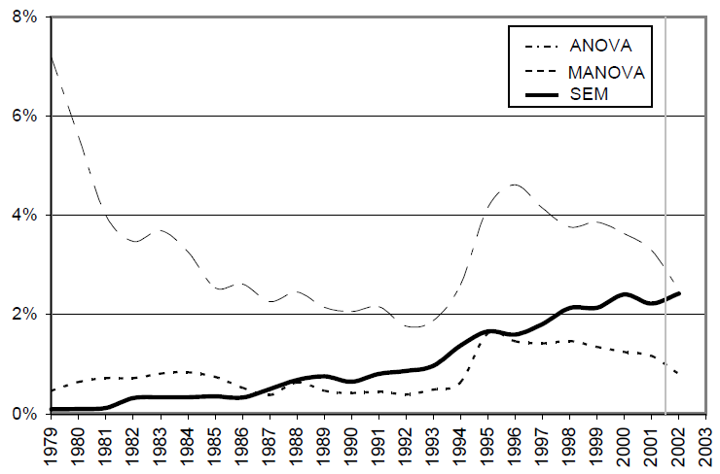
Trends in Research: ANOVA
Nachtigall, C., Kroehne, U., Funke, F., & Steyer, R. (2003).
(Why) Should we use SEM? Pros and cons of structural equation modeling. Methods of Psychological Research - Online, 8(2), 1-22.
ANOVA is a conceptual framework / foundation
Other methods like Structured Equation Modelling are also increasing in popularity
Citations in
PsychINFO,
1979-2003

Slide 4
ANOVA: Core Concepts
Extension of t-test to multiple groups
Why not just do a bunch of t-tests (all pairs)?
  Multiple comparisons: to control Type-I error, we'd have to spread out our α across all t-tests, so each one is a stricter test
  We will do this in post-hoc analysis!
ANOVA can be thought of as a form of regression, with categorical predictors
Global test for group differences (omnibus)
  Post-hoc tests then locate the differences
Notes:
* family-wise error = 1 – (.95)^{n} for ‘n’ tests; ** = ANOVA includes non-linear effects in its calculations

Slide 5
Kinds of ANOVA
All ANOVAs require parametric outcome var!
One-way ANOVA: One categorical predictor
  If IV has only two levels, this is a t-test!
Factorial (“between subjects”) ANOVA:
Two or more predictors, plus interactions
Repeated Measures (“within subjects”) ANOVA: Multiple observations of IV on each participant
  e.g., time: pre/post/follow-up
Notes:
t-test for 2 groups, only

Slide 6
Kinds of ANOVA (continued)
Mixed (between/within) ANOVA:
Some predictors are between-groups (factorial),
some are within-groups (repeated measures)
MANOVA: Two or more outcome variables, correlated, and in the same analysis
ANCOVA: Any of the above designs, trying to control for an extraneous influence (covariate) on the DV
Notes:
Miller & Chapman (2001) example: video-primed anxiety & phobias – IV = social vs. simple phobia, Cov = length of personalized videos where average length of videos the same for both groups; DV = anxiety ratings, with correlation showing between video length & anxiety levels

Slide 7
ANOVA: The F-ratio
ANOVA's test statistic is the F-ratio:
F = MS_{model} / MS_{residual}
  “Model”: variation/difference among cells
  “Residual”: variation within each cell
  Same as F-ratio in regression: model / error
Categorical IVs divide the sample into cells:
all combinations of groupings from the IVs
e.g., treatment4.sav:
  1 IV (treatment type) with 3 levels:
  CBT (cog-beh), CSG (church), WL (control)
Notes:
* family-wise error = 1 – (.95)^{n} for ‘n’ tests; ** = ANOVA includes non-linear effects in its calculations

Slide 8
Picture: Within-Cell Variation
Error bar charts can help visualize both the “between-cell” and “within-cell” variation
  Confidence intervals around cell means describe within-cell variation (residual)
  Cell mean differences describe
  between-cell variation (model effect of IV)
SPSS: Graphs → Legacy Dialogs → Error bar → Simple and “groups of cases”:
  Variable (DV): depression levels at outcome
  Category Axis (IV): treatment type
  (Also try: Line, with Options → “error bars”)
Notes:
ONE-WAY ANOVA EXAMPLE

Slide 9
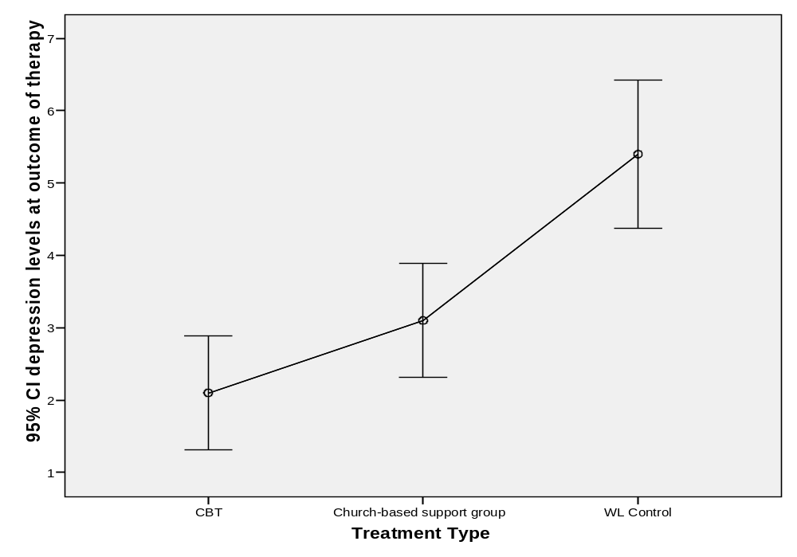

Slide 10
Picture: Repeated Measures
The same DV (depression levels) is measured on the same individual at three different times:
  Pre-treatment, at outcome of therapy, and at 6-month follow-up
SPSS: Graphs → Legacy Dialogs → Error bar → Simple and “separate variables”:
  Error Bars (DV): depression at 3 time points
This graph ignores treatment group;
i.e., collapsed across all treatment groups

Slide 11
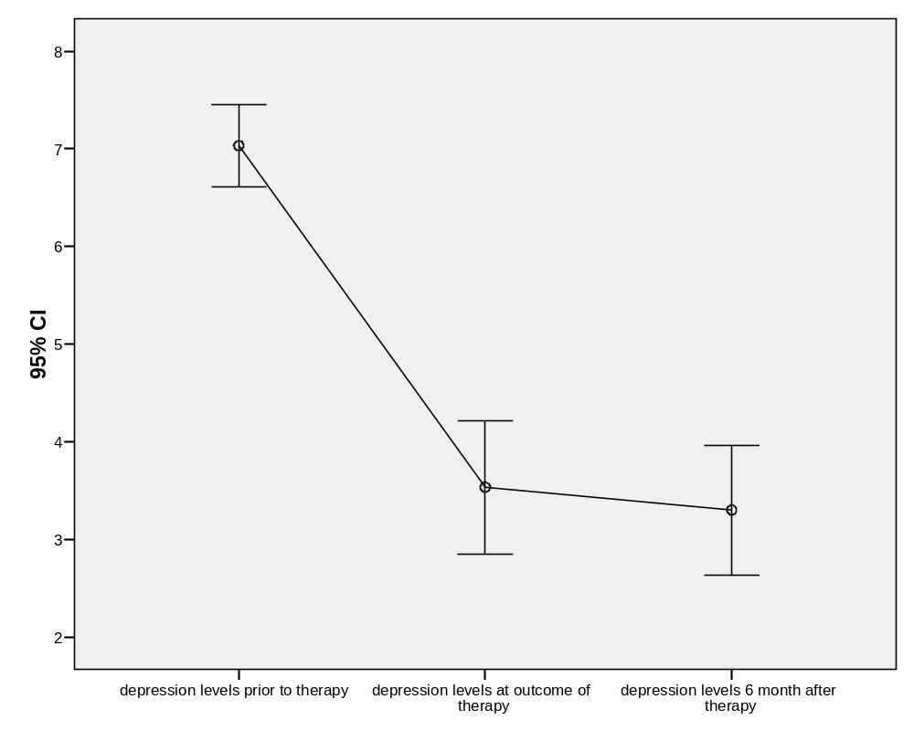

Slide 12
Repeated Measures, by Group
If we want to visualize the treatment effect, we can use clustered error bars to see the depression levels of each treatment group at each time point:
SPSS: Graphs → Legacy Dialogs → Error bar → Clustered and “separate variables”:
  Variables (DV): depression at 3 time points
  Category Axis (IV): treatment type

Slide 13
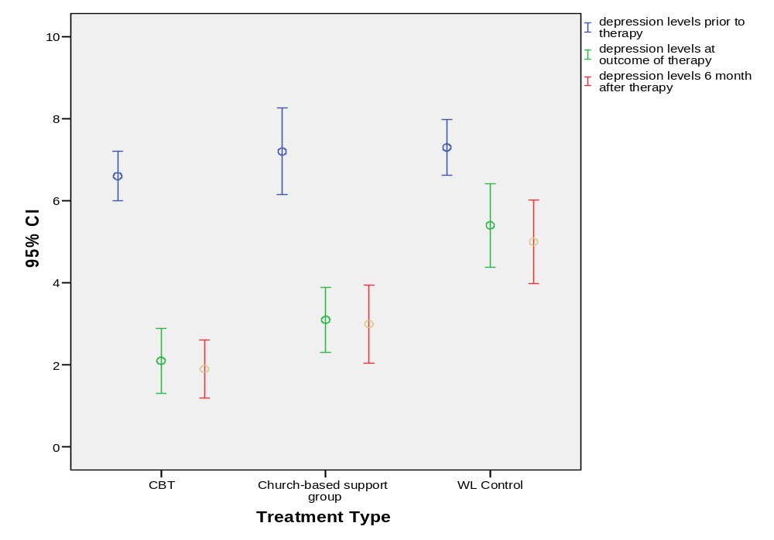

Slide 14
Outline for today
Core concepts of ANOVA (with pictures!)
  One-way, factorial, RM, MANOVA, ANCOVA
Running ANOVA in SPSS
  Interpreting output
  Follow-up analysis: post-hoc comparisons
  Follow-up analysis: planned comparisons
Assumptions of ANOVA: Parametricity
Introduction to ANCOVA
  Use of ANCOVA in therapy research

Slide 15
Running ANOVA in SPSS
Analyze → General Linear Model → Univariate:
  Dependent Variable: our outcome variable
    e.g., depression levels at outcome of therapy
  Fixed Factors: our (categorical) predictors
    e.g., Treatment Type
  Check: Options → “Estimates of effect size” and “Descriptive statistics”
Omnibus test: H₀ is that all groups are same,
H_{A} is that there is some group difference somewhere
Notes:
Random factors: more likely in experimental work, wanting to cover many levels of an IV

Slide 16
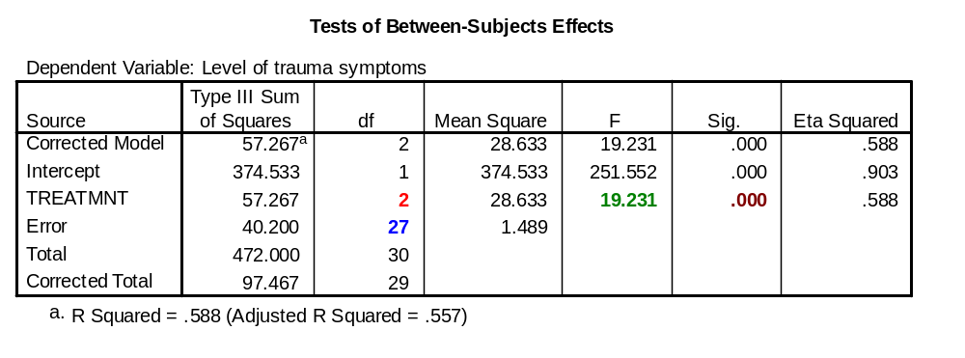
Interpreting ANOVA Output
There is a significant effect of treatment type on depression, F(2,27) = 19.23, p < .001.
This is a strong / large effect, η² = 59%

Slide 17
Finding Group Differences
Yay, so the global F-test tells us there is a group difference! Now what?
  Effect size: η² = 59%: analogous to R²
Where do the differences lie? Highest group? Lowest group? Clusters of similar groups?
Two strategies:
  Post-hoc: t-tests between all pairs of cells
    Watch out for α of multiple comparisons!
  Planned comparisons: we tell SPSS to focus on a few pairings that may show differences

Slide 19
Outline for today
Core concepts of ANOVA (with pictures!)
  One-way, factorial, RM, MANOVA, ANCOVA
Running ANOVA in SPSS
  Interpreting output
  Follow-up analysis: post-hoc comparisons
  Follow-up analysis: planned comparisons
Assumptions of ANOVA: Parametricity
Introduction to ANCOVA
  Use of ANCOVA in therapy research

Slide 20
Post-Hoc Comparisons
In post-hoc analysis, we ask SPSS to run t-tests between all possible pairings of cells
  Potentially lots of t-tests!
  Analyze → GLM → Univariate → Post-Hoc
Useful in exploratory analysis – no prior hypotheses about which groups might differ
Watch out for Type-I error! Must distribute our α=0.05 amongst all comparisons
  So each t-test gets a tiny slice of α
  Or equivalently, adjust p-values up

Slide 21
Types of Post-Hoc Tests
Tukey or REGW-Q (Ryan, Einot, Gabriel, Welch):
  Best choice if all groups are of equal size and equal variance
Gabriel: when sizes are roughly similar (~10%)
and variances are equal
Hochberg’s GT2:
  For different group sizes but equal variances
Games-Howell: if unequal variances
  You can select this one anyway and compare it with other methods

Slide 22
Post-Hoc Analysis: Notes
SPSS's menu system for ANOVA has limited options for post-hoc and planned comparisons.
  For more complex options, try
  multiple regression or SPSS syntax
Pairwise comparisons tables help to show where specific differences lie, but:
Confidence intervals must be adjusted for multiple comparisons: try Bonferroni or Sidak
  Otherwise the p-values will be smaller than they ought to be

Slide 23
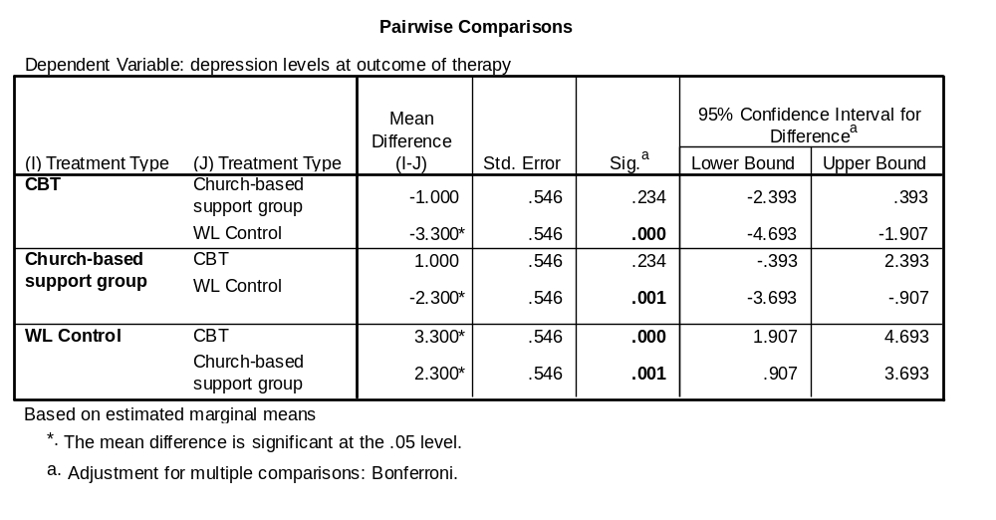
Output: Pairwise Comparisons

Slide 24
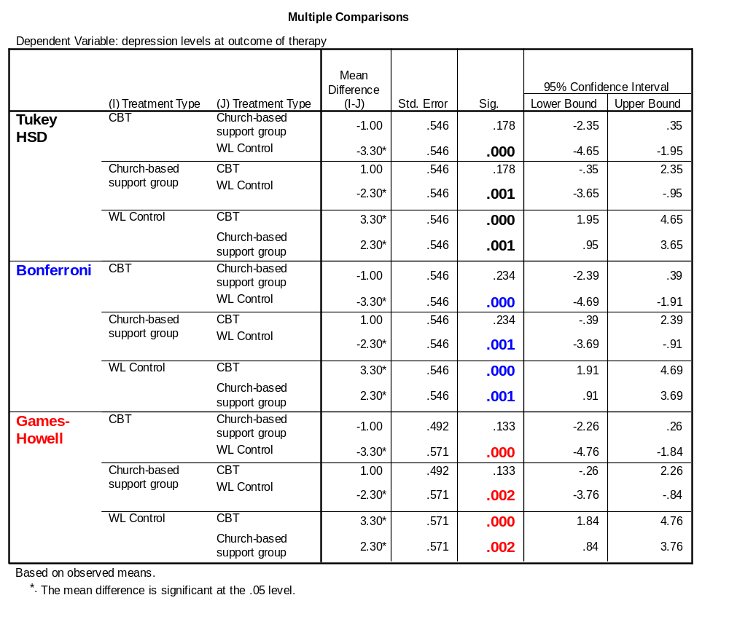
Post-Hoc: Output
Equality of variances not assumed

Slide 25
Post-Hoc: Interpretation
The various options for testing all say:
  Control group (WL) is significantly different from treatment groups (CSG & CBT), but
  The treatment groups (CSG & CBT)
  are not different from one another
Some choices of post-hoc test are more “conservative” – with lower significance levels reported (e.g., Games-Howell)

Slide 26
Outline for today
Core concepts of ANOVA (with pictures!)
  One-way, factorial, RM, MANOVA, ANCOVA
Running ANOVA in SPSS
  Interpreting output
  Follow-up analysis: post-hoc comparisons
  Follow-up analysis: planned comparisons
Assumptions of ANOVA: Parametricity
Introduction to ANCOVA
  Use of ANCOVA in therapy research

Slide 27
Planned Comparisons
“A Priori” (“before the fact”):
planned comparisons / contrasts
Instead of trying all pairs, use theory and our hypotheses to focus on comparisons of interest
  “sniper” instead of “shotgun”
  Only test conceptually relevant contrasts
Planned comparisons help to overcome the problem of inflated Type-I error due to conducting multiple significance tests
Also allows for sets of groups to be compared
(not just 1:1 pairwise comparisons)

Slide 28
Specifying a Contrast: Weights
To specify a desired contrast, set weights on each group (each level of the categorical IV)
All the positive-weight groups will be compared against all the negative-weight groups
Total sum of weights must balance to 0
Zero-weighted groups will be omitted
A group on one side cannot be combined with groups from the other side in subsequent tests
  So that the contrasts are orthogonal
  (test non-overlapping portions of variance)

Slide 29
Planned Comparisons: Example
treatment4.sav: 3 groups: CBT, CSG, WL
  Contrast 1: control (WL) vs. treatment
  (both CBT and CSG together)
  Contrast 2: compare two treatment methods (CBT vs. CSG)
SPSS: (Contrast1): 1, 1, -2; (Contrast2): 1, -1, 0
Orthogonal: 2 degrees of freedom, 2 contrasts
What if we also had anti-anxiety drug treatment (DT) and relaxation-class control (RC)?
  Possible orthogonal sets of contrasts?

Slide 30
Planned Comparisons: SPSS
Try this in One-Way ANOVA (also in Univariate):
Analyze → Compare Means → One-Way ANOVA
  Set Dependent List (DV) and Factor (IV)
  Contrasts: enter weightings, in order
    Contrast 1: (1, 1, -2). Contrast 2: (1, -1, 0)
  Options: “Descriptive” (group means) and “Homogeneity of variance” (Levene's test)
Output: “Contrast Tests” gives results for both “Assume equal variances” and
“Does not assume equal variances”:
Use the appropriate one (from Levene's test)

Slide 31
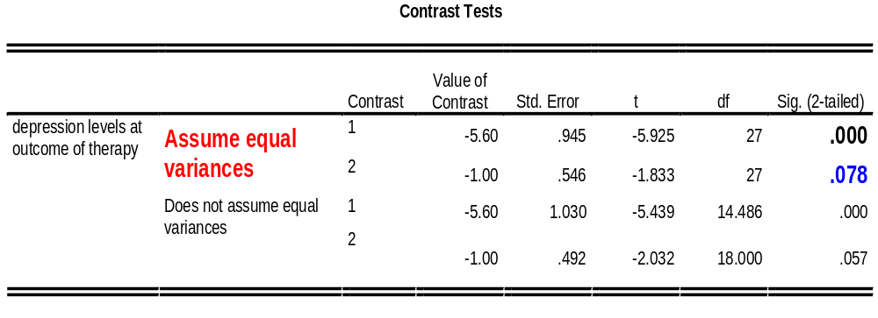
Planned Comparisons: Output
Test of Homogeneity of Variances
depression levels at outcome of therapy
Levene
Statistic
df1
df2
Sig.
Contrast 1: (1, 1, -2)
.795
2
27
.462
Contrast 2: (1, -1, 0)

Slide 32
Planned Comp.: Interpretation
From the results of our planned contrasts,
we conclude:
Contrast 1: The control group is significantly different from the two treatment groups
(p < .001)
Contrast 2: The difference between the two treatment groups is not significant (p = .078)

Slide 33
Planned Comparisions: Notes
Plan them out when designing your study, not after you have already run your ANOVA
  Tied conceptually to your variables
May need multiple runs to get all your desired comparisons
SPSS provides tools in One-Way and GLM Univariate ANOVA (less convenient in Factorial)
More complex designs can also be addressed using Multiple Regression methods
  Use dummy-coding, include only desired IVs
Notes:
#4: For GLM univariate, remember to select contrast & also click on “change” to get your contrasts output.

Slide 34
Outline for today
Core concepts of ANOVA (with pictures!)
  One-way, factorial, RM, MANOVA, ANCOVA
Running ANOVA in SPSS
  Interpreting output
  Follow-up analysis: post-hoc comparisons
  Follow-up analysis: planned comparisons
Assumptions of ANOVA: Parametricity
Introduction to ANCOVA
  Use of ANCOVA in therapy research

Slide 35
Assumption of Parametricity
Interval level DV: from research design
Independence of scores: from sampling process
Normally distributed DV: Check for outliers,
run Kolmogorov-Smirnov & Shapiro-Wilks tests:
  Analyze → Descriptive Statistics → Explore → Plots: “Normality plots with tests”
  Need DV normal within each cell
Equality of variances: Levene’s test
  Analyze → General Linear Model → Univariate → Options → “Homogeneity tests”

Slide 36
Robustness of ANOVA
But! ANOVA is pretty robust to some violations
Show-stoppers:
  Non-interval level DV
  (try ordinal or log-linear regr., or non-param)
  Dependent scores
  (try Repeated-Measures ANOVA or multi-lev)
ANOVA becomes more robust when:
  sample sizes are larger
  the groups are closer to being equal in size
  violations are minor rather than extreme

Slide 37
Handling Non-Normality
If DV is not normal (after dealing with outliers):
Check histogram: if close to normal, proceed
Otherwise, check histograms for each group:
if they are all skewed in a similar way, proceed
  Graphs → Legacy Dialogs → Histogram → Rows: put IV here
Consider applying a transform to the DV:
  e.g., SQRT() undoes a mild right-skew
  Osborne, Jason (2002). Notes on the use of data transformations. Practical Assessment, Research & Evaluation, 8(6)

Slide 38
Handling Unequal Variances
If Levene's test is significant:
If sample sizes for each group are close to equal, ANOVA is robust to heteroscedasticity
Otherwise, try Welch’s F instead of regular F
  Adjusts (lowers) within-group df
  Only available in One-Way ANOVA in SPSS
  Analyze → Compare Means →
  One-Way ANOVA → Options: Welch
  e.g., “Welch's F(2, 17.78) = 16.25, p < .001”
Use appropriate post-hoc tests (Games-Howell)

Slide 39
Assumptions Testing: Practise
Dataset: Treatment4.sav
DV: “depression at follow-up”
IV: “age” (treat as categorical rather than scale)
Check assumptions of parametricity:
  What assumptions are violated?
  For each violation, what should we do?

Slide 40
Outline for today
Core concepts of ANOVA (with pictures!)
  One-way, factorial, RM, MANOVA, ANCOVA
Running ANOVA in SPSS
  Interpreting output
  Follow-up analysis: post-hoc comparisons
  Follow-up analysis: planned comparisons
Assumptions of ANOVA: Parametricity
Introduction to ANCOVA
  Use of ANCOVA in therapy research

Slide 41
Introduction to ANCOVA
Covariates are continuous “predictor” variables used as “control” factors to help power
Covariates may be promoted to IVs if conceptually linked to other IVs or to the DV
ANCOVA factors out the portion of variance in the DV that is accounted for by the covariates
  Affects both MS_{model} and MS_{residual}
Caution is required when covariates are correlated with IVs – creating conceptual links
Notes:
Miller & Chapman (2001).

Slide 42
Using ANCOVA in Research
Reduction of error variance: Including covariate(s) related to the DV in the model accounts for some within-group error variance, thus reducing MS_{resid} and increasing the F-ratio.
F = MS_{model} / MS_{resid}
IV
Covariate
DV

Slide 43
ANCOVA: Confounding Vars
“Confounding” variables:
External variables that may systematically influence an experimental manipulation.
They can be identified through theory
Control for them by entering them as covariates (though this may or may not improve F-ratio)
IV
DV
Covariate?
Notes:
Correct this we

Slide 44
Covariates vs. Predictors
If a covariate is ‘linked’ conceptually / theoretically with another IV or with the DV, then treat the covariate as an IV.
  It could potentially be a moderator
Any interactions or interpretable IV-Cov correlations then become part of the analysis.
IV
DV
Covariate
or IV?

Slide 45
ANCOVA in Therapy Research
In therapy studies, different treatment groups often have different pre-treatment scores
  How to compare treatments when the starting points are different?
Solution: When in doubt, treat pre-treatment scores as another IV, not as a covariate.
IV
DV
Pre-test scores
Notes:
Miller & Chapman (2001) for some additional strategies. Then there is no random assignment, it is best to analyze & interpret any pre-treatment diffs as an IV.

Slide 46
Assumptions of ANCOVA
Parametricity of DV (as with regular ANOVA)
Homogeneity of regression slopes:
  Regression of the DV on the Cov is the same for all groups
  i.e., Cov is not a moderator
  Test for interactions between IVs & Cov
Conceptual independence of Cov & IVs
  So that the shared variance is “external” to our RQ

Slide 47
ANCOVA: SPSS
Analyze → General Linear Model → Univariate
  Add variables to “Covariates” box
Reporting: “Controlling/accounting for the influence of <Cov>, the effect of <IV> on <DV> is / is not significant,
F(df_{IV}, df_{error}) = ___, p = ___.”

