Slide 1
CPA 72nd Annual Convention: An Opportunity to Present Your CPSY 501Research!
Gena H. Davies
Trinity Western University

Slide 2
The Professional World of Research
Research is “professionalized.” Formal research outlets include:
Journals
Books
Conferences
National conventions
Regional conferences
Topical symposia
Notes:
Sean: I am just planning to highlight that presentations at National Conventions are just one way of disseminating research and building your professional experience and CV.

Slide 3
Types of Presentation at National Conventions
Type of Presentation | Time Allotted | Description
Poster | 1 hour, 55 minutes | Presenting empirical research. Optimal for presenting preliminary or pilot findings Arranged by CPA sections of interest.
Conversation | 55 minutes | Informal round-table events intended to stimulate discussion on a specific topic.
Theory Review | 25 minutes | Review of one or more theoretical perspective(s) or for the synthesis of different theoretical perspectives.
Workshop | 1 hour, 55 minutes | A clearly defined practical, experiential, or demonstration component. Designed for participants to learn new skills or techniques.
Symposium | 1 hour, 25 minutes | Consists of a moderator, plus 3 or 4 spoken presentations on the same topic.
(www.cpa.ca)
Notes:
Sean: I am just going to note that there are different types of presentation, but students would most likely be doing a poster presentation because their program of research will not be well developed.
Posters: Likely that your topic will apply to the Counselling Psychology Section. You specify the section when you do your online submission.
Theory Review: Not for presenting new empirical research. The presenter is normally a senior expert in the area.

Slide 4
Poster Presentations
Purpose:
Present important research results (and research in progress) in a clear, concise way
Highlight the value of your study
Stimulate interest and discussion with you
Generate contacts
Not suited for:
Presenting an exhaustive description of your study
Presenting conceptual or theoretical material (unless you have to for a class assignment)
Notes:
In CPSY 502 you will learn what makes a good poster, resources,

Slide 5
Poster Presentations
Most common type of presentation
Can accommodate many presenters in the same venue and time slot
From 1.5 to 2 hours
10 to 100 posters, depending on room size
Researchers summarize aims, results & conclusions of their study in easily digestible form on a mounted poster
Relatively informal: Presenter stands by poster, discusses the poster with anyone interested, & provides handouts

Slide 6
Poster Presentation Opportunity: CPA 72nd Annual Convention
What: Opportunity for poster or presentation sessions & student awards
When: June 2nd-4th, 2011
Where: Toronto, ON
Who: CPA members, non-members, CPA student members, & student non-members
Deadline for Abstract Submission: November 15, 2010 at 11:59 pm
How much
(www.cpa.ca)
Notes:
Sean: I am just planning on presenting on the information on the slide, but have cut and pasted some information below to refresh my memory in case I get questions on CPA and the CPA Counselling Psychology Section Student Poster Awards. I presented to the 2010 cohort on the CPA during their student orientation in September, so I am hoping the students still remember what the Association is about!
The Canadian Psychological Association was organized in 1939. Its objectives are:
To lead, advance and promote psychology as a science and as a profession for the benefit of humanity; to provide leadership in psychology in Canada; to promote a sense of identity among psychologists; to promote the advancement, dissemination, and practical application of psychological knowledge; to develop standards and ethical principles for education, training, science and practice in psychology.
The convention brings together psychology scientists, practitioners, educators and students from all corners of Canada as well as from abroad; it is our trading center for discoveries, innovations and ideas. John Gottman is presenting in the 2011 Convention.
CPA Student members are eligible for annual awards ($100.00 each) for the best PhD Dissertation, Masters Thesis, Masters Conference Poster, and Doctoral Conference Poster. These prizes are awarded for outstanding student research in the field of counselling psychology.
Best Poster Award Posters are evaluated for quality and relevant of content, and the student's engagement with the audience. All student-authored posters presented in the counselling section poster session at the CPA annual convention will be adjudicated for this award.
Students do not need to be a member of the Counselling Psychology Section to be eligible.
Best Dissertation / Thesis Award The best PhD Dissertation and best master's thesis prizes will be awarded based on a 30-page (maximum) summary of the dissertation or thesis, to be written by the student.

Slide 7
CPA Convention Poster Submission Requirements
Title: 250 word maximum
Abstract: 400 word maximum
Identify 3 Keywords
Identify any equipment needed
(www.cpa.ca)
Notes:
They do not need their poster ready until the Convention. CPSY 502 in January 2011 will help them learn how to construct a poster, what makes a good poster, etc.

Slide 8
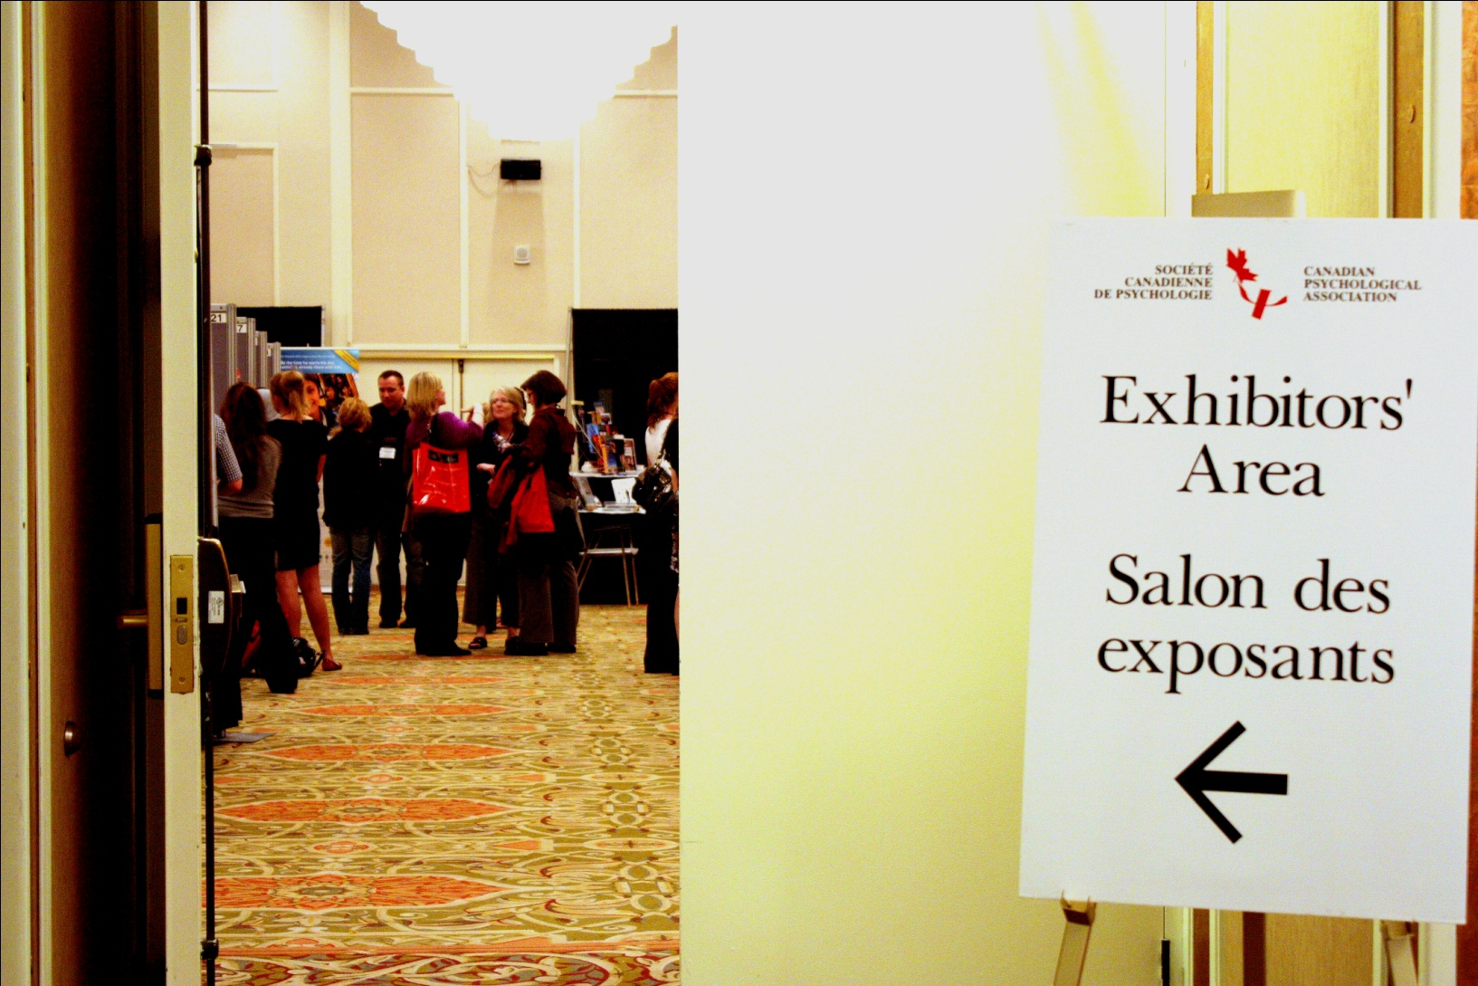
CPA 71st Annual Convention
Notes:
Poster session in 2010 convention.

Slide 9
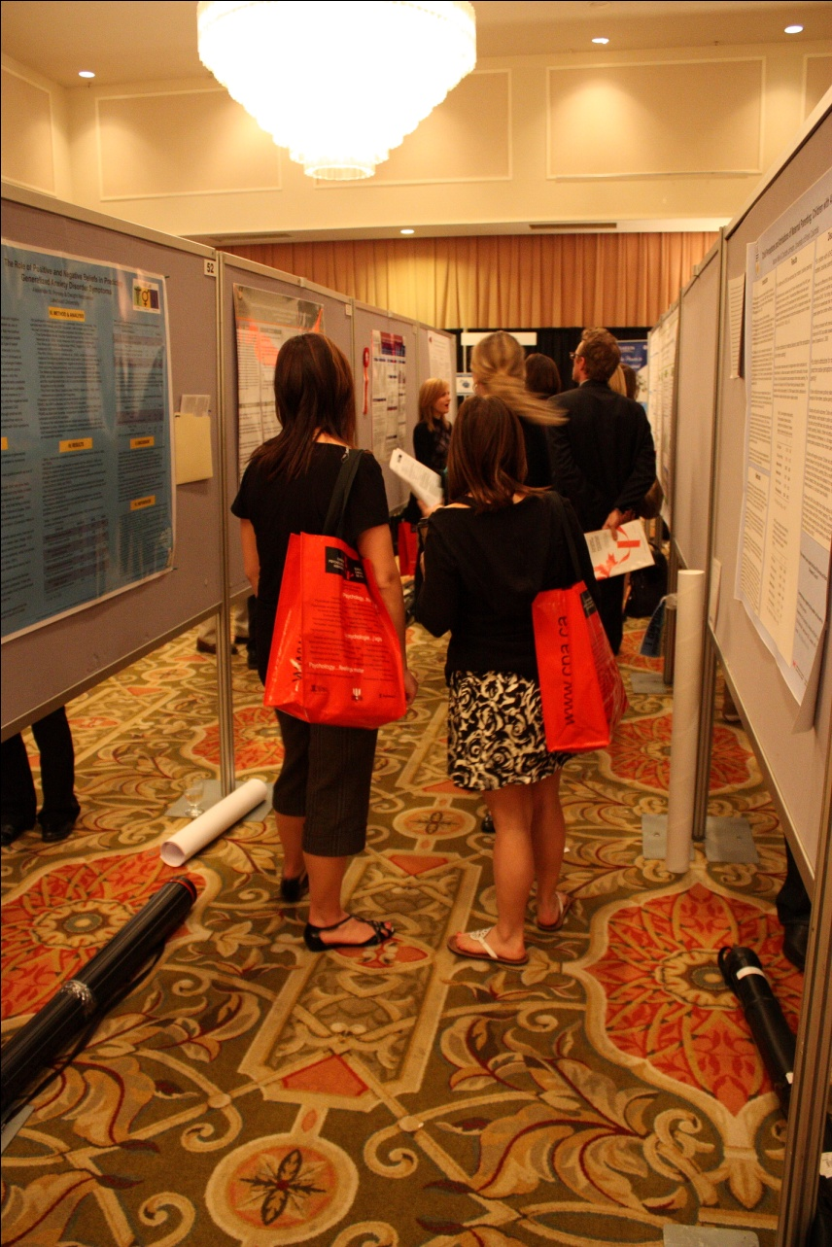
Example of a Poster Row

Slide 10
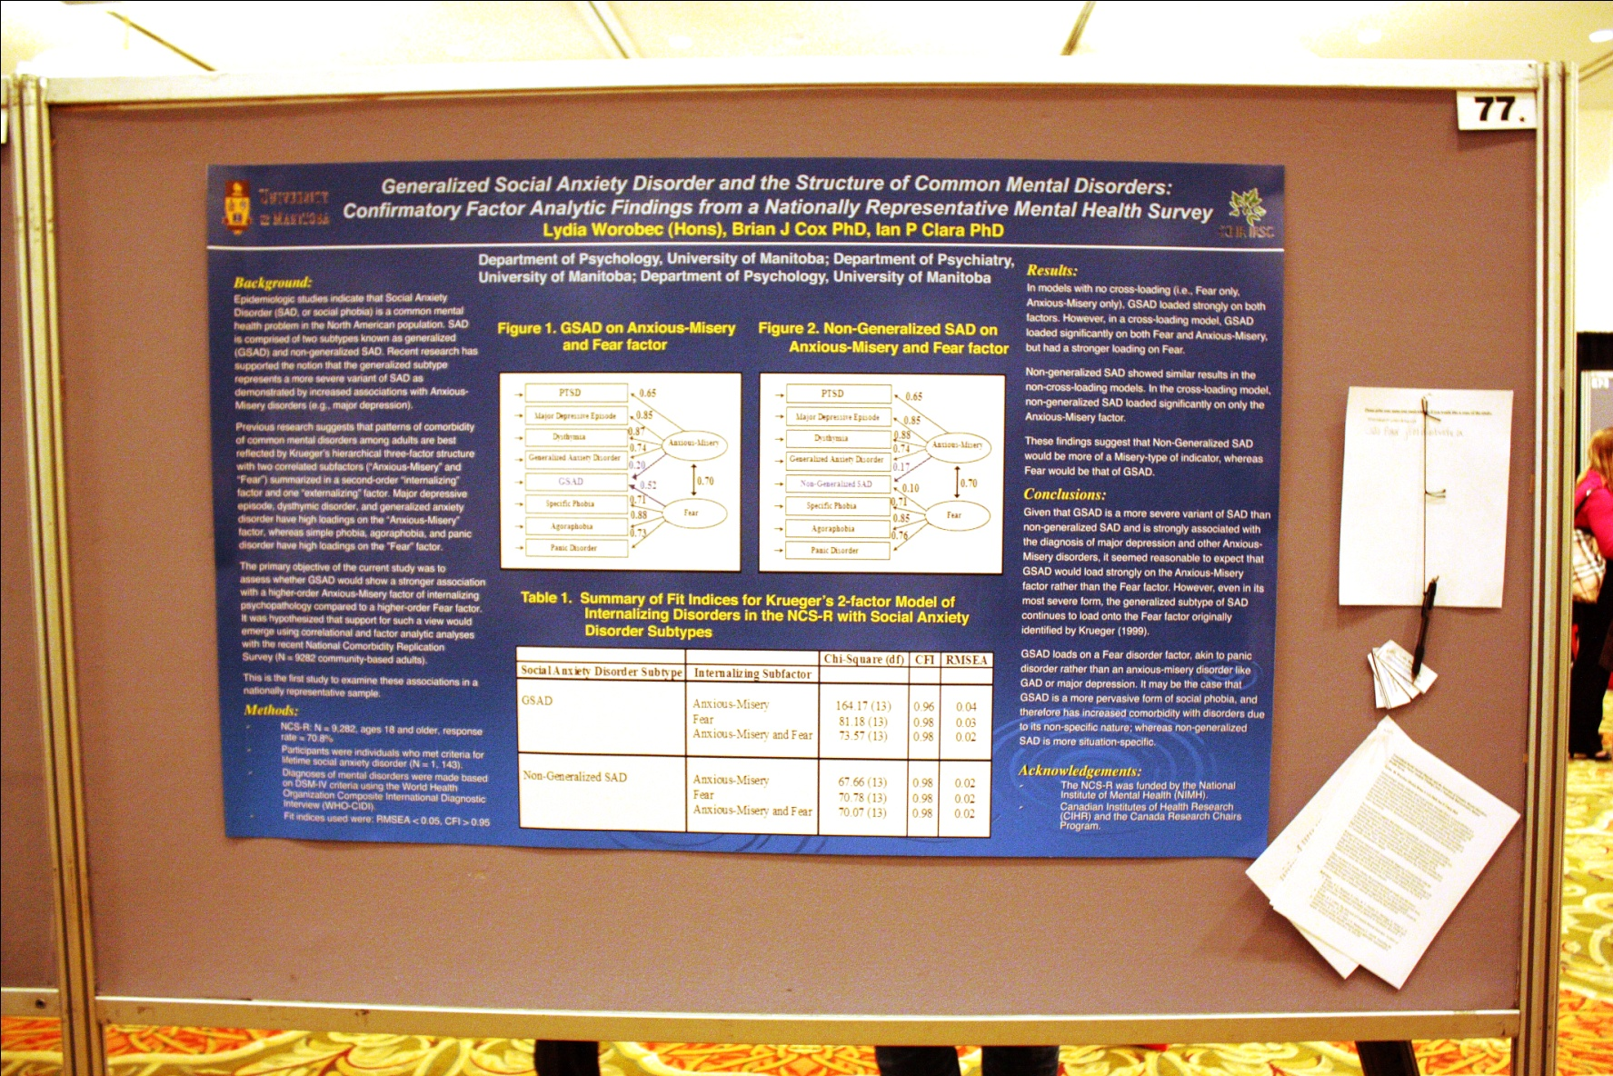
Example of Poster Layout
Notes:
(I did not bring my external flash or tripod with me and the lighting was horrible, so not the best picture!).
Note the questions sheet, business cards and handouts.

Slide 11
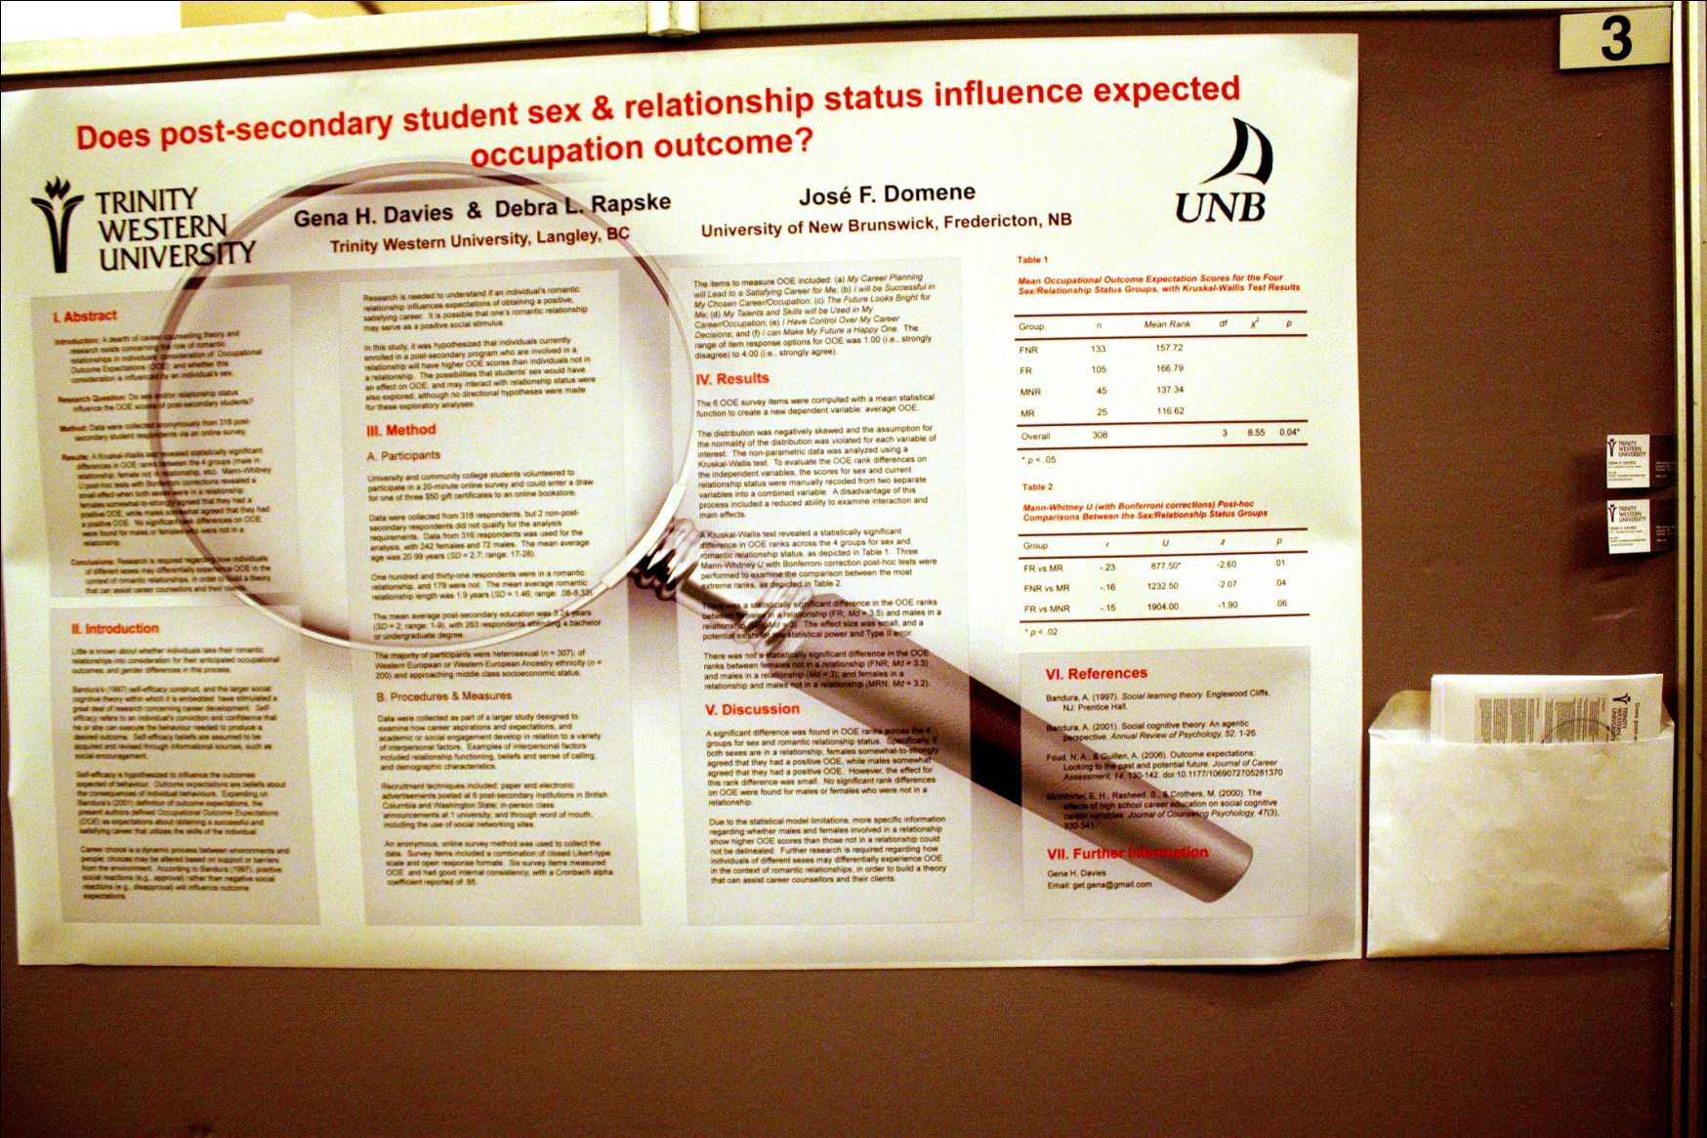
CPA Counselling Section Best MA Student Poster Award Winner!
Notes:
Our CPSY 501 Project at a National Convention!
Another style of poster layout.

