Slide 1

Meta-Analysis,
Generalized Linear Models, and
Categorical Data Analysis
Download:
Hill & Lent
GenderDepr.sav
Fitzpatrick et al.
19 Nov 2010
CPSY501
Dr. Sean Ho
Trinity Western University

Slide 2
Outline for today
Meta-Analysis
  Example: Hill & Lent (2006)
Linear models:
  Covers every test we know so far
  Logistic regression
  Log-linear regression
Categorical Data Analysis
  2 vars: chi-squared test, effect sizes
  Multiple vars: log-linear analysis
  Example: Fitzpatrick '01

Slide 3
Meta-Analysis
The APA journal has basic standards for literature review in many areas
Meta-Analysis (MA) is a tool for
combining results of quantitative studies
in a systematic, quantitative way.
Example Meta-Analysis journal article:
  Hill, C. E., & Lent, R. W. (2006). A narrative and meta-analytic review of helping skills training: Time to revive a dormant area of inquiry. Psychotherapy: Theory, Research, Practice, Training, 43(2), 154–172.

Slide 4
MA focuses on effect sizes
Choose groups of studies and subgroups of studies to combine and compare
Each individual study might not have significance, due to low sample size
  Combine results from multiple studies
  Must be careful that studies are comparable
g : difference between the means divided by the pooled standard deviation
d : unbiased estimates of the population effect size as reported by each study

Slide 5
Combining effect sizes: ex.
Example: two correlation studies, with
  r₁ = .22 and r₂ = .34
  N₁ = 125 and N₂ = 43
Combine studies to estimate r
Unweighted average: (.22 + .34) / 2 = .28
Weighted average by sample size:
[ .22(125) + .34(43) ] / (125 + 43) = .25
The larger sample has a smaller effect size!

Slide 6
Persuasiveness of MA
Quality of studies (design, etc.)
Comparability of studies:
  Variables, measures, participants, etc.
  Pay attention to moderating factors!
RQ: Differences among types of training? (instruction, modeling, feedback)
Do we know the “amount” of training time examined in each study?
What impact might these factors have on the interpretation of the meta-analysis?

Slide 7
Hill & Lent (2006)
p.159: Summary of strategy and symbols used
p.160: List of studies being summarized
(k = 14), including outcome measures, etc.
Within each study,
aggregate multiple measures by calculating mean effect size and standard error
Use Cohen’s (1988) criteria for effect size:
d=0.20 (small), d=0.50 (med), d=0.80 (large)

Slide 8
Global analysis: outlier
Hill & Lent chose to exclude one entire study as an outlier: p.161:
“Given its potential to disproportionately influence effect sizes, especially in a relatively small set of studies, the outlier study was omitted in our subsequent analyses.”
Now only 13 studies left …
Pros & cons of this omission?

Slide 9
Questions… pre-assignment
Note: The same group of studies is used in all sections of Hill & Lent…
How do the different research questions shape the MA calculations?
How do confidence intervals help us interpret effect sizes (ES)?
How do we integrate the results of different research questions?
Notes:
Being a professional means looking things up when you don’t know.

Slide 10
Outline for today
Meta-Analysis
  Example: Hill & Lent (2006)
Linear models:
  Covers every test we know so far
  Logistic regression
  Log-linear regression
Categorical Data Analysis
  2 vars: chi-squared test, effect sizes
  Multiple vars: log-linear analysis
  Example: Fitzpatrick '01

Slide 11
Introduction to linear models
All these techniques use the same framework:
  Regression and Curvilinear Regression
  ANOVA
  Multiple Regression, Factorial ANOVA
  ANCOVA
Even techniques with categorical DV:
  Log-linear Regression
  Logistic Regression
RM-ANOVA is related, using multi-level models

Slide 12
Linear model: notation
Recall the linear model of 1-way regression:
  Y = b₀ + b₁X + ε
  Y and X are random vars (DV and IV)
  b₀ and b₁ are parameters of the model
  ε are the residuals (assumed to be “IID”: independent, identically distributed, normal)
May also be specified in shorthand:
  Y ~ X, e.g., “depression ~ age”
  Constant term (intercept) is implied

Slide 13
Linear model: multiple regress.
Multiple regression, with interaction terms:
  Y ~ X₁ + X₂ + X₁:X₂
  Or simply Y ~ X₁ * X₂
  This expands to:
  Y = b₀ + b₁X₁ + b₂X₂ + b_{1,2}X₁*X₂ + ε
e.g., “depression ~ age * self_esteem”
  Includes constant term, main effects,
  and interaction term (plus residuals)

Slide 14
Linear model: ANOVA
ANOVA, using “dummy coding”: Y ~ X
  if X is cat. w/ 3 levels: e.g., {Ctrl, CBT, CSG}
  then it expands to: Y = b₀ + b₁X₁ + b₂X₂ + ε
  where X₁ and X₂ are dummy variables:
  e.g., Ctrl-vs-CBT, Ctrl-vs-CSG (both 0/1 vars)
Factorial ANOVA: Y ~ X₁ * X₂
  e.g., X₁: {Ctrl, CBT, CSG}, X₂: {M, F}
  → 2 dummy vars for X₁, 1 for X₂.
Planned comparisons:
only include selected dummy vars

Slide 15
Linear model: ANCOVA
ANCOVA = Regr! No problem to mix-and-match
scale-level and categorical predictors!
e.g., “depression ~ age * treatment”
  age is scale; trmt. is cat. {Ctrl, CBT, CSG}
  Dummy-code treatment as 2 binary vars
If age is viewed as a covariate (not predictor), then the interaction should be non-significant
  ANCOVA: partial out effect of age,
  so just focus on main effect of treatment
  Model: “depression ~ age + treatment”

Slide 16
Linear model: curvilinear regr.
Model data with a polynomial curve:
  1 IV, quadratic: Y ~ X₁ + X₁²
  2 IVs, quadratic: Y ~ (X₁ + X₂)²
  (full model has 6 terms, including constant)
More complex curves exist, e.g., splines
  Generalized Additive Model
Visualize data (e.g., scatterplots)
to guide choice of curve
Try several models: best fit, fewest terms
  → Tradeoff specificity vs. generalizability

Slide 17
Categorical data: GLM
To deal with a categorical DV, we need the Generalized Linear Model:
  f( Y ) ~ X₁ + X₂ + …
  The linear model predicts not Y directly, but the link function f() applied to Y
Examples of link functions:
  f(Y) = log(Y): log-linear regression
  Used when Y represents counts/frequencies
  f(Y) = logit(Y): logistic regression
  Used when Y represents a probability (0..1)

Slide 18
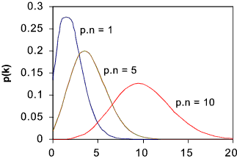
GLM: log-linear regress.
roymech.co.uk
When DV is counts/frequencies,
its distribution is often not normal, but Poisson
  e.g., DV = # violent altercations
  If mean is large, Poisson → normal
e.g., “log( violent_alts ) ~ depression”
  residuals (ε) are also Poisson distributed
Log-linear is also used to look at many cat. vars
  IVs are all categorical (factorial cells)
  DV = # people in each cell
  Fitzpatrick, et al. example paper later

Slide 19
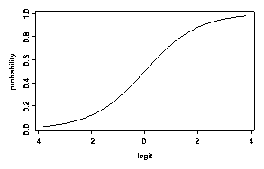
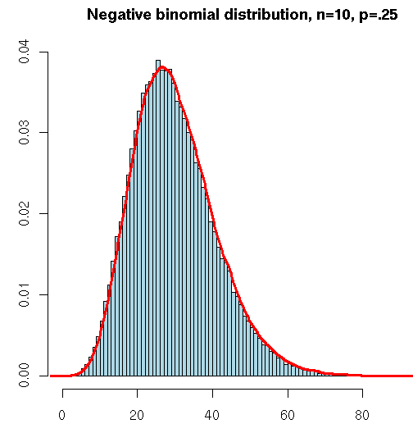
GLM: logistic regression
Princeton WWS 509
When DV is a probability (0 to 1),
the distribution is binomial
  e.g., DV = “likelihood to develop depress.”
  Probability of Y: P(Y). Odds of Y:
  Logit link function: logit(Y) = log( odds(Y) )
Also works for DV = # out of total
  e.g., DV = “# correct out of 100”
  As #tot → ∞, binomial → Poisson
Also works for binary (dichot.) DV
  e.g., DV = “is pregnant”
$\frac{P\left(Y\right)}{1−P\left(Y\right)}$
zoonek2.free.fr

Slide 20
Outline for today
Meta-Analysis
  Example: Hill & Lent (2006)
Linear models:
  Covers every test we know so far
  Logistic regression
  Log-linear regression
Categorical Data Analysis
  2 vars: chi-squared test, effect sizes
  Multiple vars: log-linear analysis
  Example: Fitzpatrick '01

Slide 21
Contingency tables
When comparing two categorical variables, all observations can be partitioned into cells of the contingency table
  e.g., two dichotomous variables: 2x2 table
  Gender vs. clinically depressed:
 | Depressed | Not Depressed
Female | 126 | 154
Male | 98 | 122
  RQ: is there a significant relationship between gender and depression?

Slide 22
SPSS: frequency data
Usually, each row in the Data View represents one participant
  In this case, we'd have 500 rows
For our example, each row will represent one cell of the contingency table, and we will specify the frequency for each cell
Open: GenderDepr.sav
Data → Weight Cases: Weight Cases by
  Select “Frequency” as Frequency Variable

Slide 23
2 categorical vars: χ² and φ
Chi-squared (χ²) test: Two categorical variables
  Asks: is there a significant relationship?
Requirements on expected cell counts:
  No cells have expected count ≤ 1, and
  <20% of cells have expected count < 5
  Else (for few counts) use Fisher's exact test
Effect size:
  φ is akin to correlation: definition: φ² = χ² / n
  Cramer's V extends φ for more than 2 levels
  Odds ratio: #yes / #no

Slide 24
SPSS: χ² and φ
Analyze → Descriptives → Crosstabs:
  One var goes in Row(s), one in Column(s)
  Cells: Counts: Observed, Expected, and Residuals: Standardized, may also want Percentages: Row, Column, and Total
  Statistics: Chi-square, Phi and Cramer's V
  Exact: Fisher's exact test: best for small counts, computationally intensive
If χ² is significant, use standardized residuals
(z-scores) to follow-up which categories differ

Slide 25
Reporting χ² results
As in ANOVA, IVs with several categories require follow-up analysis to determine
which categories show the effect
  The equivalent of a single pairwise comparison is a 2x2 contingency table!
Report:
“There was a significant association between gender and depression, χ²(1) = ___, p < .001. Females were twice as likely to have depression as males.”
  Odds ratio: (#F w/depr) / (#M w/depr)

Slide 26
Outline for today
Meta-Analysis
  Example: Hill & Lent (2006)
Linear models:
  Covers every test we know so far
  Logistic regression
  Log-linear regression
Categorical Data Analysis
  2 vars: chi-squared test, effect sizes
  Multiple vars: log-linear analysis
  Example: Fitzpatrick '01

Slide 27
Many categorical variables
Need not have IV/DV distinction
Use log-linear: Generalized Linear Model
  Include all the categorical vars as IVs
  DV = # people in each cell
  e.g., “count ~ employment * gender * depr”
Look for moderation / interactions:
  e.g., employment * gender * depression
Then lower-level interactions and main effects
  e.g., employment * depression

Slide 28
Goodness of Fit
Two χ² metrics measure how well our model (expected counts) fits the data (observed):
  Pearson χ² and likelihood ratio (G) (likelihood ratio is preferred for small n)
Significance test looks for deviation of observed counts from expected (model)
  So if our model fits the data well, then the Pearson and likelihood ratio should be small, and the test should be non-significant
SPSS tries removing various effects to find the simplest model that still fits the data well

Slide 29
Hierarchical Backward Select'n
By default, SPSS log-linear regression uses automatic hierarchical “backward” selection:
Starts with all main effects and all interactions
  For a “saturated” categorical model, all cells in contingency table are modelled, so the “full-factorial” model fits the data perfectly: likelihood ratio is 0 and p-value = 1.0.
Then removes effects one at a time, starting with higher-order interactions first:
  Does it have a significant effect on fit?
  How much does fit worsen? (ΔG)

Slide 30
Example: Fitzpatrick et al.
    Fitzpatrick, M., Stalikas, A., Iwakabe, S. (2001).
    Examining Counselor Interventions and Client Progress in the Context of the Therapeutic Alliance. Psychotherapy, 38(2), 160-170.
Exploratory design with 3 categorical variables, coded from session recordings / transcripts:
  Counsellor interventions (VRM)
  Client good moments (GM)
  Strength of working alliance (WAI)
Therapy: 21 sessions, male & female clients & therapists, expert therapists, diverse models.

Slide 31
Fitzpatrick: Research Question
RQ: For expert therapists, what associations exist amongst VRM, GM, and WAI?
Therapist Verbal Response Modes:
  8 categories: encouragement, reflection, self-disclosure, guidance, etc.
Client Good Moments:
  Significant (I)nformation,
  (E)xploratory, or (A)ffective-Expressive
Working Alliance Inventory
  Observer rates: low, moderate, high
Notes:
N = 2007 statement pairs from those 21 sessions

Slide 32
Fitzpatrick: Abstract
Client “good moments” did not necessarily increase with Alliance
Different interventions fit with
good moments of client information (GM-I)
at different Alliance levels.
“Qualitatively different therapeutic processes are in operation at different Alliance levels.”
Explain each statement and how it summarizes the results.

Slide 33
Top-down Analysis: Interaction
As in ANOVA and Regression, Loglinear analysis starts with the most complex interaction (“highest order”) and tests whether
it adds incrementally to the overall model fit
  Compare with ΔR² in regression analysis
Interpretation focuses on:
  3-way interaction: VRM * GM * WAI
  Then the 2-way interactions: GM * WAI, etc.
Fitzpatrick did separate analyses for each of the three kinds of good moments: GM-I, GM-E, GM-A

Slide 34
Results: Interactions
2-way CGM-E x WAI interaction:
  Exploratory Good Moments tended to occur more frequently in High Alliance sessions
2-way WAI x VRM interaction:
  Structured interventions (guidance) take place in Hi or Lo Alliance sessions, while
  Unstructured interventions (reflection) are higher in Moderate Alliance sessions
  Describes shared features of “working through” and “working with” clients, different functions of safety & guidance.

Slide 35
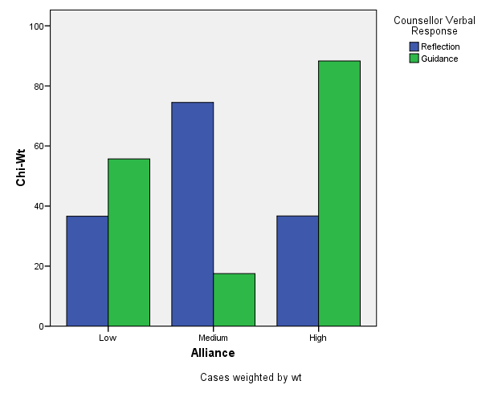
Notes:
From Table 5, p. 158; Fitzpatrick & al. (2001). Chi-square weights transformed in this graph can be interpreted as “relative deviation” descriptors, allowing comparability across cells, but without specific significance levels. (Parameter testing exaggerates experiment-wise error rates in this particular research design). N = 2007 T-C statement pairs in 21 therapy sessions, approx. 96 statements per session.

Slide 36
Formatting Tables in MS-Word
Use the “insert table” and “table properties” functions of Word to build your tables; don’t do it manually.
General guidelines for table formatting can be found on pages 147-176 of the APA manual.
Additional tips and examples: see NCFR site: http://oregonstate.edu/~acock/tables/
In particular, pay attention to the column alignment article, for how to get your numbers to align according to the decimal point.

