Slide 1

Exploratory Factor Analysis and Canonical Correlation
3 Dec 2010
CPSY 501
Dr. Sean Ho
Trinity Western University
Please download:
SAQ.sav

Slide 2
Outline for today
Factor analysis
  Latent variables
  Correlation (“R”) matrix
  Factor extraction
  Rotation
  Assumptions
  Example in SPSS
Canonical correlation … and how it explains all!
Structural Equation Modeling
  Path analysis + factor analysis

Slide 3
Latent variables
Often we have many, many variables (100s!)
and don't know (from theory) which are important
  e.g., Rosenberg Self-Esteem Scale (SES):
  rate 10 statements, each on 4-point Likert scale
Latent variables: underlying quantity to measure
  Often intangible, e.g., self-esteem
  Latent vars are estimated via observed vars
Variable selection: eliminate vars that don't help
  → simplify model (parsimony)
Orthogonalization: reduce multi-collinearity by combining highly correlated vars

Slide 4
Latent vars: Eysenck's factors
Eysenck Personality Questionnaire (EPQ-R, 1985):
  100 yes/no questions (observed)
  3 underlying (latent) dimensions of personality
Unsympathetic
Talkative
Anxious
Impulsive
Aggressive
Risk-taking
Obsessive
Achieving
Extroversion
vs. Introversion
Neuroticism
vs. Stability
Psychoticism
vs. Socialisation

Slide 5
Linear factor analysis
Define factors as linear combos of observed vars:
  F₁ = b₁X₁ + b₂X₂ + … + b_{n}X_{n}
  b_{i} are the loadings of F₁ on the observed X_{i}
  If X_{i} does not contribute to F₁, then b_{i} = 0
Exploratory Factor Analysis:
  No prior theory: find the factors from the vars
  Sample = pop: results may overfit to data
Confirmatory Factor Analysis:
  Already know the factors (from EFA, or theory)
  Test their predictive power on larger dataset

Slide 6
Why use EFA?
Parsimony: eliminate redundant vars and those with little variation (reduce 100's → 10's of vars)
  c.f. multiple regression “backward selection”: drop non-significant IVs from model (for DV)
    But in EFA there is no DV, just a collection of IVs
  Combining similar/redundant variables may be useful for enhanced reliability
  Simplify variables for subsequent analysis
Discover latent variables, construct new theory:
  Group together highly inter-correlated variables
  Interpretability of factors is key!

Slide 7
Outline for today
Factor analysis
  Latent variables
  Correlation (“R”) matrix
  Factor extraction
  Rotation
  Assumptions
  Example in SPSS
Canonical correlation … and how it explains all!
Structural Equation Modeling
  Path analysis + factor analysis

Slide 8
Factors in the R matrix
The “R matrix” is the matrix of correlations between all pairs of (observed) variables
  Symmetric, and all entries on diagonal are 1
Groups of highly-correlated variables
are good candidates for factors
  Combine several variables into one factor
  Internal consistency: Cronbach's α
1 | 0.20 | 0.11 | 0.15
0.20 | 1 | 0.85 | 0.91
0.11 | 0.85 | 1 | 0.93
0.15 | 0.91 | 0.93 | 1
Potential
factor

Slide 9
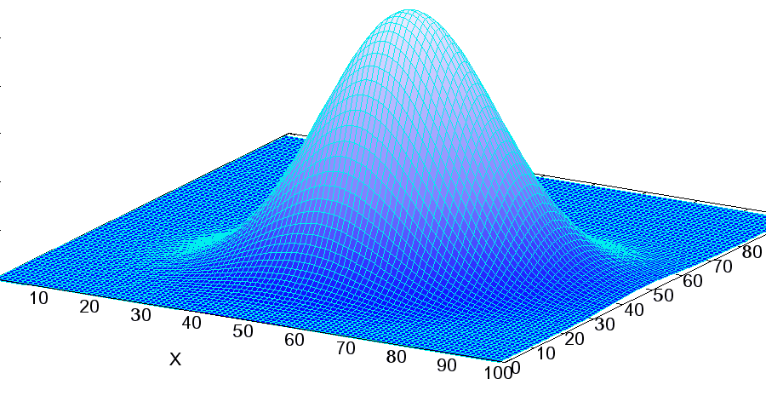
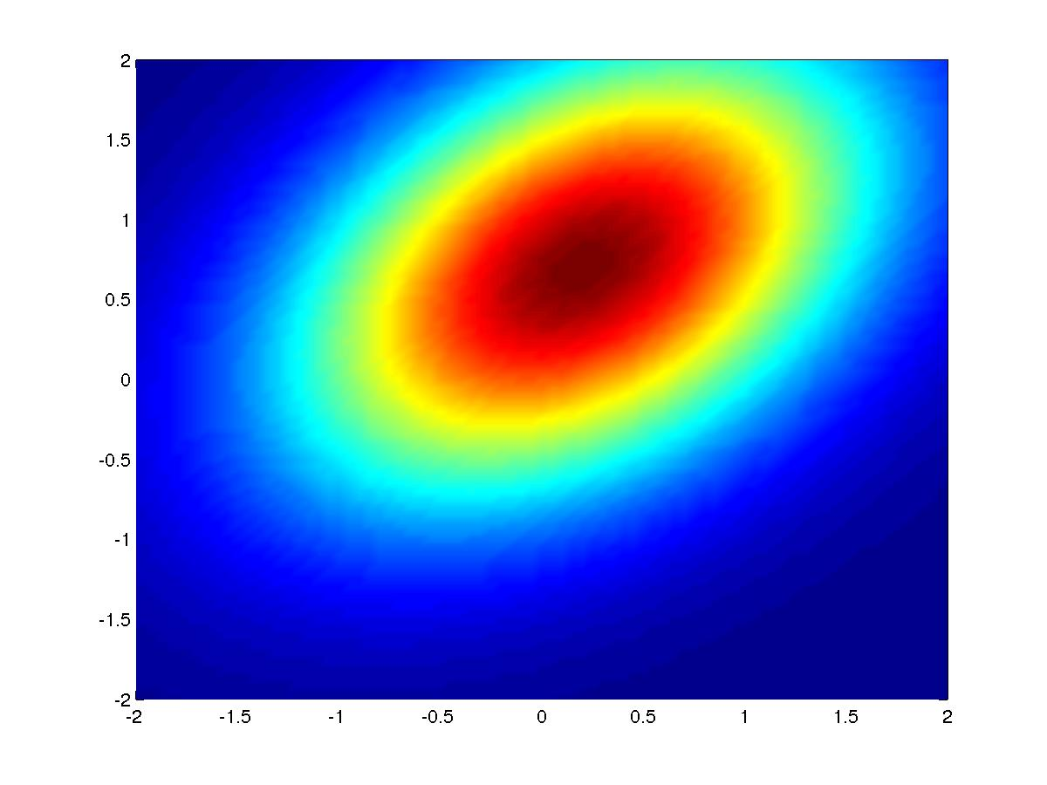
Multivariate normal distribution
(Pearson) correlation assumes normality
  Although EFA is fairly robust to non-normality
For multiple vars: multivariate normal distribution
  Quartiles, etc. form ellipsoids around mean
  Area of ellipsoids ↔ determinant of R matrix
Multi-collinearity: some vars nearly perfect correl.
  Ellipsoids become squashed; det(R) → 0
WikiMedia
GA Tech

Slide 10
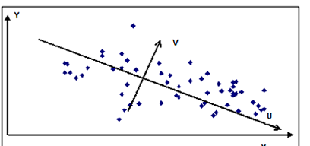
Factor extraction
NZ Gov
Each factor is an axis
through the data
PCA extracts one factor at a time:
  PC1 is the longest axis of the ellipsoid:
  capture as much variance in vars as possible
  PC2 is longest axis perpendicular to PC1:
  capture as much leftover variance as possible
  Etc.: capture most of variance w/just a few PCs
PAF is similar but only cares about the portion of variance which is shared with other variables
  Uses R matrix but diagonals are %shared var
  Useful for exploration, development of theory

Slide 11
Communality and eigenvalues
 | F₁ | F₂
X₁ | b₁₁ | b₂₁
X₂ | b₁₂ | b₂₂
... | ... | ...
X_{n} | b_{1n} | b_{2n}
Linear combinations of variables:
  F₁ = b₁₁X₁ + b₁₂X₂ + … + b_{1n}X_{n}
  F₂ = b₂₁X₁ + b₂₂X₂ + … + b_{2n}X_{n}
Factor matrix lists the loadings
Communality of a variable is
% of its variance explained by the selected factors
  Sum of squared loadings across the factors
Eigenvalue of a factor is
% of total variance explained by that factor
  Sum of squared loadings across all variables
  PCs extracted in descending order by eigenval

Slide 12
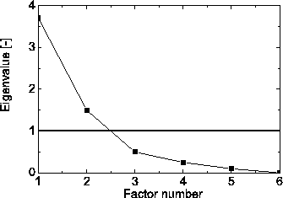
How many factors to use?
Guided by theory: # underlying dimensions
  Can you understand/interpret each factor?
Kaiser's criterion: eigvals < 1 → unstable factors
Not adding appreciably to total explained variance
If a (theoretically) important variable has
low communality, may want more factors to capture its variance
Scree plot: eigenvalues
of successive factors

Slide 13
Rotation
Factors as extracted
using PCA or PAF are often difficult to interpret
  Each variable may show up in several factors
Rotation can shuffle the extracted factors to ease interpretation
Several methods of rotation. The most common:
  Varimax (orthogonal): minimise #factors each var shows up in (“Are you in or out?”)
  Oblimin (oblique): increases eigenvalues by allowing factors to be a bit correlated (use δ)
    → in psychology, latent vars are rarely uncorrelated!

Slide 14
Outline for today
Factor analysis
  Latent variables
  Correlation (“R”) matrix
  Factor extraction
  Rotation
  Assumptions
  Example in SPSS
Canonical correlation … and how it explains all!
Structural Equation Modeling
  Path analysis + factor analysis

Slide 15
Assumptions for EFA
Sufficient sample size
  300 or more; rule of thumb is ~20 per var
  Kaiser-Meyer-Olkin (r² / partial-r²) close to 1
  Diagonals of anti-image correlation matrix >0.5 (drop any vars <0.5) (partial correl)
Linearity of relationships amongst vars (scatter)
  Normality is good, too (but not critical)
Good correlations in R matrix (many >0.5)
  Bartlett's test of sphericity (tests for goodness): if R matrix differs significantly from identity,
  i.e., off-diagonal entries not all zero

Slide 16
EFA in SPSS: SAQ.sav
Dataset: SAQ.sav (artificial data from textbook)
  23 questions on “SPSS anxiety” (5pt-Likert)
EFA: Analyze → Dimension Reduction → Factor
  Variables: select all 23 questions
Descriptives: Correlation Matrix:
  Coeffs, Det., Anti-image, KMO+Bartlett
Extraction: Method → Principal Components
  Display: Unrotated, Scree; Extract: Eigvals >1
Rotation: Varimax; Display: Rotated, Loading plot
Options: Sort, Suppress <0.4

Slide 17
Interpreting output: SAQ.sav
Assumptions: correlation matrix
  Ensure each var has several |r| > 0.3
    Should really look at significance of correl., too
  Determinant not close to 0? (multi-collinearity)
Diagonal entries of anti-image: >0.5?
KMO close to 1?
Bartlett's test? (sig is good)

Slide 18
Interpreting output: factors
How many factors were selected?
  Total Variance Explained
  Scree plot
Component Matrix: shows unrotated loadings
Rotated Component Matrix:
  Each var should show up in only 1 or 2 factors
  We asked for cut-off at 0.4
  Factors indicate groupings of vars and relative importance of each var within a grouping
Try to interpret the factors? Fear of computers, fear of stats, fear of math, peer evaluation

Slide 19
EFA summary
A way of reducing the number of variables
and finding underlying structure
  Factors are linear combinations of the variables
Extraction: one factor (axis) at a time
  Largest eigenvalues first
  PCA: total variance, good for variable reduction
  PAF: shared variance, good for theory explor.
Rotation: to ease interpretation of the factors
  Varimax: orthogonal, each var in 1-2 factors
  Oblimin: oblique, may reflect theory better

Slide 20
Factor Analysis: References
Kristopher J. Preacher & Robert C. MacCallum (2003).
Repairing Tom Swift’s Electric Factor Analysis Machine.
Understanding Statistics, 2(1), 13–43.
Anna B. Costello & Jason W. Osborne (2005).
Best Practices in Exploratory Factor Analysis: Four Recommendations for Getting the Most From Your Analysis.
Practical Assessment Research & Evaluation, 10(7), 1-9.

Slide 21
Outline for today
Factor analysis
  Latent variables
  Correlation (“R”) matrix
  Factor extraction
  Rotation
  Assumptions
  Example in SPSS
Canonical correlation … and how it explains all!
Structural Equation Modeling
  Path analysis + factor analysis

Slide 22
Canonical correlation
Hotelling, 1936: an idea to help understand many analyses: multiple regression, MANOVA, EFA, etc.
Two groups of variables X_{i} and Y_{j} (not necc. IV/DV)
Let U, V be linear combinations of the X_{i} and Y_{j}:
  U = b₁X₁ + b₂X₂ + … + b_{m}X_{m}
  V = a₁Y₁ + a₂Y₂ + … + a_{n}Y_{n}
The first canonical pair is the (U₁,V₁) which have max correlation; this corr. is 1st canonical corr.
X₁, X₂, …, X_{m}
Y₁, Y₂, …, Y_{n}
U₁ ↔ V₁

Slide 23
Canonical corr. and regression
Second canonical pair is the (U₂,V₂) which are orthogonal to (U₁,V₁) and maximize correlation
  3rd canonical pair, 3rd canonical correlation, etc.
  # canonical pairs = min(#X, #Y) = min(m, n)
Multiple regression is a special case:
  Only one Y → only one canonical pair (U,V)
  The canonical correlation is R (→ R²!)
  Coefficients of U are the b's (slopes)!

Slide 24
Canonical corr. and MANOVA
MANOVA: multiple DVs → multiple canon. corrs.
  Each V_{k} is a linear combo of the DVs:
  → they are factors of the DVs!
  Different from EFA, in that the factors are chosen to maximize correlation of Xs with Ys
  Optimal factor of the IVs, plus
  optimal factor of the DVs → to maximize correl.
Canonical factor loadings: correlation between a variable (X_{i} or Y_{j}) and one of its factors (U_{k} or V_{k})
  These are equivalent to factor loadings in EFA

Slide 25
Outline for today
Factor analysis
  Latent variables
  Correlation (“R”) matrix
  Factor extraction
  Rotation
  Assumptions
  Example in SPSS
Canonical correlation … and how it explains all!
Structural Equation Modeling
  Path analysis + factor analysis

Slide 26
Structural Equation Modelling
A way to do regression on latent variables
SEM = Path analysis + Factor analysis
  Structural model + Measurement model
Structural model: causal links between variables
  Vars may serve as both IV and DV
  (simultaneous equation analysis: econometrics)
Measurement model:
  Latent variables underlying the observed vars
SEM may be exploratory: don't know structure, don't know latent vars (EFA)
Or confirmatory: theory tells structure, latent vars

Slide 27
SEM: Path analysis
Path diagrams indicate causation amongst vars
  E.g., mediation diagram
Often group vars as: Inputs → Processes → Output
May be built from theory (confirmatory analysis)
  Or derived from correlations in the data (exploratory analysis) (might not generalize)
Input
Processes
Output
Genetics
Psycho-somatic
Behavioural
Environmental
Coping
Anxiety
Emotional
Trauma
Relational
Beliefs
Socialization

Slide 28
SEM: Simultaneous equations
Originally developed for econometrics theory
Exogenous vars serve only as IVs (inputs)
Endogenous vars are DV or both (process, output)
  Y₁ = a₁₁Y₁ + a₁₂Y₂ + b₁₀ + b₁₁X₁ + b₁₂X₂ + …
  Y₂ = a₂₁Y₁ + a₂₂Y₂ + b₂₀ + b₂₁X₁ + b₂₂X₂ + …
In matrix form: Y = α + BY + ΓX (plus resids)
  Y: vector of endogenous variables
  X: vector of exogenous variables
  α: vector of intercepts
  B: matrix of endogenous inter-relationships
  Γ: matrix relating exogenous → endogenous

Slide 29
SEM: putting it together
SEM = Path analysis + Factor analysis
The vars X, Y in the simultaneous equations need not be observed vars: can be latent vars (factors)
Measurement model maps observed vars onto latent vars via factor loadings (either EFA or CFA)
Model estimation step:
  Build structural model (path diagram) w/latents
  Build measurement model from observed vars
Model testing step (goodness of fit): χ², AIC, etc.
Repeat to refine model

Slide 30
SEM: steps for modelling
Theory
Estimation:
Structure +
Measurement
Specify
Initial
Model
Testing:
Goodness of Fit
Data and
Measures
Interpretation

