Slide 1
Swing Widgets
10 Feb 2010
CMPT166
Dr. Sean Ho
Trinity Western University

Slide 2
Outline for today
Event handling:
  Types of events
  Kinds of event handler interfaces
Swing widgets:
  Text: JLabel, JTextField, JPasswordField
  Buttons: JButton
  JCheckBox, JRadioButton, JComboBox
    Use ItemListener interface,
    itemStateChanged() method, and
    ItemEvent object
See JavaSE API docs or Google “javase (class)”

Slide 3
Event handling
widget
event
listener
Window (JFrame) creates widgets in constructor
  JButton quit = new JButton(“Quit”);
  Assigns listeners to each widget
  quit.addActionListener( handler );
Widgets generate Events upon user interaction
  Or create synthetically, e.g., timers
Event is passed to corresponding listener
  public void actionPerformed(ActionEvent e)
  Listener acts accordingly
  Screen is refreshed when listener returns

Slide 4
Which widget fired the event?
If all the widgets use the same listener, how can that actionPerformed() method tell
which widget generated an event?
  public void actionPerformed(ActionEvent e)
e.getSource() returns the widget (as an Object)
e.getActionCommand() returns a string name for the event (default: title of button)
Can set the action command string directly:
  JButton quitButton = new JButton(“Quit”);
  quitButton.setActionCommand(“q”);

Slide 5
Using inner classes as listeners
Another way: one inner class for each listener
Each widget uses its own listener object
Each listener is an instance of its own class
  public MyWin extends JFrame {
    public MyWin() {
      JButton q = new JButton(“Quit”);
      q.addActionListener( new QListener() );
    }
    private class QListener implements ActionListener {
      public void actionPerformed( ActionEvent e );

Slide 6
Types of events
Event classes are in package java.awt.event
The ActionListener interface
uses the actionPerformed() method on
an ActionEvent object

Slide 7
Other EventListener interfaces
ActionListener is but one of many interfaces
for handling events
KeyListener: KeyEvent
  Listen for keypresses
MouseListener: MouseEvent
  Press/release, enter/exit
MouseMotion: MouseEvent
  Move, drag

Slide 8
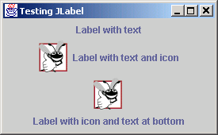
JLabel
Intended to be a text/image widget describing another component
    Label1 = new JLabel( “Rotation” );
  Change the text:
    label1.setText( “Rot” );
  Add a tooltip:
    label1.setToolTipText( “Rotation in degrees” );
  Add an icon:
    Icon rotIcon = new ImageIcon( “rot.gif” );
    label1.setIcon( rotIcon );

Slide 9
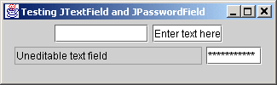
Text fields
JTextField:
  Single-line widget for user to type in text
    text1 = new JTextField( 10 ); // field width
    text2 = new JTextField( “Type your name here” );
  Read or change the text in the box with .getText() and .setText(String s)
  Disable user editing:
    text1.setEditable( false );
JPasswordField: subclass that shows only dots
JTextArea: allows multiple lines, word-wrap

Slide 10
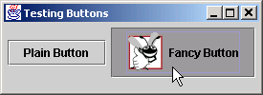
JButton
User clicks to trigger an ActionEvent
Several types:
  Command button, check box, toggle, radio
Abstract superclass: javax.swing.AbstractButton
    Icon rotIcon = new ImageIcon( “rot.png” );
    Icon rotIconDown = new ImageIcon( “rotdn.png” );
    rotButton = new JButton( “Rotate”, rotIcon );
    rotButton.setRolloverIcon( rotIconDown );

Slide 11
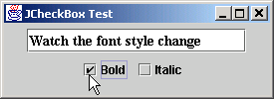
JCheckBox and ItemListener
JCheckBox uses a different listener interface:
    wireframe = new JCheckBox( “Wireframe” );
    MyItemHandler handler = new MyItemHandler();
    wireframe.addItemListener( handler );
ItemListener interface
uses itemStateChanged() method
on an ItemEvent object:
    private class MyItemHandler implements ItemListener {
public void itemStateChanged( ItemEvent event ) {
if ( event.getSource() == wireframe ) {
if ( event.getStateChange() ==
ItemEvent.SELECTED ) {
...

Slide 12
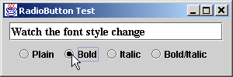
JRadioButton
    triButton = new JRadioButton( “Triangles”, false );
    quadButton = new JRadioButton( “Quads”, true );
    tristripButton = new JRadioButton( “Tristrips”, false );
Also uses ItemListener:
    MyItemListener handler = new MyItemListener();
    triButton.addItemListener( handler );
Usually put radio buttons into a ButtonGroup:
    geomGroup = new ButtonGroup();
    geomGroup.add( triButton );
    geomGroup.add( quadButton );
    geomGroup.add( tristripButton );
This is in addition to add()ing to the window

Slide 13
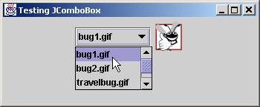
JComboBox
Drop-down list for user to choose one entry
    private String geom[] = { “Triangles”, “Quads”, “Tristrips” };
    geomCombo = new JComboBox( geom );
Show only three rows at a time:
    geomCombo.setMaximumRowCount( 3 );
Also uses ItemListener interface
See which entry user selected (0, 1, 2, etc.):
    geomCombo.getSelectedIndex()

