Slide 1
UML: Class Diagrams and Use-Cases
Reference:
Borland's UML tutorial
5 Mar 2010
CMPT166
Dr. Sean Ho
Trinity Western University

Slide 2
UML: Unified Modeling Language
Diagrams for use in designing your programs
Main diagram types:
  Static: Class diagram, object, package
  Dynamic: Use case diagram, sequence diagram, state chart
Handy for diagramming by hand, or
UML software tools, e.g., Visio, Sun JSEnterprise
Developed by Booch, Rumbaugh, and Jacobson, of OMG (Object Management Group)
Current version is 2.0: www.uml.org

Slide 3
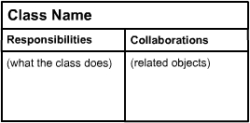
CRC diagrams
computingstudents.com
Class:
  Short descriptive name for the component
Responsibility:
  Data stored in the class
  Restrictions on access to the data
  Actions the class is responsible for
Collaborator:
  e.g., types of our attributes/data
  Other classes whose methods we call
  Other classes who call our methods

Slide 4
UML class diagram
Each box represents a class (type)
  Name, attributes, methods
  Static (class) members are underlined
  Flag: public (+), private (-), protected (#)
Lines show relationships between classes
Person
- String name - Date birthdate
+ String getName()
Student
- ID: int - GPA: float
+ float getGPA()

Slide 5
Class diagram: relationships
Person
Class relationships: e.g., superclass:
  Hollow arrow-head pointing to super
Instance relationships:
  e.g., every Car has an instance of Engine
  relationship between instances of the classes, not entire classes
Multiplicity: e.g., “*”: any number of instances
  “1..*”: one or more instances
  “0..1”: optional one instance
Student
Car
Engine
0..1
1

Slide 6
Instance relationships
Association: label with the relationship;
arrow indicates direction of dependency
Aggregation: container
“A is part of B” (but can exist apart from B)
Composition: “B owns an A”
Life-cycle dependency:
when B dies, so should its instance of A
Person
lives at
Address
*
1
Company
Employee
0..1
1..*
Car
Engine
0..1
1

Slide 7

An example class diagram
crionics.com
Ordering system:
each Order has multiple OrderDetail line items

Slide 8
Steps to OO design: wADes
  (Prereq: understand client requirements)
System behaviour
  Use-case scenarios
  User interface mockups
Components
  Self-contained blocks with
  narrow interactions
From components to classes
  Attributes, methods, relationships

Slide 9
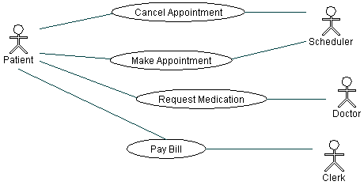
UML: Use case diagram
Describes relationships between actors:
    Patient calls the clinic to make an appointment
    Receptionist books timeslot
    Patient sees doctor and requests medication
    Patient pays bill to clerk
See Borland's UML tutorial for more details

Slide 10
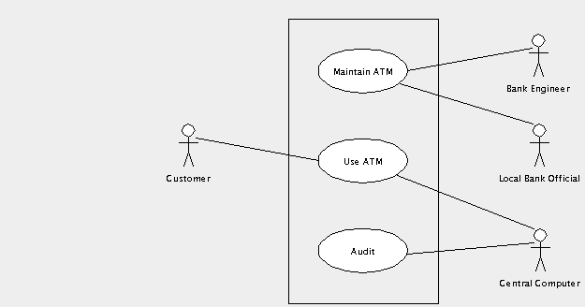
System behaviour: use-case
UML use-case diagrams show:
  The actors involved (may be nonhuman!)
  Ways in which the actors interact: relationships,
  actions,
  use cases, etc.
Example: ATM
(thanks to
ArgoUML)

