Slide 1
UML: Use-Case Diagrams
Reference:
Borland's UML tutorial
8 Mar 2010
CMPT166
Dr. Sean Ho
Trinity Western University

Slide 2

UML class diagrams
crionics.com
Ordering system:
each Order has multiple OrderDetail line items

Slide 3
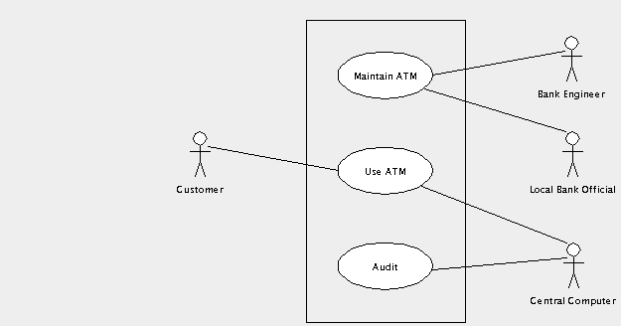
System behaviour: use-case
UML use-case diagrams show:
  The actors involved (may be nonhuman!)
  Ways in which the actors interact: relationships,
  actions,
  use cases, etc.
Example: ATM
(thanks to
ArgoUML)

Slide 4
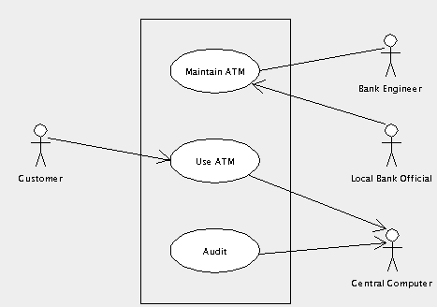
Use case diagram: navigation
Direction of arrows indicates which actor is passive and which is active:
What
direction
should the
arrows point
between
“Maintain ATM”
and
“Engineer”?

Slide 5
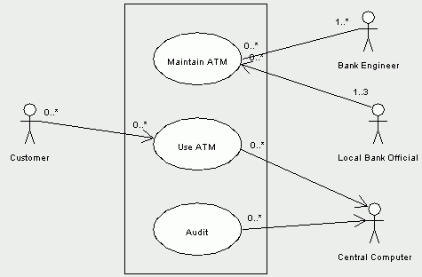
Use case diagram: multiplicity
Numbers indicate how many instances of an actor can be doing how many instances of the use case
e.g., only
allow up to 3
Bank Officials

Slide 6
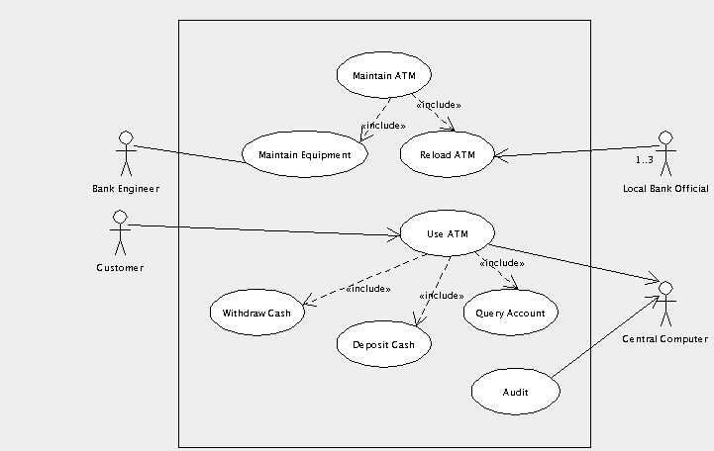
Use case diagram: includes
We may need to break down each use case into smaller chunks to implement

Slide 7
Components of a use case
Each use case should have:
  Short name
  Goal: what does it achieve for its actors?
  Names of actor(s) involved
  Pre/post-conditions?
  Basic flow: break down into steps (pseudocode!)
  Alternate flows: what if user inputs something different from the usual?

Slide 8
Ex. use case: Withdraw Cash
Name: Withdraw cash
Goal: Customer gets cash; Computer ensures account has enough money and keeps a record
Actors: Customer, Central Computer
Basic flow:
  Customer selects account to withdraw from
  Customer inputs dollar amount of cash
  ATM verifies with Computer enough money
  ATM dispenses cash to Customer
  ATM prints receipt

Slide 9
Ex. use case: alternate flows
How might the basic flow not work?
What might go wrong?
  wrong PIN, bank card can't be read
  insuff. funds
  different currency
  mismatch btw check and entered value
  power outage, network probs
  timeout / cust walks away
Each results in an alternate flow:
how to handle that alternate situation

Slide 10
Steps to OO design: wADes
  (Prereq: understand client requirements)
(1) System behaviour
  Use-case scenarios
  User interface mockups
(2) Components
  Self-contained blocks with
  narrow interactions
(3) From components to classes
  Attributes, methods

Slide 11
An OO design exercise
Problem statement:
Design a student enrolment database
like we have at TWU

Slide 12
(1) Actors and actions
Use-case scenarios: actors and actions
Who are the actors? Who will interface with us?
  students, advisors, teachers, admins
  (courses: w/in system or outside?), grade system?
What are the actions? Scenarios of use?
  apply for admission, check course capacity
  add course, approve courses
  remove unpaying student, change capacity of course
  change teacher/room/number, create new course
  get/change contact info?
  get list of courses for a student / students for a course

Slide 13
(1) Use-case diagrams
Actor
Actor
Use-case
Use-case
Actor
Actor

Slide 14
(1) Specify one use case
Name: Add Course
Actors: Student
Goal(s): Course is added to student's schedule
Pre-conditions: student is current/admitted,
currently within registration window,
course is offered and open for registration, ...

Slide 15
(1) Use case: basic flow
Basic flow:
  …

Slide 16
(1) Use case: alternate flows
What might not go according to the basic flow?
  …

Slide 17
(1) UI mockup
For each use-case (action), describe/mockup what the user interface will be like:
  Text Q&A? Windows? Interactivity?

Slide 18
(2) Component design
This is often the hardest part!
Components need not be classes
Thinly coupled: describe all interfaces between components
Component
Component
Component
Component

Slide 19
Component: ....
Name: …
Description: …
Interface to (component):
  ...
Interface to (component):
  ...

Slide 20
(3) From components to classes
Each component may need several classes to implement it
Component: …
  Class: …
    Attributes: …
    Methods: …
  Class: …
    Attributes: …
    Methods: ...

