Slide 1
TCP/IP Networking
15 Mar 2010
CMPT166
Dr. Sean Ho
Trinity Western University

Slide 2
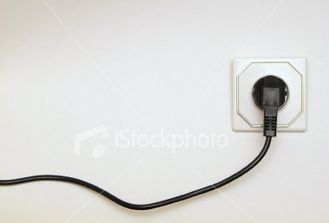
Sockets
Sockets are a protocol-
independent way of
communicating between processes
  Foundation of the Internet, including HTTP, FTP, IM, streaming media, etc.
Local or Internet: same host or diff hosts?
Connection-based or connectionless:
does each packet need to specify destination?
Packets or streams: message boundaries?
Reliable or unreliable: Can messages be lost, duplicated, reordered, or corrupted?

Slide 3
TCP vs. UDP
All data on the Internet is sent via packets conforming to the Internet Protocol (IP)
  Specify host and port (0-65535)
Two most common types of packets:
  TCP: Transmission Control Protocol:
    Virtual circuit: connection-based
    Client-server model
  UDP: User Datagram Protocol:
    Connectionless: peer-to-peer, less overhead
    Packets might disappear, or be out of order,
    or get duplicated

Slide 4
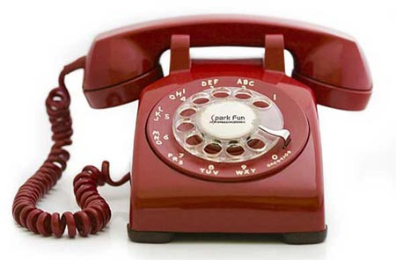
TCP client-server
TCP is connection-based:
  Phone analogy
  Initial setup, but subsequent packets do not need to specify destination again
  Server: waits, listens for client
  Client: initiates connection (phone call)
  Once connection is established, communication may be two-way (send/receive)
  Either client or server may terminate

