Slide 1
TCP/IP Networking: Socket I/O
17 Mar 2010
CMPT166
Dr. Sean Ho
Trinity Western University

Slide 2
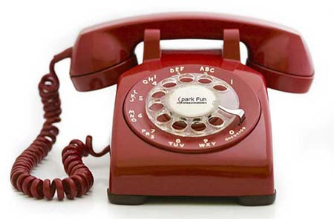
TCP client-server
TCP is connection-based:
  Phone analogy
  Initial setup, but subsequent packets do not need to specify destination again
  Server: waits, listens for client
  Client: initiates connection (phone call)
  Once connection is established, communication may be two-way (send/receive)
  Either client or server may terminate

Slide 3
Making a TCP Server in Java
java.net.ServerSocket object
    server = new ServerSocket( port, maxcl );
  maxcl: queue length (reject extra clients)
  BindException raised if port invalid or in use
Bind socket (start listening) (blocking):
    connection = server.accept();
  Returns a java.net.Socket object
Communicate via streams:
    connection.getInputStream();
    connection.getOutputStream();

Slide 4
Communicating with streams
Both client and server may send or receive:
    conn.getInputStream()
    conn.getOutputStream()
Communicate via text streams:
    new Scanner( conn.getInputStream() );
    new PrintWriter( conn.getOutputStream() );
Or object streams:
    new ObjectInputStream(
    conn.getInputStream() );
    new ObjectOutputStream(
    conn.getOutputStream() );

Slide 5
How do we accept clients?
Iterating server: only one client at a time
  One operator answering phones
  Simplest to implement
Forking server:
  Split off a child thread for each connection
  Original master thread continues to listen
  Switchboard
Concurrent single server:
  Use select to simultaneously wait on all open socket IDs

Slide 6
More on forking server
Multiple threads running concurrently
Master thread listens on port
When a client connects, fork off a thread
  Thread handles communication with that client
Master thread continues listening for other connections (switchboard)
Overhead in forking new threads: so keep pool of available threads, and reuse dormant threads

Slide 7
Connectionless client/server
TCP is connection-oriented
UDP is connectionless
  Send data one packet at a time
    Similar to envelopes through CanadaPost
    Fragment larger data into multiple packets
  Packets might:
    Not arrive at all
    Arrive out of order
    Get duplicated
  Less overhead, better latency and possibly better throughput

Slide 8
Receiving a UDP packet
Create a DatagramSocket (in java.net):
    sock = new DatagramSocket( port );
Create a DatagramPacket to store the data:
    byte payload[] = new byte[ 100 ];
    packet = new DatagramPacket(
    payload, payload.length );
Wait (block) for a packet:
    sock.receive( packet );
Read info from packet:
    packet.getData(), .getLength(), .getAddress(), .getPort()

Slide 9
Sending a UDP packet
Prepare payload:
    String msg = “Hello, World!”;
    byte[] payload = msg.getBytes();
Package payload:
    packet = new DatagramPacket(
    payload, payload.length,
    hostname, port );
Send packet:
    socket.send( packet );

