Slide 1
Multi-threading
19 Mar 2010
CMPT166
Dr. Sean Ho
Trinity Western University

Slide 2
Outline for today
Leftover from last time: UDP send/receive
Threads
  States threads can be in
  Tasks vs. threads
  In Java: Runnable, Thread
  Anonymous objects and classes
  In Swing
Dividing up the work: managing threads

Slide 3
Receiving a UDP packet
Create a DatagramSocket (in java.net):
    sock = new DatagramSocket( port );
Create a DatagramPacket to store the data:
    byte payload[] = new byte[ 100 ];
    packet = new DatagramPacket(
    payload, payload.length );
Wait (block) for a packet:
    sock.receive( packet );
Read info from packet:
    packet.getData(), .getLength(), .getAddress(), .getPort()

Slide 4
Sending a UDP packet
Prepare payload:
    String msg = “Hello, World!”;
    byte[] payload = msg.getBytes();
Package payload:
    packet = new DatagramPacket(
    payload, payload.length,
    hostname, port );
Send packet:
    socket.send( packet );

Slide 5
Multithreading
Concurrency is running multiple tasks at the same time
  Downloading a file, watching a movie, checking email
  One server talking to multiple clients
Threads are individual tasks (objects) that may run concurrently
Multithreading is built-in to Java ≥1.5

Slide 6

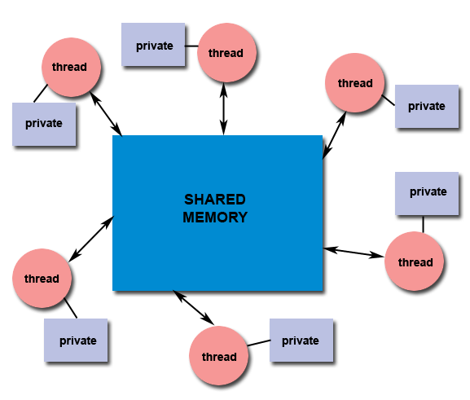
Thread model of parallelism
Threads are lightweight processes
Threads allow concurrency
  Make use of multiple processors
  But still useful even on uniprocessor
Threads use shared memory
  Synchronization issues
  for shared objects
    Thread-safe code?
  May also have
  local (private) variables

Slide 7
Thread state diagram
Threads can be in one of five states:
  New: not yet initialized
  Runnable: executing its task
  Waiting: blocked waiting for another thread
  Timed waiting: blocked for a fixed time
  Terminated
new
runnable
timed
waiting
terminate

Slide 8
Task scheduling
Create as many threads as you like
But # of processors limits # of running threads
    Multi-core; Hyper-threading
Scheduler assigns runnable threads to processors
  Part of operating system, not Java VM
  Scheduler can preempt running threads to allow others to run
  Each thread has a priority (“nice” value)
    Lower priority threads might get starved

Slide 9
Tasks vs. threads
Distinction between a task and a thread:
Task is work that needs to be done
  in Java: the Runnable interface
Thread is a process that can perform the work
  in Java: the Thread class
Define the tasks as run() methods in classes
Create threads by instantiating Thread
(or subclasses of it)
  Assign a Runnable task to the thread

Slide 10
Threads in Java: Runnable
Define a class with the Runnable interface
    class NumCruncher implements Runnable
  Define (override) the method run():
    public void run() { … }
Create an instance of Thread that uses
an instance of your class:
    Thread crunch =
    new Thread( new NumCruncher() );
Start the thread:
    crunch.start();
No imports needed: all in java.lang

Slide 11
The Thread class
Thread implements Runnable, so you may also subclass Thread:
    class NumCruncher extends Thread {
    public void run() { … }
Then just call start() directly on your object:
    NumCruncher cr = new NumCruncher();
    cr.start();
Runnable is the interface; Thread is a class
The Thread class also has static utility methods:
    Thread.sleep( 100 ); // wait for 100ms

Slide 12
Example: PrintTask
import java.util.Random;
class PrintTask implements Runnable {
private int sleepTime;
private String name;
private static Random gen = new Random();
public PrintTask( String name ) {
this.name = name;
this.sleepTime = gen.nextInt( 5000 );
}
public void run() {
System.out.println( name + “: good night!” );
Thread.sleep( sleepTime );
System.out.println( name + “: good morning!” );
}
}

Slide 13
Short-hand: anonymous
Instantiate a thread and start it in one line:
    (new NumCruncher()).start();
  The instance is an anonymous object
Even shorter: use an anonymous class
    (new Thread() {
    public void run() { … }
    }).start();
  Defines an anonymous subclass of Thread
    Inner class (defined within enclosing class)
  Creates an anonymous instance of it
  Starts the thread object

Slide 14
Example: starting a Swing app
We've used anonymous classes before as a thread-safe way of initializing a Swing GUI:
    public static void main( String[] args ) {
    SwingUtilities.invokeLater(
    new Runnable() {
    public void run() {
    new Histogram();
    }
    } );
invokeLater() runs the task on a thread designated for interaction with the Swing GUI

Slide 15
Multithreading for Swing
If an event handler (e.g., ActionListener) is very slow, the whole GUI is blocked waiting for it
So create worker threads for these callbacks
Use inner class for access to private attributes
Use anonymous class for one-off tasks:
public void ActionPerformed() {
(new Thread() {
public void run() {
/* do long operation, e.g. network */
}
}).start();
}

Slide 16
Warning: shared objects
Swing programs have multiple threads:
  Init thread (main() setup before GUI)
  Event dispatch thread (interacts w/GUI)
  Any worker threads you create
If multiple threads try to modify
a shared object, errors may occur!
Only the event dispatch thread should access the GUI (change widget text, etc.)
  Worker threads may ask the event dispatch thread to update the GUI
More details in Swing tutorial: concurrency

Slide 17
How to divide up the work?
Master/worker:
master thread assigns work to worker threads
  Master typically handles UI, input
  Static or dynamic worker pool
Coworkers: all threads are peers:
  Main thread participates in doing work
Pipeline: each thread works on a different part of the task: e.g., automobile assembly line
  Function parallelism vs. data parallelism

