Slide 1
Introduction to Android
24 Mar 2010
CMPT166
Dr. Sean Ho
Trinity Western University

Slide 2
Quiz 5: 10min, 20pts
Describe an example of a component [8] architecture (need not be computer-related). Describe some of the components, as well as an application that could be assembled from them.
Contrast TCP vs. UDP. Describe example applications when you might use each one. [6]
Pseudocode the steps to setup in Java
a TCP server and a TCP client. [6]

Slide 3
Quiz 5: answers #1-2
Describe an example of a component [8] architecture (need not be computer-related). Describe some of the components, as well as an application that could be assembled from them.
  Plug-ins for Firefox, Eclipse, Photoshop, etc.
  JavaBeans, .NET, (Android)
Contrast TCP vs. UDP. Describe example applications when you might use each one. [6]
  TCP: session (phone): HTTP, crypted, etc.
  UDP: packet (mail): may drop, re-order, or duplicate: live streaming media, stock ticker

Slide 4
Quiz 5: answers #3
Pseudocode the steps to setup in Java
a TCP server and a TCP client. [6]
Server:
  Create new ServerSocket (reserve port num)
  Bind (start listening): .accept()
  Setup streams: .get(In/Out)putStream()
Client:
  Create new Socket (call server)
  Setup streams: .get(In/Out)putStream()

Slide 5
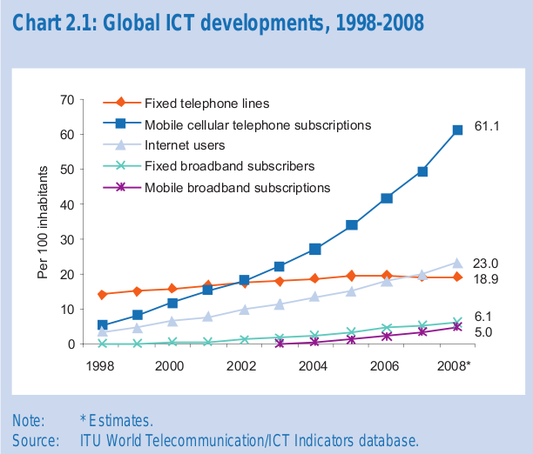
Mobile phone penetration
61% market penetration worldwide
Mobile broadband also on the rise
Source: ITU

Slide 6
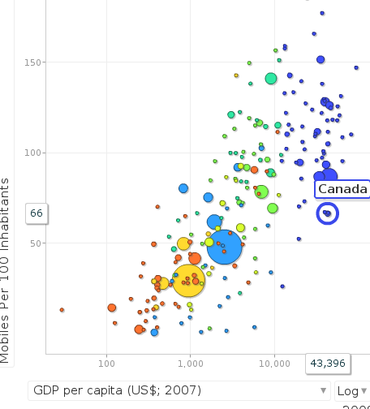
Mobile phones by country
Mobile phones per 100 inhabitants, by country
X-axis is GDP; disk size is population
Data from ITU, 1998-2008
Visualization by
Richard Heeks at
Centre for Development
Informatics, U. Man., UK
Using Google Motion Chart
Link

Slide 7
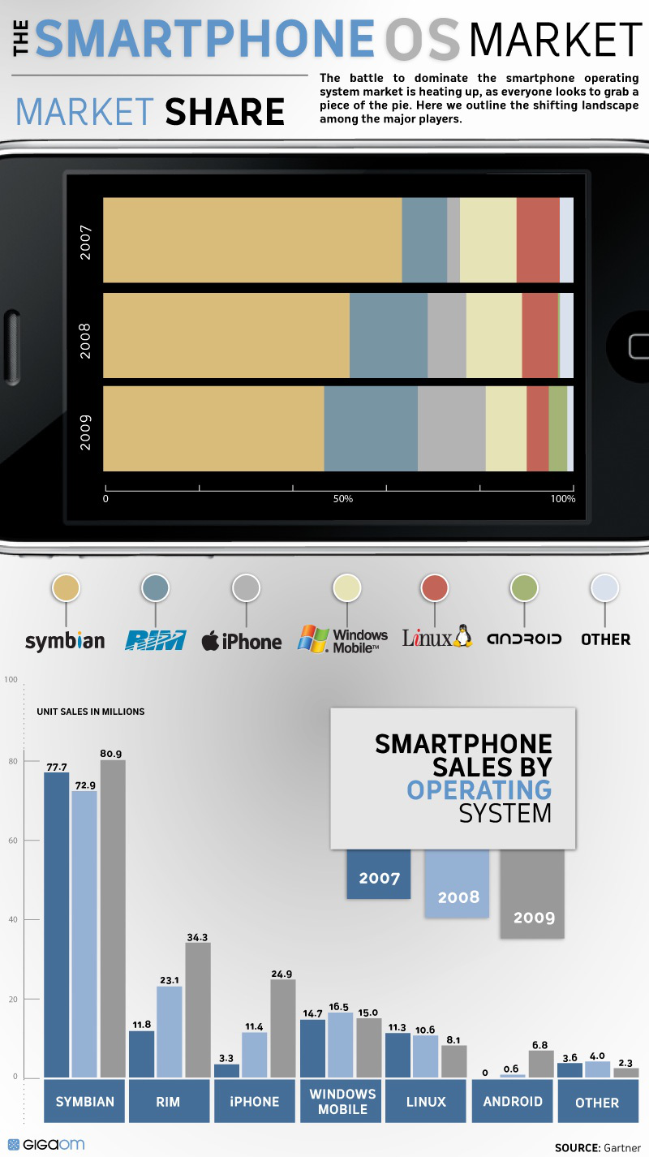
Smartphone OS market share
Symbian (Nokia) is still biggest by far,
but Android is rising quickly
Source: Gartner via GigaOM and ColumnFive

Slide 8
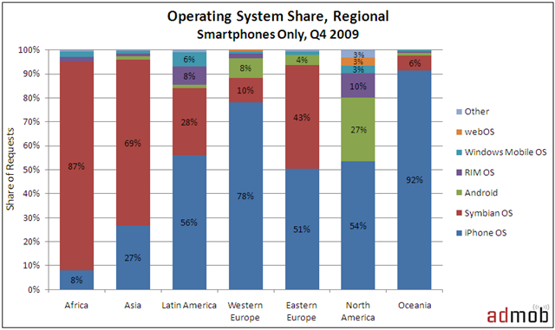
Regional effects: mobile OS
Android and iPhone have significantly larger market share in N.America
But data is from requests to mobile advertising

Slide 9
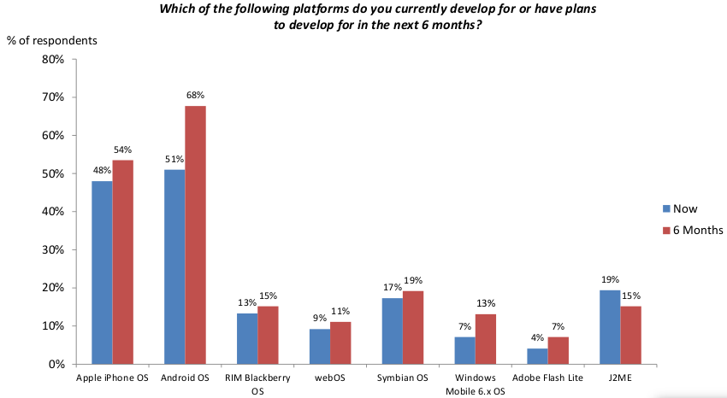
Developers of mobile apps
Increase in cross-platform development
Source: AdMob (mobile advertising)

Slide 10
Android OS
Open-source mobile OS (mostly Apache licence)
Developed by Google + Open Handset Alliance
Linux kernel
Most apps written in Java, using Android SDK
Apps run on Dalvik: custom Java VM
Android Open Source Project: fully open-source
“Google Experience”:
adds closed-source apps (Maps, Gmail, etc.)
Hardware drivers are also often closed-source

Slide 11

Android architecture
Android is: OS, core libraries, “middleware”, plus basic applications
Source:
d.android.com

Slide 12
What can you do with Android?
Component architecture: reuse parts of apps
Integrate web browser into your app (WebKit)
Audio, video, images (MPEG4, MP3, PNG, etc.)
2D and 3D graphics (OpenGL-ES 1.0/1.1)
SQLite on-board database
Telephony (calls, SMS, etc.)
EDGE/3G, WiFi data, Bluetooth
Camera, GPS, compass, accelerometer, etc.
Develop in Eclipse, debug on phone

Slide 13
Getting started with Android
Eclipse IDE for Java
Android SDK starter package
ADT plugin for Eclipse
From plugin, add Android 1.6 platform
  Could also develop for 1.5, 2.0, 2.1, etc.
  Setup an emulator instance(virtual phone)
Try the “Hello World!” tutorial
  Run/debug on the emulator
  Run/debug on actual phone via USB

