Slide 1
Introduction to Android:
“Hello, Android!”
26 Mar 2010
CMPT166
Dr. Sean Ho
Trinity Western University

Slide 2
Android OS
Open-source mobile OS (mostly Apache licence)
Developed by Google + Open Handset Alliance
Linux kernel
Most apps written in Java, using Android SDK
Apps run on Dalvik: custom Java VM
Android Open Source Project: fully open-source
“Google Experience”:
adds closed-source apps (Maps, Gmail, etc.)
Hardware drivers are also often closed-source

Slide 3

Android architecture
Android is: OS, core libraries, “middleware”, plus basic applications
Source:
d.android.com

Slide 4
What can you do with Android?
Component architecture: reuse parts of apps
Integrate web browser into your app (WebKit)
Audio, video, images (MPEG4, MP3, PNG, etc.)
2D and 3D graphics (OpenGL-ES 1.0/1.1)
SQLite on-board database
Telephony (calls, SMS, etc.)
EDGE/3G, WiFi data, Bluetooth
Camera, GPS, compass, accelerometer, etc.
Develop in Eclipse, debug on phone

Slide 5
Getting started with Android
Eclipse IDE for Java
Android SDK starter package
ADT plugin for Eclipse
From plugin, add Android 1.6 platform
  Could also develop for 1.5, 2.0, 2.1, etc.
  Setup an emulator instance(virtual phone)
Try the “Hello World!” tutorial
  Run/debug on the emulator
  Run/debug on actual phone via USB

Slide 6
Android application design
No single entry point (i.e., main())
  Instead, subclass an Android class and
  override certain methods (“hooks”)
Other apps can use parts of your app
  e.g., use Browser to request a web page
  e.g., search in Contacts for a phone number
Android can resume your app if crashed
  It can also kill your app if out of memory
  So save/load state and
  be prepared to die at (nearly) any time

Slide 7
Kinds of Android applications
Activity: present UI for one interactive task
  e.g.: get username+password, display map
Service: background task, often w/o UI
  e.g.: play music, fetch file over network
Broadcast Receiver: respond to announcements
  e.g.: if timezone changes, battery low, etc.
Content Provider: access/query a datastore
  e.g.,: music library, student database, etc.
We will focus on Activities, as the simplest kind

Slide 8
Tasks
Applications are formed from “tasks”: groups of related Activities that can call each other
Each activity is independent of each other
A “wizard”-style task might have a sequence of Activities: the “Next” button calls next Activity
Activity stack tracks history of activities
  Press hardware “back” button to go back
The main entry point for your app is specified with an intent: android.intent.action.MAIN and
category android.intent.category.LAUNCHER

Slide 9
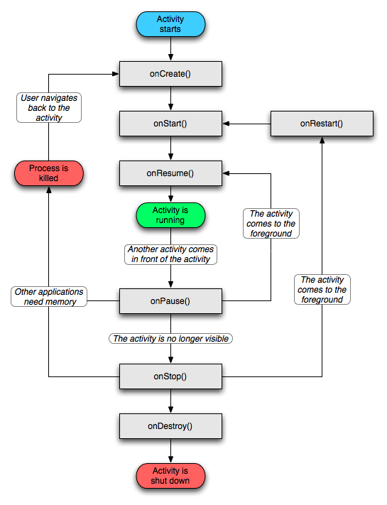
Activity life cycle
Four states:
Active: running and
in foreground
Paused: running, but a dialog has popped-up on top of it
Stopped: still running, but hidden by others
Dead: terminated, perhaps by Android OS when low on memory

Slide 10
Life cycle methods
Activity exists between onCreate/onDestroy():
  Initial setup and final tear down of resources
Activity is visible between onStart/onStop():
  onRestart() also called when return to fore
In foreground between onResume/onPause():
  In foreground means accepting user input
  onPause: commit unsaved changes, etc.
A paused activity might be destroyed before it ever resumes!

Slide 11
Saving state
Persistent state should be saved in onPause()
  e.g. draft of a message being composed
  Write to storage: preferences,
  SQL database, app-specific file, or SD card
Transient state: use onSaveInstanceState()
  e.g. how user filled out form before “submit”
  Save in a Bundle, which is passed to both onCreate() and onRestoreInstanceState()
  Use this, e.g., to fill out the form again when user goes “Back” to this activity

Slide 12
Views (widgets)
View is Android's widget class (c.f. JComponent)
Subclasses include: Button, TextView (label), EditText (text area), Spinner (pull-down list), …
  Or make your own subclass to customize!
ViewGroups are layout managers:
LinearLayout, GridView, TableLayout, TabHost,..
In the activity's onCreate(), call setContentView to declare the activity's main View (panel)

Slide 13
“Hello, Android!” tutorial
Only one activity: HelloAndroid
onCreate() method for the activity
Pass the saved state Bundle up to the superclass version of onCreate()
  Use this to restore any saved state
Set the main view to “R.layout.main”
  This is defined in the auto-generated R class
  Generated by XML layout

