Slide 1
Android:
Activities and Views
29 Mar 2010
CMPT166
Dr. Sean Ho
Trinity Western University

Slide 2
Outline for today
Android Activity: life cycle, states
  Life cycle methods
  Saving persistent / transient state
Android Views (widgets):
  Widgets and layouts
  XML configuration, layout editor

Slide 3
Kinds of Android applications
Activity: present UI for one interactive task
  e.g.: get username+password, display map
Service: background task, often w/o UI
  e.g.: play music, fetch file over network
Broadcast Receiver: respond to announcements
  e.g.: if timezone changes, battery low, etc.
Content Provider: access/query a datastore
  e.g.,: music library, student database, etc.
We will focus on Activities, as the simplest kind

Slide 4
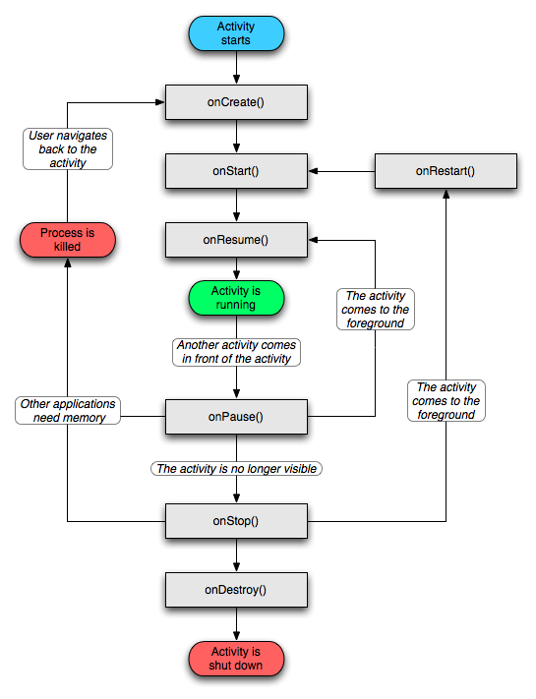
Activity life cycle
Four states:
Active: running and
in foreground
Paused: running, but a dialog has popped-up on top of it
Stopped: still running, but hidden by others
Dead: terminated, perhaps by Android OS when low on memory

Slide 5
Life cycle methods
Activity exists between onCreate/onDestroy():
  Initial setup and final tear down of resources
Activity is visible between onStart/onStop():
  onRestart() also called when return to fore
In foreground between onResume/onPause():
  In foreground means accepting user input
  onPause: commit unsaved changes, etc.
A paused activity might be destroyed before it ever resumes!

Slide 6
Saving state
Persistent state should be saved in onPause()
  e.g. draft of a message being composed
  Write to storage: preferences,
  SQL database, app-specific file, or SD card
Transient state: use onSaveInstanceState()
  e.g. how user filled out form before “submit”
  Save in a Bundle, which is passed to both onCreate() and onRestoreInstanceState()
  Use this, e.g., to fill out the form again when user goes “Back” to this activity

Slide 7
Views (widgets)
View is Android's widget class (c.f. JComponent)
Subclasses include: Button, TextView (label), EditText (text area), Spinner (pull-down list), …
  Or make your own subclass to customize!
ViewGroups are layout managers:
LinearLayout, GridView, TableLayout, TabHost,..
In the activity's onCreate() method:
call setContentView() to declare the activity's main View (panel):
  TextView tv = new TextView( this );
  setContentView( tv );

Slide 8
“Hello, Android!” tutorial
Only one activity: HelloAndroid
  Package: domain name, application name
onCreate() method: called when activity is run
The parameter is the saved state Bundle:
  Use this to restore transient state
  Also pass up to superclass onCreate()
Create a view (widget): TextView
  Set the text to “Hello, Android!”
  Set as the main view for the activity
Set a layout as main view if want > 1 widget!

Slide 9
XML layout
Laying out widgets can be complex in code
You may use an XML config file for your layouts:
  Create a file under res/layout/*.xml
  XML is like HTML: <tag> … </tag>
Specify layouts, widgets, font/colour/text/etc.
  Eclipse ADT has a WYSIWYG layout editor!
The XML layout gets compiled into an object in the R class (auto-generated; don't edit directly!)
  Refer to R.layout.myLayout
  (follows name of the XML file)

