Slide 1
XML layout
Laying out widgets can be complex in code
You may use an XML config file for your layouts:
  Create a file under res/layout/*.xml
  XML is like HTML: <tag> … </tag>
Specify layouts, widgets, font/colour/text/etc.
  Eclipse ADT has a WYSIWYG layout editor!
The XML layout gets compiled into an object in the R class (auto-generated; don't edit directly!)
  Refer to R.layout.myLayout
  (follows name of the XML file)

Slide 2
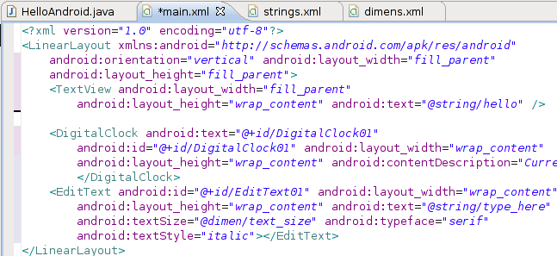
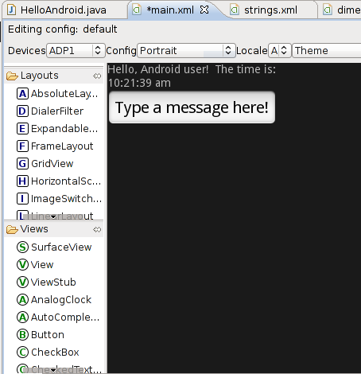
Layout editor
XML view
WYSIWYG view

Slide 3
Referring to resources
In the XML layout, the first TextView widget
has a default ID: @+id/TextView01
  @: resource ID (instead of literal value)
  +: create this resource ID if it doesn't exist
Change the widget's ID by editing Property/ID:
  e.g., @+id/top_label
Refer to this widget in the code using its ID:
  final TextView label = (TextView)
  findViewById( R.id.top_label );
  label.setText( “This text was set by code!” );

Slide 4
Text resources and i18n
“i18n”: Internationalization: single software that can be deployed in many countries
“L10n”: Localization: adapting the software for local language, formats, etc.
Separate all localizable strings into separate file
  Dialogue text, labels, etc.
  Default strings file: res/values/strings.xml
String resources: name/value pairs
  Refer to @string/name
  Use a string resource as the text of a widget

Slide 5
Drawable resources
Drawables include images, icons,
animation sequences, etc.
Store PNGs, etc. under drawable/ directory
Refer to via @drawable/filename (w/o ext)
  In properties: @drawable/filename
  From code, use getResourceById() to get a reference to the object (cast as needed):
    getResourceById( R.drawable.filename );
All resources are packaged together with your compiled code: one distributable application

Slide 6
Alternate resources
Alternate resource directories may be used depending on the device's locale, screen res, supported hardware, etc.:
res/values-fr/strings.xml: French strings
res/drawable-hdpi/: high-pixel-density images
Qualifiers: Cell network (MCC/MNC), language, region (en-CA), phys. screen size, orientation, pixel density, touchscreen type, etc.

Slide 7
Adding event listeners
Buttons have OnClickListeners:
  import android.view.View.OnClickListener;
  import android.widget.Button;
    (Resource ID need not be same as var name)
  final Button clickMe = (Button)
  findViewById( R.id.clickMe );
    Anon. inner class, anon object:
  clkMe.setOnClickListener( new OnClickListener() {
  public void onClick( View v ) {
  // do stuff when button is clicked
  }
  } );

Slide 8
Intents
Activities (and Services, etc.) are triggered by Intents: system-wide messages/events
The “glue” that connects together components
An Intent may include:
  Target: package and component (Activity)
  Action: what the target should do
  Data: URI and MIME type
  Category: home, launcher, preference, etc.

Slide 9
Implicit intents and filters
An implicit intent does not specify a particular target component (Activity)
Android matches action, data, and category against a component's intent filter to figure out which component to send the message to
e.g., to launch web browser:
  Sets action and data:
  Intent browse = new Intent( Intent.VIEW_ACTION,
  Uri.parse( “http://www.google.com/” ) );
  startActivity( browse );

Slide 10
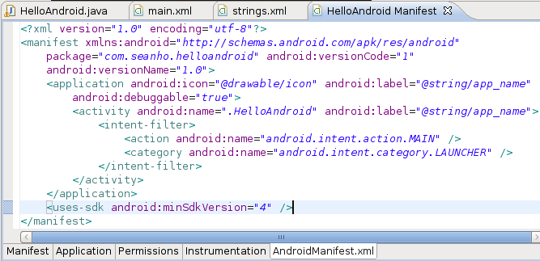
AndroidManifest.xml
Declare an activity's intent filters in manifest:
e.g., make it launchable from the home screen:
  Action: MAIN. Category: LAUNCHER

