Slide 1
Design Patterns (1)
7 Apr 2010
CMPT166
Dr. Sean Ho
Trinity Western University
See also:
Vince Huston,
JavaCamp

Slide 2
UML and reusable designs
Diagrams for
  Use-case scenarios
  Component / CRC diagrams
  Class diagram
  Sequence diagram
Christopher Alexander, “Notes on the Synthesis of Form”, Harvard University Press, 1964
Ref: Gamma, Helm, Johnson, Vlissides,
“Design Patterns: Elements of Reusable OO Software”

Slide 3
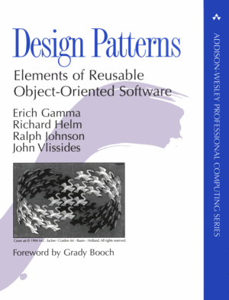
Design patterns
A pattern is a named abstraction
  from a recurring concrete form
  that expresses the essence of
  a proven general solution
A pattern has three parts:
  some recurring problem from the real world
  the context of the problem (when to solve it)
  the rule telling us how to solve it
Describe a class of problems and how to solve

Slide 4
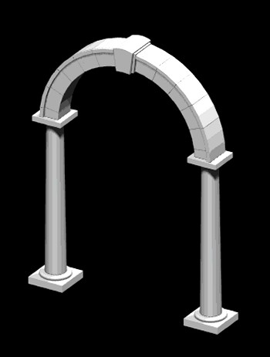
Parts of a design pattern
Name: should be meaningful
Problem: desired goal and obstacles
Context: preconditions on problem
Forces: relevant constraints, trade-offs, caveats
Solution: structure, relationships, how-to
Related patterns: co-dependencies, “see also”
Known uses: example applications

Slide 5
Classes of patterns (high to low)
Conceptual/architectural
  Structural organization of software systems
  Set of predefined components
  Relationships between components
Design
  How to refine each component
  Commonly recurring structure of components
Programming idiom
  How to code a particular component feature

Slide 6

Classes of patterns (GoF)
Creational patterns
  Interfaces to
  generate
  new objects
Structural patterns
  How to organize
  a large system
  in components
Behavioural patterns
  How components interact with each other to accomplish a common goal

Slide 7
Creational patterns
Factory Method: create a variety of objects
Abstract Factory: group of related obj factories
Builder: delegate creation of components
Prototype: clone a template object
Singleton: enforce having only one instance

Slide 8
Creational: factory method
JavaCamp,
Wikipedia
An interface to create an object,
but without specifying which subclass
Analogy: plastic injection-mould
determines shape of output
e.g., need to create a new Person; don't know in advance if it's Student, Staff, or Faculty
PersonCreator
makePerson()
Person
StudentCreator
makePerson()
Student

Slide 9
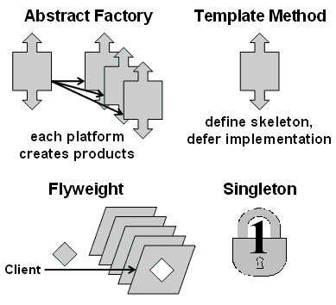
Creational: abstract factory
JavaCamp,
Wikipedia
Family of similar factories
  Client code doesn't know/care which concrete factory is used
  May use a collection of factory methods
Analogy: press to stamp out auto parts
e.g., adaptable look-and-feel of GUI widgets
GUIFactory
newScrollbar()
Scrollbar
MacGUIFactory
newScrollbar()
MacScrollbar

Slide 10
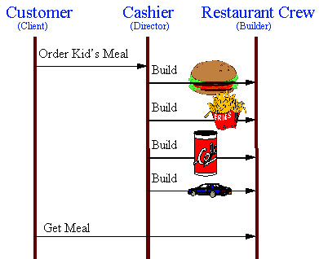
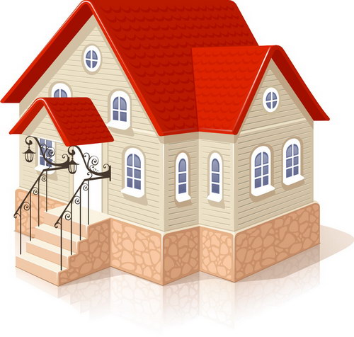
Creational pattern: builder
JavaCamp,
Wikipedia
Separate construction of a complex object
from its representation
  Analogy: assembling fast food kids' meals
Director class parses the
request and representation
Hierarchy of Builder classes
actually makes the objects

Slide 11
Creational pattern: prototype
JavaCamp,
Wikipedia
Create new objects by copying a prototype
  Analogy: biological cell division
  e.g., sheet-music editor: copy and paste notes
    Staves are objects; each note is an object
  Design each object so it knows how to copy itself: clone() method
  Copy constructor
MusicElement
clone()
Note
clone()
Rest
clone()
Fermata
clone()

Slide 12
Creational pattern: singleton
JavaCamp,
Wikipedia
Ensure a class only has one instance,
and provide a global point of access to it
    Analogy: only one Prime Minister
Often implement by making constructor private
  Provide a static get method for the singleton
    public class PrimeMinister {
private PrimeMinister thePM;
private PrimeMinister() { /* create new PM */ };
public static getPM() {
if (!thePM) thePM = new PrimeMinister();
return thePM; }

Slide 13
Structural patterns
Facade: unified/simplified interface to system
Adapter/ wrapper: Convert the interface of a class into another interface clients expect
  Lets otherwise incompatible classes cowork
Bridge: decouple an abstraction from its implementation so they can vary independently
Proxy: surrogate/placeholder for another object
Decorator: dynamically add responsibilities / functionality to an object
Flyweight: use sharing to support large
numbers of fine-grained objects efficiently

Slide 14
Structural pattern: facade
Provide a unified interface to a set of interfaces in a subsystem
  High-level interface: system is easier to use
  e.g., web front-end to complex database:
    want minimal number of widgets, input boxes
complex subsystem
user
facade

