Slide 1
Design Patterns:
Structural and Behavioural
9 April 2010
CMPT166
Dr. Sean Ho
Trinity Western University
See also:
Vince Huston,
JavaCamp

Slide 2

Design patterns (GoF)
Reusable templates for designing programs
May be very high-level, indep. of prog. language
Creational patterns
  Factory method
  Abstract factory
  Builder
  Prototype
  Singleton

Slide 3
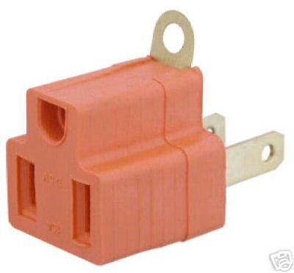

Structural pattern: Adapter
Convert interface of a class so that two incompatible classes can work together
Like converting 3-prong plug to 2-prong socket, or impedance matching electrical signals
e.g., buy prepackaged software system,
get it working with your
existing system
e.g., WindowAdapter
provides empty
implementations of all
WindowListener methods

Slide 4
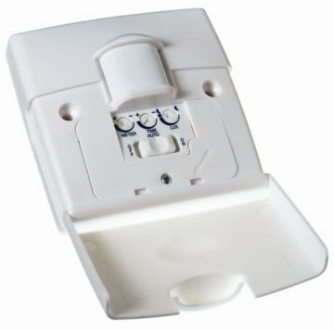
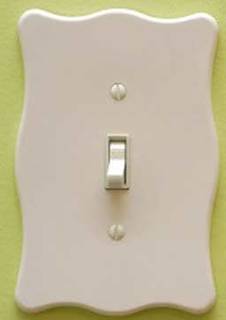
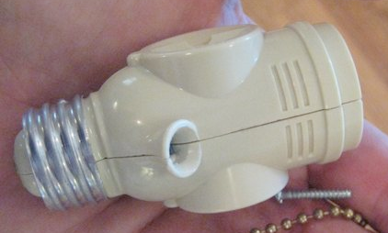
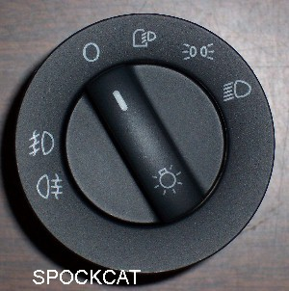
Structural pattern: Bridge
Decouple an abstraction from its implementation so that the two can vary independently
e.g., light switch abstract concept vs.
implementation of kinds of switches
client
abstraction
implementor
refinement
refinement

Slide 5
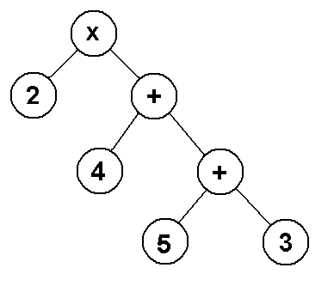
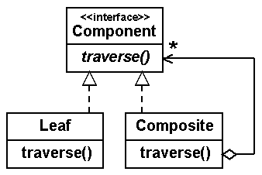
Structural pattern: Composite
Tree structure for objects: treat individual objects and composites in the same way
e.g., file directories have entries,
each of which may themselves be directories
e.g., widgets and containers (Android Views)
e.g., expression trees

Slide 6
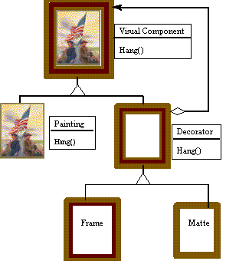

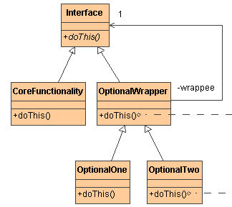
Structural pattern: Decorator
Dynamically add functionality via a wrapper
  More flexible than static subclassing
e.g., JScrollPane for widgets
e.g., ObjectOutputStream on
a FileOutputStream

Slide 7
Structural pattern: Facade
Provide a unified interface to a set of interfaces in a subsystem
  High-level interface: system is easier to use
  e.g., web front-end to complex database:
    want minimal number of widgets, input boxes
complex subsystem
user
facade

Slide 8
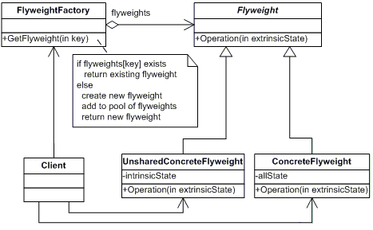

Structural pattern: Flyweight
Use sharing to support lots of “small” objects
When more objects needed,
draw from shared pool on demand
Often use factory to create initial pool
e.g., thread pool for
multithread server
Row of bank tellers

Slide 9
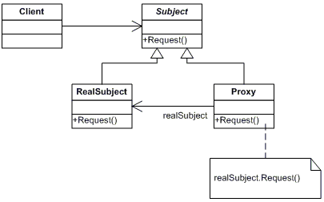

Structural pattern: Proxy
Surrogate for the real object
Control access to the real object, but still let clients think they are talking directly to it
Use superclass over both real object and proxy
Contrast with Adapter, Bridge?
e.g., proxy HTTP server
e.g., bank cheque

Slide 10
Structural patterns
Adapter/ wrapper: Convert the interface of a class into another interface clients expect
Bridge: split abstraction from implementation
Composite: organize objects into trees
Decorator: dynamically add responsibilities / functionality to an object
Facade: hide complexities behind simple interface
Flyweight: use sharing to support large numbers of fine-grained objects efficiently
Proxy: surrogate/placeholder for another object

Slide 11
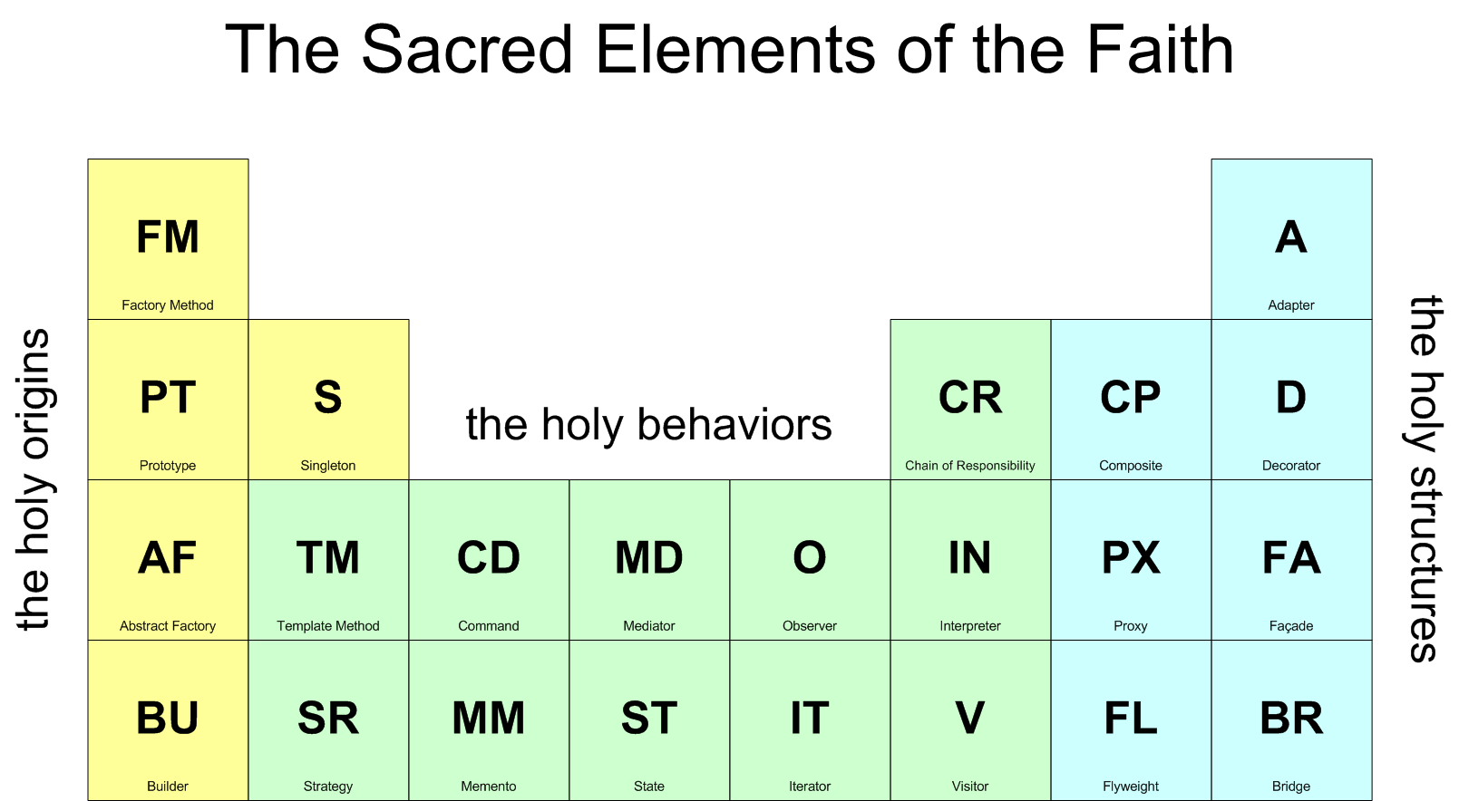
Design patterns (GoF)

Slide 12
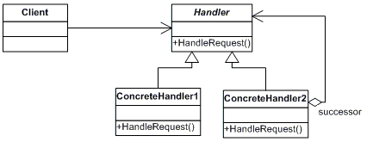
Behavior: Chain of responsibility
Decouple sender from receiver by passing request along a chain of intermediate handlers
Chain may be reconfigured dynamically
Single pipeline, but many possible handlers
e.g., coin passing through vending machine
me
my boss
2nd level mgr
regional mgr
vice president
CEO

Slide 13
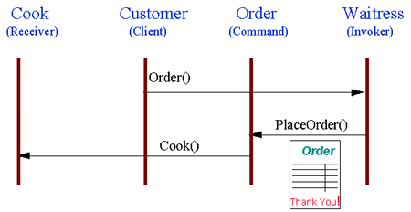
Behavioural pattern: Command
Encapsulate a request as an object
  e.g., function objects, callbacks
Specify: object, method, arguments
e.g., meal order at restaurant
Support undo/redo
client
callback
interface
receiver
concrete
callback
concrete
callback

Slide 14
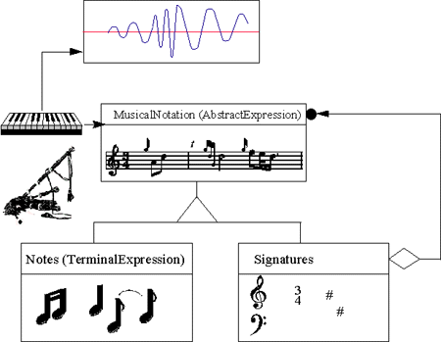
Behavioural: Interpreter
Given a domain-specific language,
define a grammar for the language and
an engine to translate into objects
Vocabulary + syntax
e.g., parse config file
e.g., read music →
produce sound
Useful for repeated,
similar problems within
a well-defined domain

Slide 15
Behavioural patterns
Chain of responsibility: avoid coupling sender directly to receiver by passing through chain
Command: make requests into objects
Interpreter: define macro language + parser
Iterator: access all elements of a collection
Mediator: object encapsulating the interactions of a set of objects: promotes loose coupling
Memento: save/restore state of object
Observer: decouple viewers from the subject

Slide 16
Design patterns (GoF)

