Slide 1
Design Patterns: Behavioural
12 April 2010
CMPT166
Dr. Sean Ho
Trinity Western University
See also:
Vince Huston,
JavaCamp

Slide 2
Quiz 6: 12min, 20pts
What is Activity in Android?
Describe some examples.
Is an Activity a complete application? [6]
Why do Android applications
not have a main() method? [4]
What are Android string resources?
Why are they cool? [4]
Name and describe two Creational design patterns from the “Gang of Four” book.
Describe an example usage of each. [6]

Slide 3
Quiz 6: answers #1-2
What is Activity in Android? [6]
  Presents UI for one focused endeavour by the user
  e.g., dialogue to get username/password
  An app generally has several Activities
Why do Android applications not have a main()?
  Each Activity is an entry point into the app
  Modular design so other apps can use parts of your app

Slide 4
Quiz 6: answers #3
What are Android string resources?
Why are they cool? [4]
  Name-value pairs, stored in res/values/strings.xml
  Don't hard-code strings in code/properties, but refer to string ID
  Facilitates internationalization: Android selects appropriate strings.xml based on current locale

Slide 5
Quiz 6: answers #4
Name and describe two Creational design patterns from the “Gang of Four” book. [6]
  Factory Method: “virtual constructor”
  Abstract Factory: “kits” for similar objects
  Builder: Director delegates to Builders
  Prototype: clone an existing object
  Singleton: allow only one instance

Slide 6
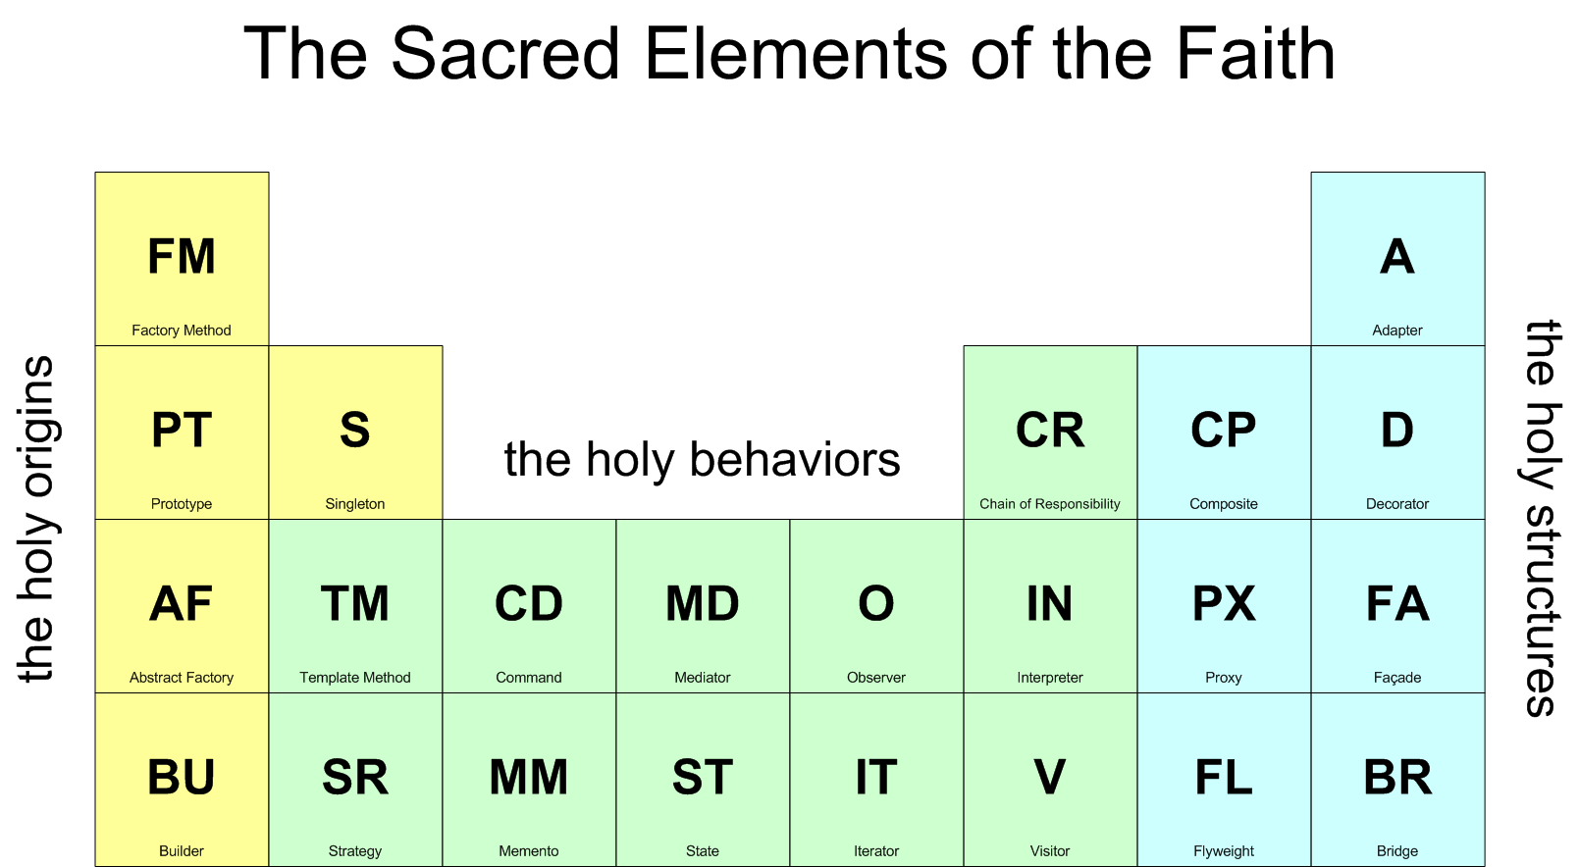
Design patterns (GoF)
Reusable templates for designing programs
May be very high-level, indep. of prog. language

Slide 7
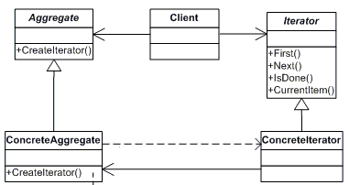
Behavioural pattern: Iterator
Abstract interface to traverse a collection
Hide how the collection is stored
Client interface: first, next, isDone
e.g., secretary knows her own filing system;
boss only needs ask for “next document”
e.g., for/each loop
through dictionaries:
  Order irrelevant

Slide 8
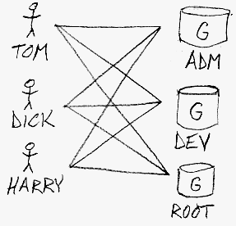
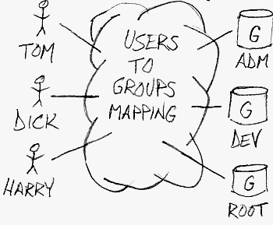
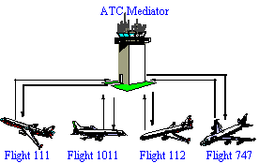
Behavioural pattern: Mediator
Simplify many-to-many relationships with one central object that all actors interact with
  Loose coupling of peers
Encapsulate many interactions (e.g., methods) into one object
e.g., ATC
w/o mediator
with mediator

Slide 9

Behavioural pattern: Memento
Record object state and restore it transparently
  e.g., pickling/serialization
Allows undo/redo, checkpoint/snapshot, etc.
Originator: object that knows how to snapshot
Caretaker: requests Originator to snapshot, keeps Memento, and restores Originator later
Memento: object representing Originator state

Slide 10
Behavioural pattern: Observer
One-to-many dependency between objects so
that when the subject changes state,
all its observers are notified and updated
  e.g., TV/radio broadcast
  e.g., RSS feeds
  e.g., server message “send to all” clients
subject
observer
observer
observer

Slide 11
Behavioural patterns
Chain of responsibility: avoid coupling sender directly to receiver by passing through chain
Command: make requests into objects
Interpreter: define macro language + parser
Iterator: access all elements of a collection
Mediator: object encapsulating the interactions of a set of objects: promotes loose coupling
Memento: save/restore state of object
Observer: decouple viewers from the subject
  (and others: TemplateMethod, State, Strategy, Visitor)

Slide 12
Design patterns (GoF)

