Slide 1

Ch2: Exploring Data: Charts
13 Sep 2011
BUSI275
Dr. Sean Ho
HW1 due Thu 10pm
Download and open
“SportsShoes.xls”

Slide 2
Outline for today
Exploring data with charts:
  Tallying frequency distributions
  Gentle intro to Excel, array formulas
  Qualitative vars: bar, pie
    Multiple vars: crosstabs, clustered bar
  Quantitative vars: histogram, line
    Multiple vars: scatter

Slide 3
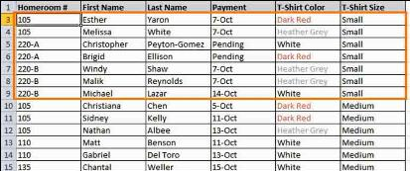
Frequency distributions
How frequently each value of a variable appears in the dataset (either pop or sample)
Data usually come as 1 row = 1 participant:
Compute by tallying up how many occurrences of each value exist in the data:
  e.g., for “T-Shirt Size” (level of meas?):
  Small: 10; Medium: 20; Large: 15

Slide 4
Excel: freq. dist. & bar chart
Dataset: SportsShoes.xls
  Add new sheet: “Charts”
Frequency distribution:
  Enter poss. values (Gender coded as 1, 2)
  FREQUENCY() array formula
  Relative Frequencies (%): divide by total
    Use '$' for abs. cell ref.; format as %
Bar chart:
  Insert > Bar > 2D > Select Data:
  Data: freqs; Cat. Axis Labels: values

Slide 5

Excel array formulas
Regular formulas (functions) take cells or cell ranges as input and produce a single output
  Array formulas output to a range of cells
Highlight the range where output will go
Enter the formula:
  =FREQUENCY()
  Data: highlight Data!M3:M102
  Bins (values): highlight cells with “1”,”2”
Don't hit OK yet! Use Ctrl-Shift-Enter instead to indicate it is an array formula

Slide 6
Multiple vars: crosstabs
Consider all combinations of values:
  e.g., Gender: 1 or 2; Activity: 1, 2, 3
  so there are 6 combos of (Gender, Act)
Cross-tabulations (Pivot Tables, Joint freq. dist):
  Insert > Pivot Table
  Select Range: L2:M102
  Row Labels: Gender
  Col Labels: Activity
  Values: either
  Summarize By: Count
Count - Activity | Activity
Gender | 1 | 2 | 3 | Total Result
1 | 12 | 27 | 4 | 43
2 | 16 | 29 | 12 | 57
Total Result | 28 | 56 | 16 | 100

Slide 7
Multiple vars: clustered bars
If one of the nominal variables only has a few possible values (categories), then
We can use clustered or stacked bar charts:

Slide 8
Quantitative vars: histograms
For quantitative vars (scale, ratio),
must group data into classes
  e.g., length: 0-10cm, 10-20cm, 20-30cm... (class width is 10cm)
  Specify class boundaries: 10, 20, 30, …
How many classes? for sample size of n,
use k classes, where 2^{k} ≥ n
Can use FREQUENCY()
w/ column chart, or
Data > Data Analysis
> Histogram

Slide 9
Cumulative distrib.: ogive
The ogive is a curve showing the cumulative distribution on a variable:
  Frequency of values
  equal to or less than
  a given value
Compute cumul. freqs.
Insert > Line w/Markers
Pareto chart is an ogive on a nominal var,
with bins sorted by decreasing frequency
  Sort > Sort by: freq > Order: Large to small

Slide 10
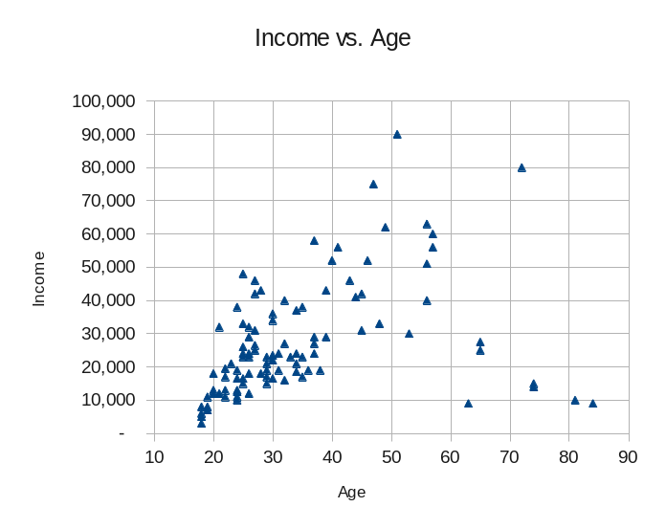
2 quant. vars: scatterplot
Each participant in the dataset is plotted as a point on a 2D graph
  (x,y) coordinates are that participant's observed values on the two variables
Insert > XY Scatter
If more than 2 vars, then either
  3D scatter (hard to see), or
  Match up all pairs:
  matrix scatter

Slide 11
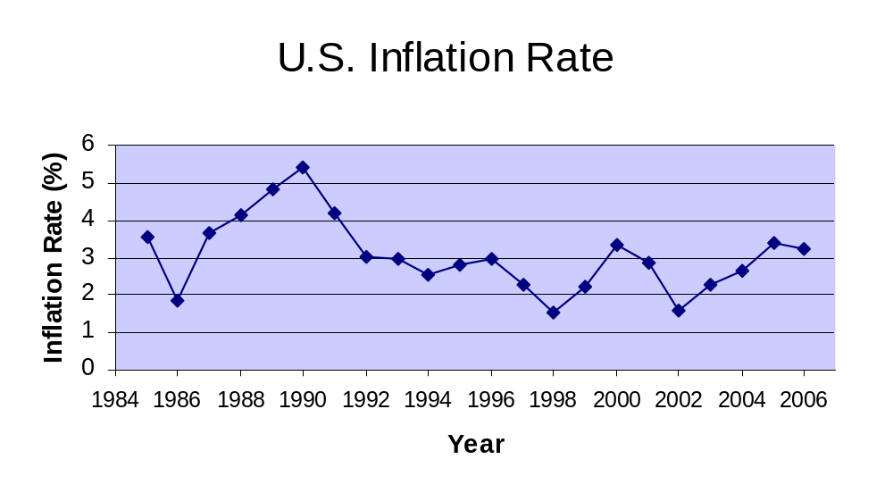
Time series: line graph
Think of time as another variable
  Horizontal axis is time
Insert > Line > Line

Slide 12
TODO
HW1 (ch1-2): due this Thu 15Sep at 10pm
  Format as a clear, neat document
  Also upload your Excel spreadsheet
  HWs are to be individual work
Get to know your classmates and form teams
  Email me when you know your team
  You can come up with a good name, too
Discuss topics/variables you are interested in
  Find existing data, or gather your own?

