Slide 1

Ch3: Exploring Your Data with Descriptives
15 Sep 2011
BUSI275
Dr. Sean Ho
HW1 due tonight 10pm
Download and open
“02-SportsShoes.xls”

Slide 2
Outline for today
Exploring data with charts: line, scatter
Exploring data with descriptives:
  Measures of Centre
    Mean, median, mode
  Quartiles, percentiles, boxplot
  Measures of Variation
    Range, IQR
    Standard deviation, variance, coef of var
  Empirical Rule and z-scores

Slide 3
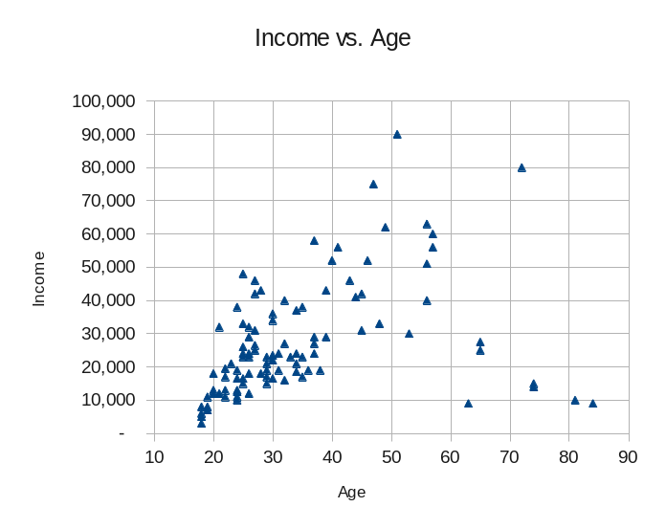
2 quant. vars: scatterplot
Each participant in the dataset is plotted as a point on a 2D graph
  (x,y) coordinates are that participant's observed values on the two variables
Insert > XY Scatter
If more than 2 vars, then either
  3D scatter (hard to see), or
  Match up all pairs:
  matrix scatter

Slide 4
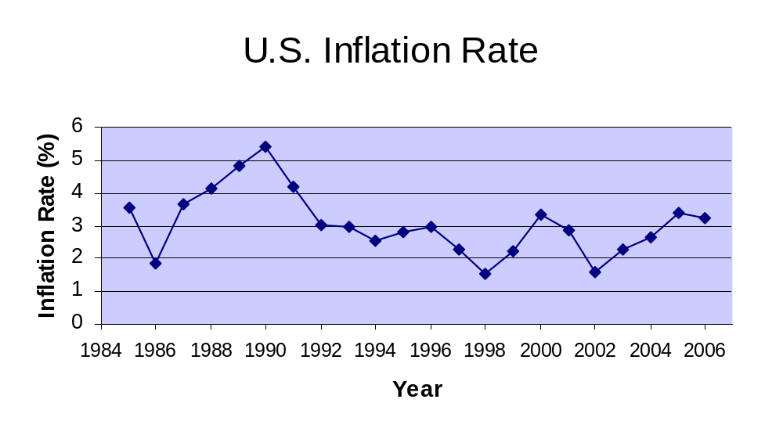
Time series: line graph
Think of time as another variable
  Horizontal axis is time
Insert > Line > Line

Slide 5
Descriptives: centres
Statistic | Age | Income
Mean | 34.71 | $27,635.00
Median | 30 | $23,250.00
Mode | 24 | $19,000.00
Visualizations are good, but numbers also help:
  Mostly just for quantitative vars
Many ways to find the “centre” of a distribution
  Mean: AVERAGE()
    Pop mean: μ ; sample mean: x
    What happens if we have outliers?
  Median: line up all observations in order and pick the middle one
  Mode: most frequently occurring value
    Usually not for continuous variables

Slide 6
Descriptives: quantiles
The first quartile, Q₁, is the value ¼ of the way through the list of observations, in order
  Similarly, Q₃ is ¾ of the way through
  What's another name for Q₂?
In general the p^{th} percentile is the value p% of the way through the list of observations
  Rank = (p/100)n: if fractional, round up
    If exactly integer, average the next two
  Median = which percentile?
Excel: QUARTILE(data, 3), PERCENTILE(data, .70)

Slide 7
Box (and whiskers) plot
Plot: median, Q₁, Q₃, and upper/lower limits:
  Upper limit = Q₃ + 1.5(IQR)
  Lower limit = Q₁ – 1.5(IQR)
IQR = interquartile range = (Q₃ – Q₁)
Observations outside the limits are considered outliers: draw as asterisks (*)
Excel: try tweaking bar charts
25% 25% 25% 25%
*
*
Outliers
Lower lim
Q1
Median
Q3
Upper lim

Slide 8
Boxplots and skew
Left-Skewed
Symmetric
Right-Skewed
Q1
Q2
Q3
Q1
Q2
Q3
Q1
Q2
Q3

Slide 9
Boxplot Example
Data:
0 2 2 2 3 3 4 5 6 11 27
Right skewed, as the boxplot depicts:
Min Q₁ Q₂ Q₃ Max
*
0 2 3 6 12 27
Upper limit = Q₃ + 1.5 (Q₃ – Q₁)
= 6 + 1.5 (6 – 2) = 12
27 is above the upper limit so is shown as an outlier

Slide 10
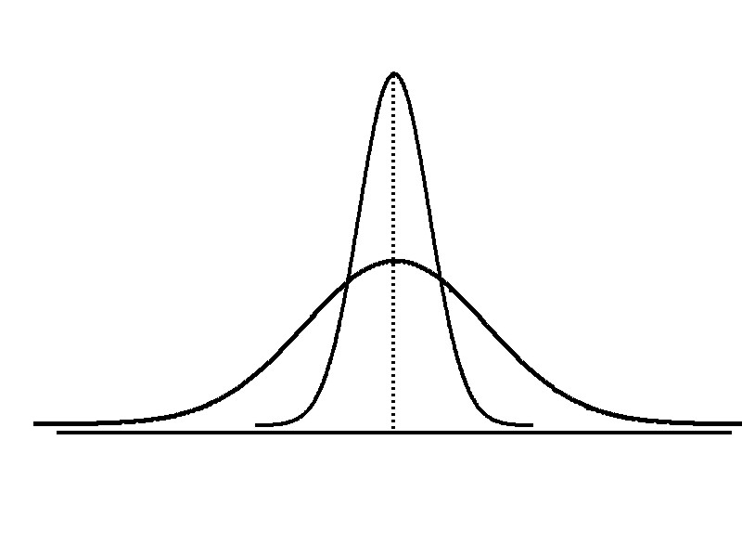
Measures of variation
Spread (dispersion) of a distribution:
are the data all clustered around the centre,
or spread all over a wide range?
Low variation
High variation
Same center,
different variation

Slide 11
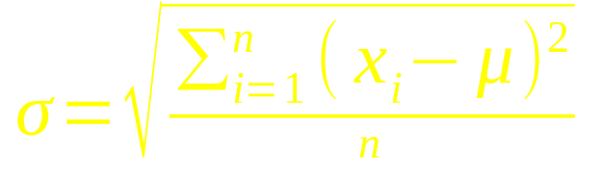
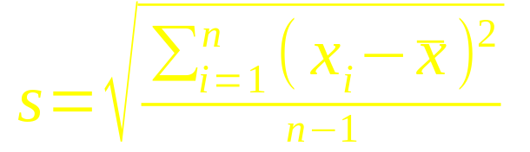
Range, IQR, standard deviation
Simplest: range = max – min
  Is this robust to outliers?
IQR = Q₃ – Q₁ (“too robust”?)
Standard deviation:
  Population:
  Sample:
  In Excel: STDEV()
Variance is the SD w/o square root
 | Pop. | Samp.
Mean | μ | x
SD | σ | s

Slide 12
Coefficient of variation
Coefficient of variation: SD relative to mean
  Expressed as a percentage / fraction
e.g., Stock A has avg price x=$50 and s=$5
  CV = s / x = 5/50 = 10% variation
Stock B has x=$100 same standard deviation
  CV = s / x = 5/100 = 5% variation
Stock B is less variable relative to its average stock price

Slide 13
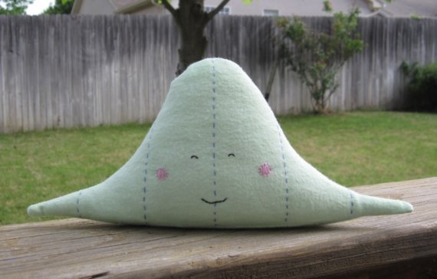
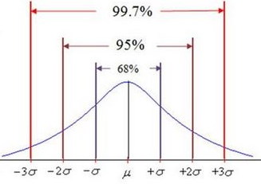
SD and Empirical Rule
Every distribution has a mean and SD, but for most “nice” distribs two rules of thumb hold:
Empirical rule: for “nice” distribs, approximately
  68% of data lie within ±1 SD of the mean
  95% within ±2 SD of the mean
  99.7% within ±3 SD
NausicaaDistribution

Slide 14
SD and Tchebysheff's Theorem
For any distribution, at least (1-1/k²) of the data will lie within k standard deviations of the mean
  Within (μ ± 1σ): ≥(1-1/1²) = 0%
  Within (μ ± 2σ): ≥(1-1/2²) = 75%
  Within (μ ± 3σ): ≥(1-1/3²) = 89%

Slide 15
z-scores
Describes a value's position relative to the mean, in units of standard deviations:
  z = (x – μ)/σ
e.g., you got a score of 35 on a test:
is this good or bad? Depends on the mean, SD:
  μ=30, σ=10: then z = +0.5: pretty good
  μ=50, σ=5: then z = -3: really bad!

Slide 16
TODO
HW1 (ch1-2): due tonight at 10pm
  Format as a clear, neat document
  Also upload your Excel spreadsheet
  HWs are to be individual work
Get to know your classmates and form teams
  Email me when you know your team
  You can come up with a good name, too
Discuss topics/variables you are interested in
  Find existing data, or gather your own?

