Slide 1

Ch4: Probability
20 Sep 2011
BUSI275
Dr. Sean Ho
HW2 due Thu 10pm

Slide 2
Outline for today
Empirical Rule and z-scores
Probability: events, outcomes, sample space
  Event trees
Venn diagrams and set theory:
  Complement, union, intersection
Addition rule for A ∪ B
  Mutual exclusivity
Conditional probability and Bayes' rule
Statistical independence

Slide 3
z-scores
Describes a value's position relative to the mean, in units of standard deviations:
  z = (x – μ)/σ
e.g., you got a score of 35 on a test:
is this good or bad? Depends on the mean, SD:
  μ=30, σ=10: then z = +0.5: pretty good
  μ=50, σ=5: then z = -3: really bad!

Slide 4
Probability
Chance of a particular event happening
e.g., in a sample of 1000 people,
say 150 will buy your product:
  ⇒ the probability that a random person from the sample will buy your product is 15%
  Experiment: pick a random person (1 trial)
  Possible outcomes: {“buy”, “no buy”}
  Sample space: {“buy”, “no buy”}
  Event of interest: A = {“buy”}
  P(A) = 15%

Slide 5
Event trees
Experiment: pick 3 people from the group
Outcomes for a single trial: {“buy”, “no buy”}
Sample space: {BBB, BBN, BNB, BNN, NBB, …}
P(BNB)
= (.15)(.85)(.15)
Event: A = {at least 2 people buy}: P(A) = ?

Slide 6
Venn diagrams
Box represents whole sample space
Circles represent events (subsets) within SS
e.g., for a single trial:
P(SS) = 1
A
B
P(B) = .15
P(A) = .35
  A = “clicks on ad”
  B = “buys product”

Slide 7
Venn: set theory
Complement: A
= “does not click ad”
  P(A) = 1 - P(A)
A
A
Intersection: A ∩ B
= “clicks ad and buys”
A ∩ B
Union: A ∪ B
= “either clicks ad or buys”
A ∪ B

Slide 8
Addition rule: A ∪ B
P(A ∪ B)
=
P(A)
+
P(B)
-
P(A ∩ B)

Slide 9
Addition rule: example
35% of the focus group clicks on ad:
  P(?) = .35
15% of the group buys product:
  P(?) = .15
45% are “engaged” with the company:
either click ad or buy product:
  P(?) = .45
⇒ What fraction of the focus group
buys the product through the ad?
  P(A ∪ B) = P(A) + P(B) – P(A ∩ B)
  ? = ? + ? - ?

Slide 10
Mutual exclusivity
Two events A and B are mutually exclusive if the intersection is null: P(A ∩ B) = 0
  i.e., an outcome cannot satisfy both A and B simultaneously
e.g., A = male, B = female
e.g., A = born in Alberta, B = born in BC
If A and B are mutually exclusive, then the addition rule simplifies to:
  P(A ∪ B) = P(A) + P(B)

Slide 11
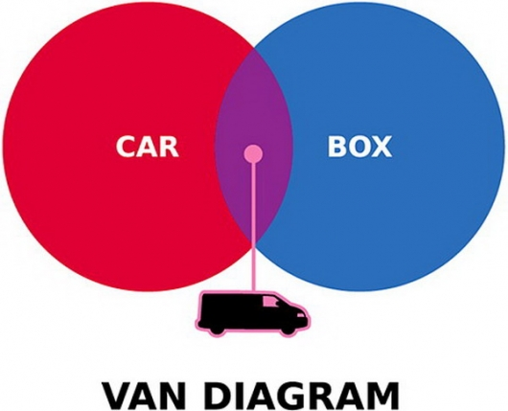
Yep!

Slide 12
Conditional probability
P(A|B): probability of A given B
  “Narrows” the sample space to B
P(buy) might be pretty small
  Especially if nobody's heard of us
P(buy | likes ad) could be much bigger
  If the ad is effective: conversion rate
Bayes' Theorem (rule): P(A|B) = P(A ∩ B) / P(B)

Slide 13
Bayes' Theorem: example
Let: A = likes our ad
B = buys our product
40% of the focus group likes our ad
  P(?) = .40
Of those who like our ad, 10% buy our product (i.e., 10% conversion rate)
  P(?) = .10
⇒ What fraction of the focus group buys our product?
  P(B | A) = P(A ∩ B) / P(A)
  ? = ? / ?

Slide 14
Statistical independence
Two events A and B are independent when:
  P(A|B) = P(A), or equivalently, P(B|A) = P(B)
  One event being true does not change the probability of the other event happening
e.g., A = wears socks, B = has blue eyes
  P(wearing socks) is the same regardless of whether the person has blue eyes
e.g., A = first person buys our product,
B = next (random) person buys our product
  Assumes customers don't talk to each other
Would these be independent?
  A = likes our ad, B = buys our product

Slide 15
Indep. vs. mutual exclusivity
A = likes our ad, B = buys our product
But what if someone says:
  “Just because someone doesn't like our ad, doesn't mean that they can't still buy our product – just because event A is true doesn't mean that event B is impossible.”
Is this a statement about independence or mutual exclusivity?

Slide 16
Independence and Bayes' rule
Recall Bayes: P(A|B) = P(A ∩ B) / P(B)
Rewrite this as:
  P(A ∩ B) = P(A|B) P(B)
Now, if we also know that A and B are statistically independent, then P(A|B) = P(A), so
  P(A ∩ B) = P(A) P(B)
P(both customers buy) =
P(cust1 buys) P(cust2 buys)
Cust1
∩
Cust2

Slide 17
TODO
HW2 (ch2-3): due Thu 22 at 10pm
  Remember to format as a document!
  HWs are to be individual work
Get to know your classmates and form teams
  Email me when you know your team
  You can come up with a good name, too
Discuss topics/variables you are interested in
  Find existing data, or gather your own?

