Slide 1

Ch5: Discrete Distributions
22 Sep 2011
BUSI275
Dr. Sean Ho
HW2 due 10pm
Download and open:
05-Discrete.xls

Slide 2
Outline for today
Example: conditional probabilities
Discrete probability distributions
  Finding μ and σ
Binomial experiments
  Calculating the binomial probability
  Excel: BINOMDIST()
  Finding μ and σ
Poisson distribution: POISSON()
Hypergeometric distribution: HYPGEOMDIST()

Slide 3
Example: conditional prob.
 | Age <18 | 18-25 | >25 | Total
Cell phone | 40 | 80 | 60 | 180
No cell | 40 | 10 | 20 | 70
Total | 80 | 90 | 80 | 250
What fraction are aged 18-25?
What is the overall rate of cellphone ownership?
What fraction are minors with cellphone?
Amongst adults over 25, what is the rate of cellphone ownership?
Are cellphone ownership and age independent in this study?

Slide 4
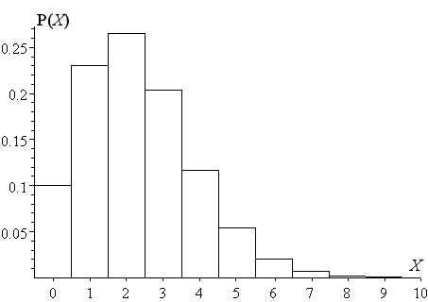
Discrete probability distribs
A random variable takes on numeric values
  Discrete if the possible values can be counted, e.g., {0, 1, 2, …} or {0.5, 1, 1.5}
  Continuous if precision is limited only by our instruments
Discrete probability distribution:
for each possible value X,
list its probability P(X)
  Frequency table, or
  Histogram
Probabilities must add to 1
  Also, all P(X) ≥ 0

Slide 5
Probability distributions
Discrete
Random Variable
Continuous
Random Variable
Ch. 5
Ch. 6
Binomial
Normal
Poisson
Uniform
Hypergeometric
Exponential

Slide 6
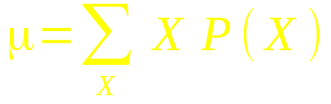
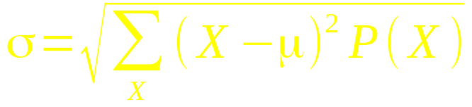
Mean and SD of discrete distr.
Given a discrete probability distribution P(X),
Calculate mean as weighted average of values:
E.g., # of email addresses: 0% have 0 addrs;
30% have 1; 40% have 2; 3:20%; P(4)=10%
  μ = 1*.30 + 2*.40 + 3*.20 + 4*.10 = 2.1
Standard deviation:

Slide 7
Binomial variable
A binomial experiment is one where:
  Each trial can only have two outcomes: {“success”, “failure”}
  Success occurs with probability p
    Probability of failure is q = 1-p
  The experiment consists of many (n) of these trials, all identical
  The variable x counts how many successes
Parameters that define the binomial are (n,p)
e.g., 60% of customers would buy again:
out of 10 randomly chosen customers,
what is the chance that 8 would buy again?
  n=10, p=.60, question is asking for P(8)

Slide 8
Binomial event tree
To find binomial prob. P(x), look at event tree:
x successes means n-x failures
Find all the outcomes with x wins, n-x losses:
  Each has same probability: p^{x}(1-p)^{(n-x)}
  How many combinations?

Slide 9
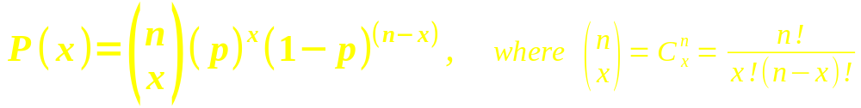
Binomial probability
Thus the probability of seeing
exactly x successes in a binomial experiment with n trials and a probability of success of p is:
“n choose x” is the number of combinations
  n! (“n factorial”) is (n)(n-1)(n-2)...(3)(2)(1),
  the number of permutations of n objects
  x! is because the ordering within the wins
  doesn't matter
  (n-x)! is same for ordering of losses

Slide 10
Pascal's Triangle
Handy way to calculate # combinations,
for small n:
1 1
1 2 1
1 3 3 1
1 4 6 4 1
1 5 10 10 5 1
1 6 15 20 15 6 1
n
x (starts from 0)
In Excel: COMBIN(n, x)
  COMBIN(6, 3) → 20

Slide 11
Excel: BINOMDIST()
Excel can calculate P(x) for a binomial:
  BINOMDIST(x, n, p, cum)
e.g., 60% of customers would buy again:
out of 10 randomly chosen customers,
what is the chance that 8 would buy again?
  BINOMDIST(8, 10, .60, 0) → 12.09%
Set cum=1 for cumulative probability:
  Chance that at most 8 (≤8) would buy again?
    BINOMDIST(8, 10, .60, 1) → 95.36%
  Chance that at least 8 (≥8) would buy again?
    1 – BINOMDIST(7, 10, .60, 1) → 16.73%

Slide 12
μ and σ of a binomial
n: number of trials
p: probability of success
Mean: expected # of successes: μ = np
Standard deviation: σ = √(npq)
e.g., with a repeat business rate of p=60%, then out of n=10 customers, on average we would expect μ=6 customers to return, with a standard deviation of σ=√(10(.60)(.40)) ≈ 1.55.

Slide 13
Binomial and normal
When n is not too small and p is in the middle, the binomial approximates the normal:

Slide 14
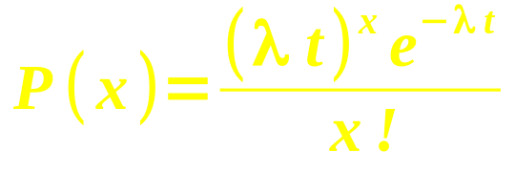
Poisson distribution
Counting how many occurrences of an event happen within a fixed time period:
  e.g., customers arriving at store within 1hr
  e.g., earthquakes per year
Parameters: λ = expected # occur. per period
t = # of periods in our experiment
  P(x) = probability of seeing exactly x occurrences of the event in our experiment
Mean = λt, and SD = √(λt)

Slide 15
Excel: POISSON()
POISSON(x, λ*t, cum)
  Need to multiply λ and t for second param
  cum=0 or 1 as with BINOMDIST()
Think of Poisson as the
“limiting case” of the
binomial as n→∞ and p→0

Slide 16
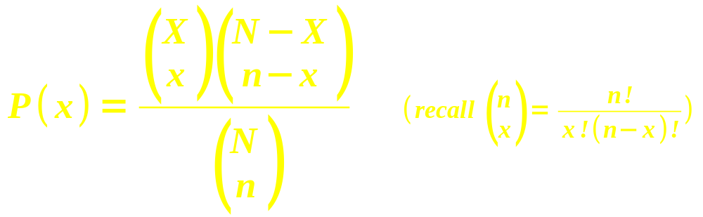
Hypergeometric distribution
n trials taken from a finite population of size N
Trials are drawn without replacement:
the trials are not independent of each other
  Probabilities change with each trial
Given that there are X successes in the larger population of size N, what is the chance of finding exactly x successes in these n trials?

Slide 17
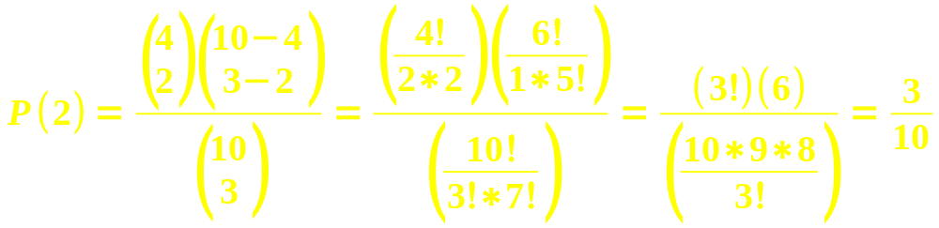
Hypergeometric: example
In a batch of 10 lightbulbs, 4 are defective.
If we select 3 bulbs from that batch, what is the probability that 2 out of the 3 are defective?
  Population: N=10, X=4
  Sample (trials): n=3, x=2
In Excel: HYPGEOMDIST(x, n, X, N)
  HYPGEOMDIST(2, 3, 4, 10) → 30%

Slide 18
TODO
HW2 (ch2-3): due tonight at 10pm
  Remember to format as a document!
  HWs are to be individual work
Form teams and find data
  Email me when you know your team
Dataset description due Tue 4 Oct

