Slide 1

Ch6: Continuous Distributions
27 Sep 2011
BUSI275
Dr. Sean Ho
HW3 due Thu 10pm
Download and open:
06-Normal.xls

Slide 2
Outline for today
Hypergeometric distribution: HYPGEOMDIST()
Normal distribution
  NORMDIST()
  Cumulative normal
  Continuity correction
  Standard normal
Uniform distribution
  μ and σ
Exponential distribution: EXPONDIST()
  Density and cumulative

Slide 3
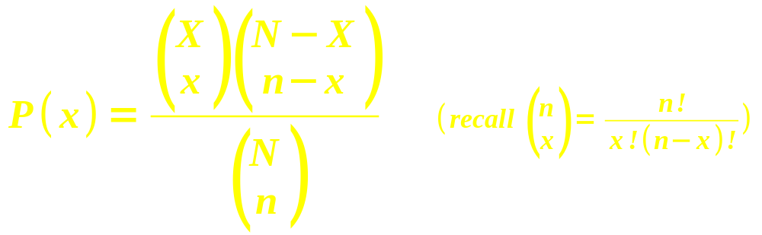
Hypergeometric distribution
n trials taken from a finite population of size N
Trials are drawn without replacement:
the trials are not independent of each other
  Probabilities change with each trial
Given that there are X successes in the larger population of size N, what is the chance of finding exactly x successes in these n trials?

Slide 4
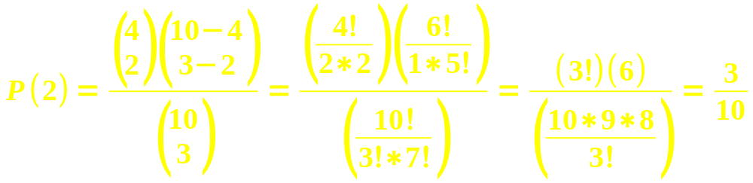
Hypergeometric: example
In a batch of 10 lightbulbs, 4 are defective.
If we select 3 bulbs from that batch, what is the probability that 2 out of the 3 are defective?
  Population: N=10, X=4
  Sample (trials): n=3, x=2
In Excel: HYPGEOMDIST(x, n, X, N)
  HYPGEOMDIST(2, 3, 4, 10) → 30%

Slide 5
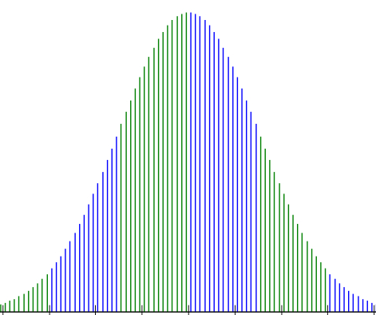
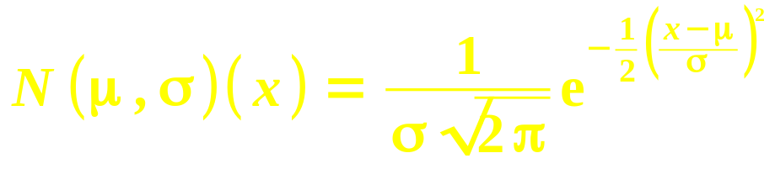
Normal distribution
The normal “bell” curve has a formal definition:
Mean is μ, standard deviation is σ
Drops exponentially with z-score
Normalized so total area under curve is 1
Excel: NORMDIST(x, μ, σ, cum)
  e.g., exam has μ=70, σ=10.
  What is probability of getting a 65?
  =NORMDIST(65, 70, 10, 0) → 3.52%

Slide 6
Cumulative normal
Usually, we are interested in the probability over a range of values:
  Area of a region under the normal curve
The cumulative normal gives area under the normal curve, to the left of a threshold:
  e.g., exam with μ=70, σ=10.
  What is probability of getting below 65?
  =NORMDIST(65, 70, 10, 1) → 30.85%
  e.g., getting between 75 and 90?
  =NORMDIST(90, 70, 10, 1) –
  NORMDIST(75, 70, 10, 1) → 28.58%

Slide 7
Inverse function
Excel can also find the threshold (x) that matches a given cumulative normal probability:
  NORMINV(area, μ, σ)
E.g., assume air fares for a certain itinerary are normally distrib with σ=$50 but unknown μ.
The 90th percentile fare is at $630.
What is the mean air fare?
  We have: NORMINV(.90, μ, 50) = 630, so
  =630 – NORMINV(.90, 0, 50) → μ=$565.92

Slide 8
Continuity correction
72.5
For discrete variables
(e.g., integer-valued):
  e.g., # of students
  per class, assumed to be normally distributed with μ=25, σ=10
The range can be inclusive or exclusive:
  Probability of a class having fewer than 10?
    <10: excludes 10
  At least 30 students? ≥30: includes 30
Edge of the bar is at ±0.5 from the centre
  <10: =NORMDIST(9.5, 25, 10, 1) → 6.06%
  ≥30: =1-NORMDIST(29.5, 25, 10, 1) → 32.6%

Slide 9
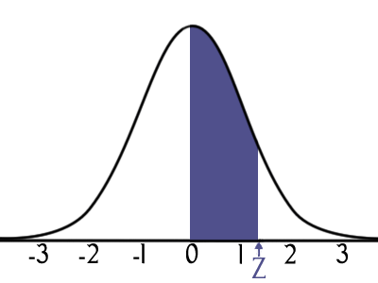
Standard normal
There is a whole family of normal distributions, with varying means and standard deviations
The standard normal is the one that has
μ=0, σ=1
This means z-scores and x-values are the same!
In Excel: NORMSDIST(x) (cumulative only) and
NORMSINV(area)

Slide 10
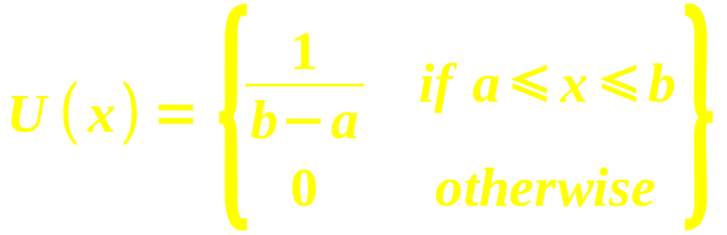
Uniform distribution
With a uniform distribution,
all values within a range are equally likely
  e.g., roll of a fair die:
  {1,2,3,4,5,6} all have probability of 1/6
  Range is from a to b:
μ=(a+b)/2, σ=√( (b-a)²/12 )

Slide 11

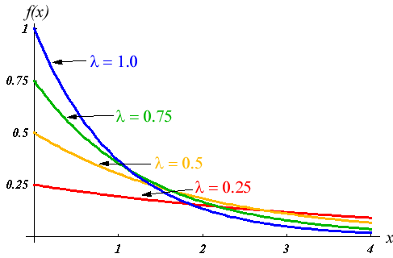
Exponential distribution
Time between occurrences of an event
  e.g., time between two security breaches
Exponential density: probability that the time between occurrences is exactly x is:
  1/λ = mean time
  between
  occurrences
  Need both x, λ > 0
EXPONDIST(x, λ, cum)
  Density: cum=0

Slide 12

Exponential probability
Exponential probability (cumulative distribution) is the probability that the time between occurrences is less than x:
  Excel: EXPONDIST(x, λ, 1)
e.g., average time between purchases is 10min.
What is the probability that two purchases are made less than 5min apart?
  EXPONDIST(5, 1/10, 1) → 39.35%
  Don't forget to convert from 1/λ to λ

Slide 13
REB forms
Any research involving human subjects requires approval by TWU's Research Ethics Board
Use of existing public data (e.g., StatCan) does not require REB approval, however:
  For class purposes, I will still require you to complete an REB form
Forms are on TWU's REB page
  Bottom of page: “Request for Ethical Review” or “Analysis of Existing Data”
Upload to myCourses by 11Oct
  For non-public data, submit signed paper copy to me by 11Oct

Slide 14
TODO
HW3 (ch3-4): due Thu at 10pm
  Remember to format as a document!
  HWs are to be individual work
Dataset description due next week! Tue 4 Oct

