Slide 1

Ch7: Sampling Distributions
29 Sep 2011
BUSI275
Dr. Sean Ho
HW3 due 10pm

Slide 2
Outline for today
Sampling distributions
  Sampling distribution of the sample mean
  μ_{x} and σ_{x}
  Central Limit Theorem
Uses of the SDSM
  Probability of sample avg above a threshold
  90% confidence interval
  Estimating needed sample size

Slide 3
Sampling error
Pop.
Sample
μ
x
Sampling is the process of drawing a sample out from a population
Sampling error is the difference between a statistic calculated on the sample and the
true value of the statistic in the population
e.g., pop. of 100 products; avg price is μ=$50
  Draw a sample of 10 products,
  calculate average price to be x=$55
  We just so happened to draw 10 products that are more expensive than the average
  Sampling error is $5

Slide 4
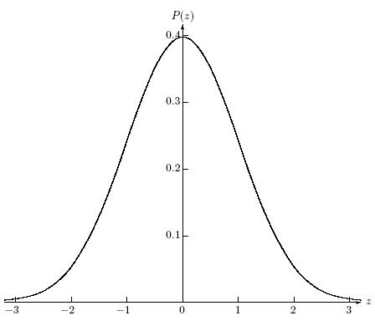
Sampling distribution
  Draw one sample of size n
  Find its sample mean x (or other statistic)
  Draw another sample of size n; find its mean
  Repeat for all possible samples of size n
  Build a histogram of all those sample means
In the histogram for the population,
each block represents one observation
In the histogram for the sampling distribution,
each block represents one whole sample!
Pop.
x
SDSM
sample
sample
x
sample
x

Slide 5
SDSM
Sampling distribution of sample means
  Histogram of sample means (x) of all possible samples of size n taken from the population
  It has its own mean, μ_{x}, and SD, σ_{x}
SDSM is centred around the true mean μ
  i.e., μ_{x} = μ
If μ=$50 and our sample of 10 has x=$55,
we just so happened to take a high sample
  But other samples will have lower x
  On average, the x should be around $50

Slide 6
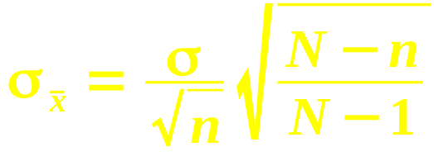
Properties of the SDSM
μ_{x} = μ: centred around true mean
σ_{x} = σ/√n: narrower as sample size increases
  For large n, any sample looks about the same
  Larger n ⇒ sample is better estimate of pop
  σ_{x} is also called the standard error
If pop is normal, then SDSM is also normal
If pop size N is finite and sample size n is a sizeable fraction of it (say >5%), need to adjust standard error:

Slide 7
Central Limit Theorem
In general, we won't know the shape of the population distribution, but
As n gets larger, the SDSM gets more normal
  So we can use NORMDIST/INV to make calculations on it
So, as sample size increases, two good things:
  Standard error decreases (σ_{x} = σ/√n)
  SDSM becomes more normal (CLT)
SDSM
@small n:
SDSM
@large n
Population:
x
x
x
x

Slide 8
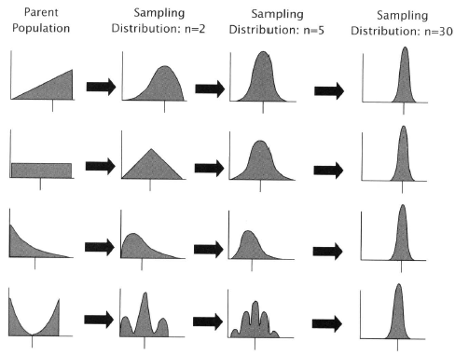
SDSM as n increases
@n=1, SDSM matches original population
As n increases, SDSM gets tighter and normal
Regardless of
shape of original
population!
Note: pop doesn't
get more normal;
it does not change
Only the sampling
distribution
changes
Hemist

Slide 9
SDSM: example
Say package weight is normal: μ=10kg, σ=4kg
  Say we have to pay extra fee if the average package weight in a shipment is over 12kg
If our shipment has 4 packages, what is the chance we have to pay fee?
  Standard error: σ_{x} = 4/√4 = 2kg
  z = (x – μ_{x})/σ_{x} = (12-10)/2 = 1
  Area to right: 1-NORMSDIST(1)=15.87%
    Or: 1 - NORMDIST(12, 10, 2, 1)
16 pkgs?
  Std err: σ_{x} = 4/√16 = 1kg; z = (12-10)/1 = 2
  Area to right: 1-NORMSDIST(2) = 2.28%
n=4
n=16

Slide 10
SDSM: example
90%
Assume mutual fund MER norm: μ=4%, σ=1.8%
  Broker randomly(!) chooses 9 funds
  We want to say, “90% of the time, the avg MER for the portfolio of 9 funds is between ___% and ___%.” (find the limits)
Lower limit: 90% in middle ⇒ 5% in left tail
  NORMSINV(0.05) ⇒ z = -1.645
  Std err: σ_{x} = 1.8/√9 = 0.6%
  z = (x – μ_{x}) / σ_{x} ⇒ -1.645 = (x – 4) / 0.6
  ⇒ lower limit is x = 4 – (1.645)(0.6) = 3.01%
Upper: x=μ+(z)(σ_{x}) = 4 + (1.645)(0.6) = 4.99%

Slide 11
MER example: conclusion
We conclude that, if the broker randomly chooses 9 mutual funds from the population
90% of the time, the average MER in the portfolio will be between 3.01% and 4.99%
  This does not mean 90% of the funds have MER between 3.01% and 4.99%!
  90% on SDSM, not 90% on orig. population
If the portfolio had 25 funds instead of 9,
the range on avg MER would be even narrower
  But the range on MER in the population stays the same

Slide 12
SDSM: estimate sample size
So: given μ, σ, n, and a threshold for x
⇒ we can find probability (% area under SDSM)
  Std err ⇒ z-score ⇒ % (use NORMDIST)
Now: if given μ, σ, threshold x, and % area,
⇒ we can find sample size n
  Experimental design: how much data needed
Outline:
  From % area on SDSM, use NORMINV to get z
  Use (x – μ) to find standard error σ_{x}
  Use σ_{x} and σ to solve for sample size n

Slide 13
Estimating needed sample size
Assume weight of packages is normally distributed, with σ=1kg
We want to estimate average weight to within a precision of ±50g, 95% of the time
  How many packages do we need to weigh?
NORMSINV(0.975) → z=±1.96
  ±1.96 = (x – μ_{x}) / σ_{x} .
  Don't know μ, but we want (x – μ) = ±50g
  ⇒ σ_{x} = 50g / 1.96
  So σ/√n = 50g / 1.96. Solving for n:
  n = (1000g * 1.96 / 50g)² = 1537 (round up)

Slide 14
TODO
HW3 (ch3-4): due tonight at 10pm
  Remember to format as a document!
  HWs are to be individual work
Dataset description due this Tue 4 Oct

