Slide 1

Ch8: Confidence Intervals
4 Oct 2011
BUSI275
Dr. Sean Ho
Dataset description
due tonight 10pm
HW4 due Thu 10pm

Slide 2
Outline for today
Making estimates on the binomial proportion
Confidence intervals
  On μ, with known σ
  On the binomial proportion π
  On μ, with unknown σ
    Student's t-distribution

Slide 3
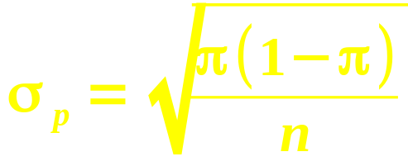
Binomial sampling distribution
For most (n,p), the binomial is approx. normal:
  μ = np, σ = √(npq)
Let π be the “true” prob of success in the pop
  p = observed prob of success in sample
Convert from “number of successes” (x)
to “probability of success” (p):
Just divide by n
(total # of trials):
 | # successes | prob. of success
Mean | μ = np | μ_{p} = π
Std dev | σ = √(npq)

Slide 4
Binomial example
.01
Assume about 70% of people like our toothpaste. We want to refine this estimate,
to a precision of ±1%, with 95% confidence.
  How many people do we need to poll?
Prob. of success ⇒ binomial
95% conf. ⇒ z = ±1.96
  NORMSINV(.025)
Std. err σ_{p} = √( (.70)(.30)/n )
Putting it together: 1.96 = .01 / σ_{p}.
⇒ n = ( 1.96 / .01 )² (.70)(.30) ≈ 8068
σ_{p}=√(.21/n)
95%

Slide 5
Confidence intervals
Tip: log(income)
is often normal
“If we were to select another random sample from the same population, 95% of the time
its mean would lie between _____ and _____.”
  Application of the SDSM
E.g., avg income of 25 students is $12,000.
  Assume σ = $4,000 (pop. SD!)
Std err is σ_{x} = σ/√n = $800
95% conf. ⇒ z = ±1.96
So the confidence interval is $12k ± (1.96)(800)
  We think the true mean income lies somewhere between $10,432 and $13,568, with 95% confidence.

Slide 6
Myths about confid. intervals
Myth: “All students in this population have income between $10.4k and $13.5k”
Myth: “95% of students in this population have income between $10.4k and $13.5k”
Myth: “If we repeated the study, 95% of the students surveyed would have income betw….”
Myth: “We are 95% sure the mean income of our sample of 25 students is between ….”

Slide 7
Confid. interval for binomial
In a poll of 80 people, 60 like our product
  Point estimate: p = 75%
Obtain a 95% confidence interval:
  95% confid. ⇒ z = ±1.96
Std err: σ_{p} = √(pq/n) = √((.75)(.25)/80) ≈ 4.84%
Put it together: (pt estimate) ± (z)(std err)
  75% ± (1.96)(4.84%)
We are 95% confident that between 65.51% and 84.49% of people like our product
  i.e., that the real proportion π is in that range

Slide 8
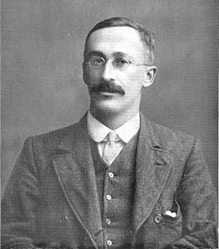
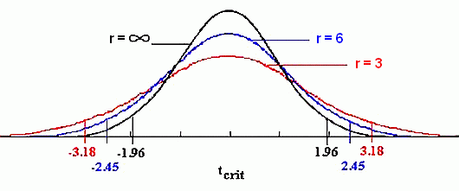
Confid. int., with unknown σ
What if we don't know the population σ?
Estimate it from the sample SD: s
  But this adds uncertainty in estimating μ
Use “Student's” t-distribution on SDSM
  Similar to normal,
  but wider (w/uncertainty)
  Degrees of freedom: df = n-1
  Approaches normal as df increases
William Sealy Gosset
in 1908
(Wikipedia)

Slide 9
t-distribution in Excel
t = 1
TDIST(t, df, tails)
  t: t-score, akin to z-score (x – μ) / SE
  df: degrees of freedom, df = n-1 for now
  tails: 1 for area in one tail, or 2 for both tails
  Result: % area under the t-dist in tail(s)
    TDIST(1, 20, 2) → 32.93%
TINV(area, df)
  Always assumes area
  is total in both tails
  Result: t-score
    TINV(0.3293, 20) → 1
32.93%

Slide 10
Confidence interval: example
Track sales this month at 25 stores out of 1000:
  Average = 8000 units, SD = 1500
Estimate the average sales this month across all 1000 stores (i.e., 95% confidence interval).
Standard error: s/√n = 1500/5 = 300
Only have s, not σ: so use t-dist (df=24)
  TINV(.05, 24) → t = ±2.0639
Putting it together: 8000 ± (2.0639)(300)
  7380.83 (round down), 8619.17 (round up)
  With 95% confidence, the average sales this month across all stores is between
  7380 and 8620 units

Slide 11
Project: variables & data
Ensure your sample size is sufficient!
Sample size = # observations
  Not total # of numbers in the spreadsheet!
  What is the unit of observation?
Select fewer but more relevant variables
  More variables = more complete model, but
  More variables = harder for you to find significant effects during analysis
E.g., survey with 100 questions, 20 participants:
  Total of 2000 numbers,
  but sample size is only 20!

Slide 12
TODO
Dataset description due tonight 10pm
HW4 (ch5): due Thu at 10pm
  Remember to format as a document!
  HWs are to be individual work
REB form due Tue 18 Oct 10pm
  Deadline postponed a week
  If using non-public human-subjects data, also submit printed signed copy to me
  You may want to submit early to allow time for processing by TWU's REB (3-4 weeks)

