Slide 1

Ch10: Comparing Two Groups
18 Oct 2011
BUSI275
Dr. Sean Ho
REB forms due
Midterm Thu
Please download:
Mileage.xls

Slide 2
Outline for today
Comparing two independent groups
  DV and IV
  Confidence interval vs. hypothesis test
  Standard error
    If we know the σ's
    If we only have the s's
    If the s's are similar (homoscedastic)
  Example: by hand (risk tolerance)
  Example: in Excel (mileage)

Slide 3
Comparing two groups
Assume: quantitative DV
Assume: two independent groups
  IV is dichotomous (nominal w/ 2 categories)
  Each participant goes in only one group
Look at difference between pop means: μ₁ – μ₂.
E.g., is CEO salary in US higher than in Can?
  DV: salary. IV: country (US vs. Can)
  H_{A}: μ_{US} – μ_{Can} > 0
E.g., does gender affect invest. risk tolerance?
  DV: risk tolerance. IV: gender (M vs. F)
  H_{A}: μ_{M} – μ_{F} ≠ 0

Slide 4
Hypothesis testing
As before, we can either:
  Estimate a confidence interval on μ₁ – μ₂
    If 0 is not in the interval, then there is a significant difference between groups
  Or do a hypothesis test on μ₁ – μ₂
    x₁ – x₂ is a threshold: p-val is area in tail
Key components:
  Point estimate (x₁ – x₂), t-score, and
  standard error
  T-distribution also needs a df

Slide 5
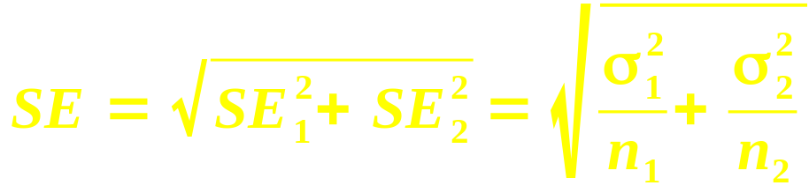
Standard error: σ known
If we have σ₁, σ₂:
SE is a “yardstick” by which we measure the group difference to see if it is significant
  Larger SE ⇒ wider confidence interval,
  less precision in our estimate
Here the SE is a combination of SE₁ and SE₂ from each of the two groups
SE
SE₁
SE₂

Slide 6
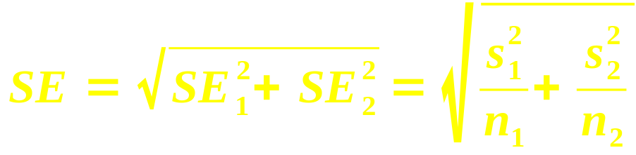
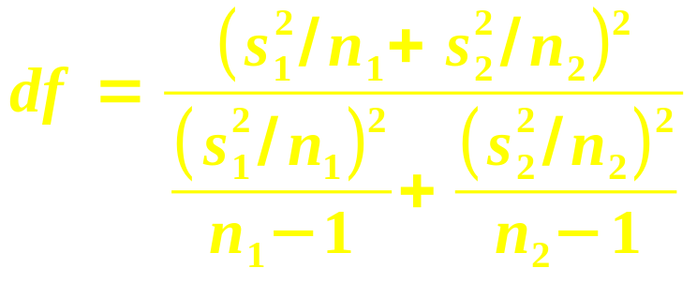
Standard error: using s
More realistically, we would only have s₁, s₂
  As well as n₁, n₂, x₁, x₂
SE is the same:
But the t-dist needs a df, and it is messy:
In general, df is somewhere in between
  min(n₁ – 1, n₂ – 1) (lower bound), and
  n₁ + n₁ – 2 (upper bound)

Slide 7
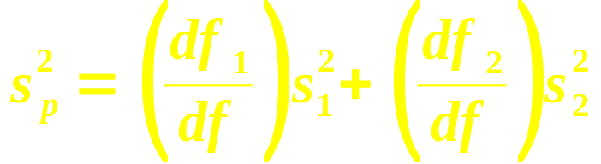
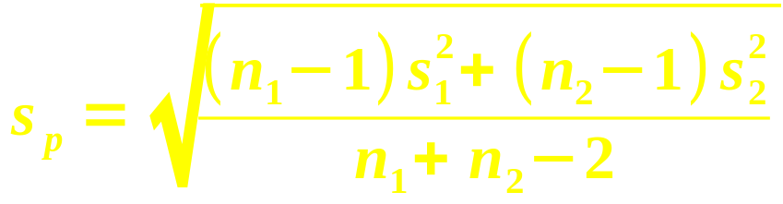
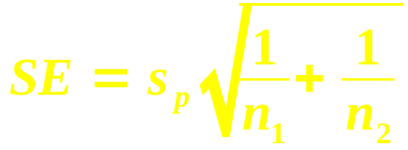
Standard error: homoscedastic
If s₁, s₂ are similar, we can try another method:
  Homoscedasticity: same variance
  Rule of thumb: s₁, s₂ within a factor of 2
df is simpler: df = df₁ + df₂ = n₁ + n₂ - 2
The pooled variance s_{p}²
is a weighted sum:
So the pooled SD is:
Then the SE simplifies to:

Slide 8
Example: risk tolerance
RQ: do M have higher risk tolerance than F?
  Data: 15 males, avg tol 7.8, SD=2
  12 females, avg tolerance 7.2, SD=2.5
Point estimate: difference in tol is x₁ – x₂ = 0.6
Standard error: using s, try heteroscedastic
  SE₁= 2/√15 ≈ 0.5164, SE₂= 2.5/√12 ≈ 0.7217
    SE = √(SE₁² + SE₂²) ≈ 0.8874
  Messy df ≈ 20.8
⇒ t-score is t = (0.6 – 0)/SE = 0.6/0.8874 ≈ 0.68
p-val: TDIST(0.68, 20.8, 1) → 25.3%
Fail to reject H₀: M tol. not significantly higher

Slide 9
TODO
REB form due today
  If approval by TWU's REB is required,
  also submit printed signed copy to me
Midterm (ch1-8): Thu
HW6 (ch9-10): next Thu 27 Oct

