Slide 1

10.3-10.4: Pairwise t-Test and t-Test on Proportions
25 Oct 2011
BUSI275
Dr. Sean Ho
HW6 due Thu
Please download:
Mileage.xls

Slide 2
Outline for today
Exploratory analysis
  Preview of statistical tests for your projects
Repeated measures
  Overview of Excel TTEST() types
T-test on paired data
  Calculating SE
  Using Excel
T-test on proportions

Slide 3
Exploratory analysis
Choosing good research questions:
Start with the outcome variable (DV)
  e.g., sales volume
Research background (prior literature) on the DV to find likely predictors
  e.g., marketing budget, consumer trends, new products from competitors, etc.
Select some effect/predictor(s) to examine
  In your analysis, control for other covariates
Correlation ≠ causation: look for hidden vars
  e.g., ice cream correlates with drownings!
    Why? What are they both correlated with?

Slide 4
Analysis Types by IV/DV
DV quantitative, IV categorical:
  IV dichotomous (two groups): t-test
  IV has many groups: ANOVA
  Multiple categorical IVs: Factorial ANOVA
    Controlling for covariates: ANCOVA
DV quantitative, IV quantitative:
  One IV: Simple Regression
  Multiple IVs: Multiple Regression
    Also if mix of categorical/quant IVs
DV dichotomous: Logistic Regr. (survival an.)
DV ordinal: Ordinal Regr.
  … and much more!

Slide 5
Repeated measures
Apply same measurement to same subjects, but at different points in time:
  e.g., annual revenue, 2000-2010
  Time series / longitudinal data
Or under different conditions:
  e.g., highway vs. city mileage (on same car!)
  e.g., wife's income, husband's income
    (What is the unit of observation?)
The measurements are linked to each other
  Not independent
Paired data is the simplest repeated measure
  Use a t-test on the pairwise differences

Slide 6
Types of t-test (as in Excel)
Type 3: two indep groups, most general:
  H_{A}: μ₁ – μ₂ ≠ 0 (or >0)
  SE = √(SE₁² + SE₂²), df is messy
Type 2: two indep groups, similar SD:
  H_{A}: μ₁ – μ₂ ≠ 0 (or >0)
  SE = s_{p}√(1/n₁ + 1/n₂), df = df₁ + df₂
Type 1: paired observations:
  Form pairwise diffs: n = # pairs
  H_{A}: μ_{d} ≠ 0 (or >0)
  SE = s_{d} / √n, df = n-1

Slide 7
Paired data t-test
e.g., Mileage.xls
Calculate the pairwise differences: =A2-B2, fill
Find n, mean (d), and SD (s_{d}) of pairs:
  COUNT(), AVERAGE(), STDEV()
  SD of diffs is not the same as diff of SDs!
Calculate standard error: SE = s_{d}/√n
Find t-score: (d – 0) / SE
Use TDIST() to find p-value, compare w/α
  TDIST(t, n-1, tails)
All-in-one Excel function:
TTEST(before, after, tails, 1)

Slide 8
T-test on proportions
e.g., customer satisfaction vs. bank branch:
  At Langley, 160/200 customers satisfied
  At Abbt., 210/300 satisfied
  Is there a significant difference?
Use normal approximation to binomial:
  When n is big enough and p is not extreme
  Rule of thumb: both np, nq > 5 (both groups)
Normal dist means no worries about df
  Just need standard error: SE = √(SE₁² + SE₂²)
  Where each SE_{i} = √(p_{i}q_{i}/n_{i})

Slide 9
Proportions: bank example
Langley: SE_{L} = √( 160*40 / 200³ ) ≈ 2.828%
Abbt.: SE_{A} = √( 210*90 / 300³ ) ≈ 2.646%
Combined standard error is SE = √(SE_{L}² + SE_{A}²)
= √( 160*40 / 200³ + 210*90 / 300³ ) ≈ 3.873%
Sample difference of proportions is
p_{L} – p_{A} = (160/200) – (210/300) = 10%
This means a z-score of
z = ((p_{L} – p_{A}) – 0) / SE ≈ 10% / 3.873% ≈ 2.582
Find the p-value (2-tailed):
  =2*(1-NORMSDIST(2.582)) → 0.0098
  Reject H₀: yes, there is a difference

Slide 10
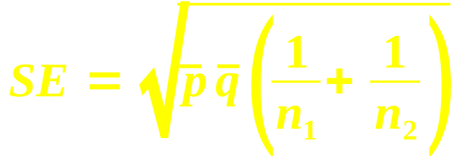
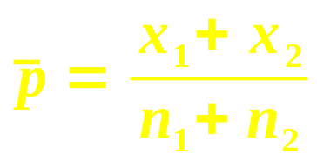
Alternate SE on proportions
The SE above is used for confidence intervals
The textbook offers a second form of the SE for binomial proportions:
Where p is the pooled proportion:
This is equivalent to the
“χ² test of goodness-of-fit” we will learn in ch13
  Most stats software uses this method

Slide 11
TODO
Project proposal due tonight
  Sample size (unit of observation?)
  Outcome variable
  Predictor variables
  What other predictors might make sense?
HW6 (ch9-10): due Thu 27 Oct

