Slide 1

Ch14: Correlation and
Linear Regression
27 Oct 2011
BUSI275
Dr. Sean Ho
HW6 due today
Please download:
15-Trucks.xls

Slide 2
Outline for today
Correlation
  Intuition / concept
  r² as fraction of variability
  t-test on correlation
    Doing it in Excel
  Extending to categorical variables
Intro to Regression
  Linear regression model
  In Excel
  Assumptions

Slide 3
Linear correlation
Correlation measures the strength of
a linear relationship between two variables
Does not determine direction of causation
Does not imply a direct relationship
  There might be a mediating variable
  (e.g., between ice cream and drownings)
Does not account for non-linear relationships
The Pearson product-moment correlation coefficient (r) is between -1 and 1
  Close to -1: inverse relationship
  Close to 0: no linear relationship
  Close to +1: positive relationship

Slide 4
Scatterplots and correlation
y
y
y
r = 0
r = -0.6
r = -1
x
x
x
y
y
r = -0.2
x
x
r = +0.3

Slide 5
Correlation is an effect size
We often want to understand the variance in our outcome variable:
  e.g., sales: why are they high or low?
What fraction of the variance in one variable is explained by a linear relationship w/the other?
  e.g., 50% of the variability in sales is explained by the size of advertising budget
The effect size is r²: a fraction from 0% to 100%
  Also called the coefficient of determination
Sales
Advert
(shared
variability)

Slide 6
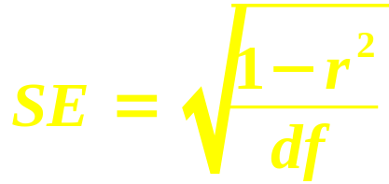
t-test on correlation
r is sample correlation (from data)
ρ is population correlation (want to estimate)
Hypothesis: H_{A}: ρ ≠ 0 (is there a relationship?)
Standard error:
  1 – r² is the variability not explained by the linear relationship
  df = n–2 because we have two sample means
Test statistic: t = r / SE
  Use TDIST() to get p-value

Slide 7
Correlation: example
e.g., is there a linear relationship between
caffeine intake and time spent in Angry Birds?
  H_{A}: ρ ≠ 0 (i.e., there is a relationship)
  Data: 8 participants, r = 0.72
Effect size: r² = 0.72² = 51.84%
  About half of variability in AB time is explained by caffeine intake
Standard error: SE = √((1-0.5184) / 6) ≈ 0.2833
Test statistic: t = 0.72 / 0.2833 ≈ 2.54
P-value: TDIST(2.54, 6, 2) → 4.41%
At α=0.05, there is a significant relationship

Slide 8
Correlation in Excel
Example in 15-Trucks.xls
Scatterplot: POE Gross (G:G), WIM Gross (H:H)
Correlation: CORREL(dataX, dataY)
  Coefficient of determination: r²
T-test:
  Sample r
  → SE
  → t-score
  → p-value

Slide 9
Correl. and χ² independence
Pearson correlation is for two quantitative (continuous) variables
For ordinal variables, there exists a
non-parametric version by Spearman (r_{s})
What about for two categorical variables?
  χ² test of goodness-of-fit (ch13)
  2-way contingency tables (pivot tables)
  Essentially a hypothesis test on independence

Slide 10
Intro to regression
Regression is about using one or more IVs
to predict values in the DV (outcome var)
  E.g., if we increase advertising budget,
  will our sales increase?
The model describes how to predict the DV
  Input: values for the IV(s). Output: DV value
Linear regression uses linear functions
(lines, planes, etc.) for the models
  e.g., Sales = 0.5*AdvBudget + 2000
  Every $1k increase in advertising budget yields 500 additional sales, and
  With $0 spending, we'll still sell 2000 units

Slide 11
Regression model
y
residual
model
The linear model has the form
  Y = β₀ + β₁X + ε
Where X is the predictor, Y is the outcome,
  β₀ (intercept) and β₁ (slope of X) are parameters of the line of best fit,
    Software can calculate these
  ε represents the residuals: where the linear model doesn't fit the observed data
    ε = (actual Y) – (predicted Y)
The residuals average out to 0, and if the model fits the data well, they should be small overall
  Least-squares: minimize SD of residuals
x

Slide 12
Regression in Excel
Example: 15-Trucks.xls
Scatterplot:
X: POE Gross (G:G)
Y: WIM Gross (H:H)
Layout → Trendline
  Linear, R²
Regression model:
  Slope β₁: SLOPE(dataY, dataX)
  Intercept β₀: INTERCEPT(dataY, dataX)
SD of the residuals: STEYX(dataY, dataX)

Slide 13
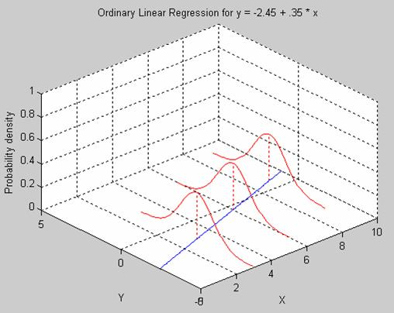
Assumptions of regression
Both IV and DV must be quantitative
  (extensions exist for other levels of meas.)
Independent observations
  Not repeated-measures or hierarchical
Normality of residuals
  DV need not be normal, but residuals do
Homoscedasticity
  SD of residuals
  constant along the line
These 4 are called: parametricity
  T-test had similar assumptions
Omid Rouhani

Slide 14
TODO
HW6 (ch9-10): due Thu 27 Oct
Projects:
  Acquire data if you haven't already
    If waiting for REB: try making up toy data so you can get started on analysis
  Background research for likely predictors of your outcome variable
  Read ahead on your chosen method of analysis (regression, time-series, logistic, etc.)

