Slide 1

14.2-14.3: Hypothesis Tests on Regression
1 Nov 2011
BUSI275
Dr. Sean Ho
HW7 due next Tues
Please download:
16-Banks.xls

Slide 2
Outline for today
Review of regression model
Decomposition of variance in regression
  Model vs. Residual
F-test on the overall regression model
  Comparison with t-test on correlation
T-test on slopes b_{i}
Confidence intervals on predicted values

Slide 3
Applying the regression model
Example: 16-Banks.xls
Scatterplot:
X: Employees (D:D)
Y: Profit (C:C)
Layout → Trendline
Correlation r:
  CORREL(datY, datX)
Regression model:
  Intercept b₀: INTERCEPT(dataY, dataX)
  Slope b₁: SLOPE(dataY, dataX)
  SD of residuals (s_{ε}): STEYX(dataY, dataX)

Slide 4
Predictions using the model
Assuming that our linear model is correct,
we can then predict profits for new companies, given their size (number of employees)
  Profit ($mil) = 0.039*Employees – 36.45
e.g., for a company with 1000 employees, our model predicts a profit of $2.558 million
  This is a point estimate; s_{ε} adds uncertainty
Predicted Ŷ values: using X values from data
  Citicorp: Ŷ = 0.039*93700 – 36.45 ≈ 3618
Residuals: (actual Y) – (predicted Y):
  Y - Ŷ = 3591 – 3618 = -27.73 ($mil)
  Overestimated Citicorp's profit by $27.73 mil

Slide 5
Analysis of Variance
In regression, R² indicates the fraction of variability in the DV explained by the model
  If only 1 IV, then R² = r² from correlation
Total variability in DV: SS_{tot} = Σ(y_{i} – y)²
  =VAR(dataY) * (COUNT(dataY) – 1)
Explained by model: SS_{mod} = SS_{tot} * R²
Unexplained (residual): SS_{res} = SS_{tot} – SS_{mod}
  Can also get from Σ(y_{i} – ŷ_{i})²
Hence the total variability is decomposed into:
  SS_{tot} = SS_{mod} + SS_{res}
  (book: SST = SSR + SSE)

Slide 6
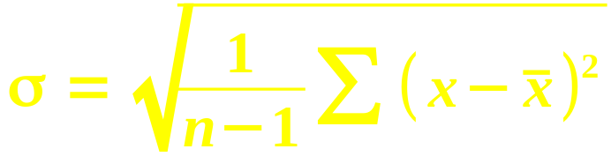
F test on overall model (R²)
Follow the pattern from the regular SD:
 | Total (on DV) | Model | Residual
SS | SS_{tot} = Σ(y - y)² | SS_{mod} = Σ(ŷ - y)² | SS_{res} = Σ(y - ŷ)²
df | n – 1 | #vars – 1 | n - #vars
MS = SS/df | SS_{tot} / (n-1) | SS_{mod} / 1 | SS_{res} / (n–2)
SD = √(MS) | s_{Y} | - | s_{ε} (=STEYX)
The test statistic is F = MS_{mod} / MS_{res}
  Get p-value from FDIST(F, df_{mod}, df_{res})

Slide 7
Calculating F test
Key components are the SS_{mod} and SS_{res}
If we already have R², the easiest way is:
  Find SS_{tot} = VAR(dataY) * (n-1)
    Bank.xls: 38879649 (≈ 39e6)
  Find SS_{mod} = SS_{tot} * R²
    e.g., 39e6 * 88.53% ≈ 34e6
  Find SS_{res} = SS_{tot} – SS_{mod}
    e.g., 39e6 – 34e6 ≈ 5e6
Otherwise, find SS_{res} using pred ŷ and residuals
Or, work backwards from s_{ε} = STEYX(Y, X)
    e.g., SS_{res} = (301)² * (n-2)

Slide 8
F-test on R² vs. t-test on r
If only one predictor, the tests are equivalent:
  F = t²,
    Banks.xls: F ≈ 378, t ≈ 19.4
  F-dist with df_{mod} = 1 is same as t-dist
    Using same df_{res}
If multiple IVs, then there are multiple r's
  Correlation only works on pairs of variables
F-test is for the overall model with all predictors
  R² indicates fraction of variability in DV explained by the complete model,
  including all predictors

Slide 9
T-test on slopes
In a model with multiple predictors,
there will be multiple slopes (b₁, b₂, …)
A t-test can be run on each to see if that predictor is significantly correlated with the DV
Let SS_{X} = Σ(x – x)² be for the predictor X:
Then the standard error for its slope b₁ is
  SE(b₁) = s_{ε} / √SS_{X}
Obtain t-score and apply a t-dist with df_{res}:
  =TDIST( b₁ / SE(b₁), df_{res}, tails )
If only 1 IV, the t-score is same as for r

Slide 10
Summary of hypothesis tests
 | Correlation | Regression | Slope on X₁
Effect | r | R² | b₁
SE | √( (1-r²) / df ) | - | s_{ε} / √SS_{X}
df | n - 1 | df1 = #var – 1 df2 = n - #var | n - #var
Test statistic | t = r / SE(r) | F = MS_{mod} / MS_{res} | t = b₁ / SE(b₁)
Regression with only 1 IV is same as correlation
  All tests would then be equivalent

Slide 11
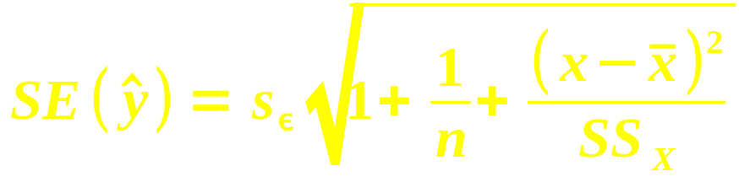
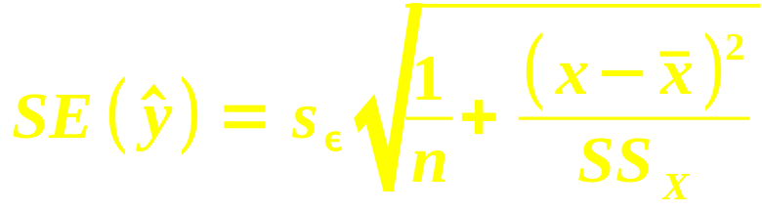
Confidence int. on predictions
Given a value x for the IV, our model predicts a point estimate ŷ for the (single) outcome:
  ŷ = b₀ + b₁*x
The standard error for this estimate is
  Recall that SS_{X} = Σ(x – x)²
Confidence interval: ŷ ± t * SE(ŷ)
When estimating the average outcome, use

Slide 12
TODO
HW7 (ch10,14): due Tue 8 Nov
Projects:
  Acquire data if you haven't already
    If waiting for REB: try making up toy data so you can get started on analysis
  Background research for likely predictors of your outcome variable
  Read ahead on your chosen method of analysis (regression, time-series, logistic, etc.)

