Slide 1

ch15: Multiple Regression
3 Nov 2011
BUSI275
Dr. Sean Ho
HW7 due Tues
Please download:
17-Hawlins.xls

Slide 2
Outline for today
Multiple regression model
  Running it in Excel
  Interpreting output
Unique contributions of predictors
  Automated predictor selection
Moderation (interaction of predictors)
  How to test for it
Regression diagnostics: checking assumptions
  Transforming variables

Slide 3
Multiple regression
1 outcome (scale), k predictors (scale)
Linear model: hyperplane
  ŷ = b₀ + b₁x₁ + b₂x₂ + … + b_{k}x_{k}
Residuals still assumed normal, homoscedastic
y
y_{i}
ŷ_{i}
Regression plane:
ŷ = b₀ + b₁x₁ + b₂x₂
ε_{i}
slope b₁
x₂
slope b₂
x₁

Slide 4
Multiple regression in Excel
Dataset: 17-Hawlins.xls
DV (y): Output (units/wk)
IV (x₁): Employees
IV (x₂): Age of Plant (yrs)
Pairwise scatters are helpful
  Note R² for each predictor
Data → Analysis → Regression
  Y Range: B1:B160
  X Range: C1:D160
  Check “Labels” and “Standardized Residuals”

Slide 5
Interpreting the output
R Square (R²): fraction of DV var explained
  Adjusted R² compensates for adding more IVs
ANOVA table: F, p, and dfs
  “Number of employees and plant age significantly predicted output:
  R² = .72, F(2, 156) = 200.7, p < .001.”
Coefficient table:
  For each predictor: slope b_{i}, t-score, and p
  Both slopes are significantly nonzero
Standardized residuals: z-scores
  Can use to look for observations that don't fit the model (e.g., |z| > 3)

Slide 6
Unique contributions
Output
Emp.
From the Employees scatter,
it predicts Output pretty well (R² = 71%)
Age? Not so well (R² = 12%)
When use both together, why is R² only 72%?
  Most of the 12% of variability in Output explained by Age is shared variability:
  Age doesn't tell us much more about Output than we already knew from Employees
  Age's unique contribution is only 1%
Compare regression using all predictors
against regression using all except Age
Age

Slide 7
Drawing conclusions
We see that Employees and Age do significantly predict Output (global F test), and
Each predictor does contribute significantly
(t-tests on slope), but
The unique contribution of Age is very small, so
Most of the predictive power is in the number of employees.
In a formal write-up, you usually want to include details such as R², F, dfs, and p,
for those who understand the statistics.

Slide 8
Automated predictor selection
“Best subsets” regression uses several runs with different combinations of predictors to try to find the set that predicts best while using the fewest predictors
  Parsimony: simpler model to understand
“Stepwise” regression adds/removes
1 predictor at a time to try to do the same
  Backward: eliminate the least significant IV
  Forward: add the next most significant IV
Only in PHStat add-on, or SPSS, Stata, R, etc.

Slide 9
Moderation
Moderator: a predictor that affects the strength of another predictor's influence on the outcome
  Interacts with the other predictor
E.g., natural disasters may affect your supply, but having multiple suppliers buffers the effect
Supply
Disasters
Supply
Many
suppliers
# of
Suppliers
Few
suppliers
Disasters

Slide 10
Testing for moderation
How do we know if predictors are interacting?
Add an interaction term to the regression:
  ŷ = b₀ + b₁x₁ + b₂x₂ + b₁₂x₁x₂
In Excel, centre both IVs (subtract their means), then make a 3rd column with the product
  Include it in the regression as if it were an IV
Check the t-test to see if the slope (b₁₂) of the interaction term is significantly nonzero
If so, check R² both with and without the interaction term to see the size of its effect
Also 3-way (x₁x₂x₃) and higher interactions!

Slide 11
Diagnostics: check assumptions
Normality of residuals:
  Check histogram of standardized residuals
Homoscedasticity:
  Residual plot: residuals vs. predicted values
  Look for any odd or “fan shaped” patterns
Linearity: curves on the residual plot
  Try adding x₁² or x₂², etc. to the model
  And/or apply transforms to variables
Indep. of residuals (time series are usually bad)
Collinearity of IVs: check correlations of IVs
Outliers / influential points: see residual plot

Slide 12
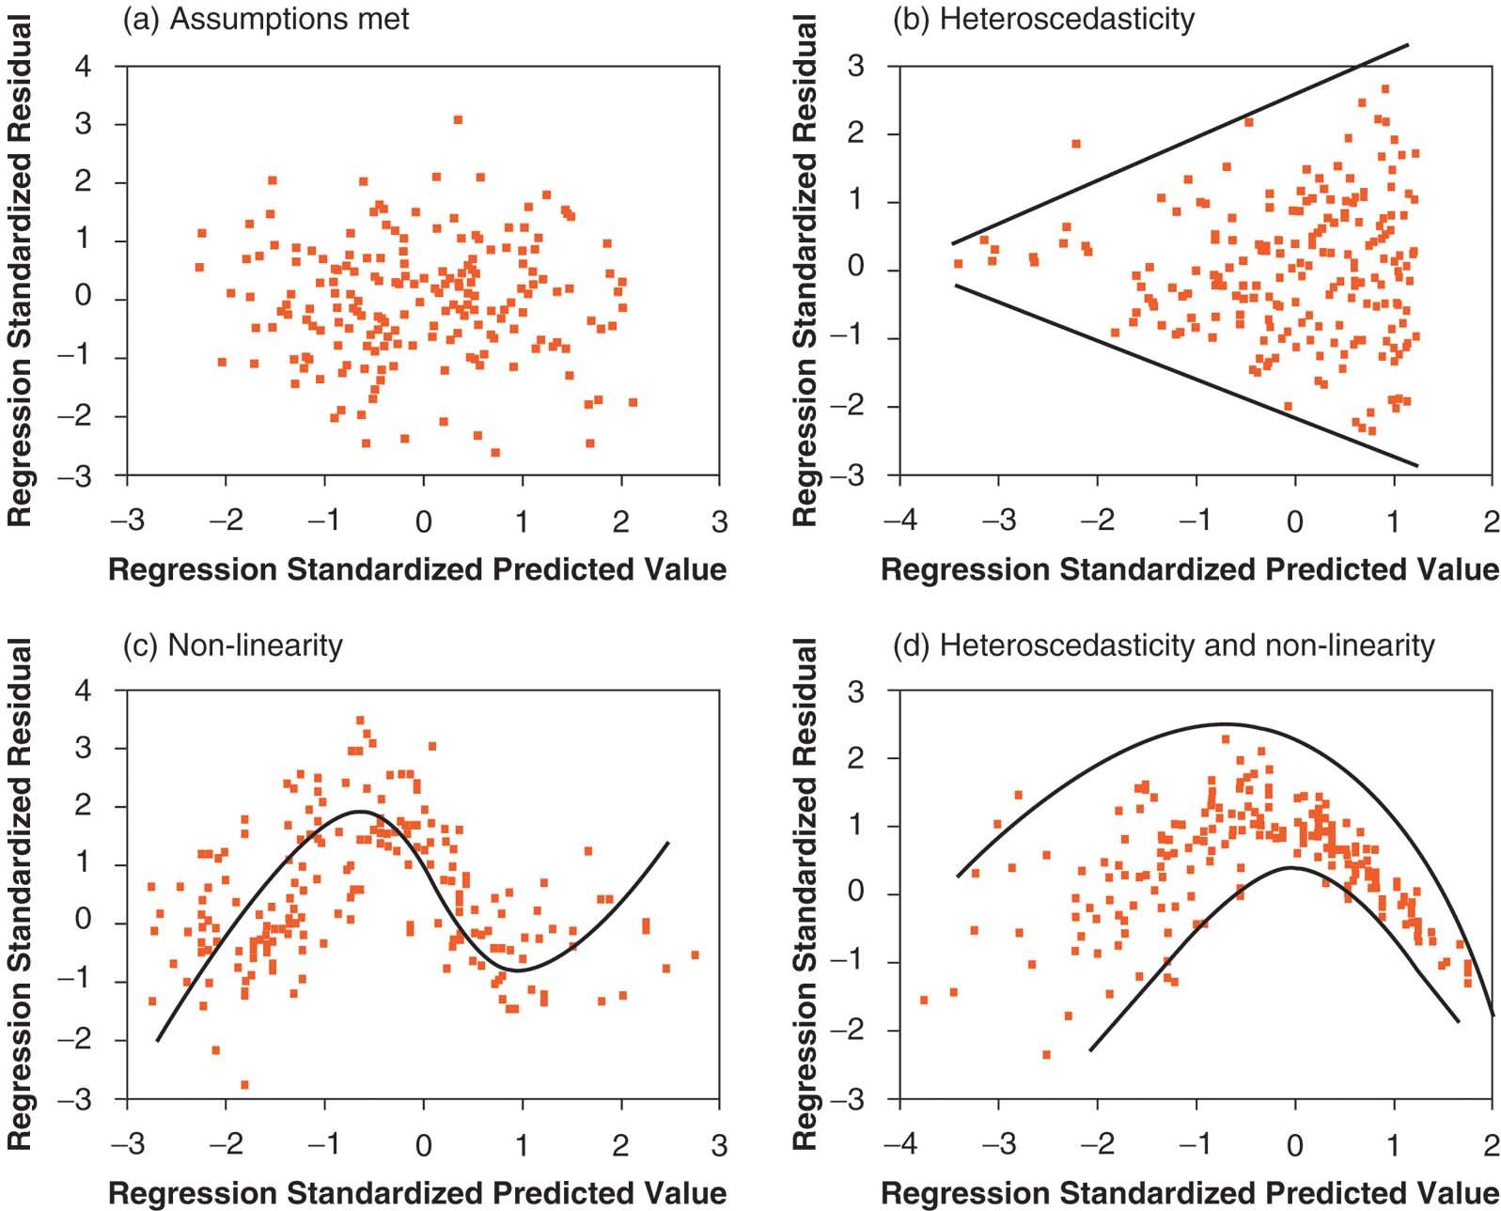
Homoscedasticity & linearity

Slide 13
Transforms
Some variables (either IVs or DV) may be so heavily skewed that they break assumptions (esp. heteroscedasticity and nonlinearity)
You can try applying a transform to make them roughly more symmetric or normal
  But strict normality is not required
  E.g., log(income) is usually more normal
The family of power transforms includes:
  √x, x², 1/x, x^{-5.2}, etc., as well as log(x)
  May need to shift (x+c) or reflect (c-x) first
  The Box-Cox procedure “automatically” selects a power transform for your variable

Slide 14
TODO
HW7 (ch10,14): due Tue 8 Nov
Projects:
  Acquire data if you haven't already
    If waiting for REB: try making up toy data so you can get started on analysis
  Background research for likely predictors of your outcome variable
  Read ahead on your chosen method of analysis (regression, time-series, logistic, etc.)

