Slide 1

12.1: One-way ANOVA
8 Nov 2011
BUSI275
Dr. Sean Ho
HW7 due tonight
Please download:
18-Delivery.xls

Slide 2
Outline for today
One-way ANOVA (1 nominal predictor)
  Assumptions of ANOVA
  Concepts of ANOVA: between vs. within
  Global F-test
  Example: Delivery.xls
Follow-up Analysis
  Post-hoc test using Tukey-Kramer
  Example: Delivery.xls
ANOVA and regression

Slide 3
ANOVA: Analysis of Variance
1 DV (scale) and one or more IVs (nominal)
  One-way ANOVA: just one IV, with k levels
  e.g., does country affect avg purchase amt?
    Groups: Canada, US, China, UK, etc.
The independent-groups t-test is a special case
  One IV that is dichotomous
ANOVA performs one global F-test to assess if the predictor has any effect on the outcome
  H₀: μ₁ = μ₂ = … = μ_{k}
  Omnidirectional (generalization of 2-tailed)
Follow-up tests then identify which groups differ

Slide 4
Assumptions: parametricity
DV is continuous
  If DV is dichotomous, try Logistic Regression
  If all vars are nominal, try Log-Linear analysis
Observations are independent, and
Groups (levels of the IV) are independent
DV is normally distributed within each group
  If not, try transforming the DV
Variance (SD) of DV in each group is roughly similar across all the groups (homoscedasticity)
  Not crucial if n in each group is large and if
  balanced design: similar n in each group

Slide 5
ANOVA concepts
How much of variability in purchase amount is due to country of origin?
  SS_{tot} = SS_{Country} + SS_{residual}
  SS_{Country} is “between-group” variation (SSB)
  SS_{residual} is “within-group” variation (SSW)
Do the group means
differ significantly?
  F-test, p-value
Fraction of variability
explained by country?
  η² (equiv. to R²)
Sale ($)
y_{US}
y_{CA}
y
y_{Ot}
Ctry
Can
US
Other

Slide 6
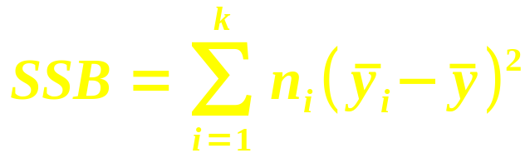
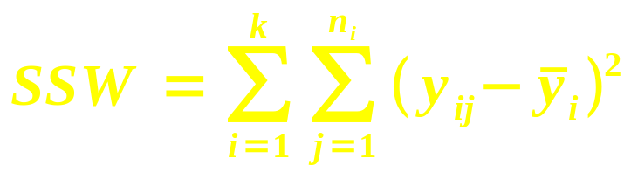
ANOVA table
Model: Y = (offset due to group) + (residual ε)
- | Group (Between) | Residual (Within)
SS
df | k – 1 | n – k
MS = SS/df | MSB = SSB / (k – 1) | MSW = SSW / (n – k)
Test statistic is F = MSB / MSW
  Model vs. residual (as in regression!)
  Use FDIST() with two dfs to get p-value

Slide 7
Example: Delivery minivans
Dataset: 18-Delivery.xls (see p.496, #12-15)
DV: operating cost per mile
  IV: manufacturer (3 companies)
  Unit of observation: one minivan (total n=13)
ANOVA table: df = (2, 9)
  SS = (6.07, 3.45), MS = (3.04, 0.38)
  ⇒ F = 7.91, so p = 0.010
Reject H₀: operating costs per mile do differ significantly depending on manufacturer

Slide 8
Follow-up analysis
ANOVA's global F test is an omnibus test:
  Just says there is a difference somewhere
  Doesn't tell us which groups differ!
There may be sets of groups that
don't differ significantly from each other
Follow-up analysis tries to find these
  Post-hoc: try all pairs of groups
    The multiple comparisons problem: “shotgun” approach leads to
    inflated Type I error
  Planned contrasts: if theory guides us to try certain comparisons of groups

Slide 9
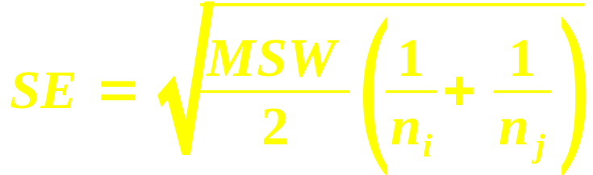
Post-hoc: Tukey-Kramer
Considers all possible pairings of groups
  (Can vs. US), (Can vs. Other), (US vs. Other)
  In general, k*(k-1) pairings!
From table in Appendix J, find critical value for q
  Test statistic for studentized range (like F)
  Use α (.05 or .01) and both dfs to look up
For each pairing (group i vs. group j):
  Find standard error:
  Compare difference of means: |x_{i} – x_{j}|
  against critical range: (q)*(SE)
  If larger, then these groups differ significantly

Slide 10
Tukey-Kramer: Delivery.xls
Which manufacturers differ significantly?
Appendix J (p.867): α=0.05 (95% conf)
  df = (2, 9) ⇒ q = 3.20
Calculate SE for each pairing
Calculate critical range
for each pair: q*SE
Compare against
mean differences:
Conclusion: manufacturer 3 is the odd one out, with significantly higher operating costs
3
1
2
q | 3.20
Pair: | 1 vs 2 | 1 vs 3 | 2 vs 3
SE | 0.303 | 0.279 | 0.317
Crit Range: | 1.024 | 0.940 | 1.071
Mean diff: | 0.633 | 1.175 | 1.808
Result | FALSE | TRUE | TRUE

Slide 11
ANOVA and regression
Sale ($)
y_{US}
With only 1 dichotomous IV:
  ANOVA = t-test = regression
  Code the IV as 0/1
    Intercept b₀ = mean of group 0 (y₀)
    Slope b₁ = difference of means
  Effect size η² = R²
If the IV has multiple levels, use dummy coding:
  Choose a reference level
  Make k-1 dummy variables, for
  each of the other levels:
  each coded 0/1
  Use multiple regression
y_{CA}
Can
US
Cty | US | Ot
Ca | 0 | 0
US | 1 | 0
Ot | 0 | 1

Slide 12
TODO
HW7 (ch10,14): due tonight
Projects:
  Acquire data if you haven't already
    If waiting for REB: try making up toy data so you can get started on analysis
  Background research for likely predictors of your outcome variable
  Read up on your chosen method of analysis (regression, time-series, logistic, etc.)

