Slide 1

12.2-3: Factorial ANOVA and Blocking
15 Nov 2011
BUSI275
Dr. Sean Ho
HW8 due next Tue
Please download:
19-Eukanuba.xls
19-Applebees.xls

Slide 2
Outline for today
Factorial ANOVA (multiple nominal IVs)
  Assumptions
  Graphing
  Model and calculations
  Main effects
  Interaction / moderation
Randomized Complete Block ANOVA
  Fixed vs. random effects
  Model and calculations
  Post-hoc analysis: Fisher's LSD

Slide 3
Factorial ANOVA
DV: Purch Amt
 | IV1: Gender
IV2: Src | $40 $20 $25 $32 | $17 $21 $19 $22
 | $30 $26 $25 | $22 $19
 | $40 $45 $52 $43 $39 $48 | $50 $60 $55
Equivalent to multiple regression
  Except with nominal predictors
  N-way ANOVA for N predictors
IVs are “between-groups” factors:
  Divide up sample into cells
  Each participant in only 1 cell
If your IVs are mixed continuous / nominal,
try regression using dummy variables
  Although this may result in many IVs!
You can also try ANCOVA:
  Continuous “covariates” are first factored out then regular ANOVA is done on residuals

Slide 4
Assumptions
DV: Purch Amt
 | IV1: Gender
IV2: Src | $40 $20 $25 $32 | $17 $21 $19 $22
 | $30 $26 $25 | $22 $19
 | $40 $45 $52 $43 $39 $48 | $50 $60 $55
Same as for regular ANOVA, per cell:
  DV continuous
  Independent observations,
  independent cells (groups)
  DV normal within each cell
  Variance of DV similar across all cells:
    (largest SD) / (smallest SD) < 2
The last two are less important as long as:
  Total sample size is reasonably large (>50)
  Balanced design: all cells similar sample size
  No rows/cols are completely empty

Slide 5
Graphing 2-way ANOVA data
Dataset: 19-Eukanuba.xls
The DV has a different distribution in each cell
One way to visualize: condense it down to the
average of DV within each cell
Pivot Table:
  Formula (row)
  Plant (col)
  Average of
  Fat (data)
Try a line chart:

Slide 6
2-way ANOVA: model
Main effects on each IV, plus interactions:
  Purchase = b₀ + (Gender effect) + (Src effct) + (Gender*Source effect) + ε
Decomposition of variance:
  SS_{tot} = SS_{Gen} + SS_{Src} + SS_{Gen*Src} + SS_{resid}
Global F-test looks for any effect of IVs on DV
  If not significant, check for violations of assumptions
Effect size η² is akin to R²: 1 – (SS_{resid} / SS_{tot})

Slide 7
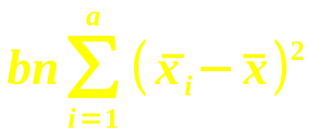
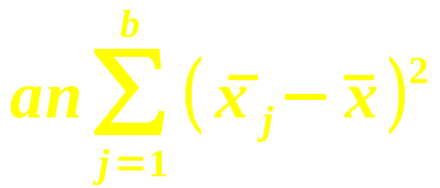
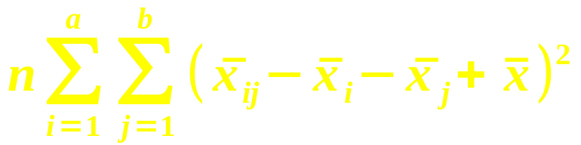
2-way ANOVA: calculating
- | IV₁ (a levels) | IV₂ (b levels) | IV₁*IV₂ (Interaction)
SS
df | a – 1 | b – 1 | (a – 1) * (b – 1)
Also find SS_{tot} as before, and SS_{res}
  df_{tot} = n – 1, and df_{res} = n – ab
  The SS and df always add up:
    Tot = IV₁ + IV₂ + (IV₁*IV₂) + Resid
3 F-tests: IV₁, IV₂, and interaction
  e.g., main effect on IV₁: F = MS₁ / MS_{res}

Slide 8
Main effects
A main effect is a one-way ANOVA on one IV, after controlling for the other predictors
  Analogous to t-tests on slope for each IV in multiple regression
  Here, the main effects are themselves F-tests
E.g., do females spend more at your site, after accounting for source?
  2-way ANOVA on both Gender and Source,
  then look at main effect of Gender
E.g., do different formulas have different fat content, across all plants?

Slide 9
Interactions
When the effect of one IV on the DV changes, depending on the level of the moderator
e.g., females spend more in response to print ads, but males spend more in response to web
e.g., Henderson generally has lower fat than the other plants, except for Large Breed, where it has the second-
highest fat:
Plot means, note
change in shape
of the curves

Slide 10
Randomized Complete Block
Special case of 2-way ANOVA, where
each cell has only 1 observation
IV1 is the factor: typically a fixed effect
  Fixed: levels are set in the hypothesis: e.g., gender, province, store branch, plant
IV2 is the block: typically a random effect
  Random: levels are sampled
  from a population:
  e.g., customer, truck, day
e.g, 19-Applebees.xls:
  Factor: Restaurant
  Block: Week
  DV: Revenue
 | Restaurant
Week | 8.34 | 6.79 | 9.18
 | 10.7 | 10.0 | 12.8
 | ... | ... | ...
 | ... | ... | ...
 | ... | ... | ...

Slide 11
Randomized Block model
A complete 2-way ANOVA on this data would have zero residual in each cell
  So the interaction term serves as “residual”
  Tot = Factor + Blocking + Residual
    df_{res} = (a – 1)(b – 1)
Factor effect (IV₁): F = MS₁ / MS_{res}
  This is usually what we're most interested in
Blocking effect (IV₂): F = MS₂ / MS_{res}
  If non-sig, then blocking was not necessary and we could've just done a 1-way ANOVA

Slide 12
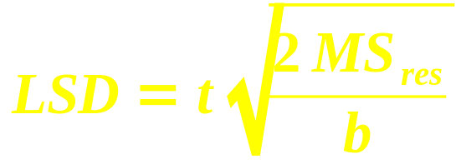
Post-hoc: Fisher's LSD test
If the factor effect is significant, one post-hoc test we can use is Fisher's least sig. diff. test
  Like Tukey-Kramer, but for equal-size cells
Critical range:
  t: 2-tails, use df_{res}
  b: # blocks (IV₂)
For all pairs of levels of the main factor,
if the difference of means |x_{i} – x_{j}| exceeds LSD, then those two groups differ significantly
  Use the results to cluster the factor levels

Slide 13
TODO
HW8 (ch15,12): due next Tues
Projects:
  Presentations in two weeks!
  If you don't know what analysis to perform, or how to perform it, ask me for help

