Slide 1

Ch13: Categorical Data
17 Nov 2011
BUSI275
Dr. Sean Ho
HW8 due Tue
Please download:
20-ChiSq.xls

Slide 2
Outline for today
χ² (chi-squared) test of goodness-of-fit
  Observed vs. Expected
χ² on a single nominal variable
  Test against uniform distribution
    CHIDIST(), CHITEST()
  Test of normality
χ² on 2-way contingency tables
  Test for independence
  Marginal probabilities
  Limitations of χ² test for independence

Slide 3
Goodness of fit
The χ² (chi-squared) test is one way to assess goodness of fit:
  How well an observed distribution fits
  a hypothesized distribution
  Hypothesized distribution can be
  uniform, normal, etc.
χ² can also be applied to test if two nominal variables are independent
  Compare pivot table (contingency table) with hypothesized results if vars independent
  Analogous to correlation for continuous vars

Slide 4
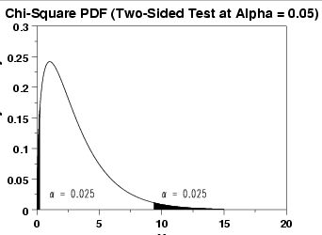
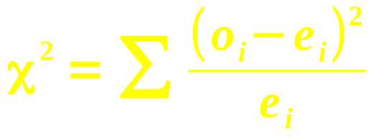
χ² vs. uniform distribution
e.g., are technical support calls
evenly distributed across the weekdays?
  H₀: evenly distributed, matches uniform dist.
Expected # calls per day (uniform distribution):
  Total observed calls (1300), divided by 5
Test statistic:
Use CHIDIST( χ², #cells – 1 )
  Or CHITEST( obs, exp )
Observed | 290 | 250 | 238 | 257 | 265
Expected | 260 | 260 | 260 | 260 | 260
itl.nist.gov

Slide 5
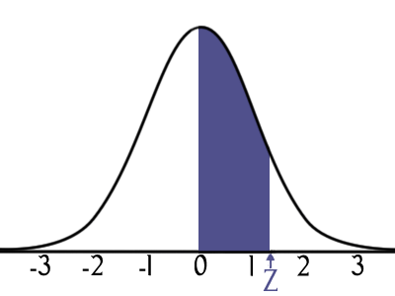
χ² vs. normal distribution
e.g., are student test scores normally distrib?
  Other normality tests: Shapiro-Wilk, K-S
Count frequency of test scores by bins
How to find expected frequencies?
  Find mean, SD of the data
  Use NORMDIST() to find percentage
  of the data that would lie within
  each bin on the ideal normal:
    NORMDIST(80, μ, σ, 1) –
    NORMDIST(75, μ, σ, 1)
Bin | Freq | Norm Freq
40
45 | 1 | 1.30
50 | 4 | 2.77
55 | 15 | 5.14
60 | 7 | 8.28
65 | 5 | 11.60
70 | 7 | 14.11
75 | 11 | 14.93
80 | 15 | 13.72
85 | 22 | 10.97
90 | 9 | 7.62
95 | 4 | 4.60
100 | 0 | 2.41

Slide 6
Contingency tables
Joint freq. distribs for multiple nominal variables
  Each cell of the table holds the # (frequency) of observations that match that combo
  Pivot tables, with Count in the Data field
E.g., Handedness vs. Gender
  H₀: handedness is independent of gender:
  the probability of being left-handed
  stays the same, regardless of the gender
    P( left | M ) = P( left | F ) = P( left )
Observed | Left | Right
Male | 17 | 163
Female | 33 | 167

Slide 7
χ² on 2-way contingency
Expected values assume independence
Calculate marginal probabilities:
  P( female ) = 200/380 ≈ 52.6%
  P( left ) = 50/380 ≈ 13.2%
Assuming independence,
  P( F ∩ L ) = P(F) * P(L) = (.526)(.132)
Thus the expected count for (F ∩ L) is
  P(F) * P(L) * (total) = (.526)(.132)(380)
Calculate χ² summed over all cells
  df = (#rows – 1) (#cols – 1)
    = 1 in this case!
 | L | R | Tot
M | 17 | 163 | 180
F | 33 | 167 | 200
Tot | 50 | 330 | 380

Slide 8
Summary on χ²
Test of goodness-of-fit: observed vs. expected
May apply to a single nominal variable:
  Expected distrib. may be uniform, normal, …
May apply to two nominal variables:
  Expected distrib. is that vars are independent
  Akin to correlation on continuous variables
    Large χ² ↔ |r| ≈ 1
But only an approximation to the true distrib:
  Results may be invalid if cell counts are <5
  May need to combine levels of a var

Slide 9
TODO
HW8 (ch15,12): due Tues
Projects:
  Presentations in two weeks!
  If you don't know what analysis to perform, or how to perform it, ask me for help

