Slide 1

Power Analysis:
Sample Size, Effect Size,
Significance, and Power
16 Sep 2011
Dr. Sean Ho
CPSY501
cpsy501.seanho.com
Please download:
SpiderRM.sav
Notes:
Welcome to today's virtual lecture!
Unit 2 is on “power analysis”; in a nutshell, it's about determining how much data we need to gather in order to perform sufficient analyses.
This is relevant to your data analysis projects as you go hunting for your data – how do you know if you have a sufficient sample size?
In preparation for today's lecture, please download the “SpiderRM.sav” dataset from our website; this is a toy dataset provided by the textbook author, Andy Field.

Slide 2
Outline for today
Discussion of research article (Missirlian et al)
Power analysis (the “Big 4”):
  Statistical significance (p-value, α)
    What does the p-value mean, really?
  Power (1-β)
  Effect size (Cohen's rules of thumb)
  Sample size (n)
    Calculating min required sample size
Overview of linear models for analysis
SPSS tips for data prep and analysis
Notes:
Here's a rough outline of today:
First, we'll spend a bit of time reviewing the journal article we assigned last week; hopefully you had a chance to skim through it.
Our main topic for today is about the “Big 4” of power analysis: significance, power, effect size, and sample size, and how all four of these are interrelated.
We'll conclude with a preview of linear models you may want to consider for your data analysis projects, as well as a couple SPSS tips for your reference.

Slide 3
Practice reading article
Last time you were asked to read this journal article, focusing on the statistical methods:
Missirlian, et al., “Emotional Arousal, Client Perceptual Processing, and the Working Alliance in Experiential Psychotherapy for Depression”, Journal of Consulting and Clinical Psychology, Vol. 73, No. 5, pp. 861–871, 2005.
How much were you able to understand?
Notes:
Hopefully, you've had a chance to read this journal article by now; what did you think? Don't worry if you weren't able to understand all of it – the first time I read a real journal article in math grad school, it took me two weeks to make it through half a page; I was quite discouraged!
Later on as we learn more of the methodology that was used in this article, you'll be able to understand and critique their methods in more detail, but for now try to get the big picture of the questions they were asking and the routes they used to answer those questions.

Slide 4
Discussion:
What research questions do the authors state that they are addressing?
What analytical strategy was used, and how appropriate is it for addressing their questions?
What were their main conclusions, and are these conclusions warranted from the actual results /statistics /analyses that were reported?
What, if any, changes/additions need to be made to the methods to give a more complete picture of the phenomenon of interest (e.g., sampling, description of analysis process, effect sizes, dealing with multiple comparisons, etc.)?
Notes:
There's a lot we can get just from the abstract:
It's a therapy study, with assessments taken at three time points (early, mid, late) throughout therapy
Therapy outcomes are measured via:
Depressive symptoms (BDI)
Self-esteem (RSE)
Interpersonal problems (IIP)
Psychopathology (SCL-90-R)
Main predictors are:
Client emotional arousal
Client perceptual processing (LCPP)
Working alliance (WAI)
Another predictor is the treatment type: person-centred vs. process-experiential
We see that for each of the four outcome variables measured at termination of therapy, after controlling for pre-treatment levels, they determined which of the three predictors (measured mid-therapy) correlated most strongly.
Lots of possibilities for how to extend this analysis: Possible correlation of the outcome measures? Follow-up re-assessment of outcomes after 6-mo?

Slide 5
Outline for today
Discussion of research article (Missirlian et al)
Power analysis (the “Big 4”):
  Statistical significance (p-value, α)
    What does the p-value mean, really?
  Power (1-β)
  Effect size (Cohen's rules of thumb)
  Sample size (n)
    Calculating min required sample size
Overview of linear models for analysis
SPSS tips for data prep and analysis
Notes:
Moving on to our main topic for today....

Slide 6
Central Themes of Statistics
Is there a real effect/relationship
amongst the given variables?
  How big is that effect?
We evaluate these by looking at
  Statistical significance (p-value) and
  Effect size (r², R², η, d, etc.)
Along with sample size (n) and statistical power (1-β), these form the “Big 4” of any test
Notes:
Often in exploratory research, we are interested in relationships amongst variables: sometimes these are directional predictor->outcome relationships; sometimes nondirectional correlative relationships.
In qualitative research, we ask, “what are the important variables?” and “how do we measure them?”
In exploratory quantitative research, we ask, “in this set of variables, which are the most important for our outcome?” “What are their relationships?”
In confirmatory quantitative research, we ask, “is the hypothesized relationship amongst these variables real, and how big is that relationship?”
The question of, “is an effect real?” is one of significance.
The question of, “how big is the effect?” is one of effect size.

Slide 7
The “Big 4” of every test
Any statistical test has these 4 facets
Set 3 as desired → derive required level of 4th
Significance
0.05
as desired, depends on test
Effect size
Sample size
derived!
(GPower)
usually 0.80
Power
Notes:
These four are in a “tug-of-war” – if we have fixed values for any three, it uniquely determines the fourth.
For instance, if we want to reduce both Type I error (lower α) and Type II error (raise power), then we either have to increase the minimum effect size that we are reliably able to detect, or we have to up our sample size (i.e., gather more data).
For your data analysis project, typically you would fix significance (α=0.05 is standard) and power (0.80 is standard, but there's wiggle room). The target effect size is determined by the particular analysis you plan to perform, and is usually specified simply as “small”, “medium”, or “large”.
The result (given by the G*Power software that we'll introduce momentarily) is the minimum sample size that you need.
Note that this does depend on the kind of analysis, which in turn depends on the number and type of variables you are using. If your analysis changes, the G*Power analysis changes, too.

Slide 8
Significance (α) vs. power (1-β)
α is our tolerance of Type-I error:
incorrectly rejecting the null hypothesis (H₀)
β is our tolerance of Type-II error: failing to reject H₀ when we should have rejected H₀.
Set H₀ so that Type-I is the worse kind of error
Power is 1-β
e.g., parachute
inspections
(what should
H₀ be?)
 | Actual truth
 | H₀ true | H₀ false
Reject H₀ | Type-I error (α) | Correct
Fail to reject H₀ | Correct | Type-II error (β)
Our decision
Notes:
Remember back to undergrad stats: the null hypothesis H₀ is the “default”, “safe” option. In research, typically it's the position that there is no relationship amongst the variables. The alternate hypothesis, H_{A}, is the position that there is a relationship.
“Rejecting the null” means asserting that there is a relationship. “Failing to reject the null” means admitting we don't have compelling evidence to show there is a relationship – perhaps there really is a relationship, but we need more data to show it.
Type I error is asserting there is a relationship, when in fact there isn't one. Researchers want to be conservative, so we consider this the worse kind of error and place a limit on it, called α, the “level of significance”.
Type II error is more “acceptable”; the limit we place on that is β, and often can go as high as 20%.
For a parachute inspector, the “safe” option is to declare the parachute defective. A Type II error means throwing away a perfectly good parachute – bad, but not catastrophic. A Type I error would be really bad news; α should be infinitesimal!

Slide 9
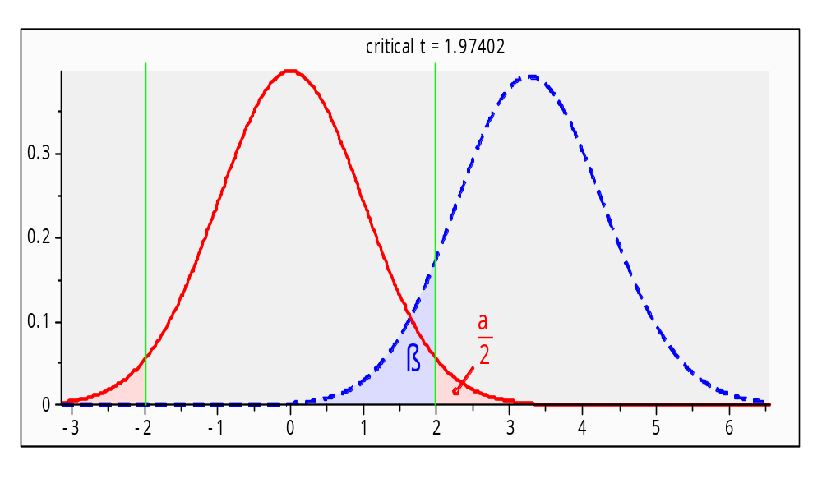
Significance: example
RQ: are depression levels higher
in males than in females?
  IV: gender; DV: depression (e.g., DES)
  What is H₀? (recall: H₀ means no effect!)
Analysis: independent-groups t-test
What does Type-I
error mean?
What does Type-II
error mean?
Notes:
Here's an example: The null hypothesis is that gender is not related to depressive symptoms; i.e., depressive levels in males are not higher than in females.
This would be a classic situation for the t-test comparing two independent groups.
Type I error is the chance of us declaring that males do have higher depressive levels, when in fact they don't.
Type II error is the chance of us shying away and saying we don't have enough evidence to show that males have higher depressive levels, when in fact they do.
The blue curve represents our guess for the average depression level in the male population – the peak is at the mean of our sample data, but there is some uncertainty to our guess. Similarly, the red curve for the females.
The pink shaded area represents the chance that actually, the female mean is higher than the male mean – i.e., the null is true. This would mean a Type I error. Similarly, the blue shaded area represents Type II error.

Slide 10
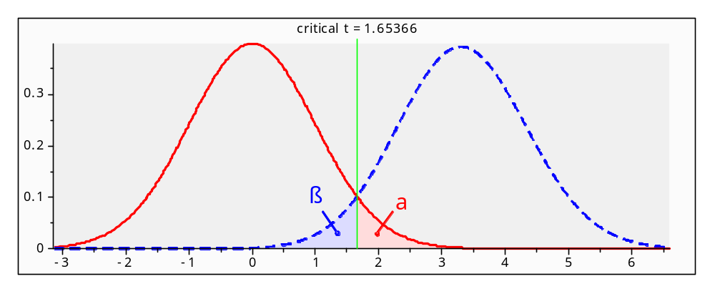
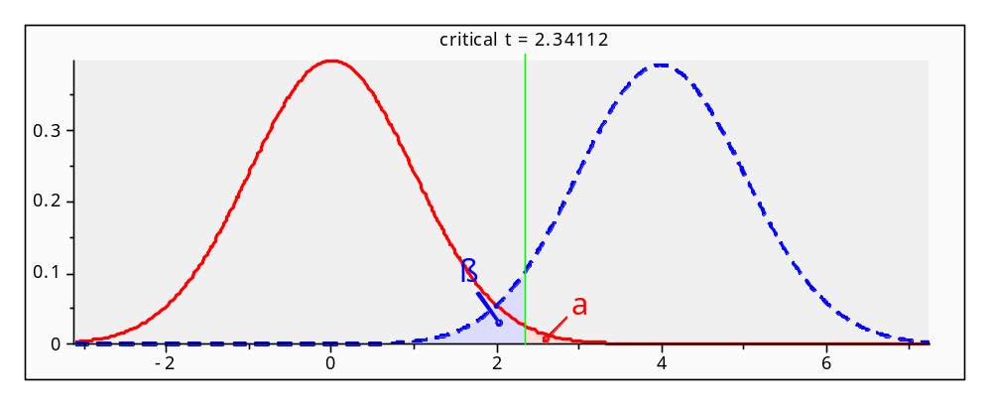
Impact of changing α
α=0.05
(without changing data)
decreasing Type-I means increasing Type-II!
α=0.01
Notes:
This pair of graphics illustrates the tug-of-war that exists between Type I and Type II error (assuming that both sample size and effect size are fixed; in this case, effect size is the distance between the two peaks, divided by the pooled standard deviation).
There is no free lunch; if we want to virtually eliminate the possibility of making a Type I error, we have to admit a much larger possibility of making Type II errors.

Slide 11
What is the p-value?
Given data and assuming a model, the p-value is the computed probability of Type-I error
  Assuming model is true and H₀ is true, p is the probability of getting data that is
  at least as extreme as what we observed
  Note: this does not tell us the probability that H₀ is true! p(data|H₀) vs. p(H₀|data)
Set the significance level (α=0.05) according to our tolerance for Type-I error: if p < α, we are confident enough to say the effect is real
Notes:
We hear so much about p-values, so what are they, exactly?
They work by first assuming that our analysis accurately models the real-world phenomenon (i.e., assuming what we hope to be true!). Then, in a kind of “proof by contradiction,” we find the probability of seeing the kind of data that we have, given that the null hypothesis is true.
If the p-value is small (<α), we probably have some pretty “extreme” data that can't be explained by the null hypothesis, so maybe that's evidence for the alternate hypothesis.
In reality, this is a roundabout way of proving our hypothesis: the p-value is a “conditional probability,” the probability of our data, assuming the null. But actually, what we ought to be after is the probability of our hypothesis (either H₀ or H_{A}), given our data – i.e., how likely is it that our hypothesis is true?
This so-called “transposition fallacy” is at the root of a lot of our misinterpretations, and in recent decades has led the community toward “Bayesian analysis”. It's exciting stuff, but unfortunately beyond the scope of our course.

Slide 12
Myths about significance
  (why are these all myths?)
Myth 1: “If a result is not significant, it proves there is no effect.”
Myth 2: “The obtained significance level indicates the reliability of the research finding.”
Myth 3: “The significance level tells you how big or important an effect is.”
Myth 4: “If an effect is statistically significant, it must be clinically significant.”
Notes:
If p>α, we “fail to reject the null”, meaning there is insufficient evidence for an effect. Perhaps the effect is real, but it's too small to detect in this study (effect size), or our sample size is too small.
Reliability is a whole other topic; it has to do with repeating the experiment on other samples within the same population, or even on different populations. The p-value pertains only to this specific study.
Effect size and significance are two different components of the “Big 4”; it's possible to have a significant but small effect, and it's possible to observe a large effect size but for it to not be significant (in which case, we might want to duplicate the study with more data).
Clinical significance is a larger topic which requires domain expertise, prior work / lit. review, etc. There are plenty of studies that show fantastic significance on an effect (or a population) that is totally irrelevant for clinical work. Garbage in, garbage out!

Slide 13
Problems with relying on p-val
When sample size is low, p is usually too big
  → if effect size is big, try bigger sample
When sample size is very big,
p can easily be very small even for tiny effects
  e.g., avg IQ of men is 0.8pts higher than IQ of women, in a sample of 10,000: statistically significant, but is it
  clinically significant?
When many tests are run, one of them is bound to turn up significant by random chance
  → multiple comparisons: inflated Type-I
Notes:
Classically, researchers would care only about the p-value, and in particular, whether it meets the “magic” threshold of 0.05. But:
A non-significant result may actually be indicative of something interesting; you just need a larger sample size to confirm it. Conversely,
Very large samples often yield significance on just about any test, because of the sheer size of the sample. So take those p-values with a grain of salt. On the IQ scale, a difference of 0.8pts means nothing.
If we take a “shotgun” approach and blindly apply dozens of statistical tests to a dataset, by sheer chance a few of them are bound to turn up significant – even if the data is purely noise. If each of those tests has its own α, all of those Type I errors add up!
We'll talk more about multiple comparisons later in ANOVA.

Slide 14
Outline for today
Discussion of research article (Missirlian et al)
Power analysis (the “Big 4”):
  Statistical significance (p-value, α)
    What does the p-value mean, really?
  Power (1-β)
  Effect size (Cohen's rules of thumb)
  Sample size (n)
    Calculating min required sample size
Overview of linear models for analysis
SPSS tips for data prep and analysis

Slide 15
Effect size
Historically, researchers only looked at significance, but what about the effect size?
A small study might yield non-significance but a strong effect size
  Could be spurious, but could also be real
  Motivates meta-analysis –
  repeat the experiment, combine results: with more data, it might be significant!
Current research standards require reporting both p-value as well as effect size
Notes:
Particularly in social sciences like psychology, gathering data can be challenging, time-consuming, and expensive. Especially for exploratory research where the metrics might not be widely accepted yet, a small study can still be quite useful if it shows a large effect, even if the p-value is not super-low below 0.05.
Meta-analysis means combining the results of many similar experiments (being careful to match populations, sampling and evaluation methodologies, and metrics).
APA rules (and the research community) expect that any result you report will include not only the p-value but also the effect size. How you determine the effect size depends on the kind of analysis.

Slide 16
Measures of effect size
For t-test and any between-groups comparison:
  Difference of means: d = (μ₁ – μ₂)/σ
For ANOVA: η² (eta-squared):
  Overall effect of IV on DV
For bivariate correlation (Pearson, Spearman):
  r or r²: r² is fraction of variability in one var explained by the other var
For regression: R² and ΔR² (“R²-change”)
  Fraction of variability in DV explained
  by overall model (R²) or
  by each predictor (ΔR²)
Notes:
For comparisons of two independent groups, the effect size is the difference of means, in units of standard deviation (think of it like a z-score).
For all other analyses looking at relationships amongst variables, the effect size measures how much of the variability in the outcome variable(s) is explained by the model.
E.g., say we're looking at levels of depressive symptoms; say BDI is our outcome variable. Our population will show a wide range of BDI scores; our objective is to explain what causes one person to have high scores and another to have low scores.
The effect size tells us what fraction of that variability in BDI scores in our sample is explained by our predictive model. We want it to be close to 100%; in reality, anything over 25% is already pretty big.
Remember, this is a separate issue from significance – which deals with whether the observed effect is real or simply spurious from our particular sample.

Slide 17
Interpreting effect size
What constitutes a “big” effect size?
Consult literature for the phenomenon of study
Cohen '92, “A Power Primer”: rules of thumb
  Somewhat arbitrary, though!
For correlation-type r measures:
  0.10 → small effect (1% of var. explained)
  0.30 → medium effect (9% of variability)
  0.50 → large effect (25%)
Notes:
These are all soft guidelines, not rigorous boundaries. See the supplementary reading for more details; you also want to do your lit. review in your field of interest and see what effect sizes other studies came up with for the same effects.
Note that the 0.10/0.30/0.50 guidelines are for r; for r-squared (i.e., fraction of variability explained), you need to square those values.

Slide 18
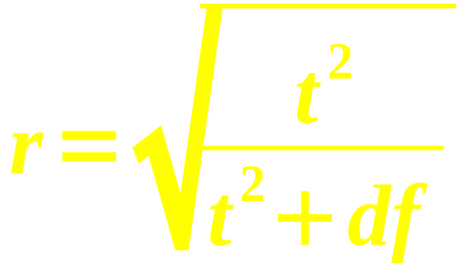
Example: dependent t-test
Dataset: SpiderRM.sav
12 individuals, first shown picture of spider, then shown real spider → measured anxiety
Compare Means → Paired-Samples T Test
SPSS results: t(11)=-2.473, p<0.05
Calculate effect size: see text, p.332 (§9.4.6)
  r ~ 0.5978 (big? Small?)
Report sample size (df),
test statistic (t), p-value,
and effect size (r)
Notes:
Quick example in SPSS: download this dataset from our webpage and open it up in SPSS. Make sure you understand what the variables represent: in this dataset, the same person is exposed both to the picture and to the real spider.
The paired-samples t-test gives us all the numbers we need.
We can then manually calculate (e.g., using a calculator, or Excel, or even Google) the effect size using the indicated equation.
We interpret this effect size as a large one.

Slide 19
Finding needed sample size
Experimental design: what is the minimum sample size needed to attain the desired level of significance, power, and effect size (assuming there is a real relationship)?
Choose level of significance: usually α = 0.05
Choose power: usually 1-β = 0.80
Choose desired effect size
  From literature or Cohen's rules of thumb
→ use GPower or similar to calculate the required sample size (do this for your project!)
Notes:
For experimental design, we typically need an “a priori” power analysis: we set α, β, and the minimum effect size we desire to detect, and then we can calculate the minimum sample size required.
A software tool we can use is G*Power; this is free for you to download and install on your own computers, and also pre-installed on campus computers. (See our course homepage for a link.)
You need to know the kind of statistical test you plan to perform (t-test, ANOVA, regression, etc.). You can choose this either by selecting a “Test family” and then a particular “Statistical test”, or simply by choosing a test from the menubar.
Next, select the “Type of power analysis” to be “A priori”. This menu illustrates the “Big 4” – define any 3, and use G*Power to calculate the 4th.
Input α (0.05), the power (0.80), and effect size (according to Cohen's guidelines), and hit “Calculate” to get the minimum required sample size.

Slide 20
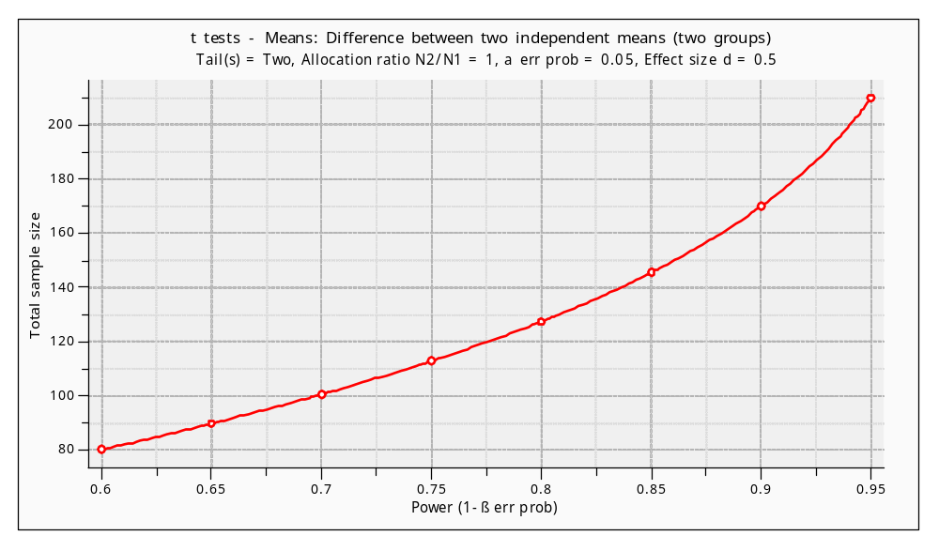
Power vs. sample size
Choose α=0.05, effect size d=0.50, and vary β:
Notes:
Instead of pressing “Calculate”, you can also get a snazzy 2D plot for any pair of parameters from the “Big 4”.
For instance, you can see how the minimum sample size goes up as the power increases (i.e., as the chance of Type II error is reduced).
The other two parameters in the “Big 4” – in this case, α and the effect size – are fixed.

Slide 21
Outline for today
Discussion of research article (Missirlian et al)
Power analysis (the “Big 4”):
  Statistical significance (p-value, α)
    What does the p-value mean, really?
  Power (1-β)
  Effect size (Cohen's rules of thumb)
  Sample size (n)
    Calculating min required sample size
Overview of linear models for analysis
SPSS tips for data prep and analysis

Slide 22
Overview of Linear Methods
For scale-level DV:
  dichotomous IV → indep t-test
  categorical IV → one-way ANOVA
  multiple categorical IVs → factorial ANOVA
  scale IV → correlation or regression
  multiple scale IVs → multiple regression
For categorical DV:
  categorical IV → χ² or log-linear
  scale IV → logistic regression
Also: repeated measures and mixed-effects
Notes:
We'll get into each one of these tests in much more detail as the semester progresses, but this is a high-level overview to help you as you find data, think about research questions to ask of the data, and determine if the dataset has sufficient sample size for your purposes.
Remember that you need to do a separate G*Power analysis for each of your main research questions!
But don't stress out; also remember that exploratory analysis means your RQs may well change as you get into the data, and you'll be re-doing the G*Power analysis each time that happens.
Let the data tell you what it holds (“exegesis”) rather than you telling the data what you want to see (“eisegesis”). The journey is more important than the destination!

Slide 23
SPSS tips!
Plan out the characteristics of your variables before you start data-entry
You can reorder variables: cluster related ones
Create a var holding unique ID# for each case
Variable names can't have spaces: try “_”
Add descriptive labels to your variables
Code missing data using values like '999'
  Then tell SPSS about it in Variable View
Clean up your output file (*.spv) before turn-in
  Add text boxes / headers; delete junk
Notes:
Did you know you can edit the SPSS output? Not to fudge the numbers, of course! But you can delete unnecessary output boxes and add text headers, to clean it up so that the TA or instructors can navigate it easier. Also, pay attention to the outline structure in the pane on the left-hand side of the output window; it's a handy way to navigate the output.

