Slide 1

Multiple Regression
Please download from
“Example Datasets”:
Record2.sav
Domene.sav
7 Oct 2011
CPSY501
Dr. Sean Ho
Trinity Western University
Notes:
Multiple regression simply means we have more than one predictor. Using “dummy coding” for categorical variables, it is mathematically equivalent to ANCOVA, and in fact offers more flexibility in the ordering of predictors in blocks.
Even if you're using some other variant of regression (logistic, ordinal, log-linear, ANOVA, ANCOVA, MANOVA, etc.), you still need to understand multiple regression well, because it forms the foundation for all those other variants.

Slide 2
Outline: Multiple Regression
Regression Modelling Process
Building a Regression Model
  Shared vs. Unique Variance
  Strategies for Entering IVs
  Interpreting Output
Diagnostic Tests:
  Residuals, Outliers, and Influential Cases
Checking Assumptions:
  Non-multicollinearity, independence, normality, homoscedasticity, linearity
Notes:
First, we'll talk about planning for a multiple regression analysis, including thinking about minimum sample size.
We'll walk through an example using the “Record2.sav” dataset, and show how to enter multiple predictors and “block” design.
There are a number of assumptions for multiple regression, and we need to understand their importance and impact of any violations, as well as to have some techniques to check if they are satisfied. We'll walk through each of those in turn.

Slide 3
Encouragement on Research
Undergrad students: “is this on the test?”
  “What do I need to do to pass?”
  Doing the bare minimum: 1 DV, 2 IVs, 1 test
Graduate students / prep for research:
  “What structure/effects are in the data?”
  Do whatever it takes to understand the data
You may need several RQs
Your RQs may change as you progress
Have a theme/goal and aim to tell a story about the effects in the dataset
Notes:
Before we begin, a few words of encouragement for your projects!
Coming from your undergrad stats courses, you might be expecting that once you have your research hypothesis and data, you'll spend the majority of your time crunching numbers before you come up with a result. You might be a bit discouraged when you realize that your initial RQ is too simplistic and you need to revise it, or expand on it, or add secondary RQs.
Don't lose heart! This is a normal part of the process. Because we have software like SPSS, the actual number crunching is very fast. The hard part is figuring out what questions to ask!
Typically, the approach is to start with the outcome variable. Then we do our lit review, theory, prior research, etc. to determine likely predictors that might feed into the outcome. Look for potential moderators and mediators (see next week's slides). The goal is a more complete understanding of what drives variability in the outcome.

Slide 4
Regression Modelling Process
RQ: IVs/DVs, metrics, sample size, collect data
Clean: data entry errors, missing data, outliers
Explore: assess requirements, xform if needed
Build model: order & method of entry from RQ
Test model: “diagnostic” issues:
  Multivariate outliers, overly influential cases
Test model: “generalizability” issues:
  Multicollinearity, linearity of residuals
Run final model and interpret results
Notes:
You do need an initial RQ or overall theme to guide your analysis and keep you focused, but be prepared for the specific RQs and analyses to change as you dive into the background lit review and into your own dataset.
A critical component of the process is checking the assumptions: “diagnostics” are checks to make sure there aren't any issues that might trip up an appropriate application of the chosen method to the data; this includes looking for troublesome cases.
“Generalizability” tests are to ensure that our model and results are applicable to future datasets and not overly biased by our specific dataset. It is also important to have an intuitive understanding of our model (a model is a collection of predictors, together with transforms and derived variables, perhaps organized in “blocks” in hierarchical regression). One might have a complex model that explains the data perfectly, but is impossible to understand or interpret; this would not be terribly useful or generalizable.

Slide 5
Required Sample Size
Depends on effect size and # of predictors
  Use G*Power to find exact sample size
  Rough estimates on pp.222-223 of Field
Consequences of insufficient sample size:
  Regression model may be overly influenced by individual participants (not generalizable)
  Can't detect “real” effects of moderate size
Solutions:
  Collect more data from more participants!
  Reduce number of predictors in the model
Notes:
As we have noted before, more predictors means an increased minimum sample size. In some fields, it is common to have hundreds or even thousands of predictors, and try to use automatic methods to filter out the most important predictors. This is useful in some specific situations, but in general we want to start with theory and prior work to select a targeted set of predictors that each have good justification for being in the model.
In my experience with 501 projects, most people will have between 2-12 predictors.
Once you know the details of your chosen analysis and predictors, you can use G*Power to estimate required sample size. The required sample size will be different for each analysis you run, and your project may necessitate multiple analyses!
If you have insufficient sample size, don't despair; this is quite common in psychology research. Continue anyway, but note the limitations of the dataset.

Slide 6
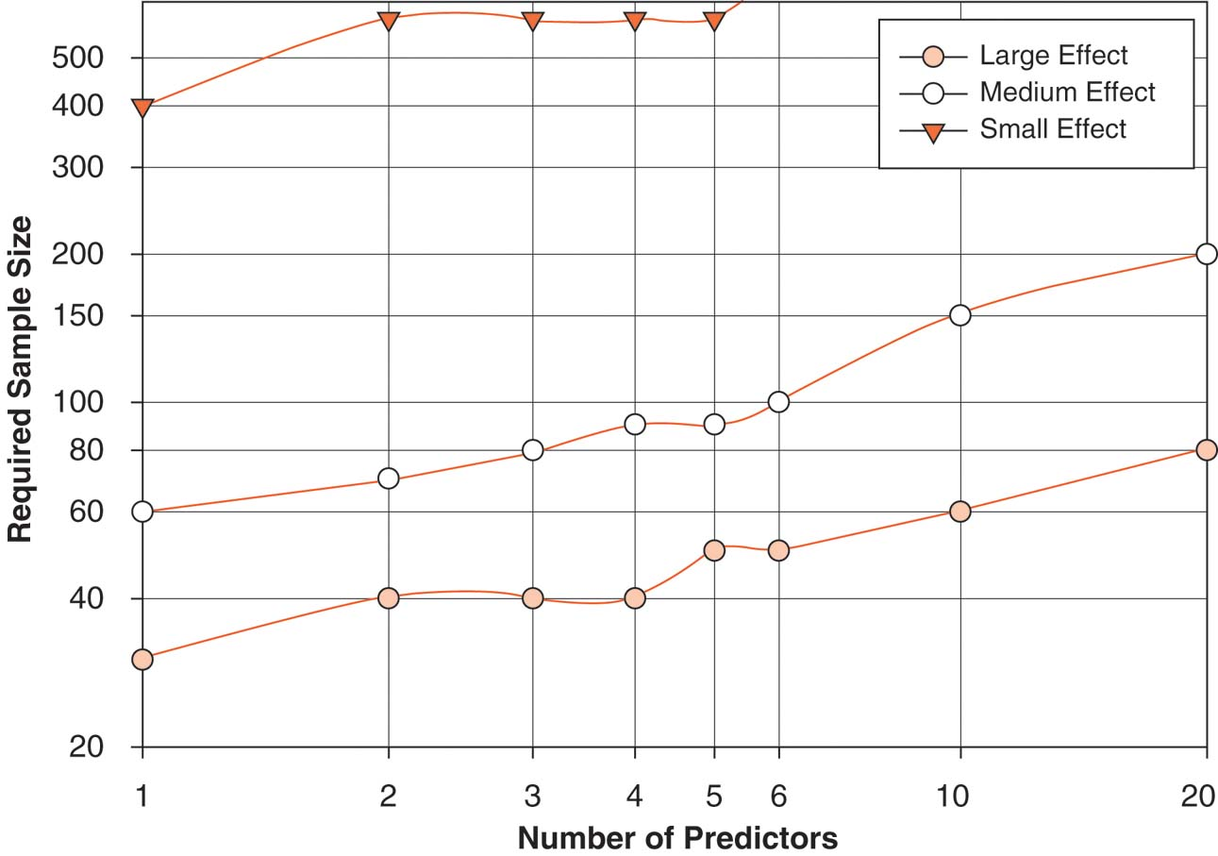
Sample Size Estimates (Field)
Notes:
A large effect is easier to detect reliably than a small effect; think of it as the “minimum effect size your analysis is able to detect”. If you want your study to detect a small effect size, you are demanding more of your data, so you need a higher sample size.

Slide 7
Outline: Multiple Regression
Regression Modelling Process
Building a Regression Model
  Shared vs. Unique Variance
  Strategies for Entering IVs
  Interpreting Output
Diagnostic Tests:
  Residuals, Outliers, and Influential Cases
Checking Assumptions:
  Non-multicollinearity, independence, normality, homoscedasticity, linearity
Notes:
On to multiple regression!

Slide 8
Example: Record Sales data
Dataset: Record2.sav
Outcome (“criterion”): record sales (RS)
Predictors: advertising budget (AB), airtime (AT)
  Both have good ‘variability’, and n=200
Research Question: Do AB and AT both show unique effects in explaining Record Sales?
Research design:
Cross-sectional, correlational study (same year?)
with 2 quantitative IVs & 1 quantitative DV
Analysis strategy: Multiple regression (MR)
Notes:
Here's our first hands-on example of multiple regression.
We want to see how well advertising budget (AB) and airtime (AT) predict record sales (RS). The idea is that sales should be driven both by how much money is spent on marketing, as well as how frequently the bands are heard on the radio.
We actually have several RQs:
First, how well does the combination of AB+AT predict RS? We examine both significance (p-value) as well as effect size (R²).
As secondary research questions, what are the unique effects of AB and AT in predicting RS? In other words, if we control for advertising budget, does airtime still have an impact on sales? (And vice-versa.)
It may turn out that AB+AT together to predict sales well, but that it's mostly airtime that's doing the heavy lifting – in that case, the record label ought to cut back on their advertising spending; they can save money and still retain good sales.

Slide 9
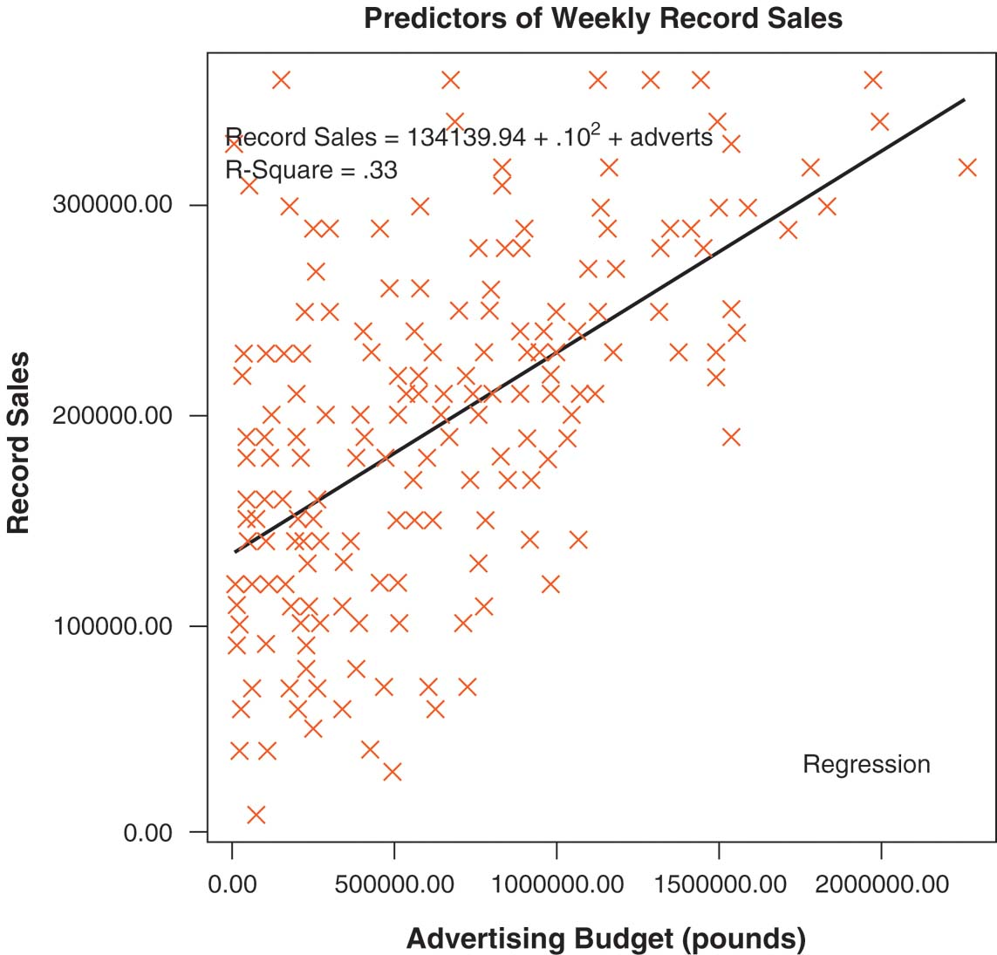
Regression Model with 1 IV
Notes:
With only one predictor (AB), the model is a straight line, and we expect that on the 2D scatterplot the data form a cloud of points around that line – normally distributed above and below the line.

Slide 10
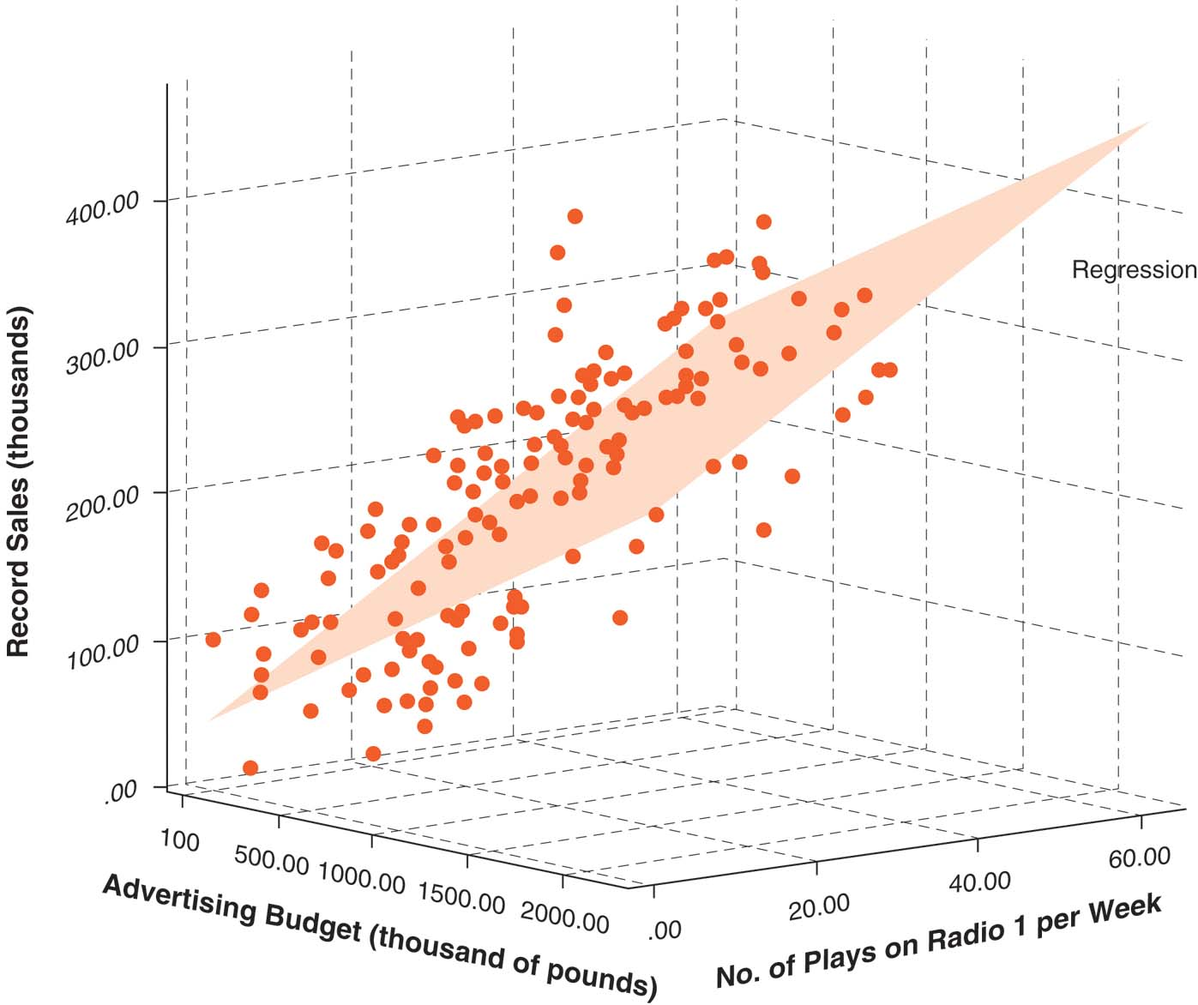
Regression Model with 2 IVs
Notes:
With two predictors, the model is a plane in 3D space. The idea is that, given values for advertising budget and airplay (coordinates in x and y), the model should be able to predict what sales will be (the z coordinate, or height of that point on the plane). Of course, just using AB and AT can't fully explain record sales; the model is that the cloud of points is normally distributed above and below the plane.

Slide 11
Asking Precise RQs
What does literature say about AB and AT in relation to record sales?
  Previous lit may be theoretical or empirical
  May focus on these variables or others
  May be consistent or conflicting results
Contrast these two seemingly similar RQs:
  Is AB or AT more important for Sales?
  Do AB and AT both show unique effects in accounting for the variance of Sales?
Notes:
To make sure we aren't overlooking any other potential predictors, we need to do some lit review to see what factors may drive the outcome variable we are interested in. It is in our interest to measure and control for these other factors.
If we do not, we won't get any warning from SPSS – we might still get a positive result with a fantastic p-value. But our conclusions could be quite misleading; it could well be that the effect we found is completely subsumed by some other well-known predictor, or that the effect we found is not a direct, proximal effect, but only an indirect effect via some other mediating variable that we did not account for.
In the two example RQs given here, the second RQ examines the effect of AB on RS after having controlled for the effect of AT (and vice-versa). The first RQ compares the strength of those two unique effects to see which is larger.

Slide 12
Example: Record Sales
Dataset: Record2.sav
Analyze → Regression → Linear
Dependent: Record Sales (RS)
Independent: Advertising (AB) & Airtime (AT)
  This is a “simultaneous” regression
Statistics: check R² change and partial correl.
Review output: t–test for each β coefficient: significance of unique effects for each predictor
Notes:
Let's first run the “overall” regression model, throwing both AB and AT into the mix together.
The “Coefficients” table in the output lists the (unstandardized) B and (standardized) β for each of the two predictors, and it also shows the results of a t-test (“Wald” test) that checks whether each slope differs significantly from zero. A predictor that is not contributing significantly would have a slope that is close to 0, and hence a large p-value.

Slide 13
Outline: Multiple Regression
Regression Modelling Process
Building a Regression Model
  Shared vs. Unique Variance
  Strategies for Entering IVs
  Interpreting Output
Diagnostic Tests:
  Residuals, Outliers, and Influential Cases
Checking Assumptions:
  Non-multicollinearity, independence, normality, homoscedasticity, linearity
Notes:
“Hierarchical” regression refers to a series of MR (multiple regression) tests. Each test in the series adds new predictors into the mix and examines their unique contribution, after having controlled for the previous predictors.
SPSS gives us an interface to design and run these hierarchical tests all at once – with just one click of the “Run” button, SPSS actually runs a whole series of tests with different sets of predictors.

Slide 14
Shared vs. Unique Variance
When predictors are correlated, they account for overlapping portions of variance in outcome
  Redundant IVs, mediation,
  shared background effects, etc.
Order of entry will help distinguish
shared and unique contributions
Notes:
It's pretty unusual to find a set of predictors that each explain non-overlapping portions of variance of the outcome (as illustrated by the leftmost figure; the blue striped triangle represents the outcome).
The overlap is because predictors often are correlated not only with the outcome, but also with each other.
In hierarchical regression, we can enter predictors in a sequence of “blocks”: those predictors in earlier blocks are first modelled and then factored out, so that we can examine the unique effects of the predictors in the later blocks.
In the middle figure, we first factor out the effect of the red predictor (i.e., put it in an earlier block), so that we can find the unique effect of the yellow predictor – this would be the small solid yellow triangle which overlaps the outcome but does not overlap the red.
In the righmost figure, we enter the predictors in the opposite order – first yellow, then red – so as to find the unique contribution of the red predictor.
The green predictor is not correlated with either yellow or red, so its order of entry does not matter. (In real datasets, it's quite unusual to have a predictor which is completely uncorrelated with the other predictors!)

Slide 15
Order of Entry
Predictors in same block are entered into model at the same time
Subsequent blocks only look at remaining variance after previous blocks have been factored out
To find a predictor's unique contribution, put it last after other predictors are factored out
Try several runs with different orderings to get each predictor's unique effect
Order for your final run should reflect theory about relative importance of predictors
Notes:
The principle to remember is that if you want to examine the unique effect of a predictor, it must go last, after all the other predictors have been accounted for (i.e., they are treated as covariates).
“Unique” only makes sense in the context of the other predictors that were factored out, so when presenting your results, you should always indicate what covariates you controlled for: “After controlling for the effect of airplay, advertising budget was able to explain 27% of the variability in record sales.”
If you have several variables that you want to find unique effects for, then you will need to run several different hierarchical regressions, taking turns for which variable goes last.

Slide 16
Options for Variable Selection
Within each block, not all IVs need to be used:
  Manual method: “Enter” (forced entry)
    All specified IVs will be included
  “Stepwise” automatic methods:
    Forward: add significant IVs one-at-a-time
    Backward: eliminate non-significant IVs
Best to use “Enter”: manual control
  You decide order according to theory/lit
Automatic methods might not show
shared effects, interaction effects
Notes:
SPSS also has some automatic variable selection algorithms: these are most useful when you have many (dozens or hundreds) of potential predictors, and no prior theory to justify selecting some of them over others.
Each block of variables may use one of these methods.
The “Forward” method starts out using none of the variables in the given block, then adds variables one at a time, each time adding the one variable which most significantly contributes to the model. When a threshold of significance is reached, selection is stopped, because the remaining variables do not contribute significantly.
The “Backward” method starts out with all the variables, then removes variables which do not contribute significantly to the model.
The default, and best method for most situations, is “Enter”; this forces all the specified variables in that block to be included in the model. This gives puts control in the hands of the researcher (you!).

Slide 17
Record Sales Example
Analyze → Regression → Linear
Dependent: Record Sales
Statistics: check R² change
Run 1: “simultaneous” regression
  Both AB and AT in Block 1
Run 2: AB in Block 1, and AT in Block 2
Run 3: AT in Block 1, and AB in Block 2
Notes:
Let's expand our example with the Record2.sav dataset.
Earlier, we ran the simultaneous regression, with both predictors in the same block.
Now, let's do two more runs, putting the two predictors in different blocks (select “Next” to enter a new block). Try both orders.

Slide 18
Calculating Shared Variance
Output from Run 1: Total effect size from both predictors together is 63%
Run 2: Airtime's unique effect size is 30%
  Look at last ΔR²: when airtime is added
Run 3: Advertising's unique effect size is 27%
Shared variance:
  = Total minus all unique effects
  = 63% – 30% – 27% ≈ 6%
Notes:
The simultaneous run tells us the overall effect size from the combination of both AB and AT.
The second run breaks down the unique contribution of AT (remember, the variable in the last block is the one whose unique effect we see). As each block of predictors is added, the total R² increases (our model explains more and more of the variability of the outcome). What we care about is the change in R² – how much this new block of predictors is adding to the model. In this case, adding airtime to the model added another 30% to the explanation of sales, above and beyond what was explained by advertising budget.
Similarly, the unique effect of advertising budget when controlling for airtime is 27%.
Putting these all together, we see that there must be a bit of an overlap between the two predictors: 6% of the variability of sales is shared by both airtime and advertising budget.

Slide 19
Steps for Entering IVs
First, create a conceptual outline of all IVs and their connections & order of entry.
  Run a simultaneous regression: look at
  beta weights & t-tests for all unique effects
Second, create “blocks” of IVs (in order) for any variables that must be in the model
  Use “Enter” method to force vars into model
  Covariates may go in these blocks
  Interaction and curvilinear terms go in last of these blocks
Notes:
Theory is important to guide our selection and sequencing of predictors.
Predictors that appear not to contribute significantly at all are candidates for being removed altogether from our study; if they are not helping to explain the outcome, then their presence only hurts our statistical power and increases our chances for violating some of the regression assumptions. You could also try the automatic “Backward” method to eliminate them.
Predictors that we suspect (or test) as being both theoretically related and empirically strongly correlated might be candidates for being put in the same block.
Covariates that we simply want to control for (i.e., not within our primary RQ) should be put in earlier blocks. These could include demographic info, background/environmental factors, baseline scores, etc.
Any interaction terms (we will talk about these in more detail in next week's lecture on moderation) and other derived variables should go in later blocks.

Slide 20
Steps for Entering IVs (cont.)
Any remaining variables go in a separate block: try all possible combinations to sort out shared & unique variance portions.
  See record sales example above
  (no interaction terms were used)
Summarize the final sequence of entry that clearly presents the predictors & their respective unique and shared effects.
Interpret the relative sizes of the unique & shared effects for the Research Question
Notes:
As with our Record2.sav example, you may need to run several different analyses to pin down the various unique effects.

Slide 21
Entering IVs: SPSS tips
Plan out your order and method on paper
Each set of variables that should be entered in at the same time should be in a single block.
  Other vars & interactions go in later blocks
Usually choose “Enter” method (default)
  Try automatic (“Backward”) only if needed
Confirm correct order & method of entry in your SPSS output
  Usually only need a few blocks of IVs
Notes:
In actual practise, especially for datasets with only a few (say, less than 10) variables, you'll rarely need more than 3 blocks.

Slide 22
Outline: Multiple Regression
Regression Modelling Process
Building a Regression Model
  Shared vs. Unique Variance
  Strategies for Entering IVs
  Interpreting Output
Diagnostic Tests:
  Residuals, Outliers, and Influential Cases
Checking Assumptions:
  Non-multicollinearity, independence, normality, homoscedasticity, linearity
Notes:
We're not done when we press “Run”! SPSS fills the output window with many tables and graphs, depending on which options we asked for, and we need to be able to interpret this output intelligently. Often, the output will contain diagnostics that we can use to check the model assumptions and make sure our model really reflects the complexity of the data.

Slide 23
Output: “Model Summary”
R²: the variance in the outcome accounted for by the model (i.e., combined effect of all IVs)
  Interpretation is similar to r² in correlation
  Multiply by 100 to convert into a percentage
  Adjusted R²: unbiased estimate of the model, always smaller than R²
R² Change (ΔR²): Increase in effect size from one block of predictors to the next.
  F-test checks whether this “improvement” is significant.
Notes:
These two are the most important numbers output; there will be as many of these as there are blocks in the regression model. Each block of predictors that is added will increase the total R². Sometimes, a block of predictors does increase the R², but not significantly; the F-test tells us about that.

Slide 24
Output: “ANOVA” Table
Summarizes results for the model as a whole: Is the “simultaneous” regression a better predictor than simply using the mean score of the outcome?
Proper APA format for reporting F statistics (see also pp. 136-139 of APA publication manual):
  F(3, 379) = 126.43, p < .001
df-regression
F-ratio
statistical
significance
df-residual
Notes:
It may well be that none of our predictors are really useful for (linearly) predicting the outcome! If that's the case, then none of the rest of the results are meaningful.
Note that in APA style, for symbols, English letters are italicized (e.g., p), whereas Greek letters are not italicized (e.g., η). Also, there is no space between F and the opening parenthesis, but there are spaces around the '=' sign and the '<' sign. Degrees of freedom are generally whole numbers; F ratios are usually given to two decimal places, and p-values are generally given to three decimal places.

Slide 25
Output: “Coefficients” Table
Individual contribution of each predictor, and whether its contribution is significant
B (b-weight, slope, gradient): Change in outcome, for every unit change of the predictor
beta (β): Standardized b-weight. Compares the relative strength of the different predictors.
t-test (p-value): Tests whether a particular variable contributes a significant unique effect in the outcome variable for that equation.
Notes:
We've talked about most of these already; they are useful when we have a whole bunch of predictors in one block, to scan down the list and see their relative weights of contribution.

Slide 26
Non-significant Predictors
What if the t-test shows a predictor's unique effect is non-significant?
In general, the ΔR² will be small. If not, then you have low power for that test & must report that.
Remove the IV unless there is a theoretical reason for retaining it in the model (e.g.,
low power, help for interpreting shared effects)
Re-run the regression after any variables have been removed
Notes:
Large effect size but large p-value is usually an indicator of low power due to insufficient sample size. It's not necessarily a show-stopper, but you want to note the caveat. Perhaps someone else will duplicate your study and get you the sample size you need (or perhaps you can successfully use this pilot study to argue that SSHRC should give you more money!).

Slide 27
Outline: Multiple Regression
Regression Modelling Process
Building a Regression Model
  Shared vs. Unique Variance
  Strategies for Entering IVs
  Interpreting Output
Diagnostic Tests:
  Residuals, Outliers, and Influential Cases
Checking Assumptions:
  Non-multicollinearity, independence, normality, homoscedasticity, linearity
Notes:
So, we've covered the promise of hierarchical regression, and we've covered how to plan out a regression study.
Now we get to the “bad news”: the assumptions. We do need to check each assumption carefully, and if there is evidence it is violated, that means our model does not adequately reflect the real structure in the dataset, and we need to tweak our model to fit the data better.
Ignoring violations of the assumptions puts us at risk of drawing conclusions that are unwarranted, overly simplistic, or even misleading.
In general, SPSS doesn't really warn us about violations – it's up to us to check the output!

Slide 28
Residuals in Regression
A residual is the difference between the actual score and the score predicted by the model
  I.e., the amount of error for each case
Examine the residuals in a trial run
  Include all IVs: simultaneous regression
  Save the residuals in a new variable:
Analyze → Regression → Linear → Save: “standardized” and/or “unstandardized”
Notes:
Technically, a residual is “fitting error” and not “statistical error”: statistical error is the difference between an observed score and what the “true” score ought to be (e.g., due to errors in observation, or other hidden variables). The residual is the difference between the observed score and the estimated score, predicted by our model. The difference is that our model is imperfect; not only does it not fit the data correctly, it probably doesn't model the “true” underlying relationship completely.
Standardizing (or more properly, “Studentizing”) the residuals is useful so that we can compare residuals from along different portions of the regression line. Large residuals in the middle of the line do not have as severe an impact on the model as do large residuals near the ends of the line. Studentizing divides the residuals by their standard deviations at corresponding points along the regression line, so that we can compare them.

Slide 29
Multivariate Outliers
Definition: Cases from a different population than what we want to study
  Combination of scores across predictors is substantially different from rest of sample
Consequence: distortion of regression line, reduced generalizability
Screening: Standardized residual ≥ ±3, and Cook’s distance > 1 (these are rules of thumb)
Solution: remove outliers from from sample
(if they exert too much influence on the model)
Notes:
The studentized residuals and Cook's distance are both measures of how much one observation differs from the rest of the observations with respect to the regression line.
If you ask SPSS to output these, it will generate two new variables for you, showing the residual and Cook's distance for each observation in the dataset. You can try sorting or selecting cases on the basis of these measures to identify potential outliers.

Slide 30
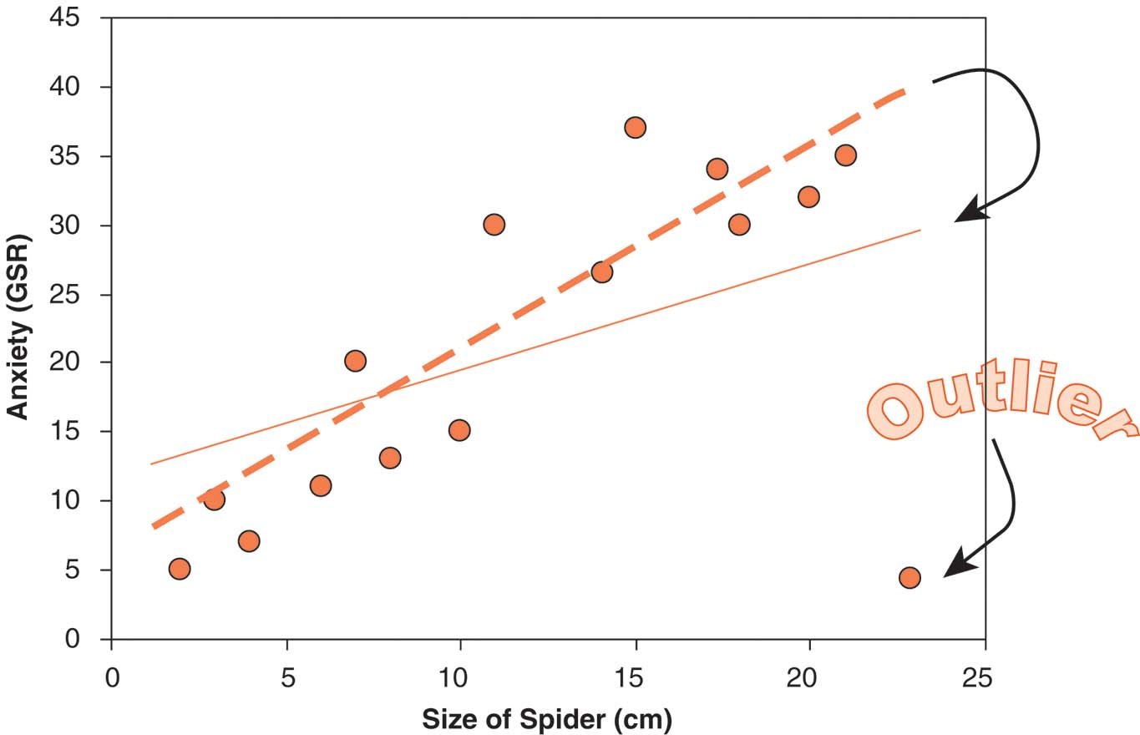
Effect of Multivariate Outliers
Notes:
An outlier near the end of the regression line can cause the line to swing dramatically, changing its slope and hence the residuals for all the other observations. The overall R² is negatively impacted, as is the Wald t-test assessing whether this predictor contributes significantly.

Slide 31
Overly-Influential Cases
Definition: A case that has a substantially greater effect on the regression model than the majority of other cases in the sample
Consequence: reduced generalizability
Screening & Solution (rules of thumb):
  if leverage > 0.50 then remove the case;
  if 0.20 ≤ leverage ≤ 0.50 and
  Cook’s distance > 1, then remove the case
Notes:
Cook's. A measure of how much the residuals of all cases would change if a particular case were excluded from the calculation of the regression coefficients. A large Cook's D indicates that excluding a case from computation of the regression statistics changes the coefficients substantially.
Leverage values. Measures the influence of a point on the fit of the regression. The centered leverage ranges from 0 (no influence on the fit) to (N-1)/N.
See SPSS help for more info!

Slide 32
Outliers & Influential cases
Outliers and influential cases should be examined and removed together
  Unlike other aspects of MR, screen only once
  Why shouldn't you repeat this screening?
SPSS: Analyze → Regression → Linear:
  Save: Standardized Resid, Cook’s, Leverage
  Will be saved as additional vars in dataset
Examine the Residual Statistics table
Examine the saved scores in the data set
  Try sorting: Data → Sort

Slide 33
Outline: Multiple Regression
Regression Modelling Process
Building a Regression Model
  Shared vs. Unique Variance
  Strategies for Entering IVs
  Interpreting Output
Diagnostic Tests:
  Residuals, Outliers, and Influential Cases
Checking Assumptions:
  Non-multicollinearity, independence, normality, homoscedasticity, linearity
Notes:
OK, so we've learned how to screen for problematic cases that might mess up our regression line.
The last thing we still need to do is assess the variables for violations of some basic assumptions which linear regression relies upon.

Slide 34
Multicollinearity
Definition: Predictors covary too highly;
i.e., too much overlap of shared variance
Consequences: deflated R²; may interfere with evaluation of β (depending on RQ & design)
In “Statistics”: check “Collinearity Diagnostics”
Indicators of possible problems: any of:
    Any VIF (Variance Inflation Factor) score > 10
    Average VIF is NOT approximately = 1
    Tolerance < 0.2
Solution: delete, combine, or transform some of the multicollinear variables
Notes:
Multicollinearity is when multiple predictors are so strongly correlated that they really behave as a single predictor.
It's not that we want all the predictors to be completely uncorrelated with each other – we've already talked about shared variance, and we would expect moderators to correlate with the predictors.
But for instance if we include both variable and a log-transformed version of the same variable, they will be perfectly correlated. Or a subscale and a composite scale which includes that subscale – e.g., BDI has an affective subscale and a somatic subscale. If we include both the affective subscale as well as the total BDI score, then we are in effect including the same information twice; we will most likely have a problem with multicollinearity. (It would be okay to put the affective and somatic subscales together in the same analysis, though.)
Graphically, picture the regression model as a tilted plane in 3D. If both predictors are extremely correlated, then the cloud of points of the dataset really looks like an elongated cigar rather than a tilted pancake. The plane can rotate freely about the axis of the cigar; the regression model is not uniquely defined. This limits the generalizability of the model.

Slide 35
Independence of Residuals
Definition: Residuals for different cases should not be systematically related
Consequence: Can interfere with α and power, although effect size is unaffected
Screening: Durbin-Watson scores that are relatively far away from 2 (on possible range of 0 to 4) indicate a problem with independence.
  D-W sensitive to case ordering, so ensure cases aren't inherently ordered in dataset
Solution: Re-evaluate sampling technique,
or try multi-level modelling.
Notes:
Independence of residuals is really another way of saying “independence of observations”, in the context of regression. It relates to experimental design and the structure of the individual cases.
The Durbin-Watson score assesses “autocorrelation” of the residuals; i.e., correlation between neighbouring residuals, as ordered in the dataset.
In theory, the ordering of the cases in our datasets should be arbitrary and random; if it isn't, the Durbin-Watson scores might suss that out.

Slide 36
Normally Distributed Residuals
Definition: Residuals normally distributed
  Predictors don't have to be normal!
Consequence: reduced generalizability
(predictive value of the model is distorted)
Screening: normality tests/plots on residuals
  save standardized residuals
  Analyze → Descriptives → Explore → “Normality tests with plots”
Solution: check if predictors are non-normal or ordinal; look for non-linearity
Notes:
We're walking through the basic assumptions of parametricity, but now in the context of regression.
We don't require that the DV by itself be normally distributed, nor the IVs, but rather that the residuals be normally distributed. Graphically, the data should be a random cloud of points centred around the regression line, normally distributed above and below it.
If the residuals show a strong skew or some other evident non-normal pattern, it could be an indicator that some transform is required on the DV.

Slide 37
Homoscedastic Residuals
Definition: Residuals should have similar variances at every point on the regression line
  Generalisation of homogeneity of variance
Consequence: the model is less accurate for some people than others
Screening: fan-shaped residual scatterplots:
  Analyze → Regression → Linear → Plots:
  X: “ZPRED” Y: “ZRESID”
Solution: identify moderators and include,
try weighted regression, or accept it and acknowledge the drop in accuracy
Notes:
We assume that the average deviation of the data away from the regression line is always the same, no matter where we are along the line. If there is some structure to this, then it means that the data fit the model more tightly at some parts then at others; we need to know why.
The ZPRED vs. ZRESID plot shows standardized residuals at different places along the regression line. We use ZPRED (standardized predicted DV score) as a way of indicating position along the regression line, because we might have multiple IVs, so we can't move along those.
A “fan-shaped” residual plot (see next slide) is a good indicator of a moderator that we need to take into account.

Slide 38
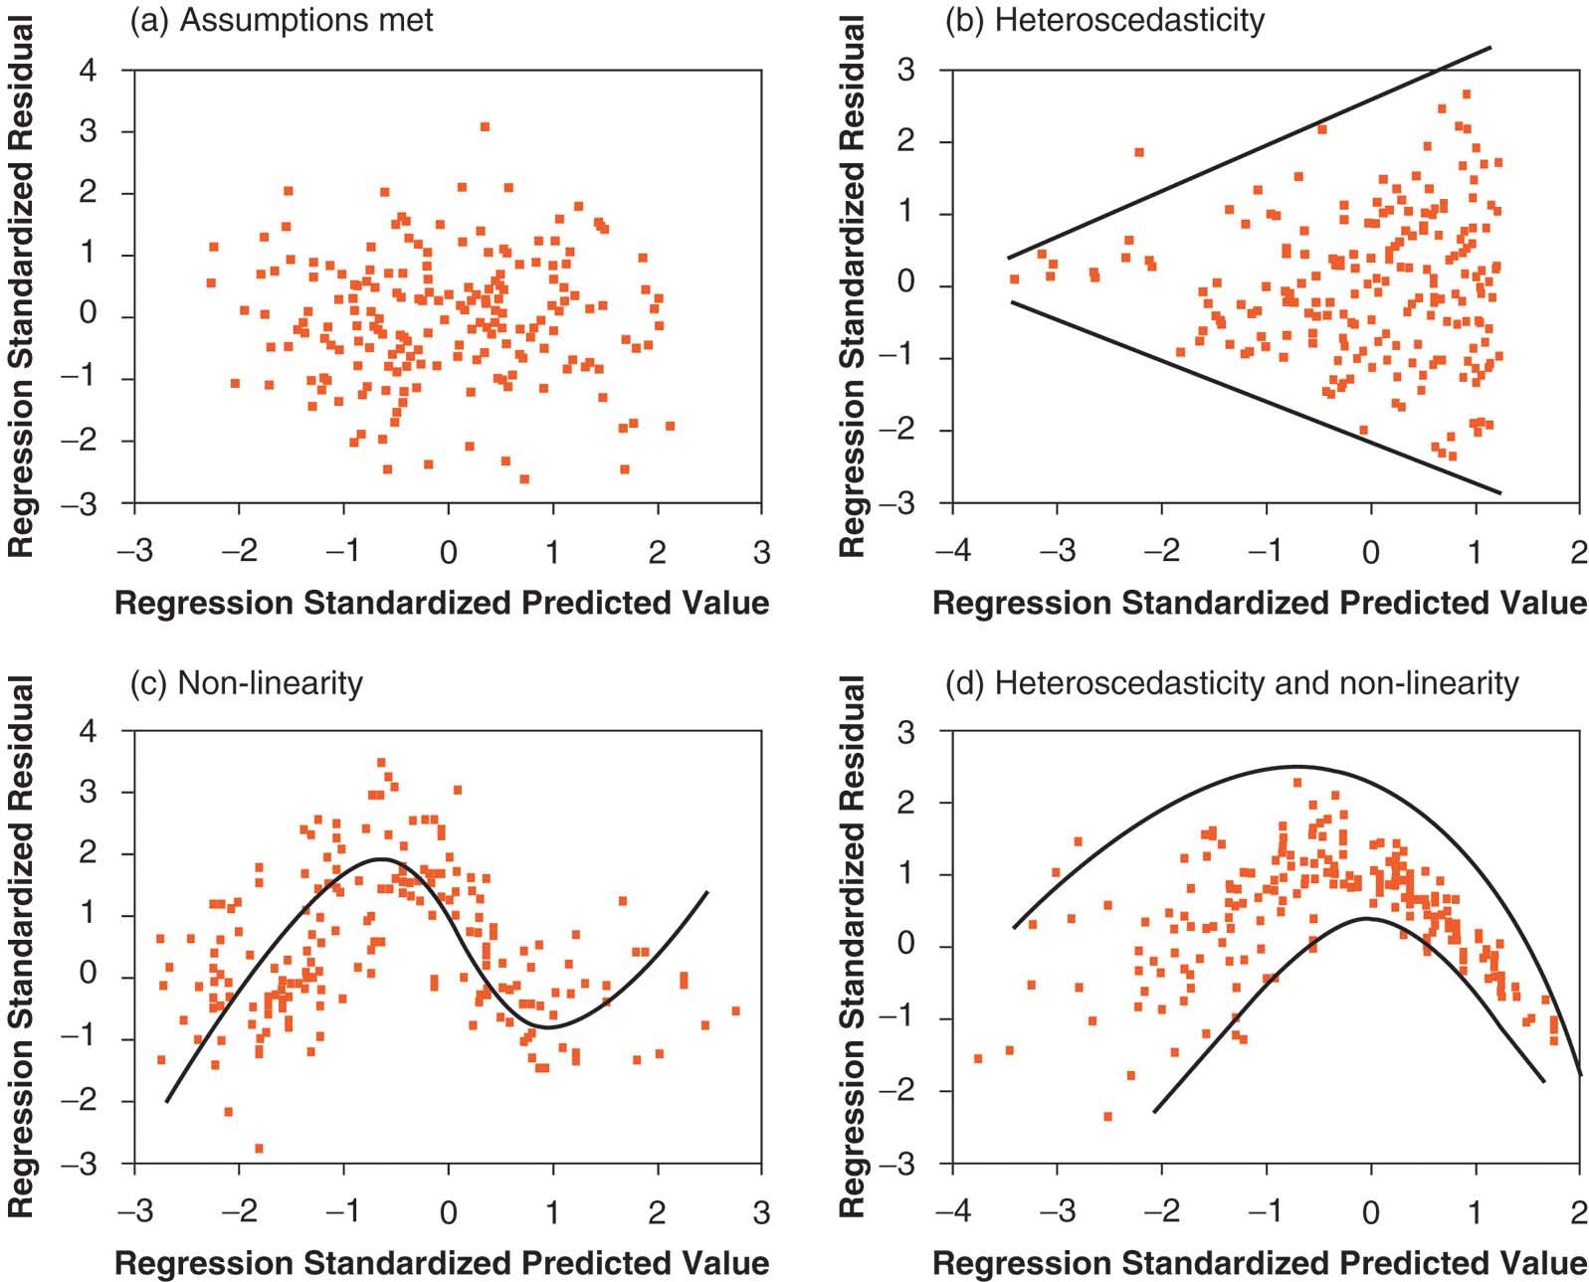
Heteroscedasticity
Notes:
The top-left graph is what we want to see: residuals are centred around the horizontal mid-line, and normally distributed above and below that line with constant variance.
The top-right graph shows heteroscedasticity, a “fan-shaped” residual plot. The variance in residuals increases with a definite structure; something odd is going on here!
The lower-left graph shows nonlinearity – the regression model assumes a linear relationship between the IVs and the DV, but perhaps the real relationship is curvilinear. We need to model that curvilinear relationship (curvilinear regression), perhaps using quadratic (X^2) or cubic (X^3) curves, or other transforms (log, exp, etc.).
The lower-right graph shows a situation with both nonlinearity and heteroscedasticity.

Slide 39
Non-linear Relationships
Definition: Relationship between predictor and outcome is not linear (i.e., a straight line).
Consequences: sub-optimal fit for the model
(R² is lower than it could be)
Screening: examine residual scatterplots
OR try curve estimation:
  Analyze → Regression → Curve estimation
Solutions: Model the non-linear relationship by entering a polynomial term into the regression equation (e.g., X², X³)
  Or just accept the poorer fit
Notes:
If your residual plot shows a clear curvilinear structure, there's something going on in your dataset, so you want to model that structure and see if there's a theoretical reason for it. It's not a bad thing – anytime you observe structure in your data, that's a good thing! But it is something we need to take into account in our model.

Slide 40
Exercise: Regression with SPSS
Dataset: Domene.sav
You try it! Build a regression model with:
  DV: “educational attainment”
  IV: Block 1: “academic performance”
  IV: Block 2: “educational aspirations” and “occupational aspirations”
  Use “Enter” method (force entry)
Ask SPSS for ΔR² and partial correlation scores

