Slide 1

Moderators and Mediators
Please download:
Peattie2.sav
ExamAnxiety.sav
14 Oct 2011
CPSY 501
Dr. Sean Ho
Trinity Western University

Slide 2
Outline for today
Moderators
  Assessment: test if we have moderation
  Interpretation
  Example: Peattie marital satisfaction dataset
Mediators
  Assessment
  Example: Exam Anxiety toy dataset
  Interpretation
  MacArthur model
Journal article: Missirlian, et al.: Regression

Slide 3
Moderators in Regression
Definition: A moderator is a variable that interacts with the predictors and the outcome,
changing the degree or direction of relationship
Predictor
Outcome
e.g., confrontational
counsellor intervention
e.g., client
outcome
Moderator
e.g., working alliance
Notes:
http://www.victoria.ac.nz/psyc/staff/paul-jose/files/modgraph/modgraph.php

Slide 4
Effect of moderation
Does the level of working alliance moderate the effect of confrontational counsellor intervention on client outcome?
High WAI
Buffering (moderating)
effect of WAI
Better
Client Outcome
Medium WAI
Low WAI
Worse
Low
Confrontational intervention
High

Slide 5
Asking good RQs
RQ1: Does working alliance moderate client outcome?
  No good: moderation requires at least three variables: IV, DV, and Mod
RQ2: Does working alliance moderate the relationship between confrontational intervention and client outcome?
  IV: confrontational intervention
  DV: client outcome
  Mod: working alliance

Slide 6
Regression vs. ANOVA
We can test for moderation in either a regression or ANOVA model:
Regression: scale-level IV and Mod
ANOVA: categorical IV and Mod
Remember that regression and ANOVA are really two sides of the same coin: both are general linear model
Today we'll focus on moderators in regression
  Assume IV, Mod, and DV are all scale-level

Slide 7
Testing for Moderation
Centre the predictor and moderator:
  Compute: IV – (IV mean) → IV_ctr
Create the interaction term:
  Compute: IV_ctr * Mod_ctr → IVxMod
Run regression model:
  Centred predictor and centred moderator go in blocks in normal order
  Interaction term goes in a subsequent block
If the interaction term is significant, you have a moderator (common in CPSY research!)

Slide 8
Interpreting Moderators
If we have moderation, the main effects (effects of each variable by itself) must be reinterpreted
The presence of a moderating effect indicates that the relationship between the predictor and the outcome variable is different for different kinds of people (as defined by the moderator)
Theory is needed to determine how to interpret the interactions.
Analytically, we need to graph the interaction to understand what is going on.

Slide 9
Example: Peattie, 2004
Birgitte Peattie’s thesis
on marriage, stress, & sanctification.
  Dataset: Peattie2.sav
RQ: Do joint religious activities buffer the effect of negative life events on marital satisfaction?
  DV: Marital Satisfaction (Mar_sat)
  IV: Negative Life Events (NLE, stress)
  Mod: Joint Religious Activities (JRA)
Buffering: high levels of a “buffer” weaken the impact of stress
  → interaction!

Slide 10
Preparing Variables
Centre predictor (NLE)
  First calculate the mean: Analyze → Descrip.
  Transform → Compute: NLE – 5.1250
  Target Variable: NLE_ctr
Centre moderator (JRA) (but don't centre DV!)
Create interaction term
  Multiply centred predictor and moderator:
  Transform → Compute: NLE_ctr * JRA_ctr
  Target Variable: NLE_x_JRA

Slide 11
Testing Moderation in Regr.
Analyze → Regression → Linear:
Dependent: Mar_sat
  Block 1: centred predictors: NLE_ctr
  Block 2: centred moderators: JRA_ctr
  Block 3: Interaction term(s): NLE_x_JRA
Statistics: R² change, Part/Partial, Collinearity, Durbin-Watson
Save: Standardized Resid., Cook's, Leverage
Plots: ZPRED vs. ZRESID, ZPRED vs. SRESID

Slide 12
Peattie Data: Model Summary
If the interaction term is significant,
we have moderation
Model Summary^{d}
Model | R | R Square | Adjusted R Square | Std. Error of the Estimate | Change Statistics
 |  |  |  |  | R Square Change | F Change | df1 | df2 | Sig. F Change
1 | .335ª | .112 | .104 | 1.39996 | .112 | 13.911 | 1 | 110 | .000
2 | .350^{b} | .122 | .106 | 1.39834 | .010 | 1.256 | 1 | 109 | .265
3 | .391^{c} | .153 | .130 | 1.37987 | .031 | 3.937 | 1 | 108 | .050
a. Predictors: (Constant), NLE_Cent
b. Predictors: (Constant), NLE_Cent, JRA_Cent
c. Predictors: (Constant), NLE_Cent, JRA_Cent, NLE_JRA_Int
d. Dependent Variable: Marital Satisfaction

Slide 13
Peattie: Coefficients Table
Coefficientsª
Model |  | Unstandardized Coefficients |  | Standardized Coefficients | t | Sig.
 |  | B | Std. Error | Beta
1 | (Constant) | 5.601 | .132 |  | 42.338 | .000
 | NLE_Cent | -.120 | .032 | -.335 | -3.730 | .000
2 (Constant) 5.600 .132 NLE_Cent -.108 .034 -.302 JRA_Cent .105 .093 .106 (Constant) 5.672 .135 NLE_Cent -.081 .036 -.224 JRA_Cent .088 .092 .089 NLE_JRA_Int .037 .019 .195 |  |  |  |  | 42.385 | .000
 |  |  |  |  | -3.195 | .002
 |  |  |  |  | 1.121 | .265
3 |  |  |  |  | 41.925 | .000
 |  |  |  |  | -2.220 | .028
 |  |  |  |  | .952 | .343
 |  |  |  |  | 1.984 | .050
a. Dependent Variable: Marital Satisfaction

Slide 14
ModGraph: Moderation Tool
Paul Jose’s ModGraph tool:
  Helps us visualize the moderating relationship: how the PV predicts the DV depending on the level of the Mod
Jose, P.E. (2008). ModGraph-I: A programme to compute cell means for the graphical display of moderational analyses: The internet version, Version 2.0. Victoria University of Wellington, Wellington, New Zealand.
http://www.victoria.ac.nz/psyc/paul-jose-files/modgraph/modgraph.php

Slide 15
Peattie: Using ModGraph
Select “Continuous Moderator”: Data Entry
Chart Labels:
  Title: “Peattie (2004)”
  X-axis (IV): “Negative Life Events”
  Y-axis (DV): “Marital Satisfaction”
  Moderator: “Joint Religious Activities”
Notes:
http://www.victoria.ac.nz/psyc/staff/paul-jose/files/modgraph/modgraph.php

Slide 16
ModGraph: Data Entry
All B values (unstandardized slopes) should come from the full (last) regression model!
Main effect:
  B=-.081, mean=0 (centred), SD=4.1157
Moderating:
  B=.088, mean=0 (centred), SD=1.4979
Interaction term and constant:
  B=.037
  Constant: 5.672

Slide 17
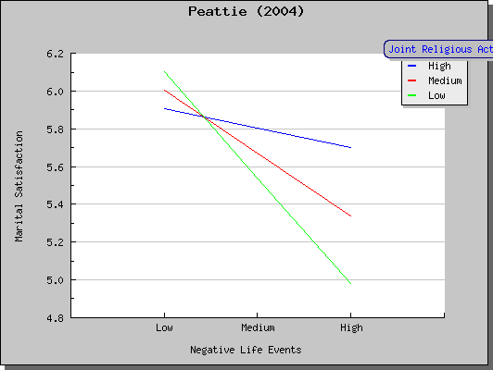
ModGraph: Results

Slide 18
Interpreting Interactions
Slope of IV regression lines differs
for various levels of the moderating variable
Peattie study example:
  In general, negative life events have a negative impact on marital satisfaction,
  However, joint religious activities weaken this negative relationship

Slide 19
Outline for today
Moderators
  Assessment: test if we have moderation
  Interpretation
  Example: Peattie marital satisfaction dataset
Mediators
  Assessment
  Example: Exam Anxiety
  Interpretation
  MacArthur model
Journal article: Missirlian, et al.: Regression

Slide 20
Mediators: Definition
A mediator is a “generative mechanism” by which a predictor influences an outcome var:
  IV has a significant relationship with DV,
  Med has sig. relshp. with both IV and DV, but
  When Med is included in the model, the relationship between IV and DV disappears
Partial mediation: if the IV-DV relationship is merely weakened rather than disappearing
Theory must support placing the mediator “between” the IV and DV in some sense

Slide 21
Mediators: Block diagram
significant, but …
Predictor
(distal)
Outcome
effect is weakened/removed
by inclusion of mediator
significant
significant
Mediator
(proximal)

Slide 22
Examples of mediators
Predictor: Childhood trauma
  Mediator: Depression
  Outcome: Eating psychopathology
Predictor: Disease severity
  Mediator: Intrusiveness of illness
  Outcome: Psychological distress
Predictor: Therapy program
  Mediator: Catharsis, problem solving, ...
  Outcome: Psychological well-being
… Others?

Slide 23
Testing for Mediators
Are all three variables significantly correlated?
Is there a relationship to mediate?
  Run regression without the mediator: sig.?
Is there a relationship between IV and Med?
  Run a simple regression with IV as predictor and Med as outcome: is it significant?
Back to the original regression model,
include the mediator in the model
(in the same block as the predictor)
  Keep any other predictors as-is in the model

Slide 24
Example: Exam Anxiety
Dataset: ExamAnxiety.sav
  (Toy dataset from the textbook)
RQ: does exam anxiety mediate the relationship between studying time and exam performance?
  IV: time spent studying
  Med: exam anxiety
  DV: exam performance
First check if all three are correlated:
  Analyze → Correlate → Bivariate

Slide 25
ExamAnxiety: Correlations
Correlations
 |  | Time Spent Revising | Exam Performance (%) | Exam Anxiety
Time Spent Studying | Pearson Correlation | 1.000 | .397** | -.709**
 | Sig. (2-tailed) |  | .000 | .000
 | N | 103 | 103 | 103
Exam Performance (%) Pearson Correlation .397** Sig. (2-tailed) .000 N 103 Pearson Correlation -.709** Sig. (2-tailed) .000 N 103 |  |  | 1.000 | -.441**
 |  |  |  | .000
 |  |  | 103 | 103
Exam Anxiety |  |  | -.441** | 1.000
 |  |  | .000
 |  |  | 103 | 103
**. Correlation is significant at the 0.01 level (2-tailed).

Slide 26
ExamAnxiety: Main effect
Next, we check to see if there is a main effect between study time and exam performance
  If not, then there is no relationship to be mediated!
Analyze → Regression → Linear:
  Dependent: Exam Performance
  Block 1: Time Spent Revising
  If we had any other predictors (including other moderators), we'd include them according to their blocks

Slide 27
Main effect: Results
Model Summary
Model | R | R Square | Adjusted R Square | Change Statistics
 |  |  |  | F Change | df1 | df2 | Sig. F Change
1 | .397ª | .157 | .149 | 18.865 | 1 | 101 | .000
a. Predictors: (Constant), Time Spent Studying
Coefficientsª
Model |  | Unstandardized Coefficients |  | Standardized Coefficients | t | Sig.
 |  | B | Std. Error | Beta
1 | (Constant) | 45.321 | 3.503 |  | 12.938 | .000
 | Time Spent Studying | .567 | .130 | .397 | 4.343 | .000
a. Dependent Variable: Exam Performance (%)

Slide 28
ExamAnxiety: IV to Med
Now we must evaluate the relationship between the predictor and the mediator:
Analyze → Regression → Linear:
  Dependent: Exam Anxiety
  Block 1: Time Spent Revising
  For this side analysis, we don't need any other variables, just simple regression

Slide 29
Predictor to Mediator: Results
Model Summary
Model | R | R Square | Adjusted R Square | Change Statistics
 |  |  |  | F Change | df1 | df2 | Sig. F Change
1 | .709ª | .503 | .498 | 102.233 | 1 | 101 | .000
a. Predictors: (Constant), Time Spent Studying
Coefficientsª
Model |  | Unstandardized Coefficients |  | Standardized Coefficients | t | Sig.
 |  | B | Std. Error | Beta
1 | (Constant) | 87.668 | 1.782 |  | 49.200 | .000
 | Time Spent Studying | -.671 | .066 | -.709 | -10.111 | .000
a. Dependent Variable: Exam Anxiety

Slide 30
ExamAnxiety: Full Model
Finally, we run the full regression model, now including the mediator in the same block as the predictor:
Analyze → Regression → Linear:
  Dependent: Exam Performance
  Block 1: Time Spent Revising, Exam Anxiety
  Any other predictors/moderators would be included according to plan
See if the mediator is significant in the model, but the predictor is now no longer significant

Slide 31
Full Model: Output
Model Summary
Model | R | R Square | Adjusted R Square | Change Statistics
 |  |  |  | F Change | df1 | df2 | Sig. F Change
1 | .457ª | .209 | .193 | 13.184 | 2 | 100 | .000
a. Predictors: (Constant), Exam Anxiety, Time Spent Studying
Coefficientsª
Model |  | Unstandardized Coefficients |  | Standardized Coefficients | t | Sig.
 |  | B | Std. Error | Beta
1 | (Constant) | 87.833 | 17.047 |  | 5.152 | .000
 | Time Spent Studying | .241 | .180 | .169 | 1.339 | .184
 | Exam Anxiety | -.485 | .191 | -.321 | -2.545 | .012
a. Dependent Variable: Exam Performance (%)

Slide 32
ExamAnxiety: Block Diagram
β = .397, p < .001
Study Time
Exam
Perform.
β = .169, p = .184
β = -.709, p < .001
β = -.321, p = .012
Exam
Anxiety
Study time influences exam performance indirectly, via the mediator of exam anxiety
Report p-values and effect sizes (β, R²)

Slide 33
MedGraph: mediation tool
Paul Jose's MedGraph:
  Tool to visualize the mediation relationship
  http://www.victoria.ac.nz/psyc/paul-jose-files/medgraph/medgraph.php
Sobel test: one way to check partial mediation
  Kristopher Preacher and Andrew Hayes
  http://people.ku.edu/~preacher/sobel/sobel.htm
  May have problems with power

Slide 34
Interpreting Mediators
Conclude that what appeared to be a real relationship between the predictor and outcome is actually an indirect relationship,
and due to the mediator variable.
Report:
  Relationships (β, R²) between the predictor and the outcome variable before and after the mediator is entered into the model
  Relationships between the mediator and predictor, and between mediator and outcome variable (in the final model)

Slide 35
Moderation or Mediation?
Does the level of dyadic coping employed by a couple change the impact that emotional expression has on a couple's stress level?
Is the relationship between quality of relationships and depression best understood by considering social skills?
Does psychotherapy reduce distress by its ability to inspire hope in clients?
The rules of thumb for discerning between moderation and mediation are somewhat fluid!

Slide 36
MacArthur Model
The current definitions and procedures for assessing moderation and mediation are largely due to Baron and Kenny (1986)
MacArthur model is a more general approach:
  Is IV correlated with DV? (can be ok if not)
  Is Med correlated with DV? (try Spearman)
  Show that the effect of IV on DV can be explained at least in part by Med:
  can use linear regression or other means
  If interaction of IV*Med significantly predicts DV, this can be evidence of mediation, too

Slide 37
MacArthur vs. Baron+Kenny
Both rely on prior theory to tell us
temporal sequencing of IV → Med → DV
B+K explicitly tests the IV → Med relationship
  MacArthur relies on temporal sequencing
MacArthur tests for interaction of IV*Med on DV
  B+K does not test interaction (moderation)
B+K adopts assumptions of linear regression (e.g., parametricity, linearity)
  MacArthur is flexible to other non-param. methods: even correlation can be Spearman

Slide 38
Further Reading
The original Baron+Kenny paper:
  Baron, R. M., & Kenny, D. A. (1986). The moderator-mediator variable distinction in social psychological research: Conceptual, strategic and statistical considerations.
  Journal of Personality and Social Psychology, 51, 1173-1182.
Comparison of B+K to MacArthur model:
  Kraemer, H. C., Kiernan, M., Essex, M., & Kupfer, D. J. (2008). How and why criteria defining moderators and mediators differ between the Baron & Kenny and MacArthur approaches. Health Psychology 27, S101–S108.
Checklist for moderators / mediators:
  Assessing Mediators and Moderators.doc

Slide 39
Outline for today
Moderators
  Assessment: test if we have moderation
  Interpretation
  Example: Peattie marital satisfaction dataset
Mediators
  Assessment
  Example: Exam Anxiety
  Interpretation
  MacArthur model
Journal article: Missirlian, et al.: Regression

Slide 40
Journal Article: Missirlian, et al.
Missirlian, T. M., Toukmanian, S. G., Warwar, S. H., & Greenberg, L. S. (2005).
Emotional Arousal, Client Perceptual Processing, and the Working Alliance in Experiential Psychotherapy for Depression. Journal of Consulting and Clinical Psychology, 73(5), 861-871.
We skimmed this before; now we can understand it more fully!
RQ: “…client emotional arousal, perceptual processing, and the working alliance, together, would be a better predictor of therapy outcome than any one of these variables alone”

Slide 41
Methodology
Participants: 32 of 500 individuals recurited met criteria for inclusion – screened to ensure mild to moderate levels of depression (no comorbid dx, no Axis-II dx, no medications, not receiving treatment elsewhere)
Method: participants were randomly assigned to 1 of 11 possible therapists to complete between 14 and 20 manualized sessions
Depression (BDI) was measured pre-treatment
4 outcome measures were collected at 3 phases (early, middle, late) in the therapeutic process

Slide 42
IVs: Therapeutic Processes
Emotional Arousal: Two independent and blind raters used video tape + transcript to rate on the Client Emotional Arousal Scale-III
Perceptual Processes: Two other independent judges watched the same tapes, rating on Levels of Client Perceptual Processing (from 'recognition' at one end to 'integration' at other)
Working Alliance: Clients completed (self-rated) the Working Alliance Inventory at the end of each session.

Slide 43
DVs: Therapeutic Outcomes
Depression: Beck Depression Inventory (BDI)
Self-esteem: Rosenberg Self-Esteem Scale (SES)
Stress due to Interpersonal Sources:
Inventory of Interpersonal Problems (IIP)
Psychopathology: Global Symptom Index (GSI) of the Symptom Checklist-90 (SCL-90)

Slide 44
Analysis Method?
What kind of a design are we working with?
  Longitudinal: Correlations between variables observed over time
  Procedure: Manualized therapy for clients with depression
  Measures: Coding of transcripts of therapy sessions (arousal, perceptions) and some self-report measures (BDI, WAI)
A series of hierarchical regression analyses test the predictive ability of the three therapeutic process measures in relation to the four outcome measures.
Notes:
Characteristics of Hierarchical Regression (review):
Regression predictors selected based on past work
Experimenter decides what order to enter the predictors into the model (known predictors always entered first according to order of importance).
New predictors can then be entered ‘all in one go’ (stepwise) or hierarchically (predictor expected to be most important entered first).

Slide 45
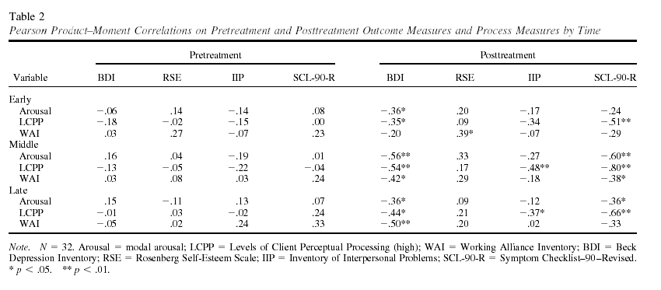
Correlation: Check Assumptions
NO perfect multicollinearity: no perfect linear relationship between two or more predictors
Linearity: Assume the relationship we're modelling is a linear one

Slide 46
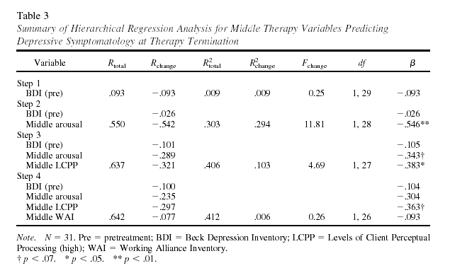
Results: Mid-Therapy
‘Arousal’ adds only marginal
Unique improvement over
Perceptual Processes
Emotional Arousal & Perceptual Processes significantly increased prediction for Depression

Slide 47
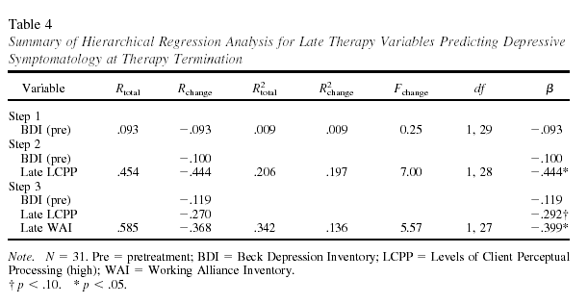
Results: Late-Therapy
LCPP adds only ‘marginally significant’
unique improvement over WAI
Adding Working Alliance on top of Perceptual Processing improved prediction of depressive symptoms (explaining 34% of the variance)

Slide 48
Limitations? Future work?
Small sample size (n=32): limited power
  But don't dismiss results simply because of “marginal significance” – look at effect size
Homogenous sample:
selecting for only mild to moderate depression doesn't mirror the reality of the clinical world
Self-report inventories for outcome measures: influenced by “demand characteristics”?
Later regression models are built
based on results of earlier regression tests:
inflated “experiment-wise” Type-I error?

