Slide 1

Categorical Data Analysis:
Logistic Regression and
Log-Linear Regression
For discussion:
Myers & Hayes
Horowitz
For the lecture:
GenderDepr.sav
Fitzpatrick et al.
26 Nov 2010
CPSY501
Dr. Sean Ho
Trinity Western University

Slide 2
Outline for today
Linear models:
  Logistic regression
  Log-linear regression
Categorical Data Analysis
  2 vars: chi-squared test, effect sizes
  Multiple vars: log-linear analysis
  Example: Fitzpatrick '01

Slide 3
Generalized Linear Model
To deal with a categorical DV, we need the Generalized Linear Model:
  f( Y ) ~ X₁ + X₂ + …
  The linear model predicts not Y directly, but the link function f() applied to Y
Examples of link functions:
  f(Y) = log(Y): log-linear regression
  Used when Y represents counts/frequencies
  f(Y) = logit(Y): logistic regression
  Used when Y represents a probability (0..1)

Slide 4
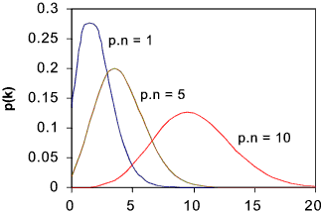
GLM: log-linear regress.
roymech.co.uk
When DV is counts/frequencies,
its distribution is often
not normal, but Poisson
  e.g., DV = # violent altercations
  If mean is large, Poisson → normal
e.g., “log( violent_alts ) ~ depression”
  residuals (ε) are also Poisson distributed
Log-linear is also used to look at many cat. vars
  IVs are all categorical (factorial cells)
  DV = # people in each cell
  Fitzpatrick, et al. example paper later

Slide 5
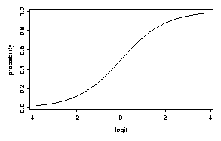
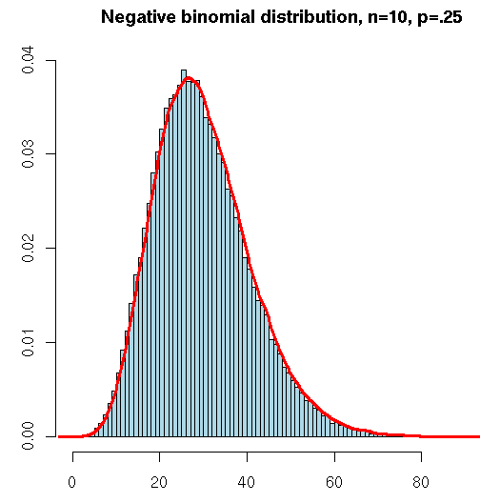
GLM: logistic regression
Princeton WWS 509
When DV is a probability (0 to 1),
the distribution is binomial
  e.g., DV = “likelihood to develop depress.”
  Probability of Y: P(Y). Odds of Y:
  Logit link function: logit(Y) = log( odds(Y) )
Also works for DV = # out of total
  e.g., DV = “# correct out of 100”
  As #tot → ∞, binomial → Poisson
Also works for binary (dichot.) DV
  e.g., DV = “is pregnant”
$\frac{P\left(Y\right)}{1−P\left(Y\right)}$
zoonek2.free.fr

Slide 6
Outline for today
Linear models:
  Logistic regression
  Log-linear regression
Categorical Data Analysis
  2 vars: chi-squared test, effect sizes
  Multiple vars: log-linear analysis
  Example: Fitzpatrick '01

Slide 7
Contingency tables
When comparing two categorical variables, all observations can be partitioned into cells of the contingency table
  e.g., two dichotomous variables: 2x2 table
  Gender vs. clinically depressed:
 | Depressed | Not Depressed
Female | 126 | 154
Male | 98 | 122
  RQ: is there a significant relationship between gender and depression?

Slide 8
SPSS: frequency data
Usually, each row in the Data View represents one participant
  In this case, we'd have 500 rows
For our example, each row will represent one cell of the contingency table, and we will specify the frequency for each cell
Open: GenderDepr.sav
Data → Weight Cases: Weight Cases by
  Select “Frequency” as Frequency Variable

Slide 9
2 categorical vars: χ² and φ
Chi-squared (χ²) test: Two categorical variables
  Asks: is there a significant relationship?
Requirements on expected cell counts:
  No cells have expected count ≤ 1, and
  <20% of cells have expected count < 5
  Else (for few counts) use Fisher's exact test
Effect size:
  φ is akin to correlation: definition: φ² = χ² / n
  Cramer's V extends φ for more than 2 levels
  Odds ratio: #yes / #no

Slide 10
SPSS: χ² and φ
Analyze → Descriptives → Crosstabs:
  One var goes in Row(s), one in Column(s)
  Cells: Counts: Observed, Expected, and Residuals: Standardized, may also want Percentages: Row, Column, and Total
  Statistics: Chi-square, Phi and Cramer's V
  Exact: Fisher's exact test: best for small counts, computationally intensive
If χ² is significant, use standardized residuals
(z-scores) to follow-up which categories differ

Slide 11
Reporting χ² results
As in ANOVA, IVs with several categories require follow-up analysis to determine
which categories show the effect
  The equivalent of a single pairwise comparison is a 2x2 contingency table!
Report:
“There was a significant association between gender and depression, χ²(1) = ___, p < .001. Females were twice as likely to have depression as males.”
  Odds ratio: (#F w/depr) / (#M w/depr)

Slide 12
Outline for today
Linear models:
  Logistic regression
  Log-linear regression
Categorical Data Analysis
  2 vars: chi-squared test, effect sizes
  Multiple vars: log-linear analysis
  Example: Fitzpatrick '01

Slide 13
Many categorical variables
Need not have IV/DV distinction
Use log-linear: Generalized Linear Model
  Include all the categorical vars as IVs
  DV = # people in each cell
  e.g., “count ~ employment * gender * depr”
Look for moderation / interactions:
  e.g., employment * gender * depression
Then lower-level interactions and main effects
  e.g., employment * depression

Slide 14
Goodness of Fit
Two χ² metrics measure how well our model (expected counts) fits the data (observed):
  Pearson χ² and likelihood ratio (G) (likelihood ratio is preferred for small n)
Significance test looks for deviation of observed counts from expected (model)
  So if our model fits the data well, then the Pearson and likelihood ratio should be small, and the test should be non-significant
SPSS tries removing various effects to find the simplest model that still fits the data well

Slide 15
Hierarchical Backward Select'n
By default, SPSS log-linear regression uses automatic hierarchical “backward” selection:
Starts with all main effects and all interactions
  For a “saturated” categorical model, all cells in contingency table are modelled, so the “full-factorial” model fits the data perfectly: likelihood ratio is 0 and p-value = 1.0.
Then removes effects one at a time, starting with higher-order interactions first:
  Does it have a significant effect on fit?
  How much does fit worsen? (ΔG)

Slide 16
Example: Fitzpatrick et al.
    Fitzpatrick, M., Stalikas, A., Iwakabe, S. (2001).
    Examining Counselor Interventions and Client Progress in the Context of the Therapeutic Alliance. Psychotherapy, 38(2), 160-170.
Exploratory design with 3 categorical variables, coded from session recordings / transcripts:
  Counsellor interventions (VRM)
  Client good moments (GM)
  Strength of working alliance (WAI)
Therapy: 21 sessions, male & female clients & therapists, expert therapists, diverse models.

Slide 17
Fitzpatrick: Research Question
RQ: For expert therapists, what associations exist amongst VRM, GM, and WAI?
Therapist Verbal Response Modes:
  8 categories: encouragement, reflection, self-disclosure, guidance, etc.
Client Good Moments:
  Significant (I)nformation,
  (E)xploratory, or (A)ffective-Expressive
Working Alliance Inventory
  Observer rates: low, moderate, high
Notes:
N = 2007 statement pairs from those 21 sessions

Slide 18
Fitzpatrick: Abstract
Client “good moments” did not necessarily increase with Alliance
Different interventions fit with
good moments of client information (GM-I)
at different Alliance levels.
“Qualitatively different therapeutic processes are in operation at different Alliance levels.”
Explain each statement and how it summarizes the results.

Slide 19
Top-down Analysis: Interaction
As in ANOVA and Regression, Loglinear analysis starts with the most complex interaction (“highest order”) and tests if
it adds incrementally to the overall model fit
  Compare with ΔR² in regression analysis
Interpretation focuses on:
  3-way interaction: VRM * GM * WAI
  Then the 2-way interactions: GM * WAI, etc.
Fitzpatrick did separate analyses for each of the three kinds of good moments:
GM-I, GM-E, GM-A

Slide 20
Results: Interactions
2-way CGM-E x WAI interaction:
  Exploratory Good Moments tended to occur more frequently in High Alliance sessions
2-way WAI x VRM interaction:
  Structured interventions (guidance) take place in Hi or Lo Alliance sessions, while
  Unstructured interventions (reflection) are higher in Moderate Alliance sessions
  Describes shared features of “working through” and “working with” clients, different functions of safety & guidance.

Slide 21
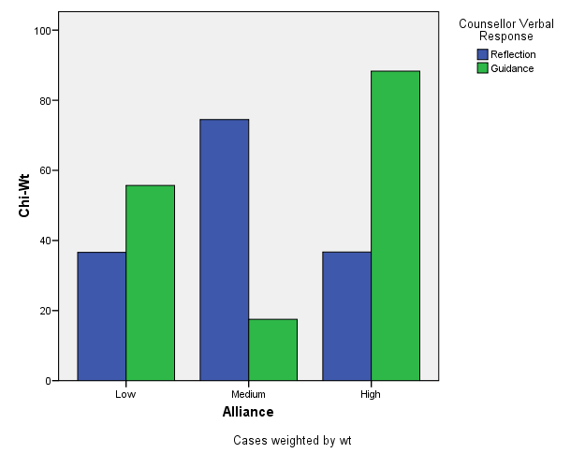
Notes:
From Table 5, p. 158; Fitzpatrick & al. (2001). Chi-square weights transformed in this graph can be interpreted as “relative deviation” descriptors, allowing comparability across cells, but without specific significance levels. (Parameter testing exaggerates experiment-wise error rates in this particular research design). N = 2007 T-C statement pairs in 21 therapy sessions, approx. 96 statements per session.

Slide 22
Formatting Tables in MS-Word
Use the “insert table” and “table properties” functions of Word to build your tables; don’t do it manually.
General guidelines for table formatting can be found on pages 147-176 of the APA manual.
Additional tips and examples: see NCFR site: http://oregonstate.edu/~acock/tables/
In particular, pay attention to the column alignment article, for how to get your numbers to align according to the decimal point.

