Slide 1
UML: Sequence Diagrams
10 Mar 2010
CMPT166
Dr. Sean Ho
Trinity Western University

Slide 2
Steps of OO design
Requirements: system behaviour
  Use-cases, UI mockups
Design: components / modules
  Component diagrams, CRC diagrams
  Sequence diagrams of messages passed
  State of objects/componets
Implementation: from components to classes
  Class diagrams, relationships
  Inheritance, composition, etc.

Slide 3
UML diagrams for design
UML is just a description of several commonly-used diagrams useful for design:
Collaboration diagrams (CRC)
Class diagrams
Use-case diagrams
Sequence diagrams
State diagrams
Activity diagrams
Component diagrams

Slide 4
Sequence diagrams
Describes behaviour via messages passed
  Lower-level than use-cases
Each object / actor / component has a lifeline
Messages: horiz. arrow. Activities: vertical box
Caller
Phone
Phone
Recipient
Pick up
Dial tone
Dial
Ring notify
Ring phone
Ring
Pick up
“Hello?”

Slide 5
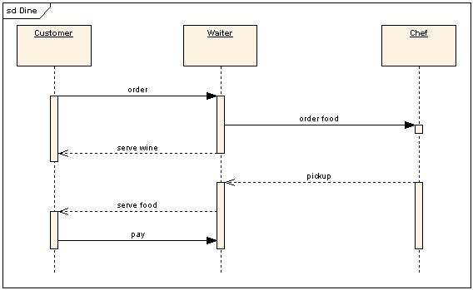
Activity lifecycle
Each vertical box represents an activity performed by the actor / object / component
The vertical length is the duration of the activity
Messages may trigger activities to start
When an activity
completes, it
may trigger a
return message
(dotted)
Wikipedia: UML

Slide 6
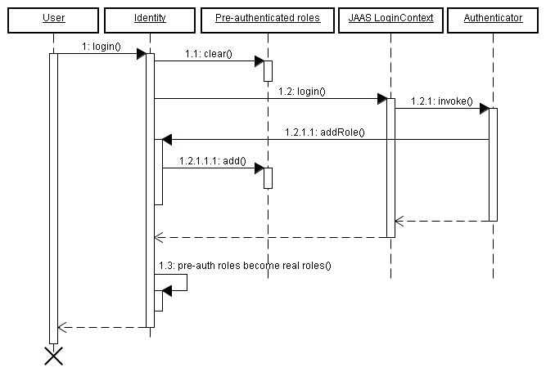
Object lifecycle
When an object dies, an 'X' marks the end of its lifeline:
RedHat: JBoss docs

Slide 7
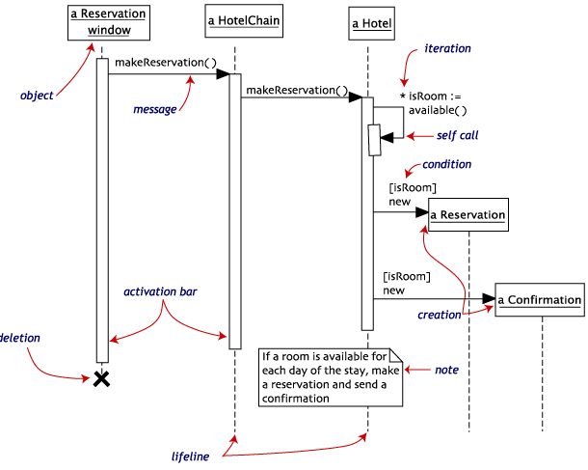
Self-called messages
An object may send a message to itself:
  Arrow loops back to itself
A message may
also be sent
multiple times:
Usually put loops
in a shaded box

Slide 8
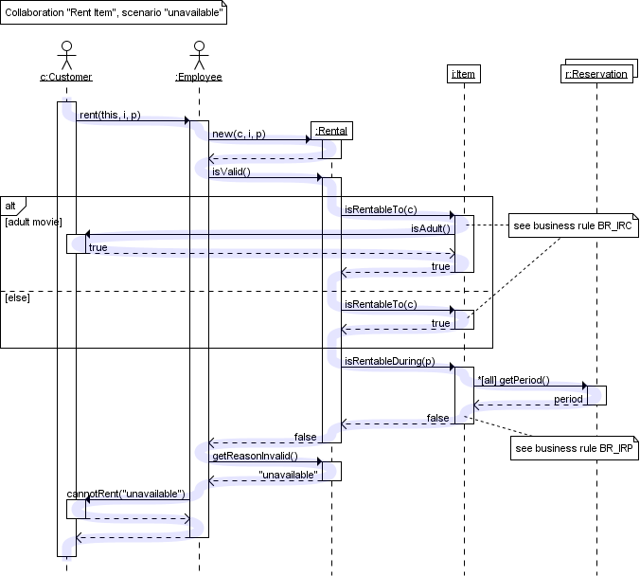
If/else clauses
TraceModeler
Put both cases
in dotted boxes,
with condition

Slide 9
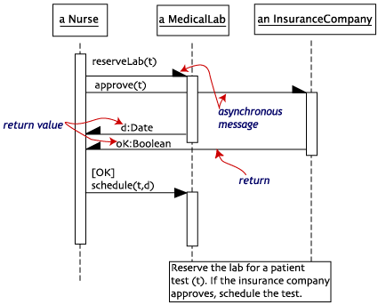
Asynchronous communication
Synchronous messages (full arrowhead)
require recipient to be listening right then
Asynchronous messages (half arrowhead)
can be read by
recipient at
a later time
  Phone call
  vs. postal mail
  Chat vs. email

Slide 10
UML Software Tools
Eclipse UML2Tools plug-in (in Model Dev. Tools)
  Help → Install New… → Add …
  Paste URLs for MDT and EMF
  Other plug-ins (M2T) can auto-generate code from your diagrams!
Dia: free diagram editor (not specifically UML)
IBM Rational Modeler
  free version of commercial Rhapsody prod.
  Complex but complete UML modelling tool
Or draw your own by hand!

