Slide 1
UML: Class Diagrams,
Use-Case Diagrams
17 February 2011
CMPT166
Sean Ho
Trinity Western University

Slide 2
What's on for today
What is UML?
CRC diagrams and class diagrams
  Subclass, association, aggregation, composition
Use-case diagrams
  Actors and use cases
  Direction, multiplicity, includes
  Basic flow, alternate flows
Component design

Slide 3
Unified Modeling Language
Diagrams to help design your programs
Main diagram types:
  Static: Class diagram, object, package
  Dynamic: Use case diagram, sequence diagram, state chart
Draw by hand, or use software tools:
Eclipse EMF, MS Visio, Oracle NetBeans
By Booch, Rumbaugh, and Jacobson, of
OMG (Object Management Group)
  Current version is 2.0: www.uml.org

Slide 4
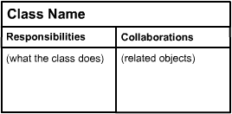
CRC diagrams
computingstudents.com
Class:
  Short descriptive name for the component
Responsibility:
  Data stored in the class
  Restrictions on access to the data
  Actions the class is responsible for
Collaborator:
  e.g., types of our attributes/data
  Other classes whose methods we call
  Other classes who call our methods

Slide 5
UML class diagram
Each box represents a class (type)
  Name, attributes, methods
  Static (class) members are underlined
  Flag: public (+), private (-), protected (#)
Lines show relationships between classes
Person
- String name - Date birthdate
+ String getName()
Student
- ID: int - GPA: float
+ float getGPA()

Slide 6
Class diagram: relationships
Person
Class relationships: e.g., superclass:
  Hollow arrow-head pointing to super
Instance relationships:
  e.g., every Car has an instance of Engine
  relationship between instances of the classes, not entire classes
Multiplicity: e.g., “*”: any number of instances
  “1..*”: one or more instances
  “0..1”: optional one instance
Student
Car
Engine
0..1
1

Slide 7
Instance relationships
Association: label with the relationship;
arrow indicates direction of dependency
Aggregation: container
“A is part of B” (but can exist apart from B)
Composition: “B owns an A”
Life-cycle dependency:
when B dies, so should its instance of A
Person
lives at
Address
*
1
Company
Employee
0..1
1..*
Car
Engine
0..1
1

Slide 8

An example class diagram
crionics.com
Ordering system: each Order has multiple OrderDetail line items

Slide 9
Steps to OO design: wADes
  (Prereq: understand client requirements)
System behaviour
  Use-case scenarios
  User interface mockups
Components
  Self-contained blocks with
  narrow interactions
From components to classes
  Attributes, methods, relationships

Slide 10
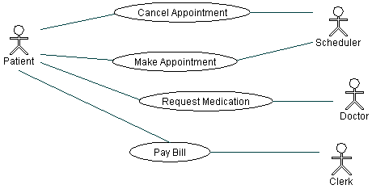
UML: Use case diagram
Describes relationships between actors:
    Patient calls the clinic to make an appointment
    Receptionist books timeslot
    Patient sees doctor and requests medication
    Patient pays bill to clerk
More details: Borland's UML tutorial

Slide 11
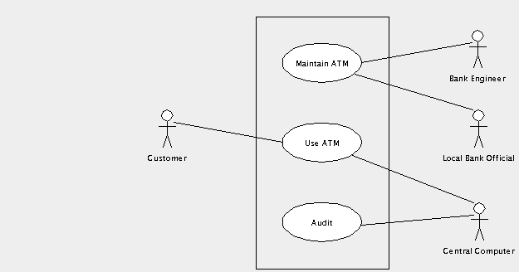
System behaviour: use-case
UML use-case diagrams show:
  The actors involved (may be nonhuman!)
  Ways in which the actors interact: relationships,
  actions,
  use cases, etc.
Example: ATM
(thanks to
ArgoUML)

Slide 12
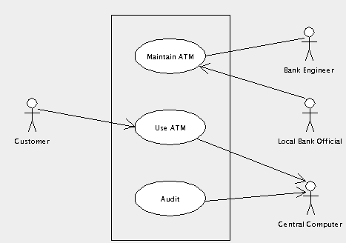
Use case: navigation
Direction of arrows indicates which actor is passive and which is active:
What
direction
should the
arrows point
between
“Maintain ATM”
and
“Engineer”?

Slide 13
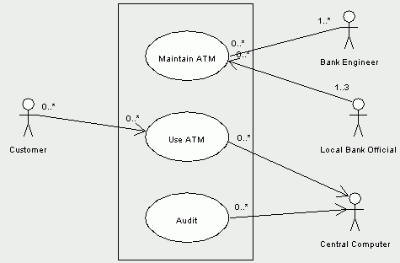
Use case: multiplicity
Numbers indicate how many instances of an actor can be doing how many instances of the use case
e.g., only
allow
up to 3
Bank Officials

Slide 14
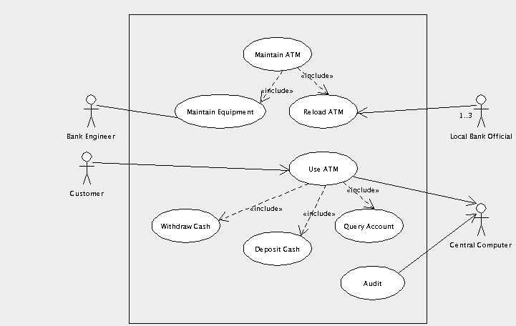
Use case diagram: includes
We may need to break down each use case into smaller chunks to implement

Slide 15
Components of a use case
Each use case should have:
  Short name
  Goal: what does it achieve for its actors?
  Names of actor(s) involved
  Pre/post-conditions?
  Basic flow: break down into steps (pseudocode!)
  Alternate flows: what if user inputs something different from the usual?

Slide 16
Ex. use case: Withdraw Cash
Name: Withdraw cash
Goal: Customer gets cash; Computer ensures sufficient funds, logs a record
Actors: Customer, Central Computer
Basic flow:
  Customer selects account to withdraw from
  Customer inputs dollar amount of cash
  ATM verifies with Computer enough money
  ATM dispenses cash to Customer
  ATM prints receipt

Slide 17
Ex. use case: alternate flows
How might the basic flow not work?
What might go wrong?
  ATM out of cash
  NSF in customer account
  Wrong PIN, bad card
  Withdraw negative amount
  Unverified deposit
  Network error, forget to logout
Each results in an alternate flow:
how to handle that alternate situation

