Slide 1
Networking in Java
10 March 2011
CMPT166
Sean Ho
Trinity Western University

Slide 2
Outline for today
Sockets: TCP vs. UDP
TCP client-server in Java
  Multithreaded server
UDP communication in Java
Networking concepts
  IP addresses
  NAT
  IPv6
  DNS

Slide 3
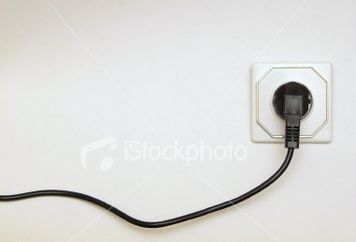
Sockets
Sockets are a way for
processes to communicate
  Foundation of the Internet, including HTTP, FTP, IM, streaming media, etc.
Local or Internet: same host or diff hosts?
Connection-based or connectionless:
must each packet specify destination?
Packets or streams: message boundaries?
Reliable or unreliable: Can messages be lost, duplicated, reordered, or corrupted?

Slide 4
TCP vs. UDP
All data on the Internet is sent via packets conforming to the Internet Protocol (IP)
  Specify host and port (0-65535)
Two most common types of packets:
  TCP: Transmission Control Protocol:
    Virtual circuit: connection-based
    Client-server model
  UDP: User Datagram Protocol:
    Connectionless: peer-to-peer, less overhead
    Packets might disappear, or be out of order,
    or get duplicated

Slide 5
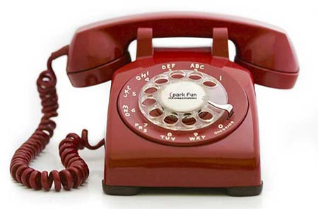
TCP client-server
TCP is connection-based:
  Phone analogy
  Initial setup, but subsequent packets do not need to specify destination again
  Server: waits, listens for client
  Client: initiates connection (phone call)
  Once connection is established, communication may be two-way (send/receive)
  Either client or server may terminate

Slide 6
Making a TCP Server in Java
java.net.ServerSocket object
    server = new ServerSocket( port, maxcl );
  port: port to listen on (0-65536, 0-1023 reserved)
  maxcl: queue length (reject extra clients)
  BindException raised if port invalid or in use
Bind socket (start listening) (blocking):
    conn = server.accept();
  Returns a java.net.Socket object
Communicate via streams:
    conn.getInputStream();
    conn.getOutputStream();

Slide 7
Communicating with streams
Both client and server may send or receive:
  conn.getInputStream()
  conn.getOutputStream()
Communicate via text streams:
  new Scanner( conn.getInputStream() );
  new PrintWriter( conn.getOutputStream() );
Or object streams:
  new ObjectInputStream( conn.getInputStream() );
  new ObjectOutputStream( conn.getOutputStream() );

Slide 8
How do we accept clients?
Iterating server: only one client at a time
  One operator answering phones
  Simplest to implement
Forking server:
  Split off a child thread for each connection
  Original master thread continues to listen
  Switchboard

Slide 9
More on forking server
Multiple threads running concurrently
Master thread listens on port
When a client connects, fork off a thread
  Thread handles communication with that client
Master thread continues listening for other connections (switchboard)
Overhead in forking new threads: so keep pool of available threads, and reuse dormant threads

Slide 10
Connectionless client/server
TCP is connection-oriented
UDP is connectionless
  Send data one packet at a time
    Similar to envelopes through CanadaPost
    Fragment larger data into multiple packets
  Packets might:
    Not arrive at all
    Arrive out of order
    Get duplicated
  Less overhead, better latency and possibly better throughput

Slide 11
Receiving a UDP packet
Create a DatagramSocket (in java.net):
    sock = new DatagramSocket( port );
Create a DatagramPacket to store the data:
    byte payload[] = new byte[ 100 ];
    packet = new DatagramPacket(
    payload, payload.length );
Wait (block) for a packet:
    sock.receive( packet );
Read info from packet:
    packet.getData(), .getLength(), .getAddress(), .getPort()

Slide 12
Sending a UDP packet
Prepare payload:
    String msg = “Hello, World!”;
    byte[] payload = msg.getBytes();
Package payload:
    packet = new DatagramPacket(
    payload, payload.length,
    hostname, port );
Send packet:
    socket.send( packet );

Slide 13
Networking layers
OSI 7-layer model of networking
7: Application (HTTP, SMTP)
6: Presentation: data repr., encryption (SSL)
5: Session: auth, session checkpointing/restore, stream synchronization (sockets, SSH, RPC)
4: Transport: reliability, connection (TCP, UDP)
3: Network: routing, addressing (IP)
2: Data link: physical address (Ethernet MAC)
1: Physical: signals (twisted-pair, fiber, radio)

Slide 14
IP addresses
Every public Internet host has an IP address:
  Four bytes: e.g., 64.114.134.52
IP addresses are partitioned into networks (blocks of addresses), via a netmask:
  e.g., 64.114.134.52 / 255.255.255.0 (or /24)
  means range: 64.114.134.0 – 64.114.134.255
Large chunks of the IP address space have been given out to countries, organizations, companies, etc.
  IBM has 9.0.0.0 / 8 (1/256th of the IP space!)

Slide 15
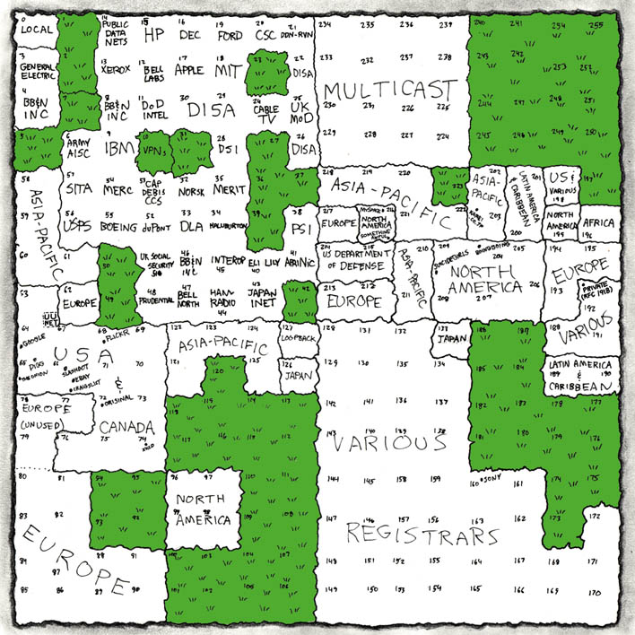
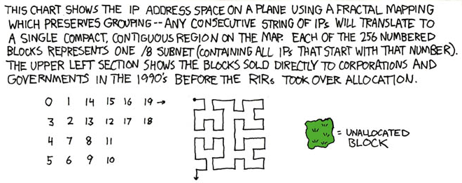
xkcd visualization of IP space
http://xkcd.com/195/

Slide 16
Running out of IP space: NAT
Very few public IP addresses left! Solutions?
NAT (Network Address Translation)
  LAN goes through router to get to Internet
  Router gets one public IP address
    64.114.134.52 is TWU's
  LAN gets private IP addresses:
    192.168.*/16, 172.16.*/12, 10.*/8
  Connections mapped to ports on the router
  How to run public services on a LAN host?

Slide 17
Running out of IP space: IPv6
Another solution: IPv6
128-bit addresses instead of 32-bit
  Each known star in the sky could get 4.5*10¹⁵ addresses!
64 bits to identify the subnet
  Hierarchy simplifies routing
  Easier to do multicast, etc.
64 bits to identify host uniquely
  Every network card has a unique 64-bit MAC (media access control) address

Slide 18
Names to numbers: DNS
Using “twu.ca” instead of 64.114.134.52
Top-level domains: .com, .org, .ca, etc.
DNS (Domain Name System):
  Query local server for host's IP address
    May return several IP addresses!
    Also info on mail server, owner, etc.
  Authoritative for its own domain
  If it doesn't know, it asks other servers
    Which may tell it which server to ask
  Root servers: [a-m].root-servers.net

