Slide 1
Android Activity Lifecycle
22 March 2011
CMPT166
Sean Ho
Trinity Western University

Slide 2
Outline for today
Component-based applications
  Activity, Service,
  BroadcastReceiver, ContentProvider
Android Activity: life cycle, states
  Life cycle methods
  Saving persistent / transient state
Android Views (widgets):
  Widgets and layouts
  XML configuration, layout editor

Slide 3
Getting started with Android
Eclipse IDE for Java
Android SDK starter package
ADT plugin for Eclipse
From plugin, add Android 1.6 platform
  Could also develop for 1.5, 2.0, 2.1, etc.
  Setup an emulator instance(virtual phone)
Try the “Hello World!” tutorial
  Run/debug on the emulator
  Run/debug on actual phone via USB

Slide 4
Component-based apps
No single entry point (i.e., main())
  Instead, subclass an Android class and
  override certain methods (“hooks”)
Other apps can use parts of your app
  e.g., use Browser to request a web page
  e.g., search in Contacts for a phone number
Android can resume your app if crashed
  It can also kill your app if out of memory
  So save/load state and
  be prepared to die at (nearly) any time

Slide 5
Android app components
Activity: present UI for one interactive task
  e.g.: get username+password, display map
Service: background task, often w/o UI
  e.g.: play music, fetch file over network
Broadcast Receiver: respond to announcements
  e.g.: if timezone changes, battery low, etc.
Content Provider: access/query a datastore
  e.g.,: music library, student database, etc.
We will focus on Activities (simplest)

Slide 6
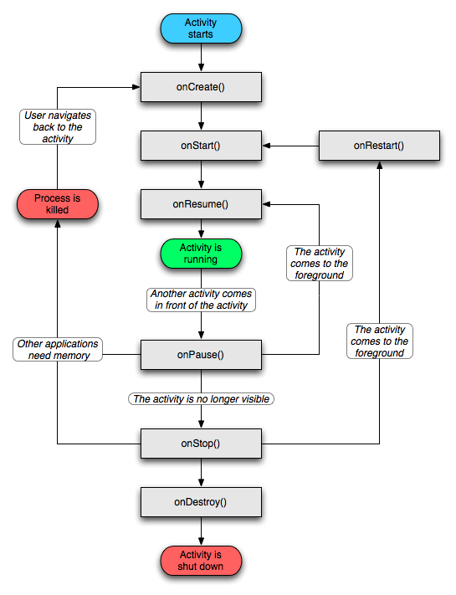
Activity life cycle
Four states:
Active: running and
in foreground
Paused: running, but a dialog has popped-up on top of it
Stopped: still running, but hidden by others
Dead: terminated, perhaps by Android OS when low on memory

Slide 7
Life cycle methods
Activity exists from onCreate to onDestroy():
  Initial setup and final tear down of resources
Activity is visible from onStart to onStop():
  onRestart() also called when return to fore
In foreground from onResume to onPause():
  In foreground means accepting user input
  onPause: commit unsaved changes, etc.
A paused activity might be destroyed before it ever resumes!

Slide 8
Saving state
Persistent state can be saved in onPause()
  e.g. draft of a message being composed
  Write to storage: preferences,
  SQL database, app-specific file, or SD card
Transient state: use onSaveInstanceState()
  e.g. how user filled out form before “submit”
  Save in a Bundle, which is passed to both onCreate() and onRestoreInstanceState()
  Use this, e.g., to fill out the form again when user goes “Back” to this activity

Slide 9
Views (widgets)
View is Android's widget class (JComponent)
Subclasses: Button, TextView (label), EditText (text area), Spinner (pull-down list),
  Or make your own subclass to customize!
ViewGroups (layout managers) LinearLayout Relative, GridView, TableLayout, TabHost, …
Within onCreate(), call setContentView() to declare the activity's main View (panel):
  TextView tv = new TextView( this );
  setContentView( tv );

Slide 10
“Hello, Android!” tutorial
Only one activity: HelloAndroid
  Package: domain name, application name
onCreate(): called when activity is run
The parameter is the saved state Bundle:
  Use this to restore transient state if desired
  Also pass up to superclass' onCreate()
Create a view (widget): TextView
  Set the text to “Hello, Android!”
  Set as the main view for the activity
  Use a layout if want > 1 widget

Slide 11
XML layout
Laying out widgets can be complex in code
You may use an XML config file for layout:
  Create a file under res/layout/*.xml
  XML is like HTML: <tag> … </tag>
Specify layouts, widgets, font/colour/text/...
  Eclipse ADT has a WYSIWYG layout editor!
XML gets compiled into an object (R class)
  R is auto-generated; don't edit directly!
  Refer to R.layout.myLayout
  (follows name of the XML file)

