Slide 1
Component Architectures
29 March 2011
CMPT166
Sean Ho
Trinity Western University

Slide 2
Software components
Pre-fabricated, reusable building blocks for software systems
Rapid development, consistent reuse
Not tying together libraries (chunks of code)
  But coordinating running code (dynamic cooperation of live objects with active state)
Bigger than single objects, can combine
Relate “peer-to-peer”, not in hierarchy
May operate across a suite of applications
  Provide consistent interfaces to applications

Slide 3
Component concepts
Applications use a palette of components
  The programmer composes or “wires” them together to make a complete application
Requires:
  Ways to define new components
  Standards to specify component interfaces
  Each component has “hooks” (methods) by which other components interact with it
Compare to hardware components:
  Transistors, integrated chips, etc.

Slide 4
Components vs. code
Hardware components are black boxes with spec sheets: wires connect them together
Software components are represented as black boxes with interfaces: you write code to connect them up
Software companies may sell components as binaries (black boxes) with API documentation
  Need not sell the actual source code
  e.g., NVIDIA binary graphics drivers for Linux
  e.g., Scantron ClassClimate and myTWU portal

Slide 5
Component-based apps
Components are assembled into containers
  The finished assembly is the application
May also take document-centric view:
  e.g., a container document may hold
  text, images, videos, buttons, etc.
  Editing any item passes control to the appropriate component:
  text editor, image editor, etc.
  The document is the application!
  Peer-to-peer: no one component is “boss”

Slide 6
Component-based develop.
Deliver solutions by building or buying interoperable components
Don't reinvent the wheel: write once, deploy many times (server, desktop, handheld, ...)
Rigid adherence to software infrastructure:
  Standards of how components work together
Fits into distributed, multi-language, multi-platform heterogeneous environments:
  Don't care what language it's written in
  Don't care where it runs

Slide 7
Component structures can...
Tie together departments within a company (ERP – enterprise resource planning):
  Accounting, invoicing, human resources
Connect data of mergers of banks, hospitals
Use rich, complex data stores:
  Data mining, pattern recognition,
  image analysis, genomics, StatsCan, ...
Add multimedia to a field salesperson's laptop/handheld
  Use same back-end applications as at office

Slide 8
Layering
Student
Portal
Aqueduct
Enrolment
Database
Sometimes component architecture is deployed as “middleware”:
  A set of components that allow a variety of database stores or applications to be manipulated by a common interface
  Other applications must go through the middleware in order to access the datastore
Security, ease of debugging, simplicity
Allows format of back-end database to change while preserving the front-end UI for users

Slide 9
Examples of component arch.
Application plug-in interface: Firefox, Eclipse
LAPACK/BLAS: std. linear algebra library
ActiveX/COM: interoperation of MS apps
  e.g., graphics, outlining, cut-and-paste
.NET: Microsoft's (2002) component arch.
  CLR (Common Language Runtime) is the equivalent of the JVM
  C#, but may use other languages, too
JavaBeans: components for Java

Slide 10
Example: ODBC
Open DataBase Connectivity
  Standard API to relational database systems:
  MS-SQL, Oracle, DB/2, mySQL, PostgreSQL, ...
  Simplifies use of standard SQL commands
    Structured Query Language: query/edit the DB
    SELECT Titles.Title, Authors.Name
    FROM Titles, Authors
    WHERE Titles.ISBN = Authors.ISBN
    Can also access vendor-specific commands
  Cross-platform, cross-language
    The Java implementation is called JDBC

Slide 11
Example: JavaBeans
Introspection: components advertise what features they provide (methods, events, …)
Use Swing's event model to communicate
  All Swing components are JavaBeans!
Persistence: Beans can save/restore state
Builder: IDE to assemble components
  JavaStudio, NetBeans, Eclipse, IntelliJ, etc.
Enterprise JavaBeans (EJB) integrate with the JavaEE ecosystem

Slide 12
Applets vs. Servlets
Applets run embedded in the browser
  User must install JVM and browser plug-in
Client Browser
Web Server
JVM
Internet
Applet
Servlets are compiled Java programs that run on the web server (servlet container)
  Return a XHTML web-page to be sent to client
Client Browser
Servlet Container
Internet
JVM
Servlet

Slide 13
Servlets and JSP
Java Server Pages (JSP)
are interpreted by the servlet container and compiled into servlets as needed
  Pre-compiled servlet is used if available
Scriptlet code mingled with HTML markup
  Similar to MS Active Server Pages (ASP), PHP, WSGI + Python, etc.
    <html><head>
    <%! int servervar = 1; %>
    <% int localvar = 1; %>
    <h1><%= toStringOrBlank(“hello, world!”) %></h1>

Slide 14
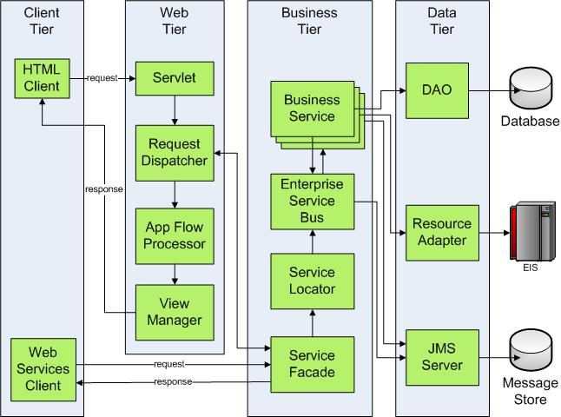
Beyond Servlets: JavaEE
JavaEE is a component ecosystem for enterprise applications:
  Servlets
  EJB: components
  JMS: messaging
  JSF: UI widgets
  (“faces”)
  JCA: connector
  to datastores
Jeff Hanson, JavaWorld 2008

Slide 15



JavaEE software
Official reference implementation: Oracle
  Glassfish Open-source edition
  Glassfish Enterprise (commercial)
Apache (open-source):
  Geronimo (JavaEE) + Tomcat (Servlets)
IBM WebSphere Application Server:
  Community Edition (based on Geronimo)
  Application Server (commercial)
RedHat JBoss (open-source)
SAP NetWeaver (commercial)

